Slide 1
9/16/2024
Quiz 3 (30 minutes)
Biological target presentation and report
Searching the scientific literature
Databases
Accessing articles
Search strategies
Zotero

Slide 2
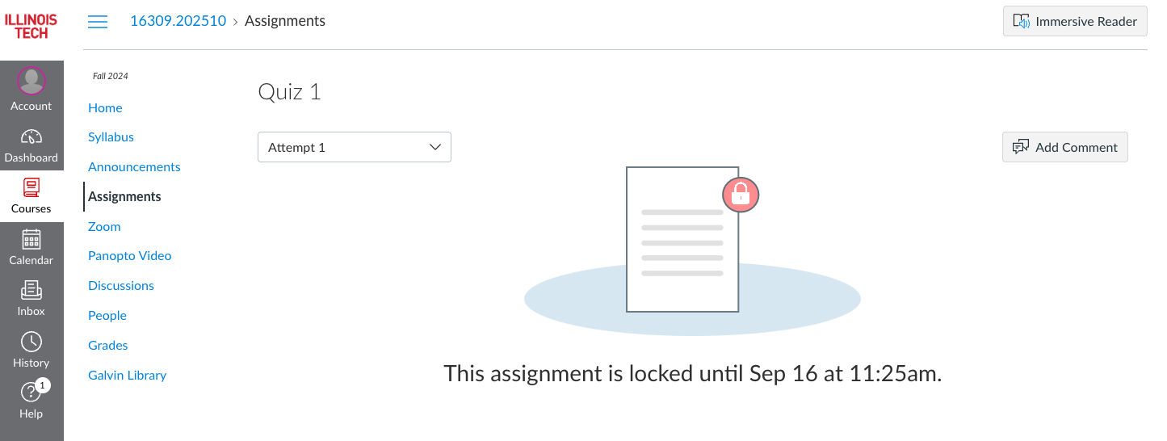
Quiz 1
Go to the Canvas page and look under “Assignments” to find Quiz 1.
Download the file
Upload it to your shared folder on Google Drive under “quizzes”
Work on it. Save it at the end of the quiz.
Submit it on Canvas.

Slide 3
Biochemistry-related databases
Google/Google Scholar
Web of Science
PubMed
Others: https://guides.library.iit.edu/c.php?g=474723&p=3248565

Slide 4
Accessing articles
Free
Open access - article is free online. Usually requires larger author payment
Many NIH-funded articles are available online after one year
Preprint servers, e.g. bioarXiv - free, but may not be peer reviewed
Sometimes available from authors on their websites or upon request
Paywall
IIT subscribes to a selection of scientific journals, which can be accessed
in the library
online from campus
via a proxy server or VPN
Interlibrary loan (MyILL) can be used to request nearly any article, but requires a lead time

Slide 5
Search strategies
Consider alternative names, e.g. coronavirus main protease and 3c-like protease.
Proteins from different species are usually similar
Look at citations
cited by an article of interested
that cite the article of interest
A research group will often work on similar proteins

Slide 6
Zotero
Open source and free
Available online and as an application
Automatically organizes manuscript files & notes
Allows sharing with others via group libraries
Creates bibliographies
linked with MS Word and Google Docs
exportable to BibTeX

