Slide 1
11/4/2024
Today’s lecture is a key step towards the following learning objective: Explain key concepts related to binding free energy calculations. Compare and contrast molecular docking and binding free energy calculations.
Simulating and analyzing thermodynamic processes

Slide 2
Simulating and analyzing thermodynamic processes
The lecture will cover
importance sampling
umbrella sampling
thermodynamic processes
replica exchange
statistical estimators for thermodynamic properties
At the end of this module, you should be able to answer the following questions:
What is a thermodynamic process?
What are the benefits of umbrella sampling?
What are the benefits of performing replica exchange?
How do you know if there are enough states along a thermodynamic process?
You should be able to calculate
expectation values
free energy differences between thermodynamic states

Slide 3
Importance Sampling

Slide 4
Importance sampling
Sampling from one distribution and estimating quantities in another
$${⟨A⟩}_{T}=∫A(x)p_{T}(x)dx=∫A(x)\left(\frac{p_{T}(x)}{p_{S}(x)}\right)p_{S}(x)dx={⟨wA⟩}_{S}$$
$p_{T}(x)$ is the probability density in the target distribution
$p_{S}(x)$ is the probability density in the sampled distribution
$w=\left(\frac{p_{T}}{p_{S}}\right)$ is the ratio of weights in the two distributions

Slide 5
Why do importance sampling?
Use one simulation to estimate quantities in multiple thermodynamic states, e.g. different temperatures
Less computational expense to sample from one distribution, e.g. sample with molecular mechanics and calculate quantities in QM/MM distribution
Sample from distribution with smaller configuration space, e.g. harmonic restraint towards a crystal structure

Slide 6
Caveat: Importance sampling
The target and sampled distribution should be similar
If the support differs, important configurations may be missed
If the probability density significantly differs
the reweighing term can be noisy
thermodynamic expectations will require more samples to converge

Slide 7
Idealized importance sampling
Covers the entire relevant configuration space along an order parameter

Slide 8
Harmonic umbrella sampling
Sampling that covers the entire relevant configuration space along an order parameter
Typically involves
a harmonic restraint towards a specific value of the order parameter, $U_{b}(x)=\frac{1}{2}k(z[x]-z_{o})^{2}$
$k$ is the spring constant
$z[x]$ is the value of the order parameter for configuration $x$
multiple simulations with different spring centers
the observed probability distributions should overlap
Used with permission from Fiona Naughton: http://fiona-naughton.github.io/blog/2016/05/25/What-is-this-MD-thing-anyway

Slide 9
A cat analogy of umbrella sampling
Which toy does the cat like best? To quantify this, we can look at the fraction of time they spend near a specific toy.
But we can be watching the cat for a long time…
Used with permission from Fiona Naughton: http://fiona-naughton.github.io/blog/2016/05/25/What-is-this-MD-thing-anyway

Slide 10
Umbrella sampling with a cat
If we put a restraint on the cat, we can determine what they prefer in a smaller area. Overall, we don’t need to watch as long.
Used with permission from Fiona Naughton: http://fiona-naughton.github.io/blog/2016/05/25/What-is-this-MD-thing-anyway

Slide 11
Thermodynamic processes
A thermodynamic process involves a change in one or more variables that specify a thermodynamic state
In general and physical chemistry, you learn about specifying a state with
temperature
pressure/volume
number of particles/chemical potential
Processes include
isothermal expansion - a change in volume but not temperature
adiabatic expansion - a change in volume without heat transfer in and out of a system
In molecular simulations, additional variables can define the potential energy
harmonic spring constant and center (umbrella sampling)
alchemical parameter for
transforming one substituent into another
decoupling a molecule from solvent

Slide 12
Replica exchange
Simulations of multiple thermodynamic states with different parameters
originally, variation in temperature
often used for alchemical coupling
Configurations from thermodynamic states are periodically swapped
Equivalently, thermodynamic parameters are swapped
Swapping satisfies detailed balance; both states sample from respective Boltzmann distributions

Slide 13
Swapping
λ = 1
X
λ = 0.8
X
λ = 0.6
λ = 0.4
λ = 0.2
X
X
λ = 0

Slide 14
Why perform replica exchange?
Improve mixing of MCMC chains; higher-entropy states help sample configurations in lower-entropy states
At high temperature, energetic barriers are crossed more quickly than at low temperature
Decoupled ligands move freely compared to bound ligands. See http://mypages.iit.edu/~dminh/images/pubs/dock_1hnn.gif.
Minimal added computational expense

Slide 15
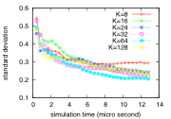
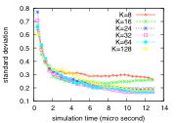
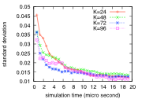
Selecting thermodynamic states
Thermodynamic state selection has been thought to be a tricky optimization problem
In Nguyen and Minh (2016) [1]
processes were simulated 100x each for each number of states, K
the standard deviation of the free energy was evaluated as a function of the total simulation time
If there are not enough states, the convergence curve levels off
If there are enough states, the standard deviation of free energy estimates depends on the aggregate simulation time and is insensitive to the number of states.
Deca-alanine heating
Deca-alanine pulling
Host-guest extraction

Slide 16
Review
What is a thermodynamic process?
What are the benefits of umbrella sampling?
What are the benefits of performing replica exchange?
How do you know if there are enough states along a thermodynamic process for replica exchange?

Slide 17
Estimating thermodynamic properties

Slide 18
Estimating Thermodynamic Properties
Molecular simulations are used to calculate thermodynamic and kinetic properties
In general, the thermodynamic properties are
expectation values of an observable, including
probability of the observable having a certain range of values
potential of mean force with respect to the observable
free energy differences between thermodynamic states
in biomolecular systems, ΔG ~ ΔA

Slide 19
What is ΔG?
ΔU is the change in average internal energy.
internal energy can be computed for individual structures
in biomolecular simulations, internal energy is modeled by the molecular mechanics force field
ΔH = ΔU + Δ(pV) is the change in enthalpy
in biomolecular simulations, change in pV is usually negligible
ΔG is the Gibbs free energy
at constant pressure and temperature, dictates
spontaneity and
equilibrium constant of process
in biomolecular simulation, interest in free energy differences between
conformations of a macromolecule
thermodynamic states with different temperature, pressure, volume, or other parameters
ΔG = ΔH + TΔS, but ΔS is very challenging to compute

Slide 20
What is ΔA?
ΔA is the Helmholtz free energy
at constant volume and temperature, dictates
spontaneity and
equilibrium constant of process
in biomolecular simulation, ΔA and ΔG are usually assumed to be equal

Slide 21
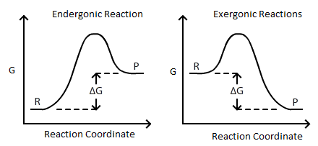
What is the free energy of a reaction?
$$ΔG=ΔH-TΔS=RTlnK$$
https://chem.libretexts.org/Bookshelves/Analytical_Chemistry/Supplemental_Modules_(Analytical_Chemistry)/Electrochemistry/Electrochemistry_and_Thermodynamics

Slide 22

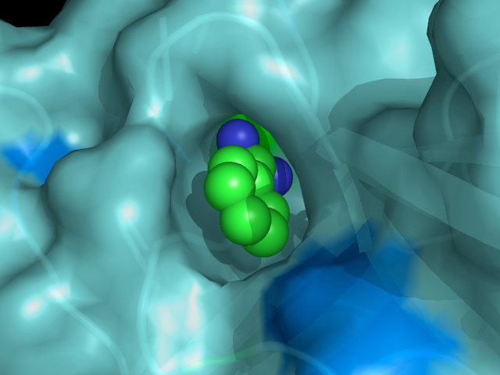
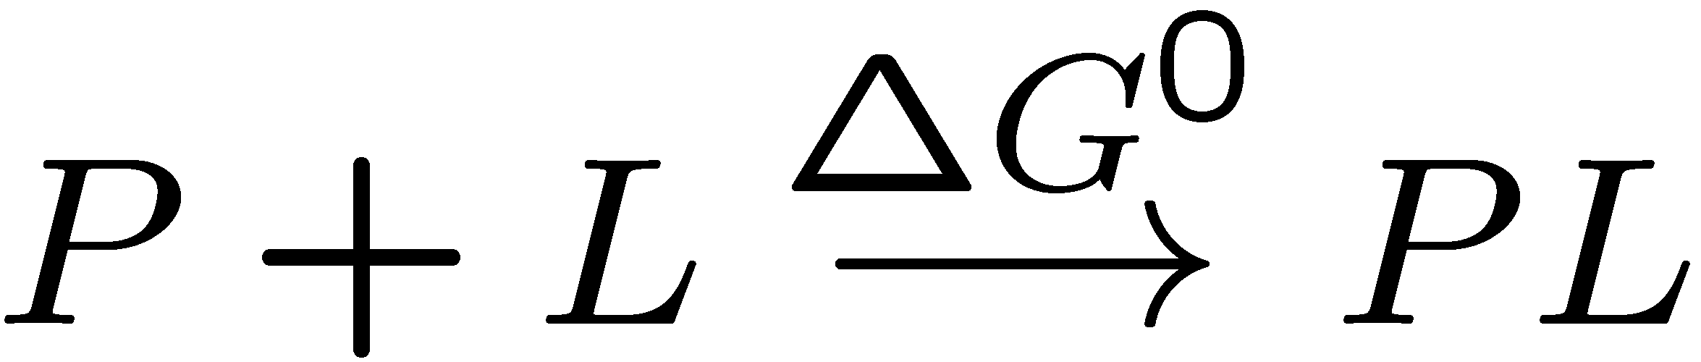
How are free energy calculations useful?
Noncovalent binding between molecules (see [2])
Design molecules to manipulate protein function
Recognize toxins
Identify enzyme functions
Protein design: design binders to target molecule
Aid medicinal chemistry, guide synthesis
Hydration free energies
Part of binding free energy & solubility
Conformational free energies relevant to
biological mechanism
binding free energy
(from [1])

Slide 23
How are ΔG/ΔA calculated from molecular simulations?

Slide 24
Basic Statistical Mechanics
In the Boltzmann distribution, the probability of a configuration $r^{N}$ with energy $U_{s}(r^{N})$ is,
$π_{s}(r^{N})∝exp\left[-βU_{s}(r^{N})\right]$ (unnormalized)
$ρ_{s}(r^{N})=exp\left[-βU_{s}(r^{N})\right]/Q_{s}$ (normalized)
A partition function is the normalizing constant of the Boltzmann distribution
$$Q_{s}=∫π_{s}(r^{N})dr^{N}$$
The free energy difference is related to a ratio of partition functions
$$β(A_{1}-A_{0})=-ln\left(\frac{Q_{0}}{Q_{1}}\right)$$

Slide 25
The Zwanzig Relation: Derivation
From before, $β(A_{1}-A_{0})=-ln\left(\frac{Q_{0}}{Q_{1}}\right)$.
Substituting in partition functions, $β(A_{1}-A_{0})=-ln\left(\frac{∫e^{-βU_{1}(r^{N})}dr^{N}}{∫e^{-βU_{0}(r^{N})}dr^{N}}\right)$.
Multiplying by one, $β(A_{1}-A_{0})=-ln\left(\frac{∫e^{-βU_{1}(r^{N})+βU_{0}(r^{N})-βU_{0}(r^{N})}dr^{N}}{∫e^{-βU_{0}(r^{N})}dr^{N}}\right)$.
Defining the potential energy difference $ΔU(r^{N})=U_{1}(r^{N})-U_{0}(r^{N})$, $β(A_{1}-A_{0})=-ln\left(\frac{∫e^{-βΔU(r^{N})}e^{-βU_{0}(r^{N})}dr^{N}}{∫e^{-βU_{0}(r^{N})}dr^{N}}\right)$

Slide 26
The Zwanzig Relation: In Practice
Using the definition of $ρ_{s}(r^{N})$, $β(A_{1}-A_{0})=-ln∫ρ_{0}(r^{N})e^{-βΔU(r^{N})}dr^{N}$.
The Zwanzig relation [3] is
$β(A_{1}-A_{0})=-ln{⟨e^{-βΔU}⟩}_{0}$ in a simpler notation.
$β(A_{1}-A_{0})=-ln{⟨e^{βΔU}⟩}_{1}$ can be derived with similar steps
This shows us that
The free energy difference can be computed based on an average over configurations taken from one of the states of interest
We can generate these configurations with MC or MD
The free energy comes from evaluating the energies of these configurations in both potentials $U_{0}$ and $U_{1}$, and taking an appropriate average of the energy difference

Slide 27
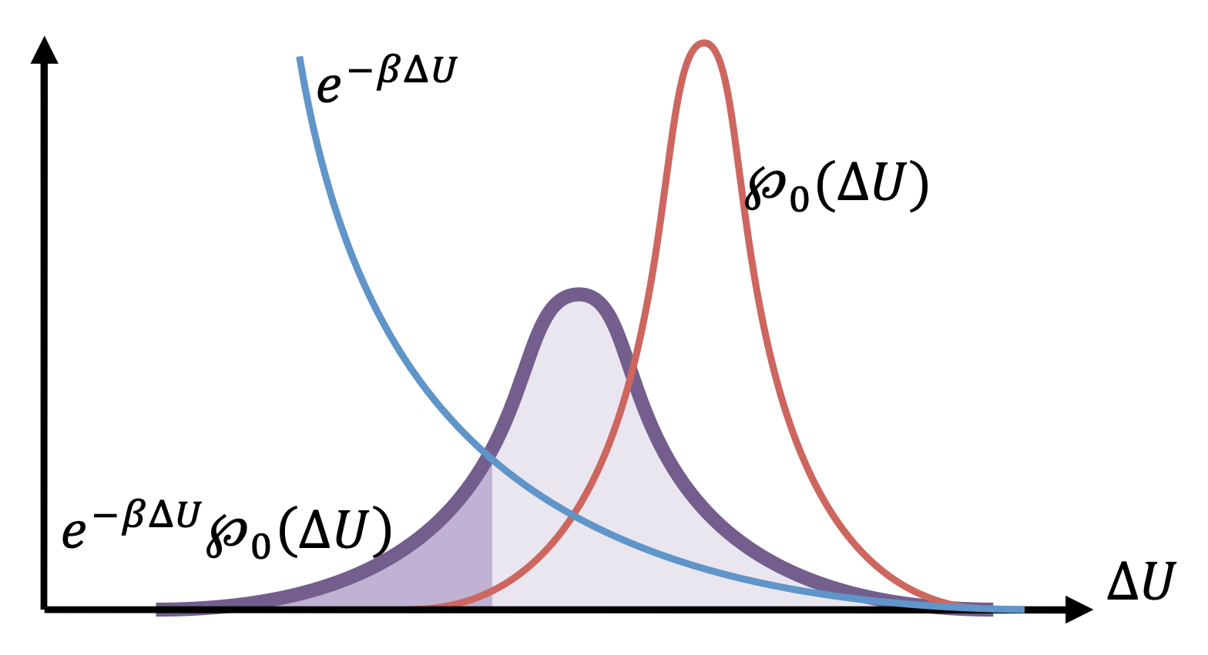
The Zwanzig Relation: Limitations
In terms of an integral over the distribution of $ΔU$ (instead of over $ρ_{o}(r^{N})$) the Zwanzig relation is,$β(A_{1}-A_{0})=-ln∫e^{-βΔU}ρ_{0}(ΔU)dΔU$.
Sampling is from the red curve
Accurate estimation requires the purple curve
The calculation will not be accurate if $U_{0}$ and $U_{1}$ are very different!
Potential energies will be different if the states access different parts of configuration space
(from [1])

Slide 28
Other ways to calculate ΔG
Multistate Bennett Acceptance Ratio (MBAR) [5]
estimates free energies and thermodynamic expectations from a series of states
extension of Bennett Acceptance Ratio (BAR) [4], which uses data from two states
Proven to be statistically optimal
Thermodynamic integration is based on the fundamental theorem of calculus, integrating one the derivative of the free energy with respect to a parameter
All of the methods require thermodynamic states with configuration space overlap, meaning that
similar configurations have similar energies
the most relevant configuration space is similar

Slide 29
References
[1] Nguyen, T. H.; Minh, D. D. L. Intermediate Thermodynamic States Contribute Equally to Free Energy Convergence: A Demonstration with Replica Exchange. Journal of Chemical Theory and Computation 2016, 12 (5), 2154–2161. https://doi.org/10.1021/acs.jctc.6b00060.
[2] Many parts of this module were adapted from a lecture by David Mobley (https://github.com/MobleyLab/drug-computing/tree/master/uci-pharmsci/lectures/free_energy_basics) under the CC BY 4.0 license. The lecture is part of the Drug Discovery Computing Techniques course (PharmSci 175/275) at UC Irvine.
[3] Zwanzig, R. High-Temperature Equation of State by a Perturbation Method. I. Nonpolar Gases. Journal of Chemical Physics 1954, 22 (8), 1420.
[4] Bennett, C. H. Efficient Estimation of Free-Energy Differences from Monte Carlo Data. Journal of Computational Physics 1976, 22 (2), 245–268.
[5] Shirts, M. R.; Chodera, J. D. Statistically Optimal Analysis of Samples from Multiple Equilibrium States. Journal of Chemical Physics 2008, 129 (12), 124105.

