Slide 1
4/20/2026
Solubility Prediction
The importance of solubility prediction
The Solubility Challenge (2008)
QSPR prediction of solubility
Free energy calculations of solubility
Exercise 13 - QSPR prediction of solubility

Slide 2
The importance of solubility prediction

Slide 3
Why predict solubility? [Llinàs 2008]
Drug candidates should have sufficient solubility to be
tested in biological assays
stored
bioavailable
Rules of thumb are unreliable

Slide 4
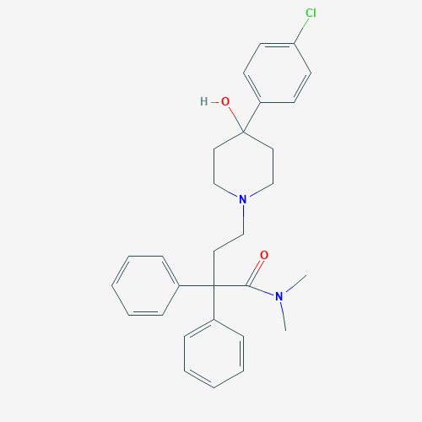
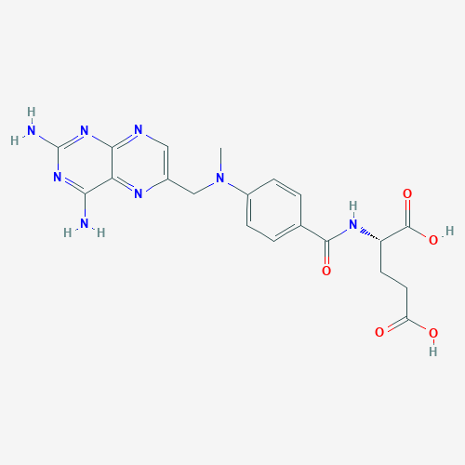
Poor solubility is a major problem [Llinàs 2008]
Pharmacokinetics
Up to 40% of drug discovery programs abandoned due to pharmacokinetics - the movement of drugs within the body
Low solubility is associated with problems with pharmacokinetics
Precipitation
Loperamide (diarrhea drug) can sometimes precipitate when injected
Methotrexate (cancer drug) has kidney toxicity due to precipitation
Polymorphs can affect solubility and have different bioavailability, e.g. ritonavir (HIV drug) had to be reformulated
Loperamide
Methotrexate

Slide 5
Polymorphs are problem for drug scale-up
Chemical structure and SEM images from [4]
LAB687 (lower triglyceridess and LDL cholesterol)
Early on, observed form A and B
Later, found form C
Form D observed in scale up, and began to predominate!

Slide 6
Why work with low-solubility compounds?
Practical reason
increased weight and lipophilicity of test compounds from high-throughput synthesis and screening
Principled reasons
drugs usually need to permeate cell membranes
increased binding affinity - the molecule prefers the complex over the solvent - often associated with reduced solubility

Slide 7
How are solubility problems hidden?
use of solvents, e.g. DMSO, in early-stage assays
pH dependence
free acid/free base is less soluble than salt
intrinsic solubility is solubility of free acid/free base
kinetic solubility - appearance or disappearance of precipitate at different concentrations than the thermodynamic saturating concentration (sub- or supersaturation)
polymorphs not always known
These problems are also reasons why solubility is difficult to measure and predict

Slide 8
The Solubility Challenges (2008 & 2018)

Slide 9
Solubility Challenge [Llinàs 2008, Hopfinger 2009]
measured
intrinsic solubility (free acid/free base)
highly reproducible (thermodynamic versus kinetic solubility)
published 100 solubilities
challenged researchers to predict 32 more
received >100 entries between July and September 2008

Slide 10
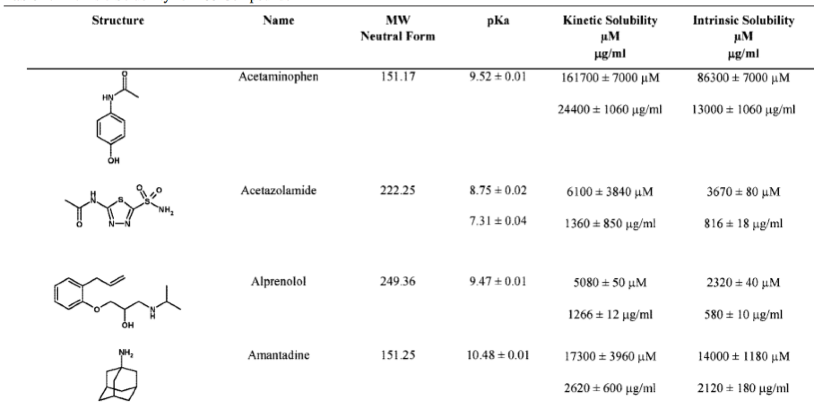
Examples from the dataset [2]

Slide 11
Overall performance in the solubility challenge
Figure 2 from Hopfinger 2009.
“Correct” is within 0.5 logS
Blue bars are percentage correct
Red is actual logS

Slide 12
Major findings [Hopfinger 2009]
For measured set of 28 compounds, percent correct on
absolute S (±10%) ranges from 0%-18%
logS (±0.5 logS) ranges from 10-61%
Worst two compounds 2% and 4% correct by logS
R² ranges from 0 to 0.65
No polymorph predictions
Compounds with “normal” solubility (logS = 0.5 to 3) were easiest
Many methods, but none clearly the best

Slide 13
Solubility Challenge 2 [Llinas 2019, Llinas 2020]
No specified training set
Test sets
mostly saturation shake-flask measurements curated from literature
with different interlaboratory standard deviation
“Well-determined” ~0.17 log unit
“Contentious” ~0.62 log units
Predictions
34 predictions from 20 groups
Training sets with different levels of standardization

Slide 14
Major Findings [Llinas 2020]
Have computational methods improved?
“No prediction improvement of the new methods over the classic MLR ones”
How does prediction performance compare between sets?
“From the comparison of the outcome of SC-1 with SC-2, it is clear that there is no significant difference regarding prediction performances”
Predictions more accurate for high-quality set, but inaccuracy also related to higher standard deviation

Slide 15
QSPR prediction of solubility

Slide 16
Historically informative descriptors [Hewitt 2009]
Molecular size or surface area - cost of forming cavity in water
Octanol:water partition coefficient (P) - solubility relative to a non polar phase
Melting point - higher means more stable solid
Hydrogen bonding - favors water solubility
Atom/group contributions
Molecular connectivities
Possible limitation: lack of long-range order in descriptors prevents understanding of crystalline state [Llinas 2020]

Slide 17
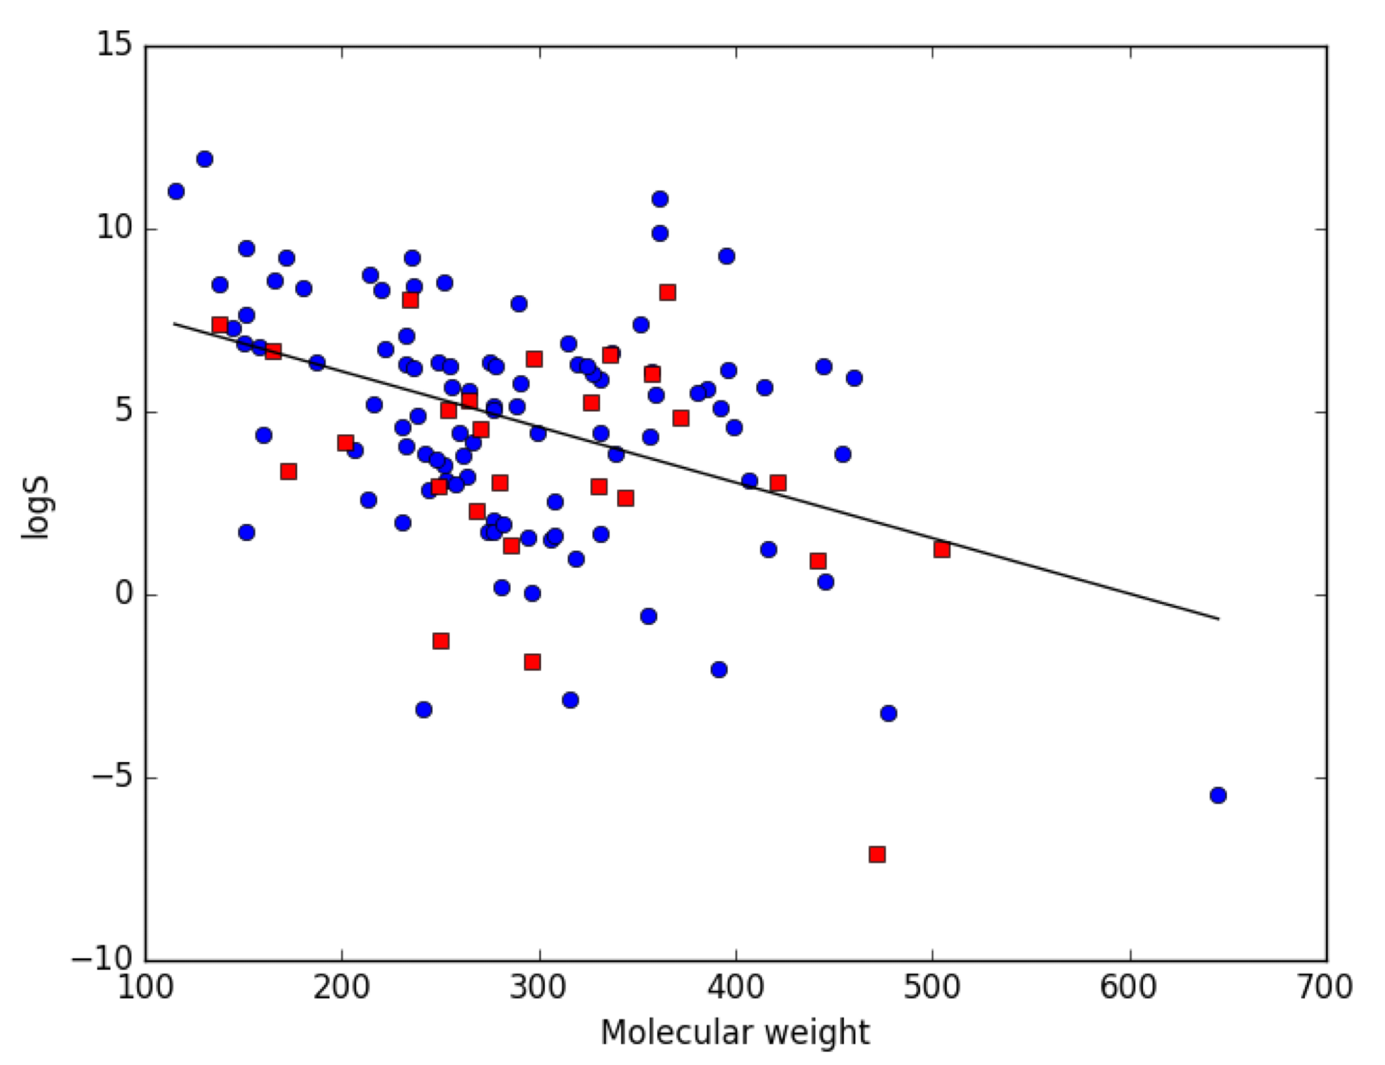
Molecular weight has some predictive power
From Ref [Mobley 2022]
Blue: training
Red: test
Black: predictions

Slide 18
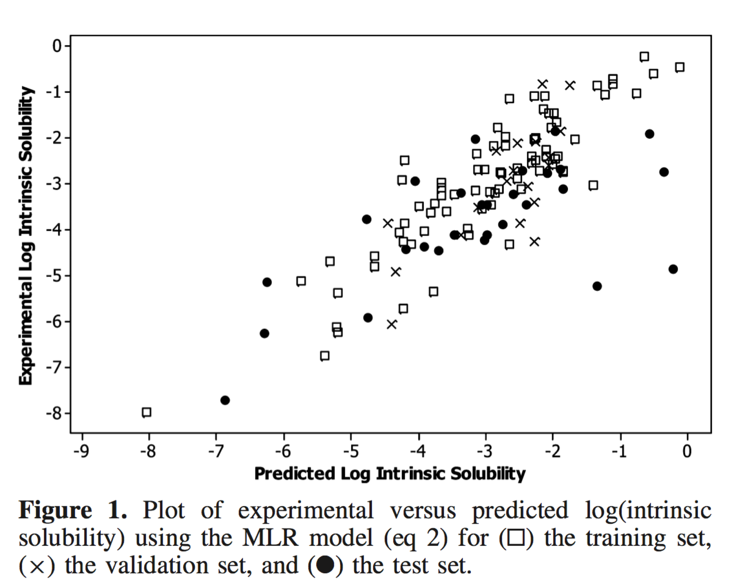
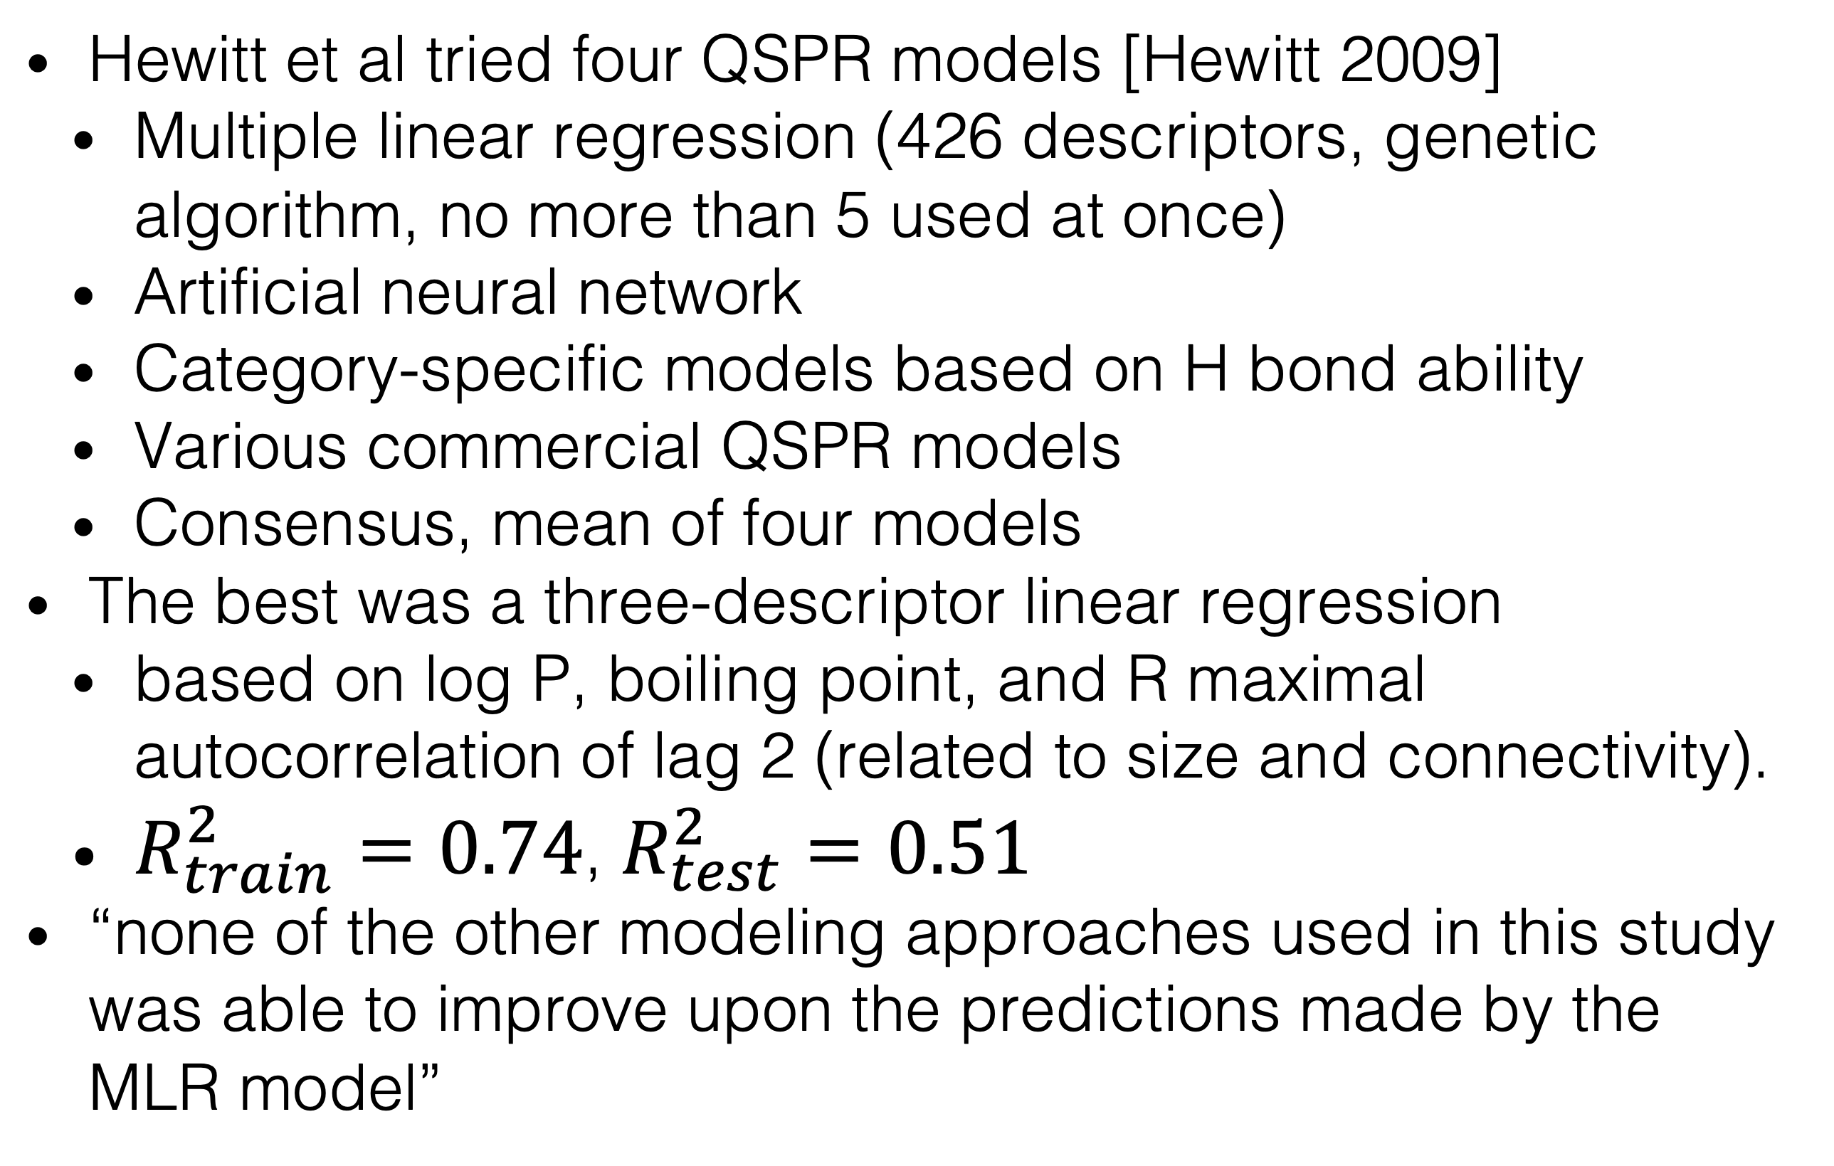
QSPR in the solubility challenge
Hewitt et al tried four QSPR models [Hewitt 2009]
Multiple linear regression (426 descriptors, genetic algorithm, no more than 5 used at once)
Artificial neural network
Category-specific models based on H bond ability
Various commercial QSPR models
Consensus, mean of four models
The best was a three-descriptor linear regression
based on log P, boiling point, and R maximal autocorrelation of lag 2 (related to size and connectivity).
$R_{train}^{2}=0.74$, $R_{test}^{2}=0.51$
“none of the other modeling approaches used in this study was able to improve upon the predictions made by the MLR model”

Slide 19
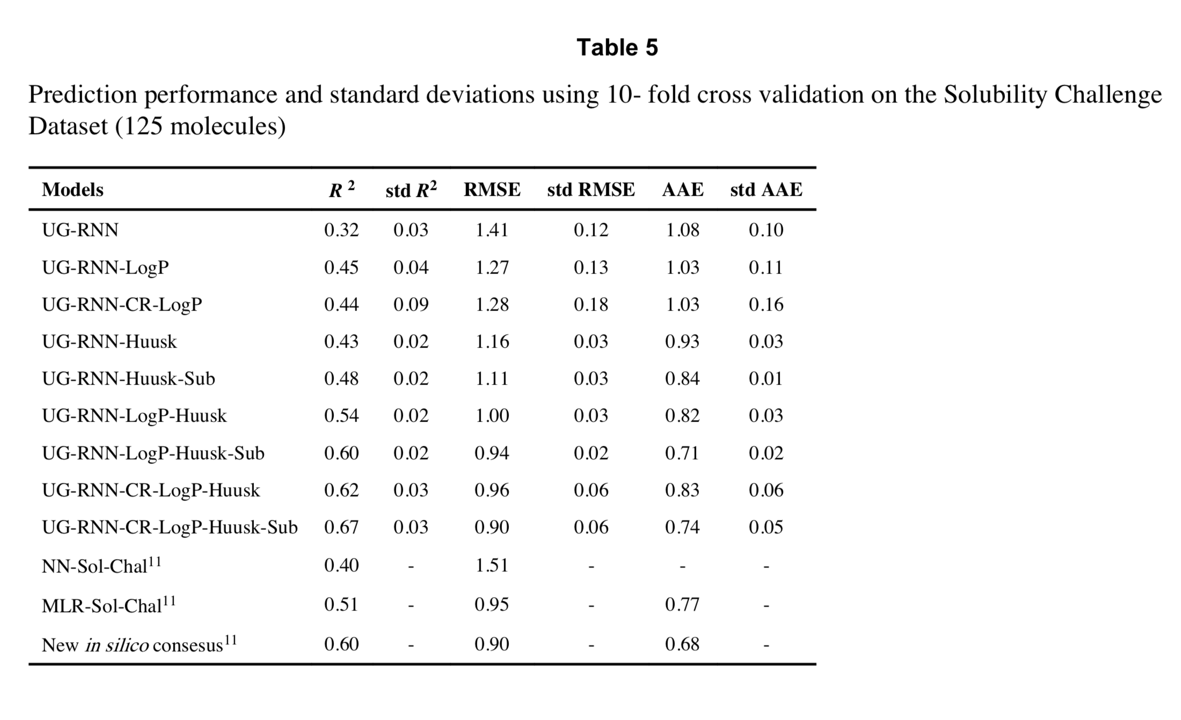
Can deep learning do better? [Lusci 2013]
Better than simple neural network, but worse than MLR
Huusk results are based on more data.
Sub results use different solubility values.
In summary, deep learning can do better if there is more data.

Slide 20
Opening the black box?
Recent deep learning method seems to perform well in solubility prediction and
also highlights moieties that contribute to (red) or detract from (blue) solubility. See Tang 2020.

Slide 21
Free energy calculations of solubility

Slide 22
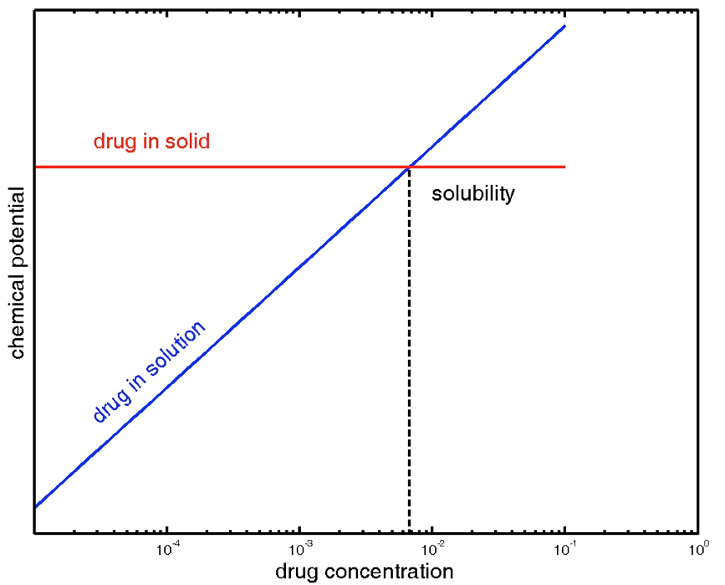
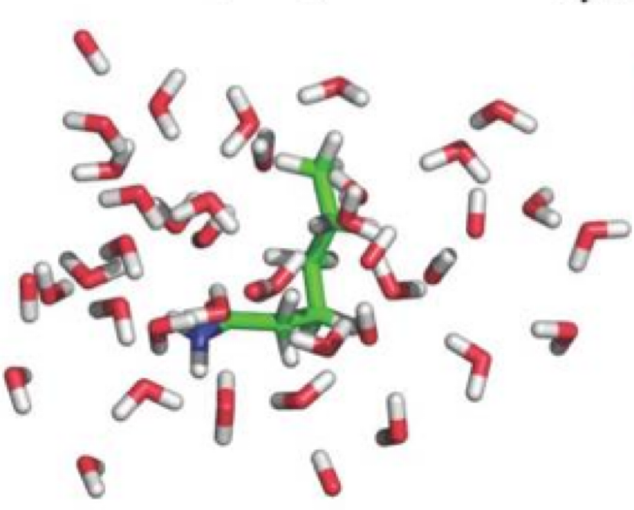
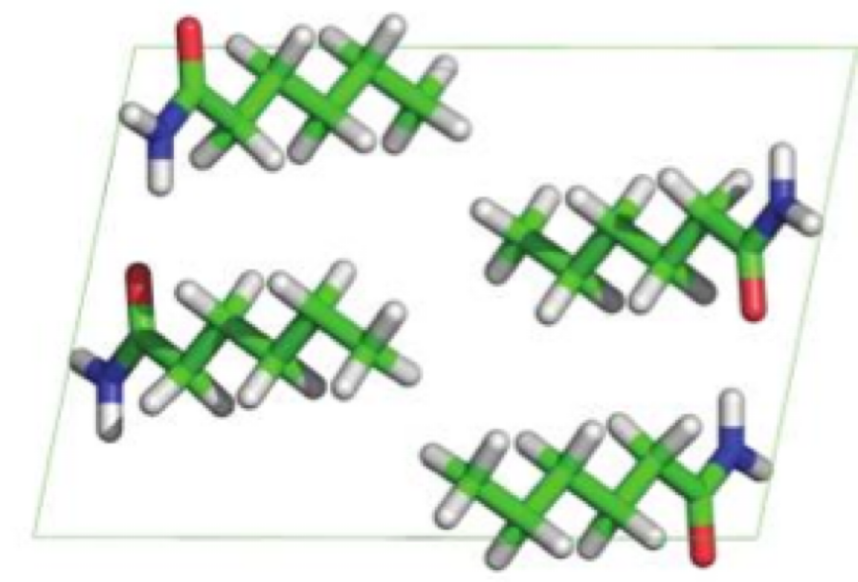
Chemical potential determines solubility
Polymorphs have
different chemical potential
From Ref [8]
From Ref [1]

Slide 23
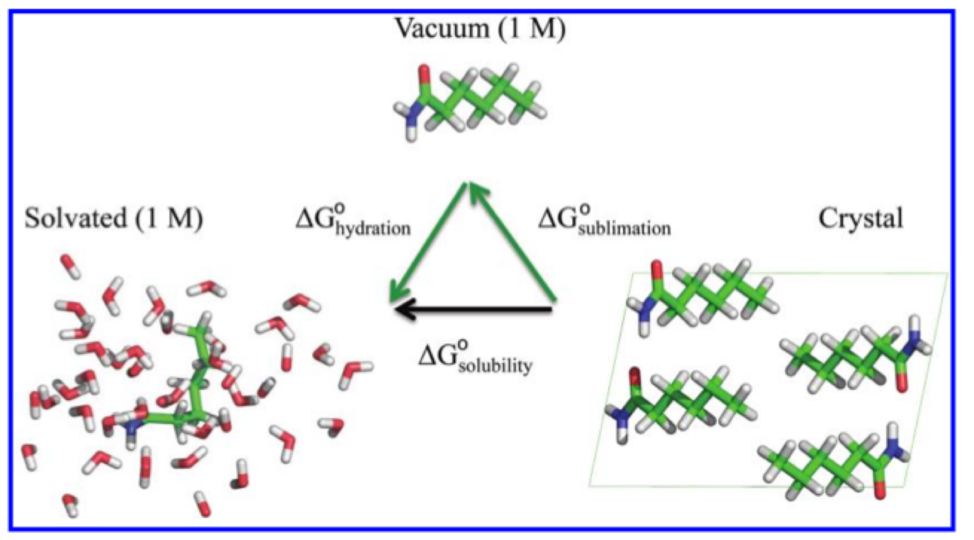
A thermodynamic cycle for solubility
From Ref [8]. Note that solubility ≠ solvation or hydration.
Hydration + sublimation free energies calculated with alchemical free energy methods.

Slide 24
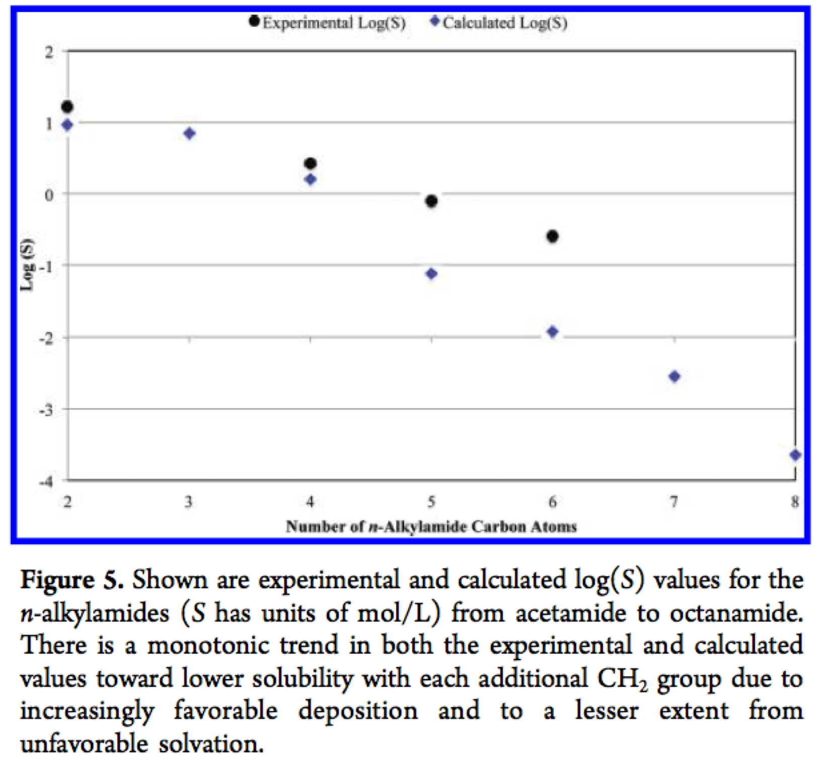
Results on an initial series appear promising without any tuning
From Ref [8]

Slide 25
References
Many parts of today’s lecture were adapted from a lecture by David Mobley (https://github.com/MobleyLab/drug-computing/tree/master/uci-pharmsci/lectures/free_energy_basics) under the CC BY 4.0 license. The lecture is part of the Drug Discovery Computing Techniques course (PharmSci 175/275) at UC Irvine.
Hewitt, M.; Cronin, M. T. D.; Enoch, S. J.; Madden, J. C.; Roberts, D. W.; Dearden, J. C. In Silico Prediction of Aqueous Solubility: The Solubility Challenge. J. Chem. Inf. Model. 2009, 49 (11), 2572–2587. https://doi.org/10.1021/ci900286s.
Hopfinger, A. J.; Esposito, E. X.; Llinàs, A.; Glen, R. C.; Goodman, J. M. Findings of the Challenge To Predict Aqueous Solubility. J. Chem. Inf. Model. 2009, 49 (1), 1–5. https://doi.org/10.1021/ci800436c.
Llinàs, A.; Glen, R. C.; Goodman, J. M. Solubility Challenge: Can You Predict Solubilities of 32 Molecules Using a Database of 100 Reliable Measurements? J. Chem. Inf. Model. 2008, 48 (7), 1289–1303. https://doi.org/10.1021/ci800058v.
Llinas, A.; Avdeef, A. Solubility Challenge Revisited after Ten Years, with Multilab Shake-Flask Data, Using Tight (SD ∼ 0.17 Log) and Loose (SD ∼ 0.62 Log) Test Sets. J. Chem. Inf. Model. 2019, 59 (6), 3036–3040. https://doi.org/10.1021/acs.jcim.9b00345.
Llinas, A.; Oprisiu, I.; Avdeef, A. Findings of the Second Challenge to Predict Aqueous Solubility. J. Chem. Inf. Model. 2020, 60 (10), 4791–4803. https://doi.org/10.1021/acs.jcim.0c00701.
Lusci, A.; Pollastri, G.; Baldi, P. Deep Architectures and Deep Learning in Chemoinformatics: The Prediction of Aqueous Solubility for Drug-Like Molecules. J. Chem. Inf. Model. 2013, 53 (7), 1563–1575. https://doi.org/10.1021/ci400187y.
Prashad, M.; Sutton, P.; Wu, R.; Hu, B.; Vivelo, J.; Carosi, J.; Kapa, P.; Liang, J. Process Research and Development of a MTP Inhibitor: Another Case of Disappearing Polymorphs upon Scale-Up. Org. Process Res. Dev. 2010, 14 (4), 878–882. https://doi.org/10.1021/op100115u.
Schnieders, M. J.; Baltrusaitis, J.; Shi, Y.; Chattree, G.; Zheng, L.; Yang, W.; Ren, P. The Structure, Thermodynamics, and Solubility of Organic Crystals from Simulation with a Polarizable Force Field. J. Chem. Theory Comput. 2012, 8 (5), 1721–1736. https://doi.org/10.1021/ct300035u.
Tang, B.; Kramer, S. T.; Fang, M.; Qiu, Y.; Wu, Z.; Xu, D. A Self-Attention Based Message Passing Neural Network for Predicting Molecular Lipophilicity and Aqueous Solubility. J Cheminform 2020, 12 (1), 15. https://doi.org/10.1186/s13321-020-0414-z. Figures adapted under the CC BY 4.0 license.

Slide 26
Exercise 13: QSPR prediction of solubility

