Slide 1
3/09/2026
Monte Carlo Integration
Markov chain Monte Carlo

Slide 2
Monte Carlo
Today’s lecture is intended to help you achieve the following learning objective: Explain the key objectives of molecular simulation
Monte Carlo Integration
Markov Chain Monte Carlo

Slide 3
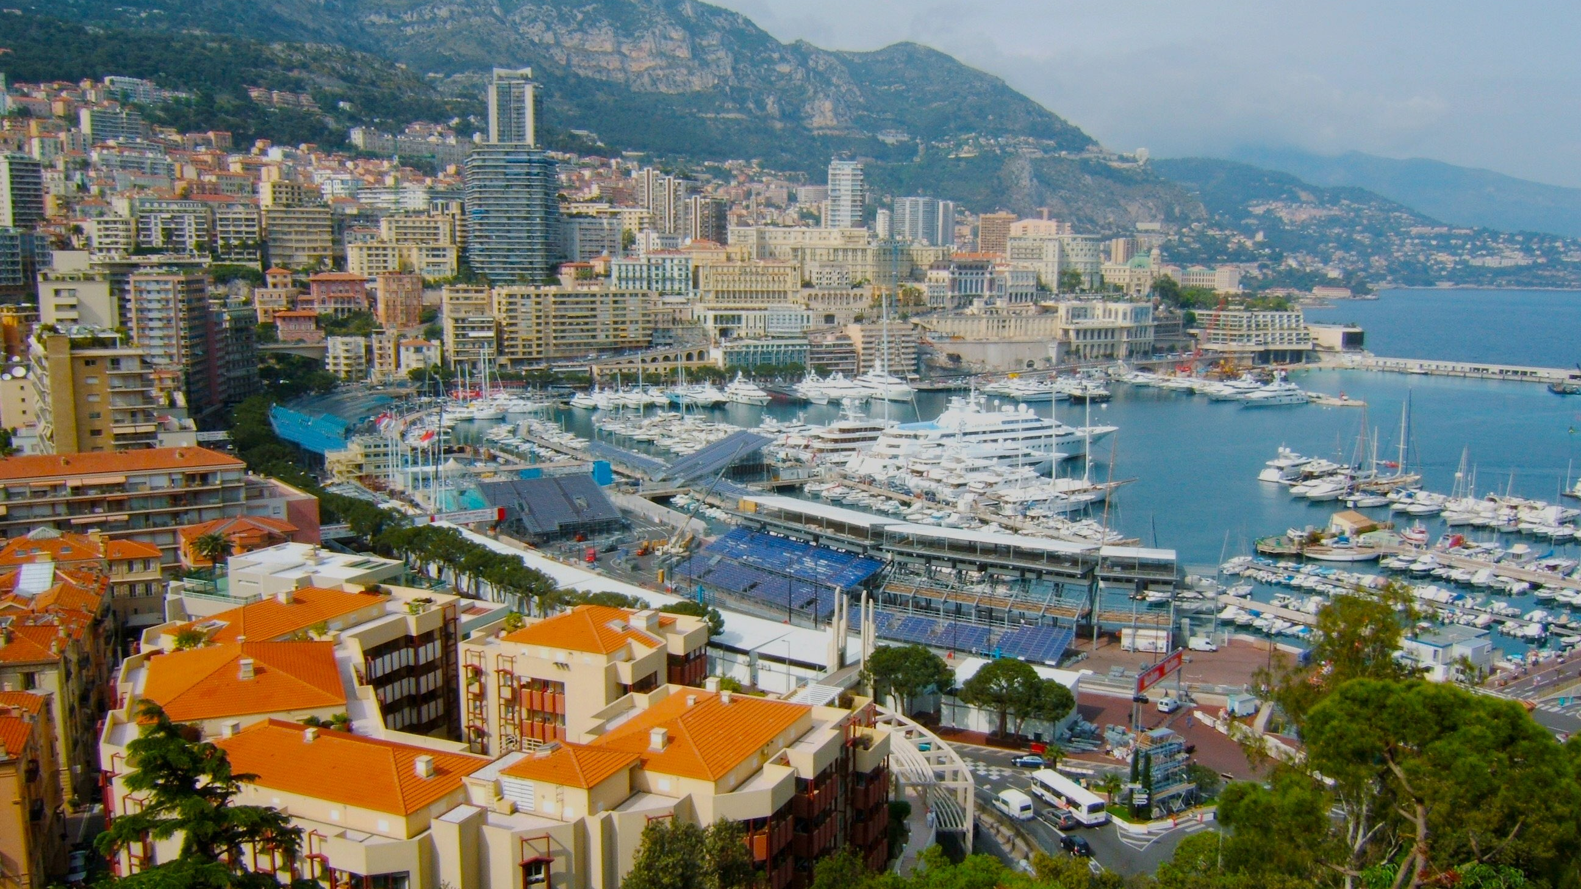
Monte Carlo Integration
If you keep guessing, you may eventually get it

Slide 4


Slide 5
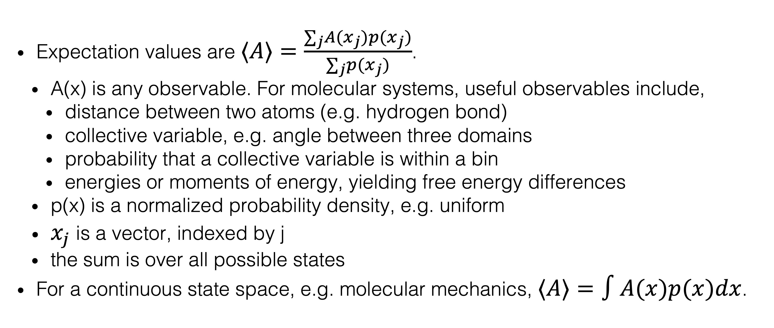
Expectation Values
Expectation values are $⟨A⟩=\frac{∑_{j}A(x_{j})p(x_{j})}{∑_{j}p(x_{j})}$.
A(x) is any observable. For molecular systems, useful observables include,
distance between two atoms (e.g. hydrogen bond)
collective variable, e.g. angle between three domains
probability that a collective variable is within a bin
energies or moments of energy, yielding free energy differences
p(x) is a normalized probability density, e.g. uniform
$x_{j}$ is a vector, indexed by j
the sum is over all possible states
For a continuous state space, e.g. molecular mechanics, $⟨A⟩=∫A(x)p(x)dx$.

Slide 6
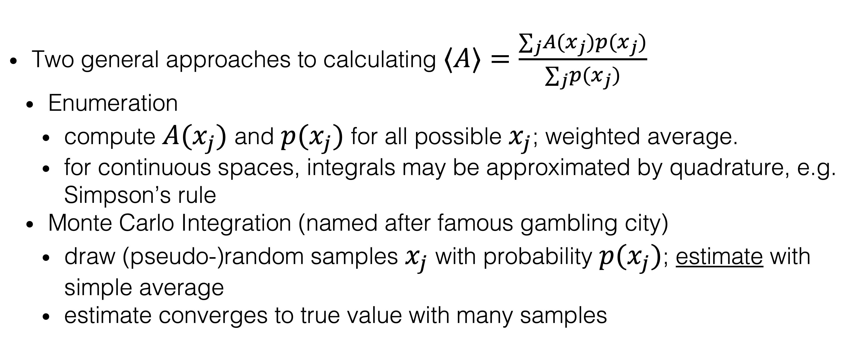
Calculating Expectation Values
Two general approaches to calculating $⟨A⟩=\frac{∑_{j}A(x_{j})p(x_{j})}{∑_{j}p(x_{j})}$
Enumeration
compute $A(x_{j})$ and $p(x_{j})$ for all possible $x_{j}$; weighted average.
for continuous spaces, integrals may be approximated by quadrature, e.g. Simpson’s rule
Monte Carlo Integration (named after famous gambling city)
draw (pseudo-)random samples $x_{j}$ with probability $p(x_{j})$; estimate with simple average
estimate converges to true value with many samples

Slide 7
Example: Dice
How do you compute the expectation value of the sum of two six-sided dice?
(2 + 3*2 + 4*3 + 5*4 + 6*5 + 7*6 + 8*5 + 9*4 + 10*3 + 11*2 + 12)/36 = 7
Roll the dice many times and calculate the average
 | 1 | 2 | 3 | 4 | 5 | 6
1 | 2 | 3 | 4 | 5 | 6 | 7
2 | 3 | 4 | 5 | 6 | 7 | 8
3 | 4 | 5 | 6 | 7 | 8 | 9
4 | 5 | 6 | 7 | 8 | 9 | 10
5 | 6 | 7 | 8 | 9 | 10 | 11
6 | 7 | 8 | 9 | 10 | 11 | 12

Slide 8
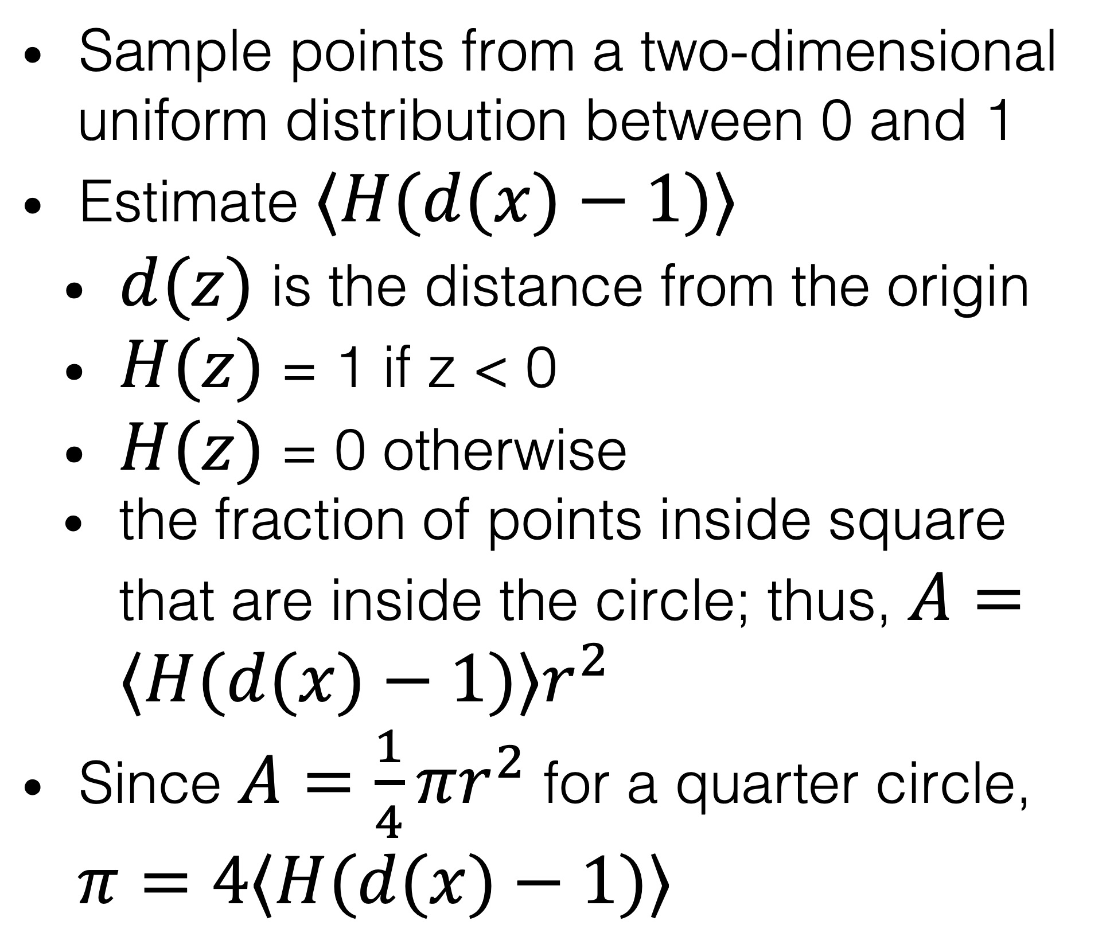
Example: Calculating π
Sample points from a two-dimensional uniform distribution between 0 and 1
Estimate $⟨H(d(x)−1)⟩$
$d(z)$ is the distance from the origin
$H(z)$ = 1 if z < 0
$H(z)$ = 0 otherwise
the fraction of points inside square that are inside the circle; thus, $A=⟨H(d(x)−1)⟩r^{2}$
Since $A=\frac{1}{4}πr^{2}$ for a quarter circle, $π=4⟨H(d(x)−1)⟩$

Slide 9
Limitations
Both examples were for
a simple distribution (uniform)
low dimensions
Drawing independent random samples is difficult for complex high-dimensional probability distributions, such as biological macromolecules

Slide 10

Markov Chain Monte Carlo
A smarter way to sample the Nile

Slide 11
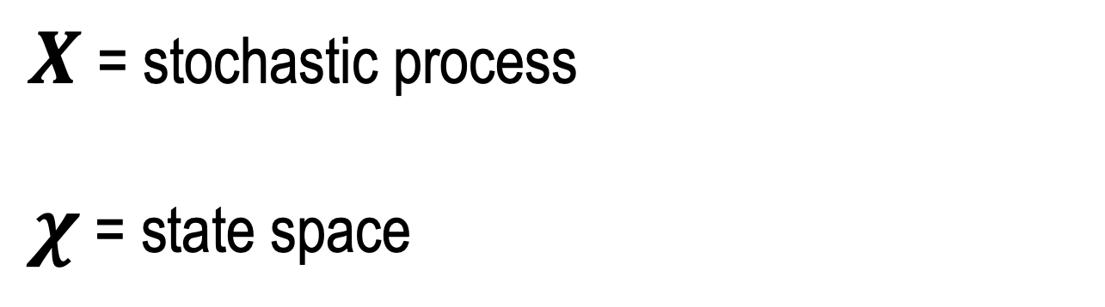
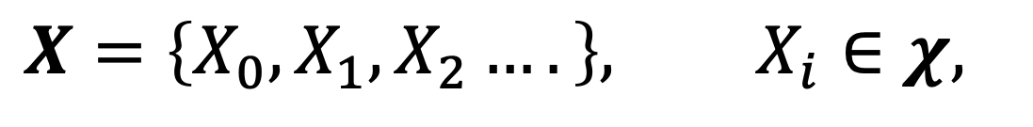
Sampling the Nile
Let’s say that you want to calculate the average depth of the Nile. If your boat is on the Nile river, which is the smarter way to sample other places in the Nile?
Throw darts at a map of Egypt. Check whether the darts landed in the Nile. If so, move there and measure the depth.
Randomly move within the river. Measure at regular time intervals.
In the former, samples would be independent and identically distributed (i.i.d.)
In the latter, samples would be from a stochastic process, a sequence of indexed random variables
$X$ = stochastic process
$χ$ = state space
$$X=\left\{X_{0},X_{1},X_{2}….\right\}, X_{i}∈χ,$$

Slide 12


Markov Chains
Special class of stochastic process
Markovian = memoryless
future depends only on the present, not the past
independent and identically distributed (i.i.d.) is a special case
But wait… can you use samples from a Markov chain to estimate expectation values?
Yes, if it satisfies certain conditions which I will explain
PAST
PRESENT
FUTURE
$$P\left(X_{i+1} | X_{i}=x_{i},X_{i−1}=x_{i−1}…,X_{0}=x_{0}\right)=P\left(X_{i+1} | X_{i}=x_{i} \right)$$

Slide 13
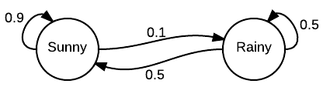

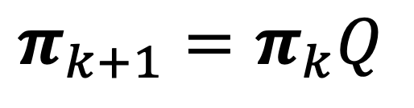

Representing Transition Probabilities
Graphs
nodes are states
edges are transition probabilities
Matrices
with $Pr(j|i)=P_{i,j}$.
Transition matrices satisfy $\overset{α}{\underset{j=1}{∑}}P_{i,j}=1$
transition matrix
probability vector evolution
$$Q=\left(\begin{matrix}0.9 & 0.1 \\ 0.5 & 0.5\end{matrix}\right)$$
$$π_{k+1}=π_{k}Q$$
If it is sunny on Monday, what is the probability that it is sunny on Tuesday?

Slide 14
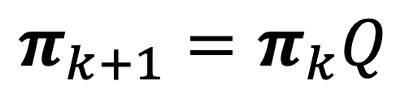

Stationary Probability
If the probability of Monday being sunny is 1/2, what is the probability of it being sunny on Tuesday?
1/2*0.9 + 1/2*0.5 = 0.7
If the probability of Monday being sunny is 5/6, what is the probability of it being sunny on Tuesday?
5/6*0.9 + 1/6*0.5 = (4.5 + 0.5)/6 = 5/6
This is known as the stationary probability, which does not change under application of the transition matrix
transition matrix
probability vector evolution
$$Q=\left(\begin{matrix}0.9 & 0.1 \\ 0.5 & 0.5\end{matrix}\right)$$
$$π_{k+1}=π_{k}Q$$

Slide 15
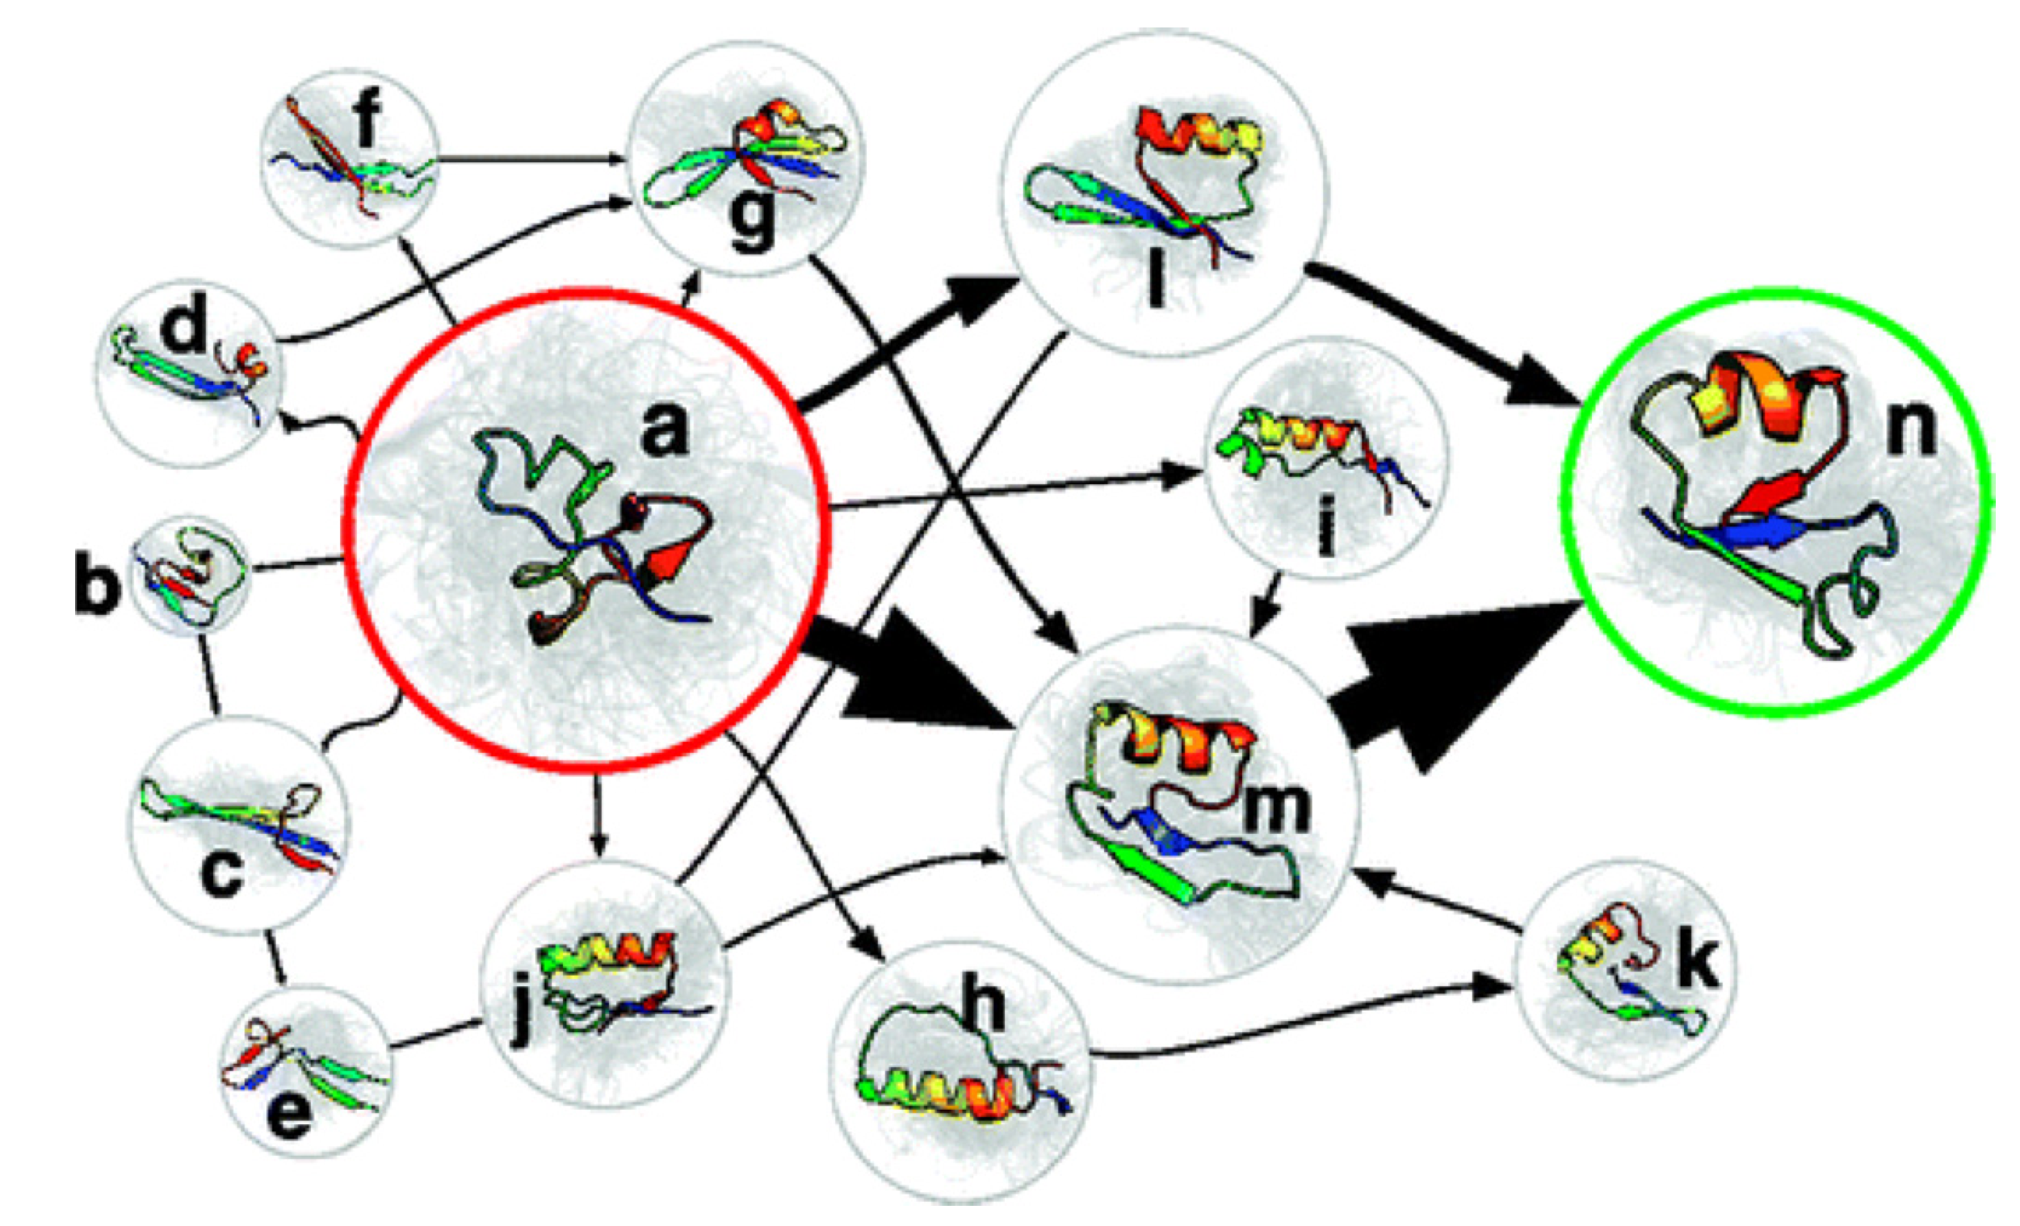
Markov State Model
. V.A. Voelz et al., J. Am. Chem. Soc. 132 (5) (2010) 1526–1528.

Slide 16
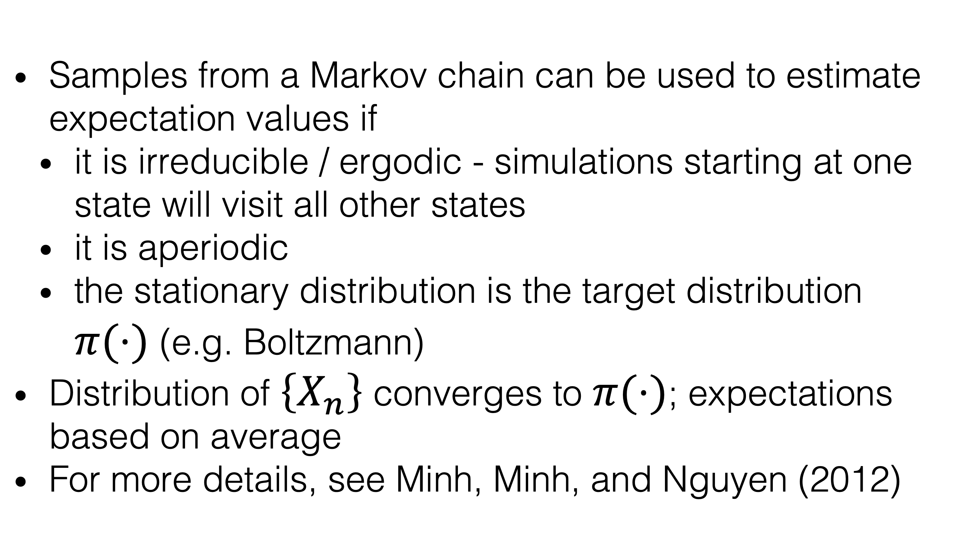
Expectations from Stochastic Processes
Samples from a Markov chain can be used to estimate expectation values if
it is irreducible / ergodic - simulations starting at one state will visit all other states
it is aperiodic
the stationary distribution is the target distribution $π(⋅)$ (e.g. Boltzmann)
Distribution of $\left\{X_{n}\right\}$ converges to $π(⋅)$; expectations based on average
For more details, see Minh, Minh, and Nguyen (2012)
A
B
C
D
Can you use a Markov chain with
this kernel to estimate expectations?

Slide 17
Biased Estimation
Estimates are biased unless
initial value from target distribution
the chain is regenerative (returns to initial state) and expectation based on data between regeneration times. See Minh, Minh, and Nguyen (2012) for more details.
Bias diminishes with sample size

Slide 18
References
Grossfield A, Zuckerman DM. Quantifying uncertainty and sampling quality in biomolecular simulations. Annu Rep Comput Chem. 2009 Jan 1;5:23-48. doi: 10.1016/S1574-1400(09)00502-7. PMID: 20454547; PMCID: PMC2865156.
Kalos, Malvin H.; Whitlock, Paula A. (2008). Monte Carlo Methods.
Levin DA, Peres Y and Wilmer EL, “Markov Chains and Mixing Times”, American Mathematical Soc., Oct 31, 2017, ISBN: 1470429624, 9781470429621
Minh, D. L.; Minh, D. D. L.; Nguyen, A. L. Regenerative Markov Chain Monte Carlo for Any Distribution. Communications in Statistics - Simulation and Computation 2012, 41 (9), 1745–1760. https://doi.org/10.1080/03610918.2011.615433.

