Slide 1
4/8/2026 Free Energy Calculations
Free energy calculations
Binding free energy calculations
Work on exercises / meet with teams
Today’s lecture is a key step towards the following learning objective: Explain key concepts related to binding free energy calculations. Compare and contrast molecular docking and binding free energy calculations.

Slide 2
Free energy calculations

Slide 3
Estimating Thermodynamic Properties
Molecular simulations are used to calculate thermodynamic and kinetic properties
In general, the thermodynamic properties are
expectation values of an observable, including
probability of the observable having a certain range of values
potential of mean force with respect to the observable
free energy differences between thermodynamic states
in biomolecular systems, ΔG ~ ΔA

Slide 4
What is ΔG?
ΔU is the change in average internal energy.
internal energy can be computed for individual structures
in biomolecular simulations, internal energy is modeled by the molecular mechanics force field
ΔH = ΔU + Δ(pV) is the change in enthalpy
in biomolecular simulations, change in pV is usually negligible
ΔG is the Gibbs free energy
at constant pressure and temperature, dictates
spontaneity and
equilibrium constant of process
in biomolecular simulation, interest in free energy differences between
conformations of a macromolecule
thermodynamic states with different temperature, pressure, volume, or other parameters
ΔG = ΔH + TΔS, but ΔS is very challenging to compute

Slide 5
What is ΔA?
ΔA is the Helmholtz free energy
at constant volume and temperature, dictates
spontaneity and
equilibrium constant of process
in biomolecular simulation, ΔA and ΔG are usually assumed to be equal
ΔA ≈ ΔG breaks down for pressure-dependent processes
We usually compute ΔA in simulation and interpret it as ΔG under typical biomolecular conditions

Slide 6
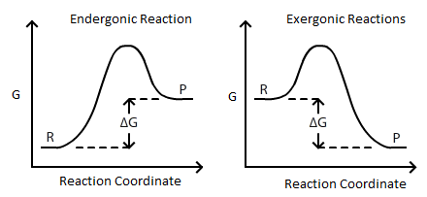
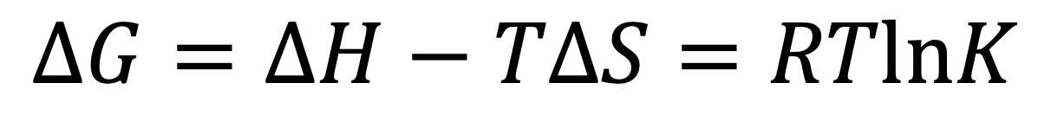
What is the free energy of a reaction?
$$ΔG=ΔH−TΔS=RTlnK$$
https://chem.libretexts.org/Bookshelves/Analytical_Chemistry/Supplemental_Modules_(Analytical_Chemistry)/Electrochemistry/Electrochemistry_and_Thermodynamics

Slide 7

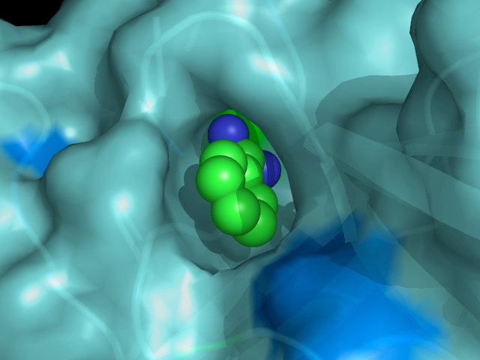
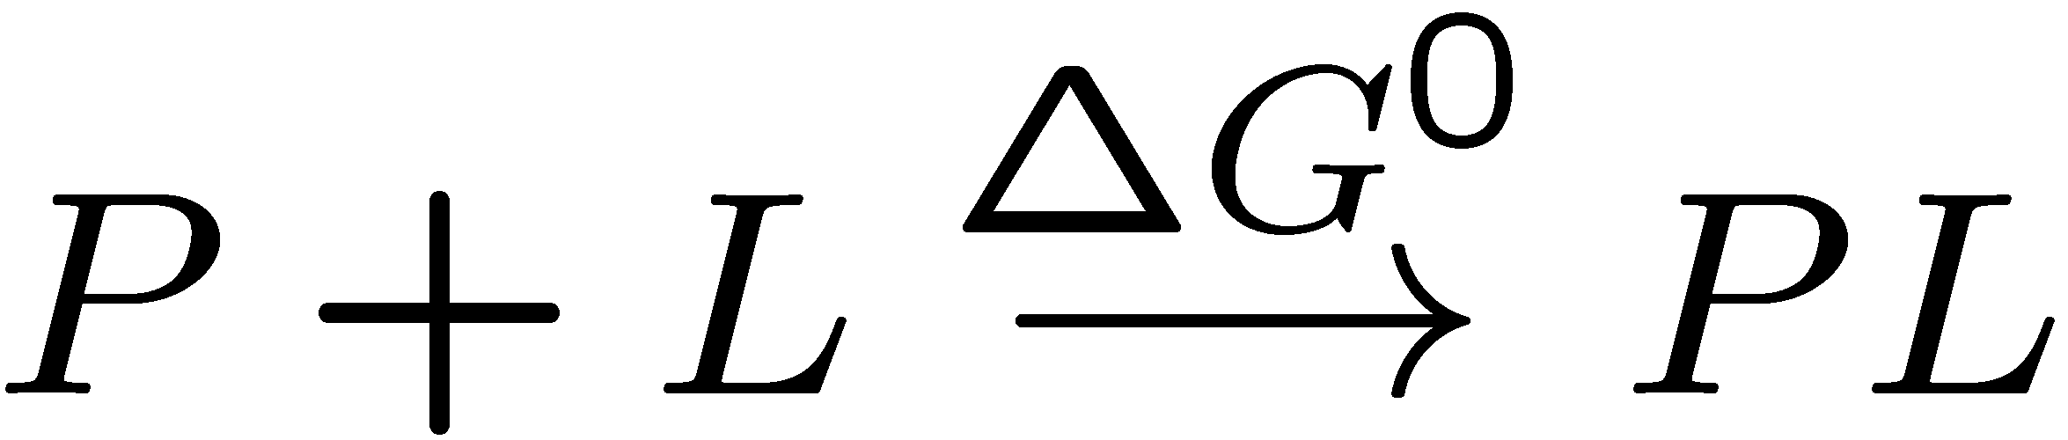
How are free energy calculations useful?
Noncovalent binding between molecules (see [2])
Design molecules to manipulate protein function
Recognize toxins
Identify enzyme functions
Protein design: design binders to target molecule
Aid medicinal chemistry, guide synthesis
Hydration free energies
Part of binding free energy & solubility
Conformational free energies relevant to
biological mechanism
binding free energy
(from [1])

Slide 8
How are ΔG/ΔA calculated from molecular simulations?

Slide 9
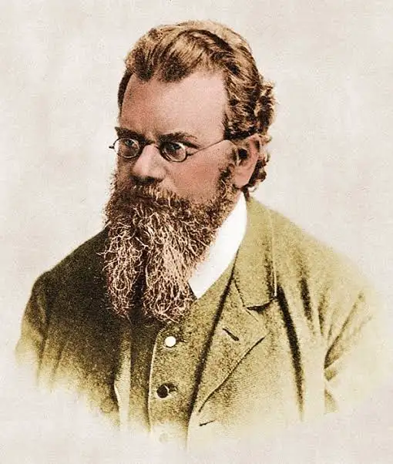
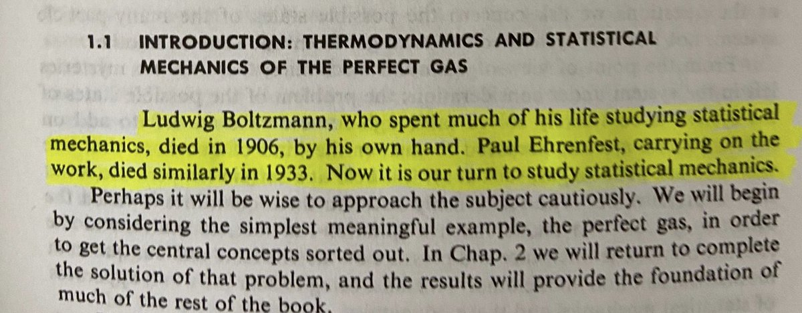
Ludwig Boltzmann, who spent much of his life studying Statistical Mechanics, died in 1906, by his own hand. Paul Ehrenfest, carrying on the work, died similarly in 1933. Now it is our turn to study Statistical Mechanics. Perhaps it will be wise to approach the subject cautiously.
David L. Goodstein (1975) in "States of Matter"

Slide 10
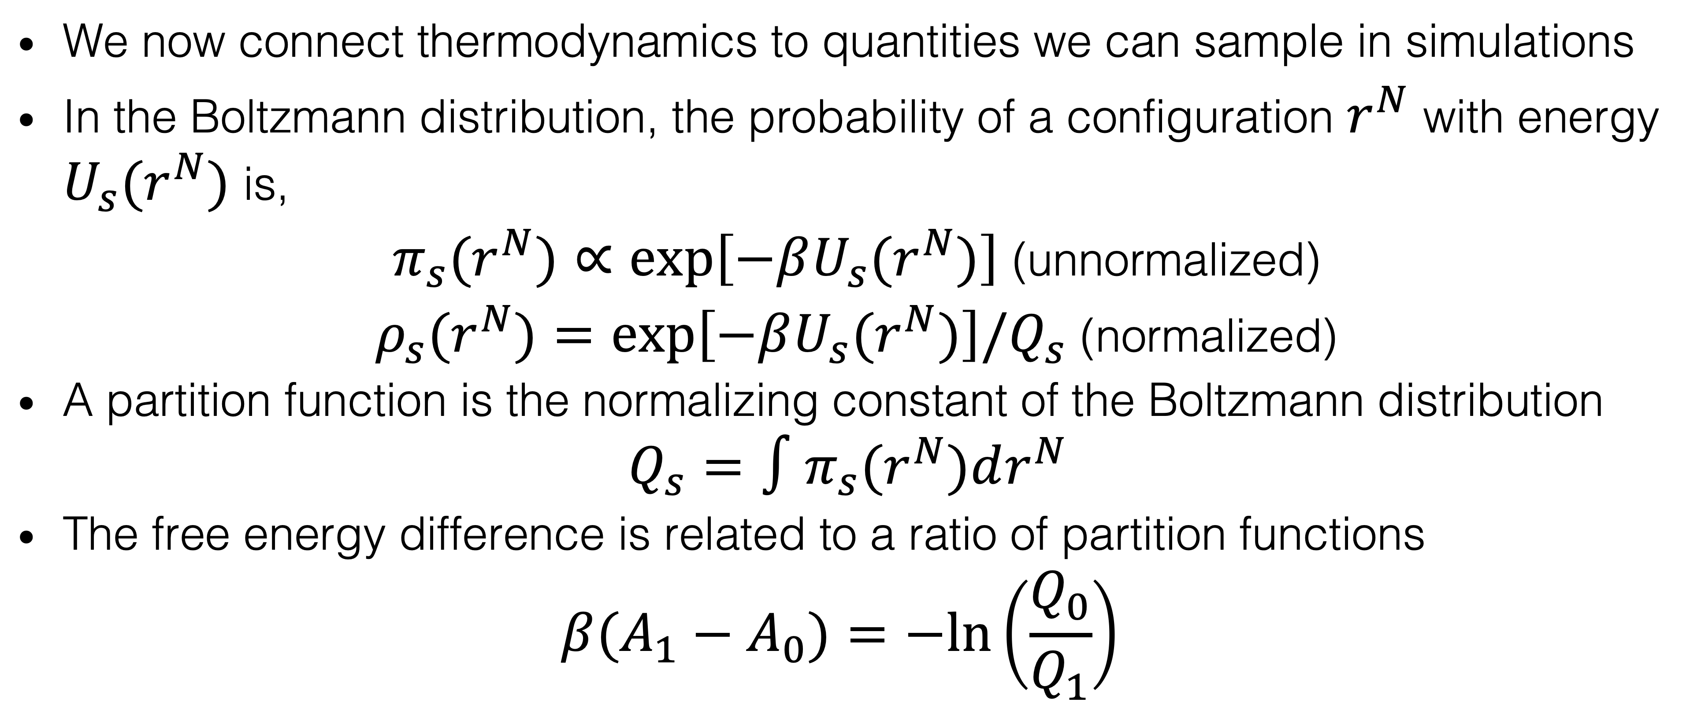
Basic Statistical Mechanics
We now connect thermodynamics to quantities we can sample in simulations
In the Boltzmann distribution, the probability of a configuration $r^{N}$ with energy $U_{s}(r^{N})$ is,
$π_{s}(r^{N})∝exp\left[−βU_{s}(r^{N})\right]$ (unnormalized)
$ρ_{s}(r^{N})=exp\left[−βU_{s}(r^{N})\right]/Q_{s}$ (normalized)
A partition function is the normalizing constant of the Boltzmann distribution
$$Q_{s}=∫π_{s}(r^{N})dr^{N}$$
The free energy difference is related to a ratio of partition functions
$$β(A_{1}−A_{0})=−ln\left(\frac{Q_{0}}{Q_{1}}\right)$$

Slide 11
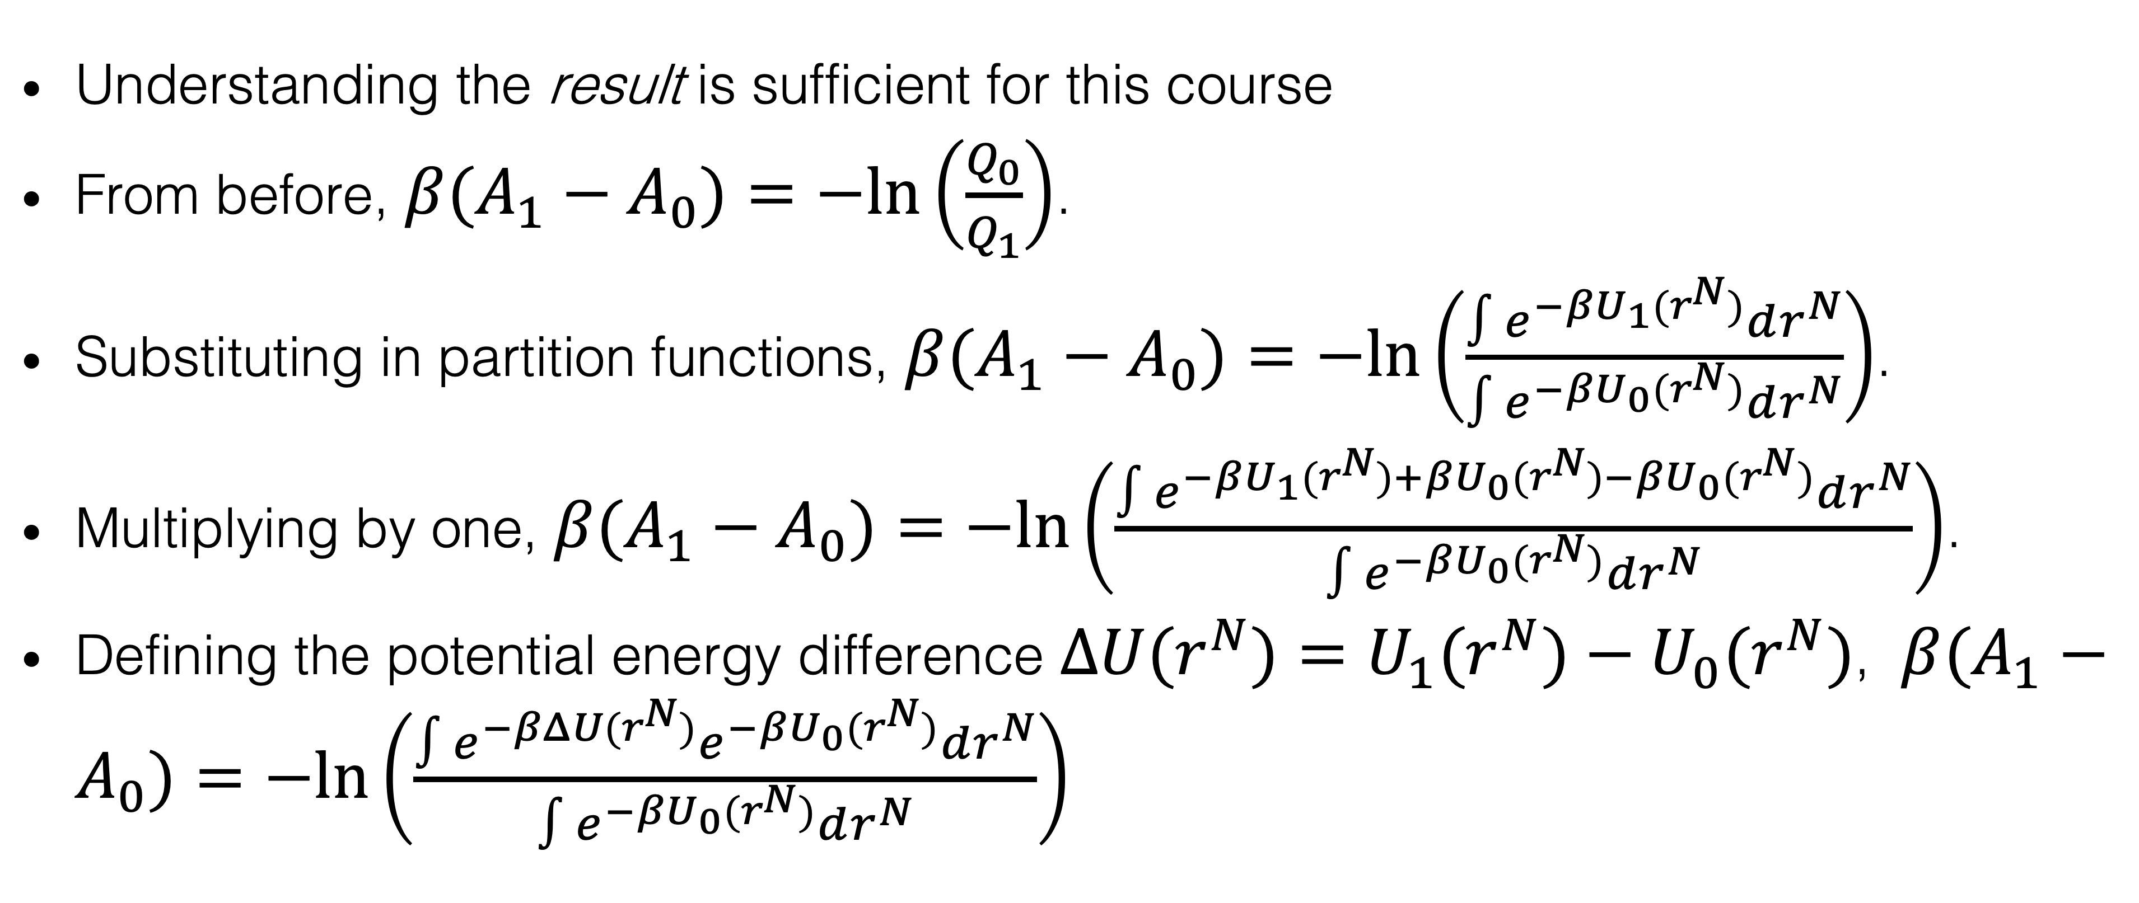
The Zwanzig Relation: Derivation
Understanding the result is sufficient for this course
From before, $β(A_{1}−A_{0})=−ln\left(\frac{Q_{0}}{Q_{1}}\right)$.
Substituting in partition functions, $β(A_{1}−A_{0})=−ln\left(\frac{∫e^{−βU_{1}(r^{N})}dr^{N}}{∫e^{−βU_{0}(r^{N})}dr^{N}}\right)$.
Multiplying by one, $β(A_{1}−A_{0})=−ln\left(\frac{∫e^{−βU_{1}(r^{N})+βU_{0}(r^{N})−βU_{0}(r^{N})}dr^{N}}{∫e^{−βU_{0}(r^{N})}dr^{N}}\right)$.
Defining the potential energy difference $ΔU(r^{N})=U_{1}(r^{N})−U_{0}(r^{N})$, $β(A_{1}−A_{0})=−ln\left(\frac{∫e^{−βΔU(r^{N})}e^{−βU_{0}(r^{N})}dr^{N}}{∫e^{−βU_{0}(r^{N})}dr^{N}}\right)$

Slide 12
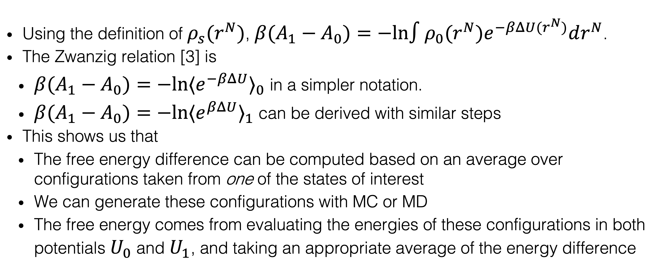
The Zwanzig Relation: In Practice
Using the definition of $ρ_{s}(r^{N})$, $β(A_{1}−A_{0})=−ln∫ρ_{0}(r^{N})e^{−βΔU(r^{N})}dr^{N}$.
The Zwanzig relation [3] is
$β(A_{1}−A_{0})=−ln{⟨e^{−βΔU}⟩}_{0}$ in a simpler notation.
$β(A_{1}−A_{0})=−ln{⟨e^{βΔU}⟩}_{1}$ can be derived with similar steps
This shows us that
The free energy difference can be computed based on an average over configurations taken from one of the states of interest
We can generate these configurations with MC or MD
The free energy comes from evaluating the energies of these configurations in both potentials $U_{0}$ and $U_{1}$, and taking an appropriate average of the energy difference

Slide 13
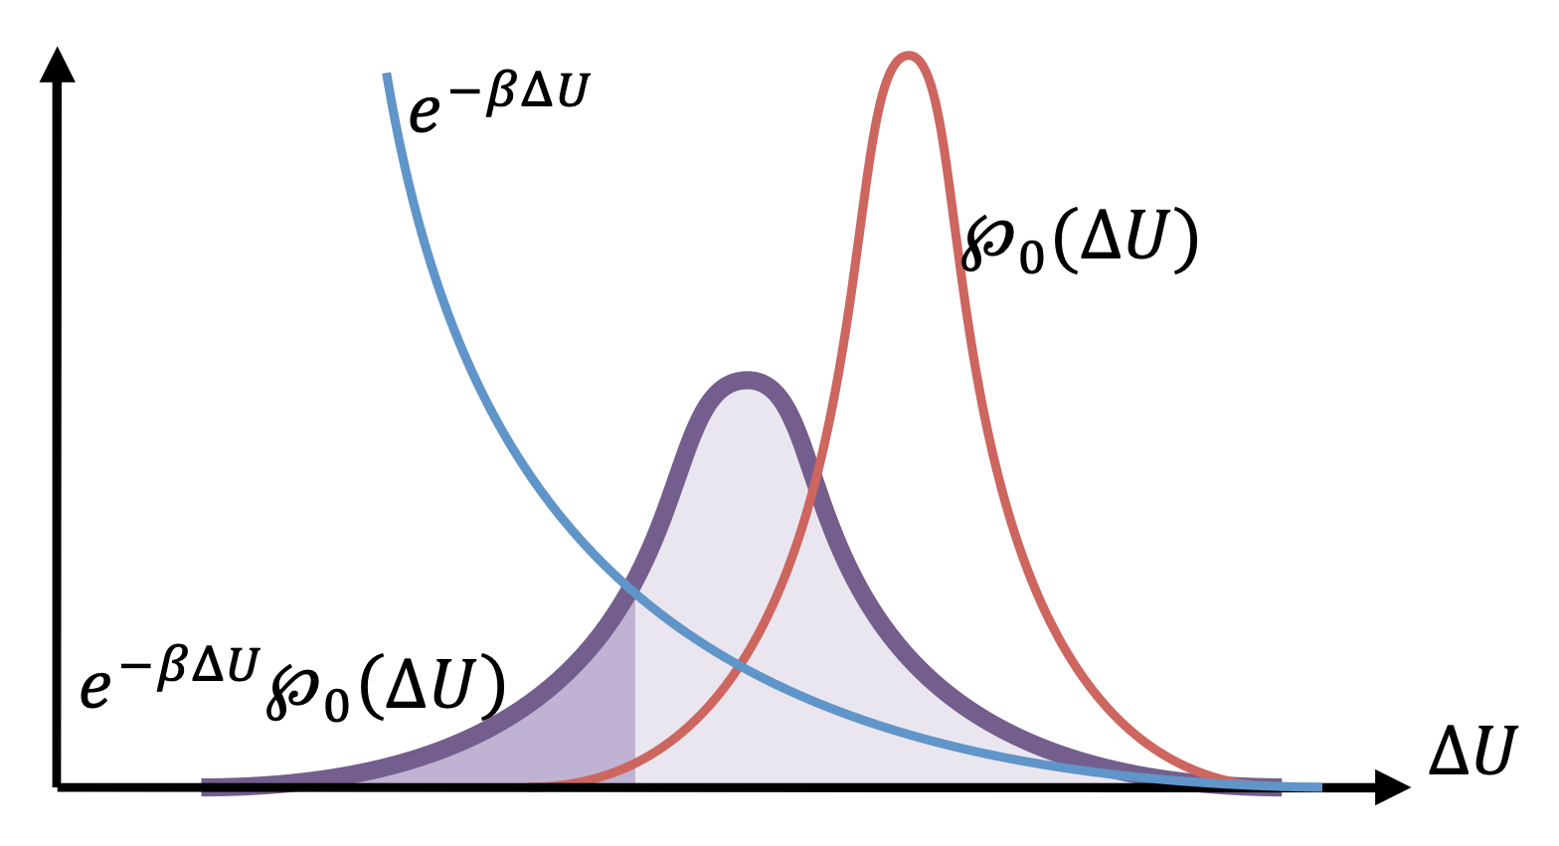
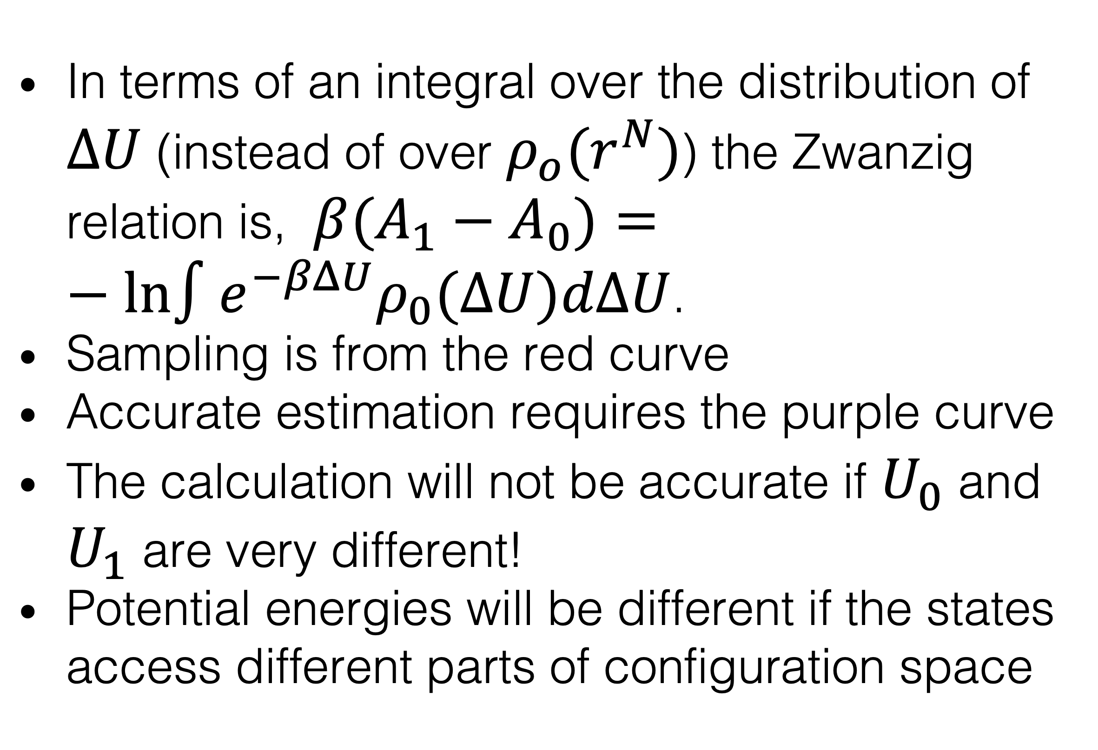
The Zwanzig Relation: Limitations
In terms of an integral over the distribution of $ΔU$ (instead of over $ρ_{o}(r^{N})$) the Zwanzig relation is, $β(A_{1}−A_{0})=−ln∫e^{−βΔU}ρ_{0}(ΔU)dΔU$.
Sampling is from the red curve
Accurate estimation requires the purple curve
The calculation will not be accurate if $U_{0}$ and $U_{1}$ are very different!
Potential energies will be different if the states access different parts of configuration space
(from [1])

Slide 14
Configuration Space Overlap
Good overlap
A
B
Poor overlap
A
B
Overlap ensures that configurations important for one state are sampled in the other, enabling accurate free energy estimates.
Good overlap leads to well-behaved exponential averages and convergence, while poor overlap causes bias and high variance.
Intermediate thermodynamic states and restraints improve configuration overlap, enhancing free energy calculation reliability.
Choosing transformation pathways and sampling strategies based on overlap is key to successful free energy predictions.

Slide 15
Other ways to calculate ΔG
Zwanzig gives intuition, but other methods are more accurate
Multistate Bennett Acceptance Ratio (MBAR) [5]
estimates free energies and thermodynamic expectations from a series of states
extension of Bennett Acceptance Ratio (BAR) [4], which uses data from two states
Proven to be statistically optimal
Thermodynamic integration is based on the fundamental theorem of calculus, integrating one the derivative of the free energy with respect to a parameter
All of the methods require thermodynamic states with configuration space overlap, meaning that
similar configurations have similar energies
the most relevant configuration space is similar

Slide 16
Binding Free Energy Calculations
This module will be on the theory of binding free energy calculations
At the end of this module, you should be able to answer the following questions:
How do binding free energy calculations differ from molecular docking?
What is a thermodynamic cycle? What types of thermodynamic cycles are used in binding free energy calculations?
What is an alchemical transformation?

Slide 17





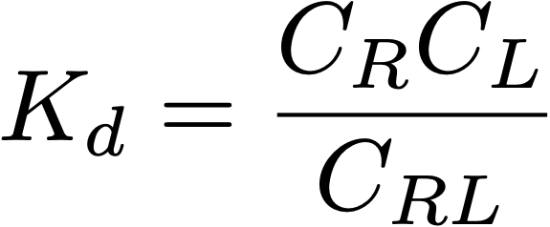


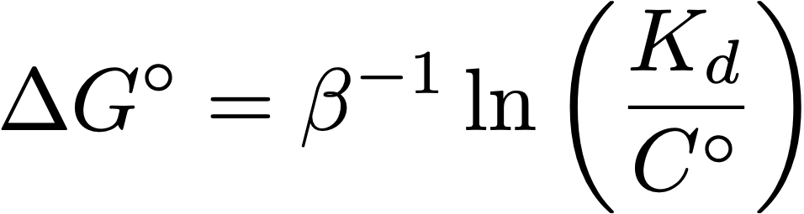





ΔG○ quantifies binding strength
free receptor concentration
dissociation constant
free ligand concentration
complex concentration
standard state concentration (1 M)
binding free energy
highest biological
affinity
good drugs
lead compounds
weak
biomolecular
fM
pM
nM
μM
mM
M
STRONG
WEAK
K_{d} is the reciprocal of K_{a}
More negative $ΔG^{∘}$ = stronger binding
-20.8
-16.6
-12.4
-8.3
-4.1
0
kcal/mol
biotin:streptavidin
lipitor:HMG-CoA
reductase
benzamidine:
bovine trypsin
ATP:kinase
Notes:
We are considering a noncovalent association process. It has a equilibrium constant and binding free energy. Free energies include enthalpy and entropy
\Delta G^\circ = \beta^{-1} \ln \left( \frac{K_d}{C^\circ} \right)

Slide 18
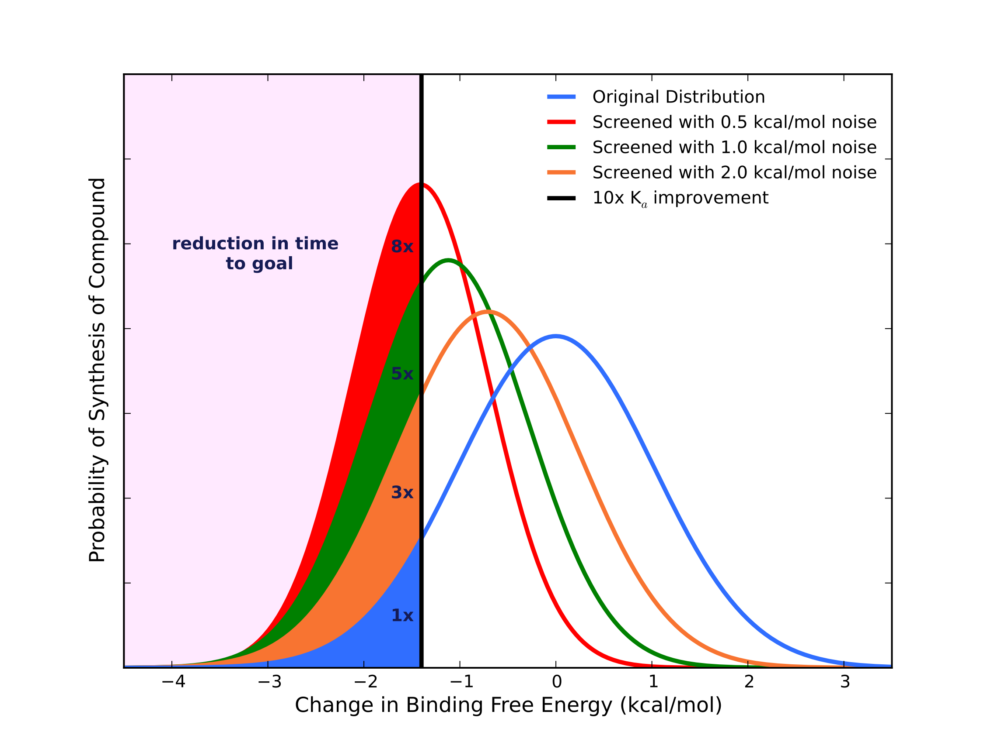
Modestly accurate ΔG○ predictions can aid drug discovery
Hypothetical pipeline:
Medicinal chemist suggests 100 derivatives or compounds per week
Your job is to pick the top 10 to carry forward
Question: How many molecules do we have to make to gain a factor of 10 in affinity?
- 0.5 kcal/mol noise: Decreases # required by 8x
- 1.0 kcal/mol noise: Decreases by 5x
- 2 kcal/mol noise: Decreases by 3x
Shirts, Mobley, and Brown, “Free Energy Calculations in Structure-based Drug Design”, in “Structure Based Drug Design” by Merz et al., Cambridge University Press, 2010. See also Mobley & Klimovich, JCP 2013
Notes:
Abbott has looked at the distribution of affinity changes due to suggested mutations and it is very nearly Gaussian
We already have better than 2 kcal/mol noise.
Thus depending on synthesis time required this can pay off.

Slide 19
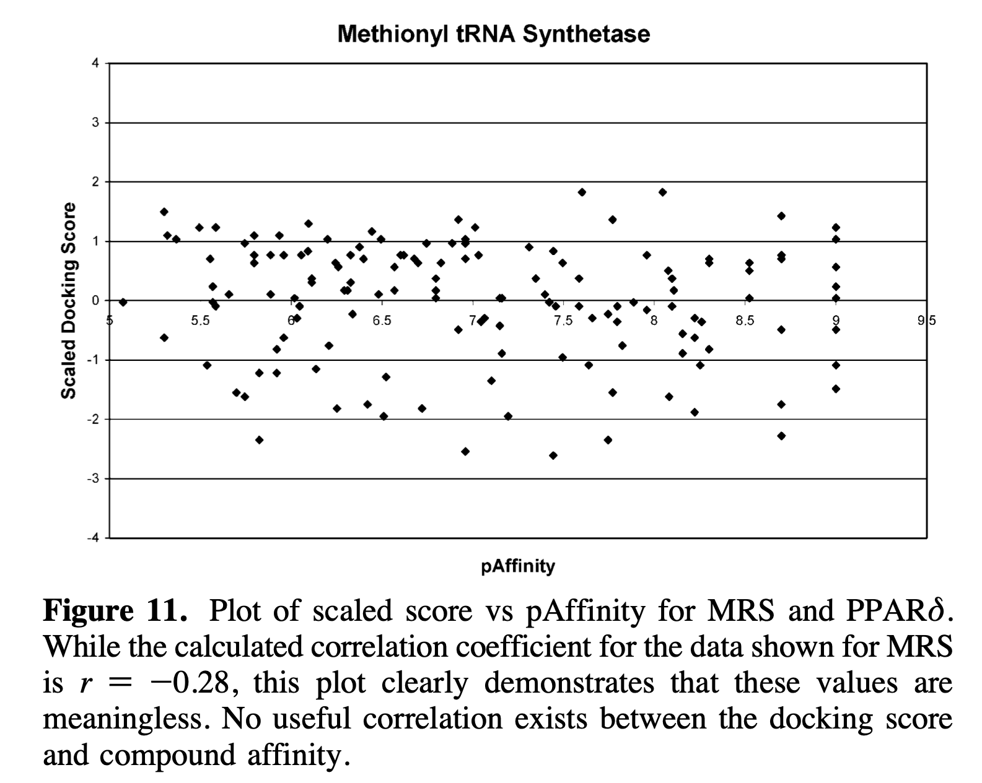
Docking scores do not correlate with ΔG○
“For prediction of compound affinity, none of the docking programs or scoring functions made a useful prediction of ligand binding affinity.”
From Warren et al. [GSK], “A Critical Assessment of Docking Programs and Scoring Functions”, J. Med. Chem. 49:5912, 2006.

Slide 20
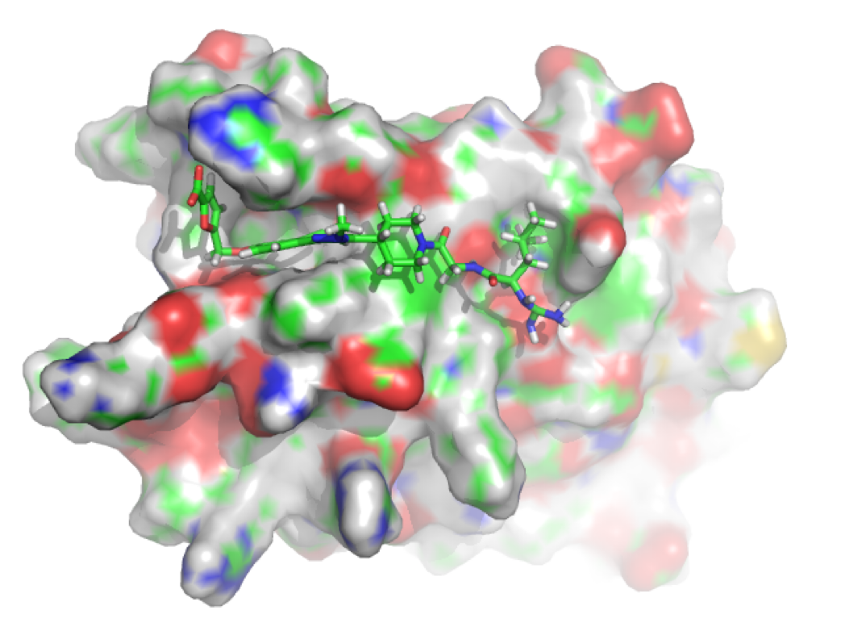
Docking approximates ΔS
ΔG = ΔH + TΔS
Docking score ~ ΔH
It sometimes involves
ad hoc ΔS based on the number of rotatable bonds
ΔGsolv
Docking is based on “optimal” configurations
(from [1])

Slide 21
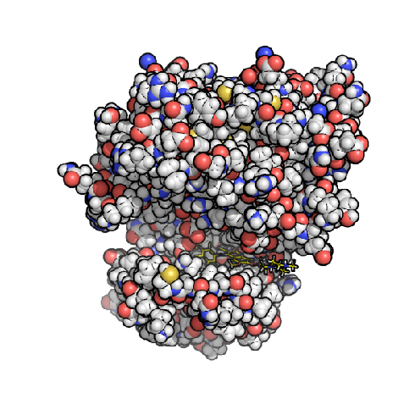
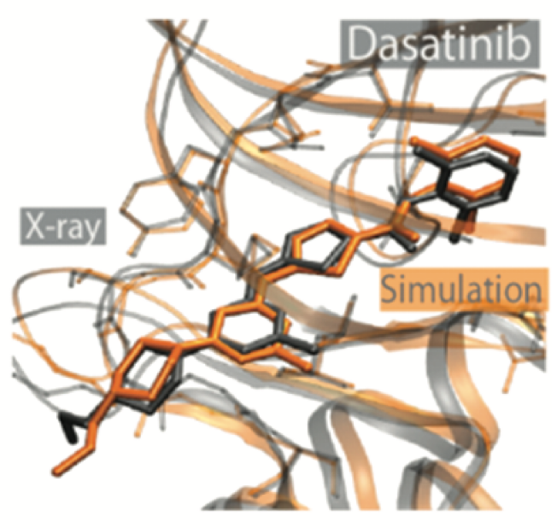

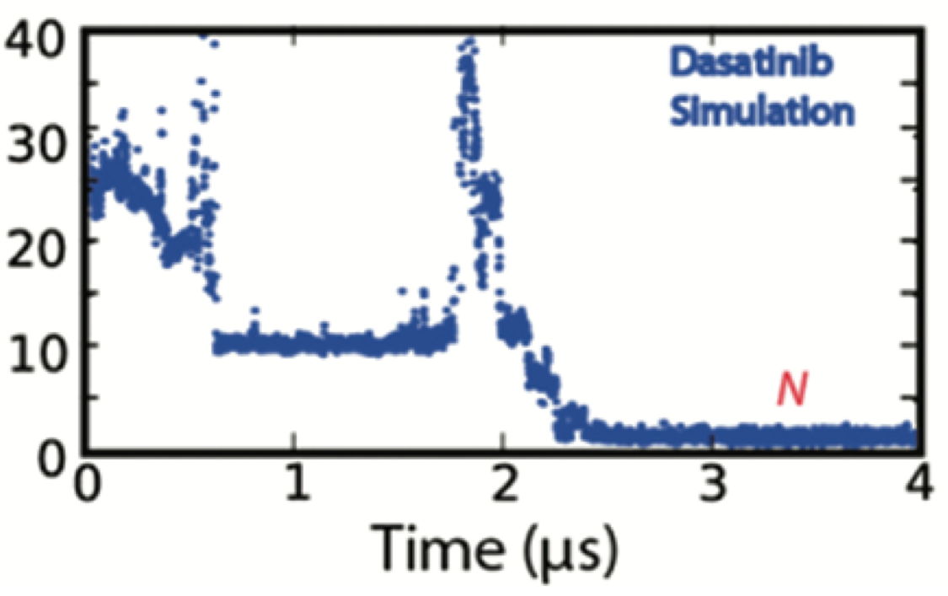
Binding free energies can be determined from long simulations
In principle, we could watch many binding/unbinding events
unbound
bound
time
but this is expensive, and only a small number of heroic simulations have been done
Src Kinase
Shan, …, Shaw, JACS 2011
Notes:
This gives the crystal structure - maybe the force field isn’t too bad!

Slide 22
Faster ΔG○ methods are based on thermodynamic cycles
Free energy is a state function
Other common state functions are height, weight, location
The path doesn’t matter
Thermodynamic cycles are a series of thermodynamic processes which return to the initial state
The total free energy difference around a thermodynamic cycle is zero
Differences between free energies (and other thermodynamics state functions) may be determined indirectly

Slide 23
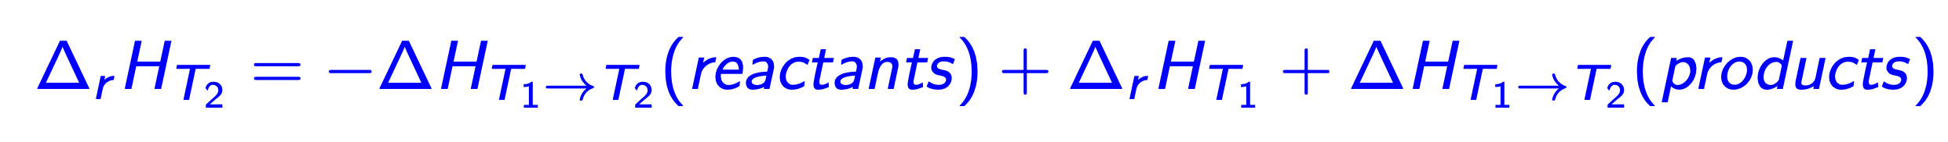
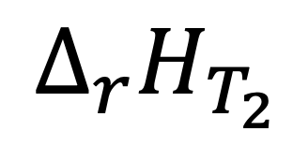
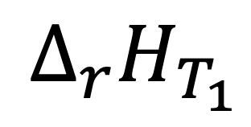


Exercise: given this themodynamic cycle, write an expression for $Δ_{r}H_{T_{2}}$ in terms of $Δ_{r}H_{T_{1}}$, $Δ_{r}H_{T_{1}→T_{2}(reactants)}$, and $Δ_{r}H_{T_{1}→T_{2}(products)}$.
$$Δ_{r}H_{T_{2}}$$
Reactants, T2
Products, T2
$$ΔH_{T_{1}→T_{2}}(\text{reactants})$$
$$ΔH_{T_{1}→T_{2}}(\text{products})$$
$$Δ_{r}H_{T_{1}}$$
Reactants, T1
Products, T1

Slide 24
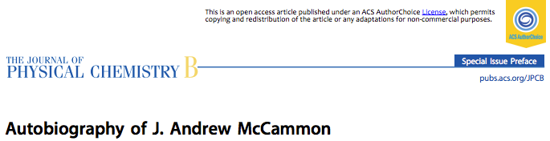
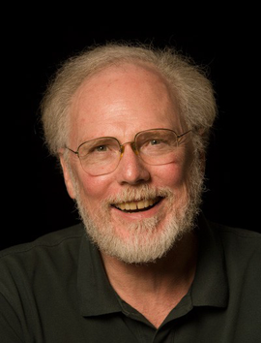
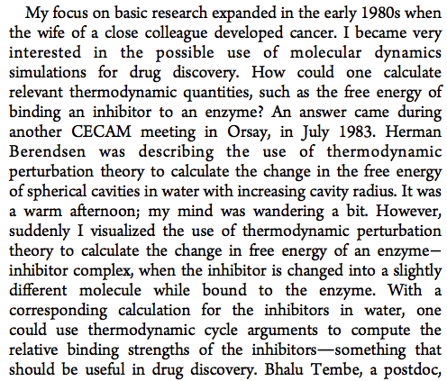


Slide 25
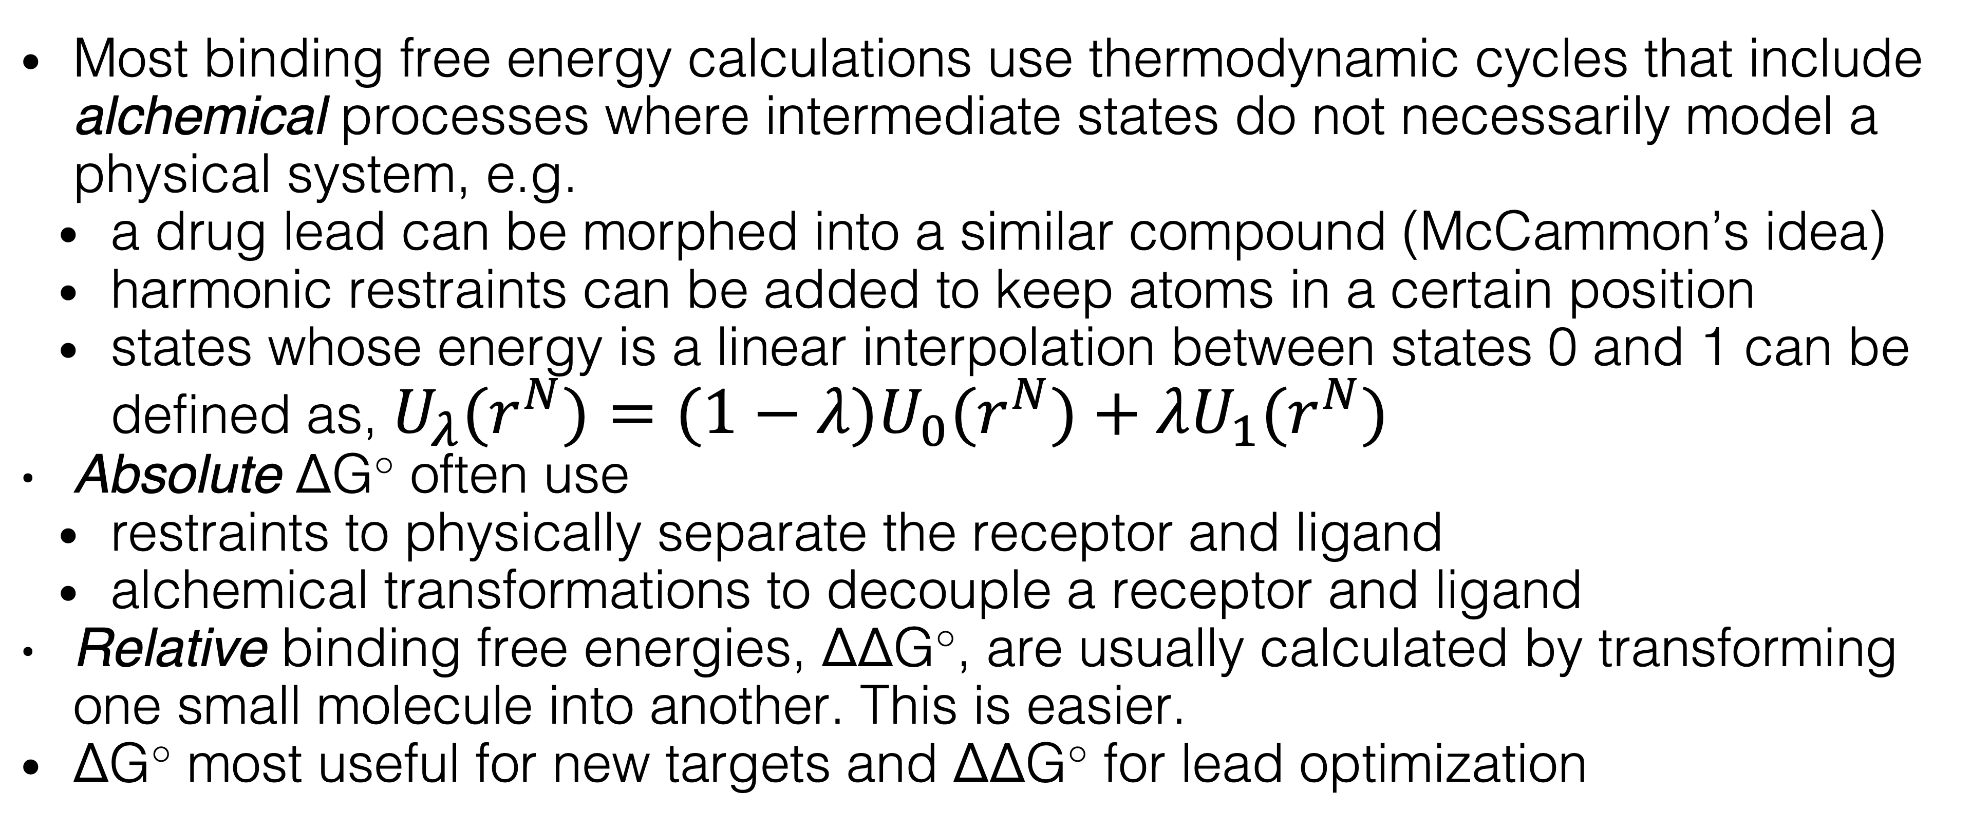
Thermodynamic cycles in ΔG○ calculations
Most binding free energy calculations use thermodynamic cycles that include alchemical processes where intermediate states do not necessarily model a physical system, e.g.
a drug lead can be morphed into a similar compound (McCammon’s idea)
harmonic restraints can be added to keep atoms in a certain position
states whose energy is a linear interpolation between states 0 and 1 can be defined as, $U_{λ}(r^{N})=(1−λ)U_{0}(r^{N})+λU_{1}(r^{N})$
Absolute ΔG○ often use
restraints to physically separate the receptor and ligand
alchemical transformations to decouple a receptor and ligand
Relative binding free energies, ΔΔG○, are usually calculated by transforming one small molecule into another. This is easier.
ΔG○ most useful for new targets and ΔΔG○ for lead optimization

Slide 26



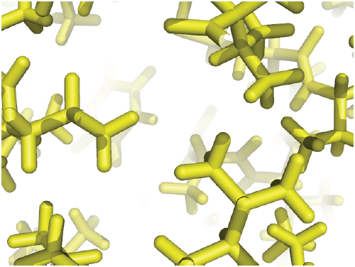
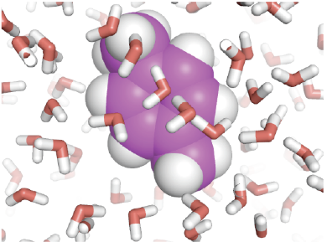
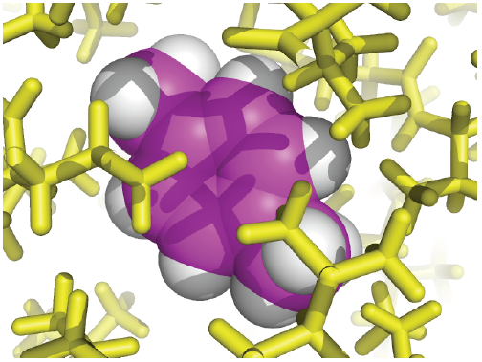




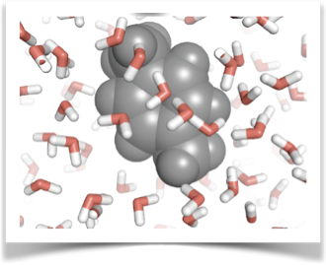
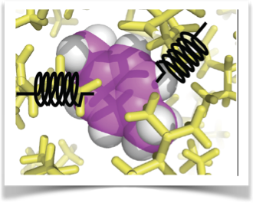
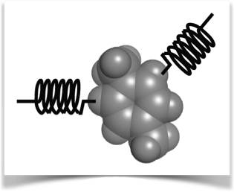
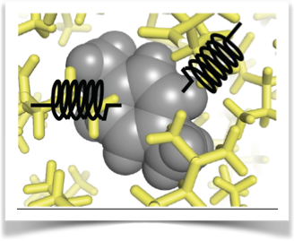


A Thermodynamic Cycle for Absolute ΔG of Binding
Cycle: Boresch et al., J. Phys. Chem. B 107:9535 (2003)
See also Gilson, Biophys J. 1997.
From [1]
Notes:
Discuss here that we are using MD simulations (AMBER FF, GROMACS) to get at the ratio of partition functions

Slide 27
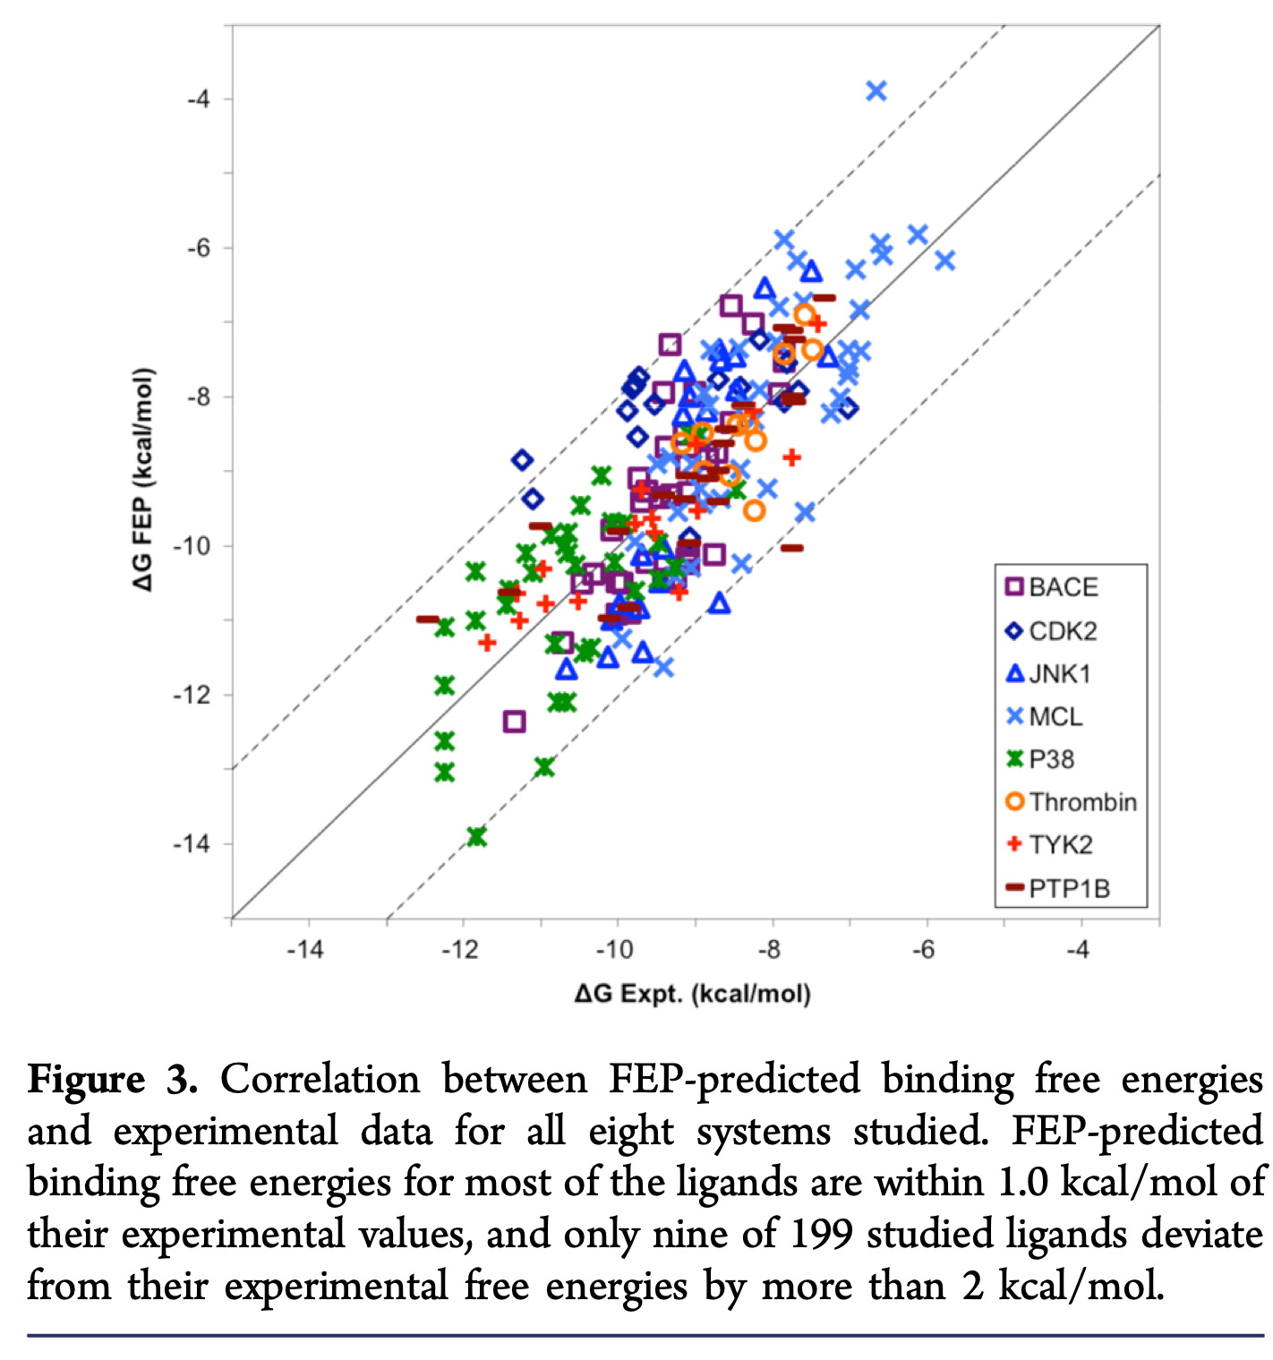
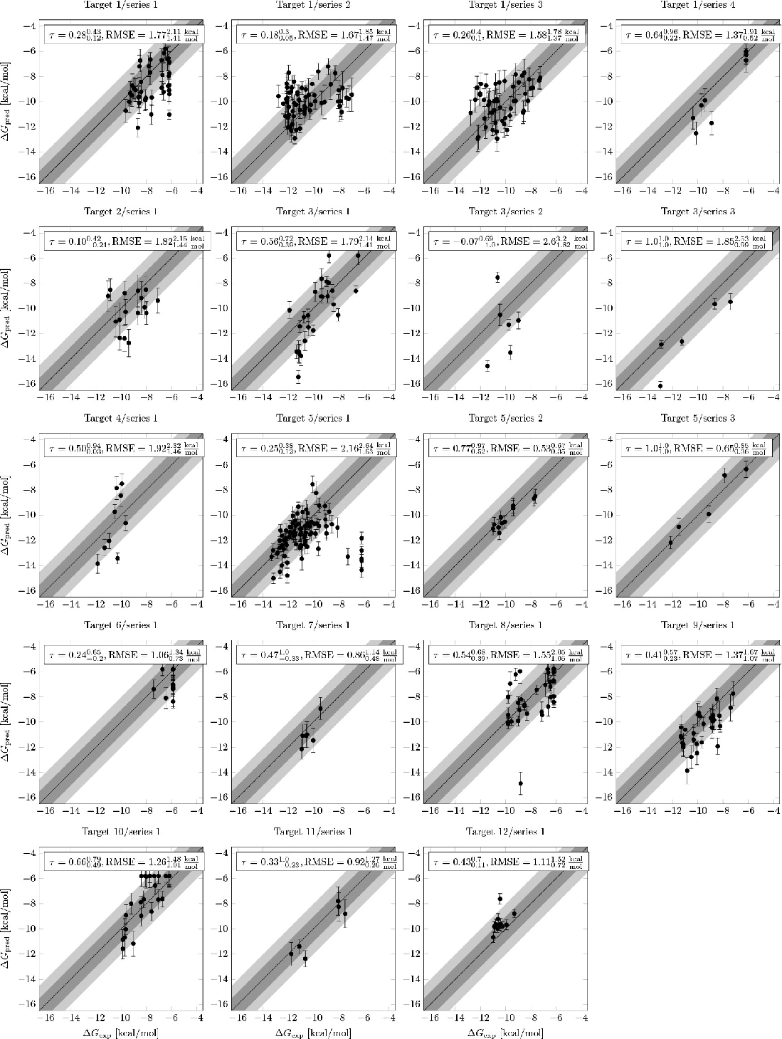
Alchemical methods can accurately calculate small ΔΔG○
from Wang et al. [Schrodinger], J. Am. Chem. Soc. 137:2695-2703 (2015)
Figure 3. Prospective FEP+ results from 12 targets and 19 chemical series. From Schindler et al. [Merck] J. Chem. Inf. Model. 60:5457-5474 (2020)

Slide 28
Docking versus Free Energy
Docking | Free Energy
Fast | Expensive
Optimized structures | Ensemble averages
Poor absolute ΔG | Quantitative ΔG or ΔΔG
Heuristic entropy | Statistical mechanics

Slide 29
Review
How do binding free energy calculations differ from molecular docking?
What is a thermodynamic cycle? What types of thermodynamic cycles are used in binding free energy calculations?
What is an alchemical transformation?

Slide 30
Additional Resources
Resource for alchemical binding free energy calculations (http://www.alchemistry.org/wiki/Main_Page)

