Slide 1
8/29/2023
Uncertainty (last lecture)
Simultaneous specification of observables
Heisenberg and generalized uncertainty principles
Time evolution of expectation values
General derivation
Ehrenfest’s theorem
Implications of the Schrödinger equation
Constraints on wavefunctions
Curvature
Penetration
Quantization
Exercise 1: Introduction to Google Colab

Slide 2
Uncertainty
This module is intended to help you achieve the following learning objectives:
Use the general uncertainty principle to evaluate limits on the simultaneous specification of a pair of quantities
At the end of this module, you should be able to
answer the following questions:
What condition must be satisfied for two quantum observables to be simultaneously specified?
derive an uncertainty principle for an arbitrary pair of observables

Slide 3
Simultaneous specification
Recall that two operators commute if $[\overset{̂}{A},\overset{̂}{B}]=0$.
If two operators commute, then their corresponding observables can be simultaneously specified.
If two operators do not commute, then their corresponding observables cannot be simultaneously specified. They are complementary observables.
This is counterintuitive.

Slide 4
Uncertainty
Heisenberg uncertainty principle: $ΔxΔp_{x}≥\frac{1}{2}ℏ$
General uncertainty principle: $ΔAΔB≥\frac{1}{2}\left|⟨[\overset{̂}{A},\overset{̂}{B}]⟩\right|$
$ΔA={\left\{⟨A^{2}⟩-{⟨A⟩}^{2}\right\}}^{\frac{1}{2}}$ is the root mean square deviation of the observable. The mean square deviation is,$⟨(δA)^{2}⟩=⟨(A-⟨A⟩)^{2}⟩=⟨A^{2}-2A⟨A⟩+{⟨A⟩}^{2}⟩$ $=⟨A^{2}⟩-2⟨A⟩⟨A⟩+{⟨A⟩}^{2}=⟨A^{2}⟩-{⟨A⟩}^{2}$
Uncertainty $≠$ measurement error. Improved instruments do not reduce uncertainty beyond a certain point.

Slide 5
Proof
The general uncertainty relation is based on Postulate 3
To show this, we will
define spread operators
expand an integral that can be manipulated to the uncertainty relation

Slide 6
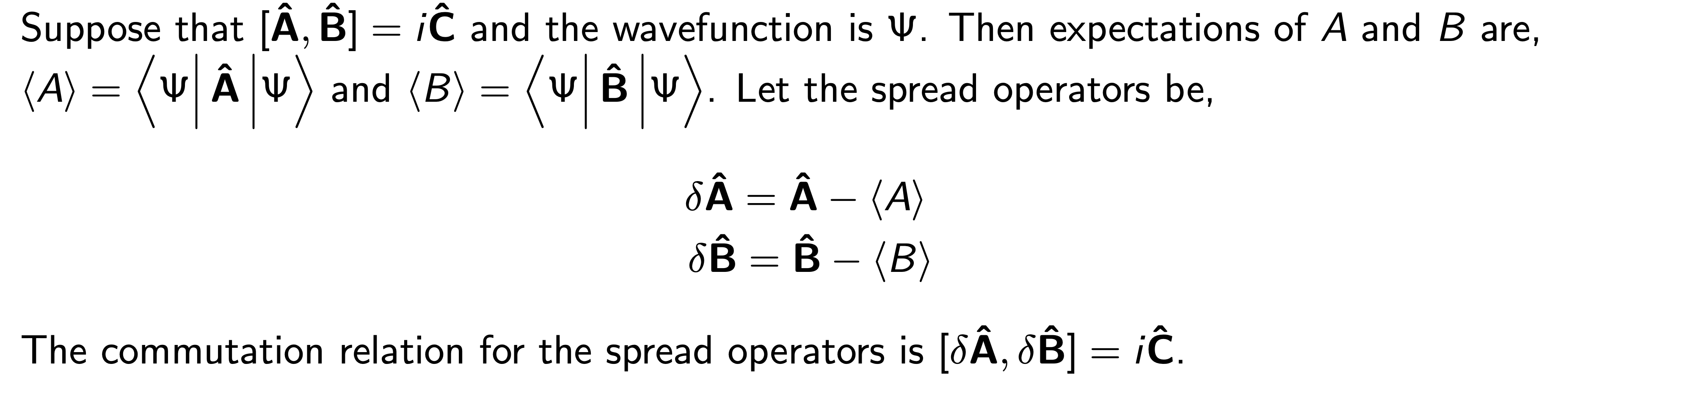
Spread operators

Slide 7
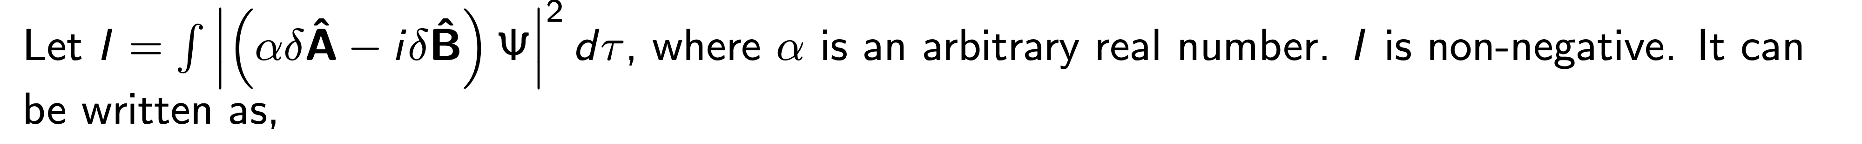
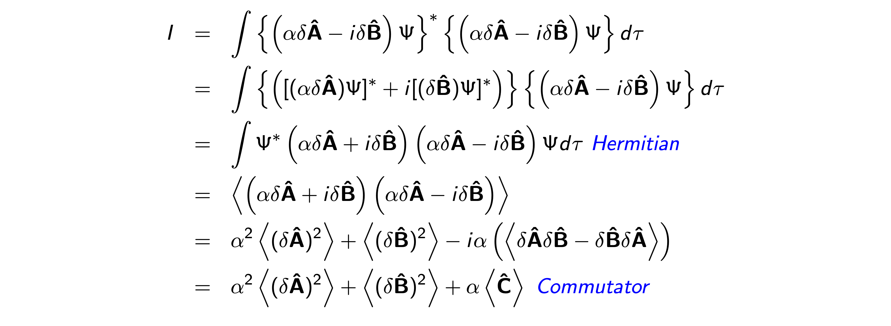

Slide 8
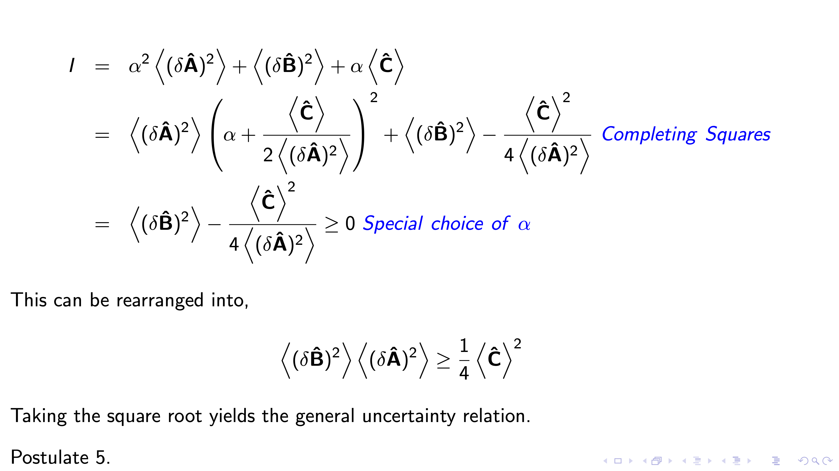

Slide 9
Review
Check that you can
answer the following questions:
What condition must be satisfied for two quantum observables to be simultaneously specified?
derive an uncertainty principle for an arbitrary pair of observables

Slide 10
Time Evolution of Expectation Values
This module is intended to help you achieve the following learning objectives:
Express time derivatives of expectation values
At the end of this module, you should be able to
answer the following questions:
What condition must be satisfied for an observable to change with time?
How do classical and quantum observables correspond to one another?
determine how the expectation value of an observable changes with time

Slide 11
Time Evolution of Arbitrary Expectations
$\frac{d⟨Ω⟩}{dt}=\frac{d⟨Ψ|\overset{̂}{Ω}|Ψ⟩}{dt}$, by a time derivative of the third postulate
$\frac{d⟨Ω⟩}{dt}=∫Ψ^{*}\overset{̂}{Ω}\left(\frac{∂Ψ}{∂t}\right)dτ+∫\left(\frac{∂Ψ^{*}}{∂t}\right)\overset{̂}{Ω}Ψdτ$ using differentiation by parts. Using the Schrödinger equation and the properties of Hermitian operators,
$$∫Ψ^{*}\overset{̂}{Ω}\left(\frac{∂Ψ}{∂t}\right)dτ=\frac{1}{iℏ}∫Ψ^{*}\overset{̂}{Ω}\overset{̂}{H}Ψdτ$$
$$∫\left(\frac{∂Ψ^{*}}{∂t}\right)\overset{̂}{Ω}Ψdτ=-\frac{1}{iℏ}∫{\left(\overset{̂}{H}Ψ\right)}^{*}\overset{̂}{Ω}Ψdτ=-\frac{1}{iℏ}∫Ψ^{*}\overset{̂}{H}\overset{̂}{Ω}Ψdτ$$
$$\frac{d⟨Ω⟩}{dt}=-\frac{1}{iℏ}\left[⟨Ψ|\overset{̂}{H}\overset{̂}{Ω}|Ψ⟩-⟨Ψ|\overset{̂}{Ω}\overset{̂}{H}|Ψ⟩\right]=\frac{i}{ℏ}⟨\left[\overset{̂}{H},\overset{̂}{Ω}\right]⟩$$

Slide 12
Time Evolution of Position
Given that $\frac{d⟨Ω⟩}{dt}=\frac{i}{ℏ}⟨\left[\overset{̂}{H},\overset{̂}{Ω}\right]⟩$, then
If an operator commutes with the Hamiltonian, then its expectation value does not change with time
This can be used to prove Ehrenfest’s theorem, an example of the correspondence principle - for large numbers and large energies, quantum calculations agree with classical calculations
$$\frac{d}{dt}⟨p_{x}⟩=-⟨\frac{dV}{dx}⟩=⟨F⟩$$
$$\frac{d}{dt}⟨x⟩=\frac{⟨p_{x}⟩}{m}$$

Slide 13
Review
Check that you can
answer the following questions:
What condition must be satisfied for an observable to change with time?
How do classical and quantum observables correspond to one another?
determine how the expectation value of an observable changes with time

Slide 14
Implications of the Schrödinger Equation
This module is intended to help you achieve the following learning objectives:
Explain quantum penetration and tunneling
At the end of this module, you should be able to
answer the following questions:
What are the requirements on the derivatives of a wavefunction for $|Ψ|^{2}$ to be a probability density and for $Ψ$ satisfy the Schrödinger equation?
How does the potential and kinetic energy relate to the curvature of the wavefunction?
What is penetration? Is it permitted in classical mechanics? Is it permitted in quantum mechanics?
Under what conditions must energy be quantized?

Slide 15
Constraints on wavefunctions
$$∫Ψ^{*}Ψdτ=1$$
As$|Ψ|^{2}$ is a probability density, $Ψ$
Cannot be infinite over a finite region
Must be single-valued
In order for $Ψ$ to be a solution to a second-order differential equation, it must have a second derivative. This implies that, except in ill-behaved regions of the potential, the function
is continuous and
has a continuous first derivative,

Slide 16
Curvature
Colloquially, the second derivative can be thought of as the curvature
The time-independent Schrödinger equation is
$$-\frac{ℏ^{2}}{2m}\frac{∂^{2}Ψ}{∂x^{2}}+VΨ=EΨ$$
$$\frac{∂^{2}Ψ}{∂x^{2}}=\frac{2m}{ℏ^{2}}(V-E)Ψ$$
Thus the curvature depends on the relative potential and total energy

Slide 17
Curvature and Penetration
Consider a particle moving right in a harmonic potential
In classical mechanics, what happens with the
potential and kinetic energy?
probability density? It is possible to see E < V?
Based on $\frac{∂^{2}Ψ}{∂x^{2}}=\frac{2m}{ℏ^{2}}(V-E)Ψ$, what happens to the curvature and slope of the wavefunction if
E > V?
the curvature is negative; the slope decreases
E = V?
the curvature is zero; the slope is constant
E < V?
the curvature is positive; the slope increases
In QM there is penetration into the classically forbidden region
Kinetic energy is negative but the expectation value is positive
Energy, E
Potential Energy, E
Wavefunction, $Ψ$
Position, x

Slide 18
Quantization
When there are two boundary conditions to satisfy (a particle is bounded), then it is possible to find acceptable solutions to $\overset{̂}{H}Ψ=EΨ$ for only certain values of E
The need to satisfy two boundary conditions implies quantization of the energy
Quantization is not required if there is only one boundary
Energy, E
Unquantized
Potential Energy, E
Potential Energy, E
Quantized
Wavefunction, $Ψ$
Position, x

Slide 19
Review
Check that you can
answer the following questions:
What are the requirements on the derivatives of a wavefunction for $|Ψ|^{2}$ to be a probability density and for $Ψ$ satisfy the Schrödinger equation?
How does the potential and kinetic energy relate to the curvature of the wavefunction?
What is penetration? Is it permitted in classical mechanics? Is it permitted in quantum mechanics?
Under what conditions must energy be quantized?

Slide 20
Exercise 1: Introduction to Google Colab
colab

