Slide 1
8/26/2024
Syllabus
Introductions
Operators
Applying operators
Commutation
Linear operators
Hermitian operators
Eigenfunctions and eigenvalues
Complex conjugates
Dirac Bra-ket Notation
Definition of a Hermitian operator
This lecture is designed to help you achieve the following learning objectives
Define operators and apply them to functions
Evaluate commutators
Write mathematical expressions in Dirac Bra-Ket notation

Slide 2
Syllabus
https://daveminh.github.io/Chem550-2024F/

Slide 3
Introductions

Slide 4
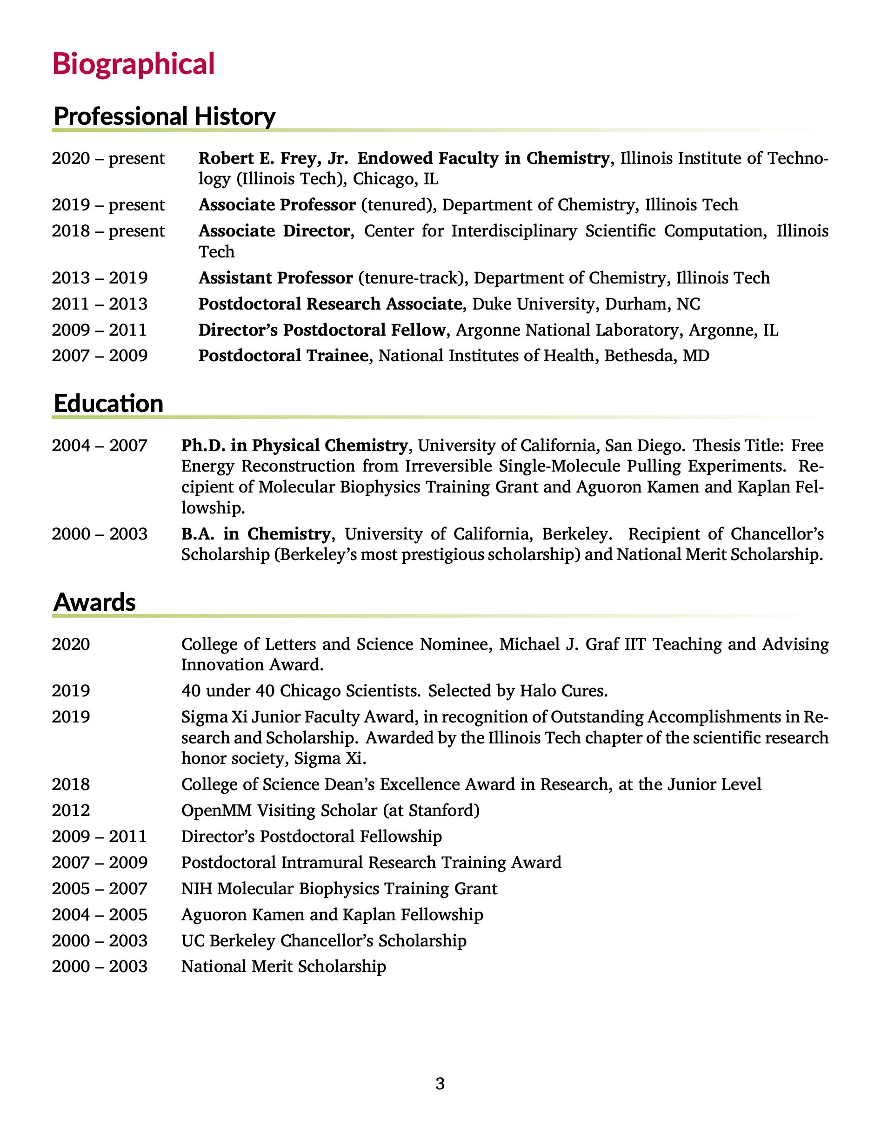
About me: work
Coauthored 56 peer-reviewed journal articles
Cited over 1500 times with an h-index of 22, according to Google scholar.
Current research in computational chemistry
Developing methods related to structure-based drug design
predicting binding affinities and ligand efficacy
simulating biological macromolecules
Involved in antibiotic drug discovery
research has been funded by NIH and NSF
Full curriculum vitae: https://ccbatiit.github.io/downloads/DavidMinh_CV.pdf

Slide 5
About me: beyond work
Outside of work, I like to
play sports, especially Taekwondo, tennis, and basketball.
listen to podcasts and audiobooks. Some of my favorite podcasts are Hidden Brain and Planet Money from NPR.
play board games, especially strategy and word games.
sometimes play music, especially classical piano. Sometimes I also play guitar and bass.
read news and sometimes books
play video games
exercise, especially weights, swimming, biking, and skiing
travel. I’ve been to 6 continents
I am
Australian-born and American-raised by Vietnamese parents of Vietnamese and Chinese descent
married, with 2 children
Christian
incredibly blessed!

Slide 6
[Introduce yourself]
What is your full name? What do you like to be called?
Which degree program are you in?
What are you hoping to learn in this class?
How will this help you achieve your goals?
Share something interesting about yourself

Slide 7
Operators
This lecture is intended to help you achieve the following learning objectives:
Define operators and apply them to functions
Evaluate commutators
Write mathematical expressions in Dirac Bra-ket notation
At the end of this lecture, you should be able to
answer the following questions:
What are operators and how are they useful in quantum mechanics?
What does it mean for an operator to commute? What is a commutator?
What is an eigenfunction and an eigenvalue?
What are some properties of quantum mechanical operators?
apply a series of operators to a function
evaluate a commutator
determine whether a function is an eigenfunction of an operator and its eigenvalue
write mathematical expressions in Dirac Bra-ket notation
determine whether an operator is linear and Hermitian

Slide 8
Operators
Observable - any dynamical variable that can be measured
e.g. position or momentum
All quantum observables have corresponding operators
Operator - a symbol for an instruction to carry out an ``operation'' on a function
e.g. multiplication or differentiation
For a general operator, we will use the hat symbol $\overset{̂}{A}$
If $f=3x+10$ and $\overset{̂}{A}f=5f$, then what is $\overset{̂}{A}f$ in terms of $x$?
$$\overset{̂}{A}f=15x+50$$
If $f=3x+10$ and $\overset{̂}{A}f=|\sqrt{f}|$, then what is $\overset{̂}{A}f$ in terms of $x$?
$$\overset{̂}{A}f=|\sqrt{3x+10}|$$

Slide 9
Applying Multiple Operators
Operators are always applied from the right to the left
Does it matter what order operators are applied?
Suppose that $f=3x+10$ and $\overset{̂}{A}f=f^{2}$ and $\overset{̂}{B}f=\frac{∂}{∂x}f$
What is $\overset{̂}{A}\overset{̂}{B}f$ in terms of $x$?
$$\overset{̂}{A}\overset{̂}{B}f=\overset{̂}{A}(3)=9$$
What is $\overset{̂}{B}\overset{̂}{A}f$ in terms of $x$?
$$\overset{̂}{B}\overset{̂}{A}f=\overset{̂}{B}(9x^{2}+60x+100)=18x+60$$

Slide 10
Commutation
$[\overset{̂}{A},\overset{̂}{B}]=\overset{̂}{A}\overset{̂}{B}-\overset{̂}{B}\overset{̂}{A}$ is commutation
If $[\overset{̂}{A},\overset{̂}{B}]=0$, the operators $\overset{̂}{A}$ and $\overset{̂}{B}$ are said to commute
Evaluate the commutator $\left[x,\frac{d}{dx}\right]$. Do the operators commute?
$$\left[x,\frac{d}{dx}\right]f=x\frac{df}{dx}-\frac{d}{dx}(xf)=x\frac{df}{dx}-f-x\frac{df}{dx}=-f$$
$\left[x,\frac{d}{dx}\right]=-1$. Since this is not zero, the operators do not commute.

Slide 11
Operators for QM observables are linear and Hermitian
What does this mean?

Slide 12
Linear Operators
Linear operators satisfy the following criterion
$\overset{̂}{A}(af)=a\overset{̂}{A}f$, where a is a constant and f is a function
$\overset{̂}{A}(f+g)=\overset{̂}{A}f+\overset{̂}{A}g$, where a is a constant and f and g are functions
Which of the following operators are linear?
Integration, $\overset{̂}{A}f=∫_{a}^{b}fdx$
Multiplication, $\overset{̂}{A}f=af$
Logarithm, $\overset{̂}{A}f=ln(f)$
Square root, $\overset{̂}{A}f=\sqrt{f}$
Integration and multiplication are linear

Slide 13
Hermitian Operators
To understand a Hermitian operator, you need to understand
eigenfunctions and eigenvalues
complex conjugates
quantum mechanical integrals
We will also introduce Dirac Bra-ket notation, a simplification that will be used throughout the course

Slide 14
Eigenfunctions and eigenvalues
Applying an operator to an eigenfunction will yield a constant, the eigenvalue, times the original eigenfunction, such that $\overset{̂}{A}f=af$.
e.g. for the operator $\overset{̂}{A}f=\frac{d^{2}}{dx^{2}}f$, an eigenfunction is $f=sin(ax)$.
What is the eigenvalue?
$$\overset{̂}{A}f=\frac{d^{2}}{dx^{2}}sin(ax)=a\frac{d}{dx}cos(ax)=-a^{2}sin(ax)$$
The eigenvalue is $-a^{2}$
Is $f=sin(ax)$ an eigenfunction of $\overset{̂}{A}f=\frac{d}{dx}f$?
No, the function changes upon applying the operator

Slide 15
Eigenfunction Self-Test
Which of the following are eigenfunctions of $\overset{̂}{A}f=\frac{d}{dx}f$? For the eigenfunctions, what are the eigenvalues?
$$f=x^{2}$$
$$f=e^{4x}$$
$$f=sin(2x)$$
$$f=ax+b$$
The only eigenfunction is $f=e^{4x}$. Its eigenvalue is 4.

Slide 16
Complex Conjugate
Let $f^{*}$ denote the complex conjugate of $f$
In a complex conjugate of a complex number
the real part is the same
the imaginary part has the same magnitude but the opposite sign
If $f=3+9i$, what is $f^{*}$?
$$f^{*}=3-9i$$

Slide 17
Quantum Mechanical Integral Notation
Integrals of the form $I=∫f_{m}^{*}\overset{̂}{A}f_{n}dτ$ are common in quantum mechanics
the integral is over all space
$dτ$ is the volume element
n and m are indices for functions
Dirac Bra-ket notation simplifies this type of integral to $⟨m|\overset{̂}{A}|n⟩$
$⟨m|=f_{m}^{*}$ is known as the bra
$|n⟩=f_{n}$ is known as the ket
The operator $\overset{̂}{A}$ is applied on the ket
If $\overset{̂}{A}f=f$, then the bra-ket is $⟨m|n⟩$; the middle is omitted
An even shorter notation for the same integral is the matrix element, $A_{mn}$

Slide 18
Dirac Bra-ket Notation Practice
In Dirac Bra-ket notation, $∫f_{m}^{*}\overset{̂}{A}f_{n}dτ=⟨m|\overset{̂}{A}|n⟩$
Write the following in bra-ket notation
$$∫f_{n}^{*}x^{2}f_{m}dτ$$
$$∫f_{1}^{*}\frac{d}{dx}f_{3}dτ$$
$$∫Ψ_{1}^{*}Ψ_{2}dτ$$
$$=⟨n|x^{2}|m⟩$$
$$=⟨1\left|\frac{d}{dx}\right|3⟩$$
$$=⟨1|2⟩$$

Slide 19
Hermitian Operators
For a Hermitian operator,$∫f_{m}^{*}\overset{̂}{A}f_{n}dτ={\left\{∫f_{n}^{*}\overset{̂}{A}f_{m}dτ\right\}}^{*}=∫(\overset{̂}{A}f_{m})^{*}f_{n}dτ$
Write the first equality in Dirac Bra-ket notation
$$⟨m|\overset{̂}{A}|n⟩={⟨n|\overset{̂}{A}|m⟩}^{*}$$

Slide 20
Properties of Hermitian Operators
For a Hermitian operator,$∫f_{m}^{*}\overset{̂}{A}f_{n}dτ={\left\{∫f_{n}^{*}\overset{̂}{A}f_{m}dτ\right\}}^{*}=∫(\overset{̂}{A}f_{m})^{*}f_{n}dτ$
Properties
The eigenvalues of Hermitian operators are real
Eigenfunctions corresponding to different eigenvalues of a Hermitian operator are orthogonal, such that $S=∫f_{m}^{*}f_{n}dτ=0$

Slide 21
Review on Operators
Ask yourself whether you can
answer the following questions:
What are operators and how are they useful in quantum mechanics?
What does it mean for an operator to commute? What is a commutator?
What is an eigenfunction and an eigenvalue?
What are some properties of quantum mechanical operators?
apply a series of operators to a function
evaluate a commutator
determine whether a function is an eigenfunction of an operator and its eigenvalue
write mathematical expressions in Dirac Bra-ket notation
determine whether an operator is linear and Hermitian

