Slide 1
8/28/2024
Postulates of quantum mechanics
States and wavefunctions
Observables and representations
The outcome of measurements
Eigenfunction expansions, including Fourier series
Collapse of wavefunctions and Schrödinger’s cat
The Born interpretation: probabilities of particle positions
The Schrödinger equation
The Hamiltonian operator
Time-independent form by separation of variables
Time dependence of the wavefunction
This lecture is designed to help you achieve the following learning objectives
Recall and explain the postulates of quantum mechanics
Evaluate expectations for given wave functions
Express time derivatives of expectation values

Slide 2
Postulates
This module is intended to help you achieve the following learning objectives:
Recall and explain the postulates of quantum mechanics
At the end of this module, you should be able to
answer the following questions:
What does a wavefunction describe?
What the the commutators for position and momentum operators?
How do you evaluate an expectation value if the wavefunction is not an eigenfunction of an operator?
What happens if you perform a measurement on a superposition state?
What is the probability of finding a particle in a particular region?
What is the time-independent Schrödinger equation?

Slide 3
About the Postulates
Assumptions that are the basis of quantum mechanics
Are not intuitive
Not provable
Results consistent with observations

Slide 4
1. States and wavefunctions
The state of a system is fully described by a function $Ψ(r_{1},r_{2},...,t)$, known as the wavefunction
$r_{n}$ is the position of particle $n$
particles can include electrons and nuclei
$t$ is time, which is often not considered
Over semester, we will study progressively more complex $Ψ$ with more and more particles and dimensions

Slide 5
2. Observables
Observables are represented by Hermitian operators chosen to satisfy the the commutation relations $[q,p_{q^{′}}]=iℏδ_{qq^{′}}$, $[q,q^{′}]=0$, $[p_{q},p_{q^{′}}]=0$.
$q$ and $q^{′}$ are coordinates like $x$, $y$, and $z$. They may be the same or different.
$p_{q}$ is the momentum in the direction of $q$
$$i=\sqrt{-1}$$
$ℏ=\frac{h}{2π}$, where $h=6.62607015×{10}^{-34}{J.Hz}^{-1}$ is Plank’s constant
$δ_{qq^{′}}$ is a Kronecker delta function. It is one when $q=q^{′}$ and zero if $q≠q^{′}$.
Any set of operators that satisfy this postulate may be chosen
Many QM manipulations can actually be performed without representations

Slide 6
Representations
Set of operators that represent observables
The most popular are
Position representation
$$x→x×$$
$$p_{x}→\frac{ℏ}{i}\frac{∂}{∂x}$$
Momentum representation
$$x→-\frac{ℏ}{i}\frac{∂}{∂p_{x}}$$
$$p_{x}→p_{x}×$$
More generally, $x$ may be replaced by $q$, which is $x$, $y$, or $z$.

Slide 7
Representations and Postulate 2
Does the position representation satisfy $[q,p_{q^{′}}]=iℏδ_{qq^{′}}$? Here is how to show this.
$\left[q,\frac{ℏ}{i}\frac{∂}{∂q^{′}}\right]f=q\frac{ℏ}{i}\frac{∂f}{∂q^{′}}-\frac{ℏ}{i}\frac{∂}{∂q^{′}}(qf)$ $=\frac{ℏ}{i}\left[q\frac{∂f}{∂q^{′}}-\frac{∂q}{∂q^{′}}f-q\frac{∂f}{∂q^{′}}\right]$ $=-\frac{ℏ}{i}\frac{∂q}{∂q^{′}}f=iℏδ_{qq^{′}}f$
Position representation
$$x→x$$
$$p_{x}→\frac{ℏ}{i}\frac{∂}{∂x}$$
Momentum representation
$$x→-\frac{ℏ}{i}\frac{∂}{∂p_{x}}$$
$$p_{x}→p_{x}$$

Slide 8
Representations and Postulate 2
Does the momentum representation satisfy $[q,p_{q^{′}}]=iℏδ_{qq^{′}}$? Try it.
$\left[-\frac{ℏ}{i}\frac{∂}{∂p_{q}},p_{q^{′}}\right]f$ $=-\frac{ℏ}{i}\left[\frac{∂}{∂p_{q}}(p_{q^{′}}f)-p_{q^{′}}\frac{∂f}{∂p_{q}}\right]$ $=-\frac{ℏ}{i}\frac{∂p_{q^{′}}}{∂p_{q}}f=iℏδ_{qq^{′}}f$
Position representation
$$x→x$$
$$p_{x}→\frac{ℏ}{i}\frac{∂}{∂x}$$
Momentum representation
$$x→-\frac{ℏ}{i}\frac{∂}{∂p_{x}}$$
$$p_{x}→p_{x}$$

Slide 9
3. The outcome of measurements
The mean value of the observable in a series of measurements is equal to the expectation value of the corresponding operator,
$$⟨A⟩=\frac{⟨Ψ\left|\overset{̂}{A}\right|Ψ⟩}{⟨Ψ|Ψ⟩}$$
This is like the expectation value of flipping a coin or rolling dice
$⟨Ψ|Ψ⟩$ is a normalizing constant. If $Ψ$ is normalized (as we will assume), then $⟨Ψ|Ψ⟩=1$ can be omitted from the expectation value.

Slide 10
What if $Ψ$ is not an eigenfunction of $\overset{̂}{A}$?
If $\overset{̂}{A}Ψ=aΨ$, then $⟨A⟩=⟨Ψ\left|\overset{̂}{A}\right|Ψ⟩=a$.
Otherwise, we can expand $Ψ$ in terms of basis functions - building blocks for more complex functions

Slide 11
Eigenfunction Expansions
Any function may be expressed as a linear combination of all the eigenfunctions of an operator, $g=\underset{n}{∑}c_{n}f_{n}$.
$c_{n}$ are coefficients
$f_{n}$ are eigenfunctions. They are basis functions for $g$.

Slide 12
Example Eigenfunctions
Any function may be expressed as a linear combination of all the eigenfunctions of an operator, $g=\underset{n}{∑}c_{n}f_{n}$.
Consider the operator $\overset{̂}{A}=\frac{d^{2}}{dx^{2}}$. What are the eigenfunctions? Hint: we talked about one in the last class period.
$sin(ax)$, where $a$ is a positive integer. The eigenvalue is $-a^{2}$.
$cos(bx)$, where $b$ is a positive integer. The eigenvalue is $-b^{2}$.
$c$, a number. The eigenvalue is 0.

Slide 13
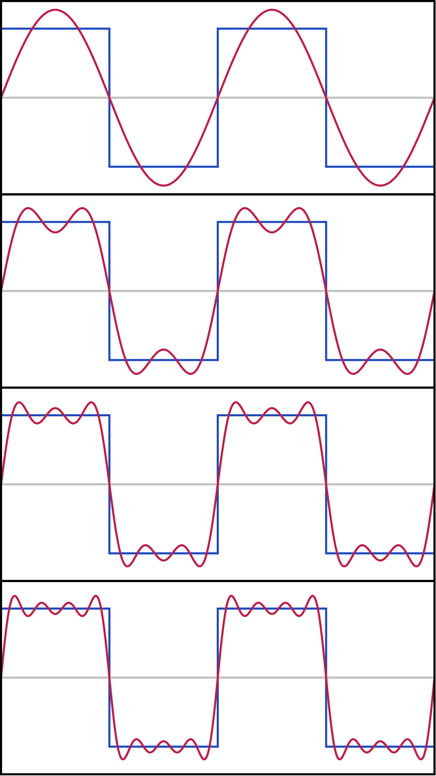
Fourier Series
An expansion of a periodic function in terms of sines and cosines
To the right: the first four partial sums of the Fourier series for a square wave. As more terms are added, the partial sums converge to the square wave.
For more details, examples, and expressions for coefficients, see Wolfram MathWorld.
By Jim.belk - Own work, Public Domain, https://commons.wikimedia.org/w/index.php?curid=8312935

Slide 14
Mean values for linear combinations
Given $Ψ=\underset{m}{∑}c_{m}Ψ_{m}$, the probability of measuring a particular eigenvalue $ω_{n}$ is proportional to $|c_{m}|^{2}$.
$c_{m}$ is the coefficient
$Ψ_{m}$ are eigenfunctions of $\overset{̂}{A}$
$|c_{m}|^{2}$ can be thought of as weights in a weighted sum, $⟨A⟩=∫{\left(\underset{n}{∑}c_{n}Ψ_{n}\right)}^{*}\overset{̂}{A}\left(\underset{m}{∑}c_{m}Ψ_{m}\right)dτ=\underset{n}{∑}\underset{m}{∑}∫{\left(c_{n}Ψ_{n}\right)}^{*}\left(a_{m}c_{m}Ψ_{m}\right)dτ=\underset{m}{∑}a_{m}|c_{m}|^{2}$

Slide 15
Measurement
Immediately after the measurement, the state of the system will be $Ψ_{n}$
Unlike in classical mechanics, in QM, measurement alters the system. It makes the system collapse onto a state.
This implies that before measurement, the system described by $Ψ=\underset{m}{∑}c_{m}Ψ_{m}$ is in a superposition of states.
Does this make sense? Schrödinger didn’t think so. Yet this Copenhagen interpretation of QM remains.

Slide 16
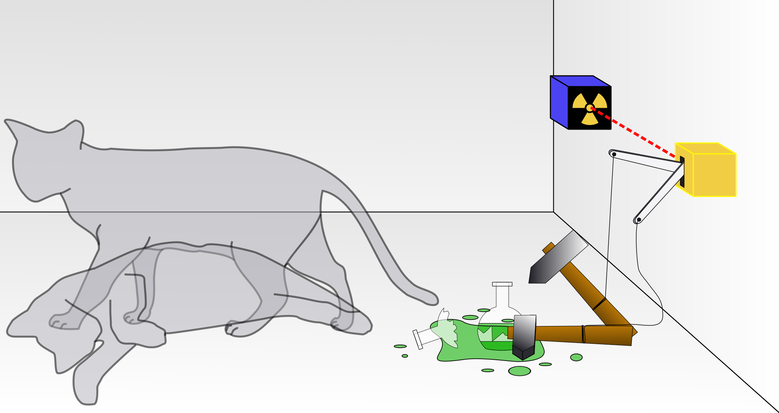
Schrödinger’s Cat
By Dhatfield - Own work, CC BY-SA 3.0, https://commons.wikimedia.org/w/index.php?curid=4279886
Schrödinger's cat: a cat, a flask of poison, and a radioactive source connected to a Geiger counter are placed in a sealed box. As illustrated, the objects are in a state of superposition: the cat is both alive and dead.

Slide 17
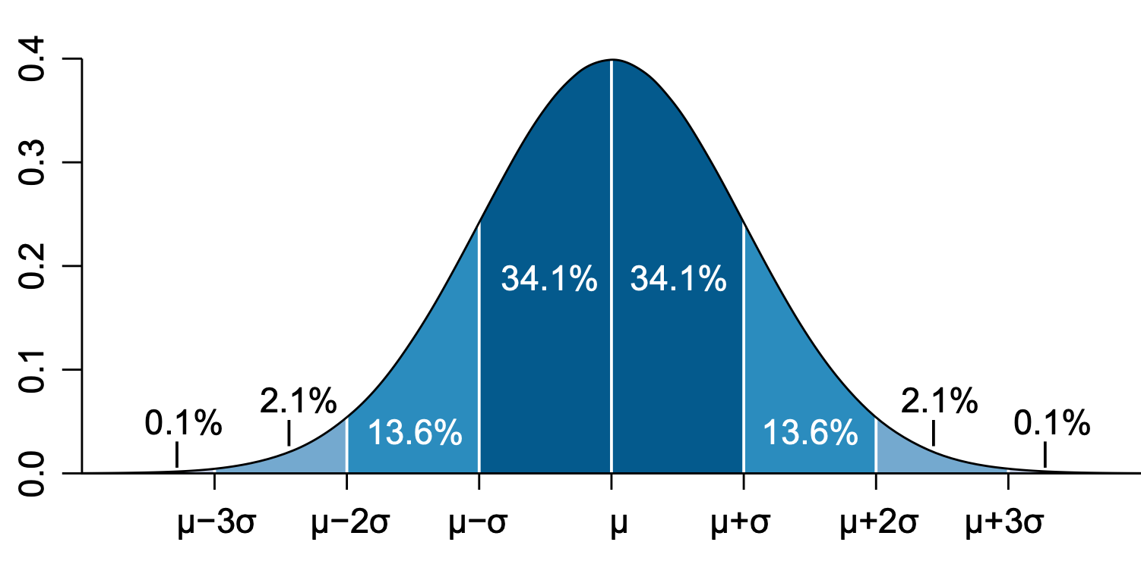
4. Probabilities of particle positions
Born interpretation: the probability that a particle will be found in the volume element $dτ$ at the point $r$ is proportional to $|Ψ(r)|^{2}dτ$.
The probability density function is $|Ψ(r)|^{2}$
$∫{\left|Ψ\right|}^{2}dτ<∞$ because the particle must be somewhere
PDF of a normal distribution
By Ainali - Own work, CC BY-SA 3.0, https://commons.wikimedia.org/w/index.php?curid=3141713
$$f(x)=\frac{1}{\sqrt{2π}σ}e^{-\frac{1}{2}\left({\frac{x-μ}{σ}}^{2}\right)}$$

Slide 18
5. The equation for the wavefunction
The wavefunction evolves in time according to the time-dependent Schrödinger equation, $iℏ\frac{∂Ψ}{∂t}=\overset{̂}{H}Ψ$
introduced by Erwin Schrödinger in 1926
If the potential energy is time-independent, then the equation may be simplified to the time-independent Schrödinger equation, $\overset{̂}{H}Ψ=EΨ$
the focus of this class
can be derived by separation of variables (will do so shortly)
$\overset{̂}{H}$ is the Hamiltonian operator, which specifies the total (kinetic + potential) energy of the system

Slide 19
The Hamiltonian operator
$\overset{̂}{H}$ is the Hamiltonian operator, which specifies the total (kinetic + potential) energy of the system
The kinetic energy of a particle with mass $m$ and momentum $p$ is
$$T=\frac{p^{2}}{2m}$$
In the position representation, $\overset{̂}{T}=\frac{ℏ^{2}}{2m}∇^{2}$. $∇^{2}=\frac{∂^{2}}{∂x^{2}}+\frac{∂^{2}}{∂y^{2}}+\frac{∂^{2}}{∂z^{2}}$.
The potential energy of a particle depends on the system. Over the semester we will consider different potential energy functions

Slide 20
Time-Independent Schrödinger equation
using separation of variables to derive $\overset{̂}{H}Ψ=EΨ$

Slide 21
Separation of Variables, p. 1
The Schrödinger equation is $\overset{̂}{H}Ψ=iℏ\frac{∂Ψ}{∂t}$
In one dimension, this is $-\frac{ℏ}{2m}\frac{∂^{2}Ψ}{∂x^{2}}+V(x)Ψ=iℏ\frac{∂Ψ}{∂t}$
Separation of variables works by assuming that $Ψ(x,t)=Ψ(x)Θ(t)$, which is true if the potential does not vary with time
This yields $-\frac{ℏ^{2}}{2m}Θ\frac{∂^{2}Ψ}{∂x^{2}}+V(x)ΨΘ=iℏΨ\frac{∂Θ}{∂t}$

Slide 22
Separation of Variables, p. 2
Dividing by $ΨΘ$ gives, $-\frac{ℏ^{2}}{2m}\frac{1}{Ψ}\frac{∂^{2}Ψ}{∂x^{2}}+V(x)=iℏ\frac{1}{Θ}\frac{∂Θ}{∂t}$
The lhs is solely a function of $x$ and the rhs is solely a function of $t$; they are separable.
When $x$ changes, the rhs does not change. When $t$ changes, the lhs does not change.
Both sides are equal to a constant, E.
As a self-test, write the two eigenfunction equations
$$-\frac{ℏ^{2}}{2m}\frac{∂^{2}Ψ}{∂x^{2}}+V(x)Ψ=\overset{̂}{H}Ψ=EΨ$$
$$iℏ\frac{∂Θ}{∂t}=EΘ$$
Time-independent Schrödinger equation

Slide 23
Time Dependence
One of the differential equations is $iℏ\frac{∂Θ}{∂t}=EΘ$
What is the solution of this differential equation?
$$Θ=e^{-\frac{iE}{ℏ}t}$$
Thus if we have a solution for $\overset{̂}{H}Ψ=EΨ$, the complete equation is $Ψ(x,t)=Ψ(x)e^{-\frac{iE}{ℏ}t}$.
Recall the Born interpretation: the probability that a particle will be found in the volume element $dτ$ at the point $r$ is proportional to $|Ψ(r)|^{2}dτ$. Does the probability of the particle position depend on time?
No

Slide 24
Summary of Postulates
The state of a system is fully described by a function $Ψ(r_{1},r_{2},...,t)$, known as the wavefunction
Observables are represented by Hermitian operators chosen to satisfy the the commutation relations $[q,p_{q^{′}}]=iℏδ_{qq^{′}}$, $[q,q^{′}]=0$, $[p_{q},p_{q^{′}}]=0$
The mean value of the observable in a series of measurements is equal to the expectation value of the corresponding operator. For an eigenfunction expansion $Ψ=\underset{m}{∑}c_{m}Ψ_{m}$, the probability of measuring a particular eigenvalue $ω_{n}$ is proportional to $|c_{m}|^{2}$. Measurement makes the system collapse onto a state.
The probability that a particle will be found in the volume element $dτ$ at the point $r$ is proportional to $|Ψ(r)|^{2}dτ$.
The wavefunction evolves in time according to $iℏ\frac{∂Ψ}{∂t}=\overset{̂}{H}Ψ$. If the potential energy is time-independent, then $\overset{̂}{H}Ψ=EΨ$

Slide 25
Review
What does a wavefunction describe?
What the the commutators for position and momentum operators?
How do you evaluate an expectation value if the wavefunction is not an eigenfunction of an operator?
What happens if you perform a measurement on a superposition state?
What is the probability of finding a particle in a particular region?
What is the time-independent Schrödinger equation?

