Slide 1
9/16/2024
Hydrogenic Atoms
Schrodinger equation
Steps to solving the equation
Radial probability density
Angular Momentum Operators
Review of angular momentum operators
Commutators
Shift operators
Spin
Types of angular momentum
Eigenfunctions and eigenvalues
Matrix form
Plan for Wednesday: Practice Midterm, shortened by 15 minutes to go over answers
This lecture is designed to help you achieve the following learning objectives
Obtain and interpret solutions of the Schrodinger equation for tractable systems including the particle in a box, harmonic oscillator, rigid rotor, and hydrogen atom

Slide 2
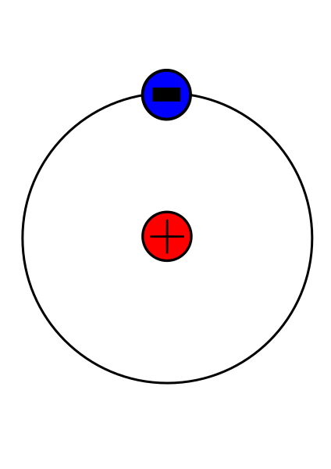
Hydrogenic Atoms
Hydrogen consists of a proton and an electron
Potential energy based on Coulomb potential, $\overset{̂}{H}=-\frac{ℏ^{2}}{2m_{e}}{\overset{̂}{∇}}_{e}^{2}-\frac{ℏ^{2}}{2m_{N}}{\overset{̂}{∇_{N}}}^{2}-\frac{Ze^{2}}{4πϵ_{o}r}$
Also describes other hydrogenic atoms with one electron and a charged nucleus with arbitrary atomic number
Can be thought of as a set of concentric spheres

Slide 3
Coordinate Transformation
Changing the coordinate system, $\overset{̂}{H}=-\frac{ℏ^{2}}{2m}{\overset{̂}{∇}}_{cm}^{2}-\frac{ℏ^{2}}{2μ}{\overset{̂}{∇}}^{2}-\frac{Ze^{2}}{4πϵ_{o}r}$
$$m=m_{e}+m_{N}$$
$$\frac{1}{μ}=\frac{1}{m_{e}}+\frac{1}{m_{N}}$$
Terms 1 & 2 are like rigid rotor
Term 1 is translation
Terms 2 & 3 depend on relative positions

Slide 4
Separation of translational and internal variables
$$\overset{̂}{H}Ψ_{total}=\left[-\frac{ℏ^{2}}{2m}{\overset{̂}{∇}}_{cm}^{2}-\frac{ℏ^{2}}{2μ}{\overset{̂}{∇}}^{2}-\frac{Ze^{2}}{4πϵ_{o}r}\right]Ψ_{total}=E_{total}Ψ_{total}$$
$\left[-\frac{ℏ^{2}}{2m}{\overset{̂}{∇}}_{cm}^{2}\right]Ψ_{cm}=E_{cm}Ψ_{cm}$ for center of mass, will no longer consider
$\left[-\frac{ℏ^{2}}{2μ}{\overset{̂}{∇}}^{2}-\frac{Ze^{2}}{4πϵ_{o}r}\right]Ψ=EΨ$ for internal coordinates, will be focus here

Slide 5
Separation of radial and angular variables
$\left[-\frac{ℏ^{2}}{2μ}{\overset{̂}{∇}}^{2}-\frac{Ze^{2}}{4πϵ_{o}r}\right]Ψ=EΨ$ is for internal coordinates
$\frac{1}{r}\frac{∂^{2}}{∂r^{2}}rΨ+\frac{1}{r^{2}}{\overset{̂}{Λ}}^{2}Ψ+\frac{Ze^{2}μ}{2πϵ_{o}ℏ^{2}r}Ψ=-\left(\frac{2μE}{ℏ^{2}}\right)Ψ$, by applying Laplacian in spherical polar coordinates and rearranging
Assuming separation of variables, $Ψ(r,θ,ϕ)=R(r)Y(θ,ϕ)$,
$$\frac{1}{r}\frac{∂^{2}}{∂r^{2}}rRY+\frac{1}{r^{2}}{\overset{̂}{Λ}}^{2}RY+\frac{Ze^{2}μ}{2πϵ_{o}ℏ^{2}r}RY=-\left(\frac{2μE}{ℏ^{2}}\right)RY$$
$\frac{1}{r}\frac{d^{2}}{dr^{2}}rR+\left(\frac{Ze^{2}μ}{2πϵ_{o}ℏ^{2}r}-\frac{l(l+1)}{r^{2}}\right)R=-\left(\frac{2μE}{ℏ^{2}}\right)R$, by dividing by Y
Thus, $Y(θ,ϕ)$ is independent of R. Solutions are spherical harmonics. What about radial portion?

Slide 6
Radial Solution
$$\frac{1}{r}\frac{d^{2}}{dr^{2}}rR+\left(\frac{Ze^{2}μ}{2πϵ_{o}ℏ^{2}r}-\frac{l(l+1)}{r^{2}}\right)R=-\left(\frac{2μE}{ℏ^{2}}\right)R$$
By setting $u=rR$ and multiplying all by $-\frac{ℏ^{2}}{2μ}r$,$-\frac{ℏ^{2}}{2μ}\frac{d^{2}}{dr^{2}}u+\left(-\frac{Ze^{2}}{4πϵ_{o}r}+\frac{l(l+1)ℏ^{2}}{2μr^{2}}\right)u=Eu$
This is a 1D Schrodinger equation with $V_{eff}=-\frac{Ze^{2}}{4πϵ_{o}r}+\frac{l(l+1)ℏ^{2}}{2μr^{2}}$, the sum of a Coulomb potential energy and angular momentum term

Slide 7
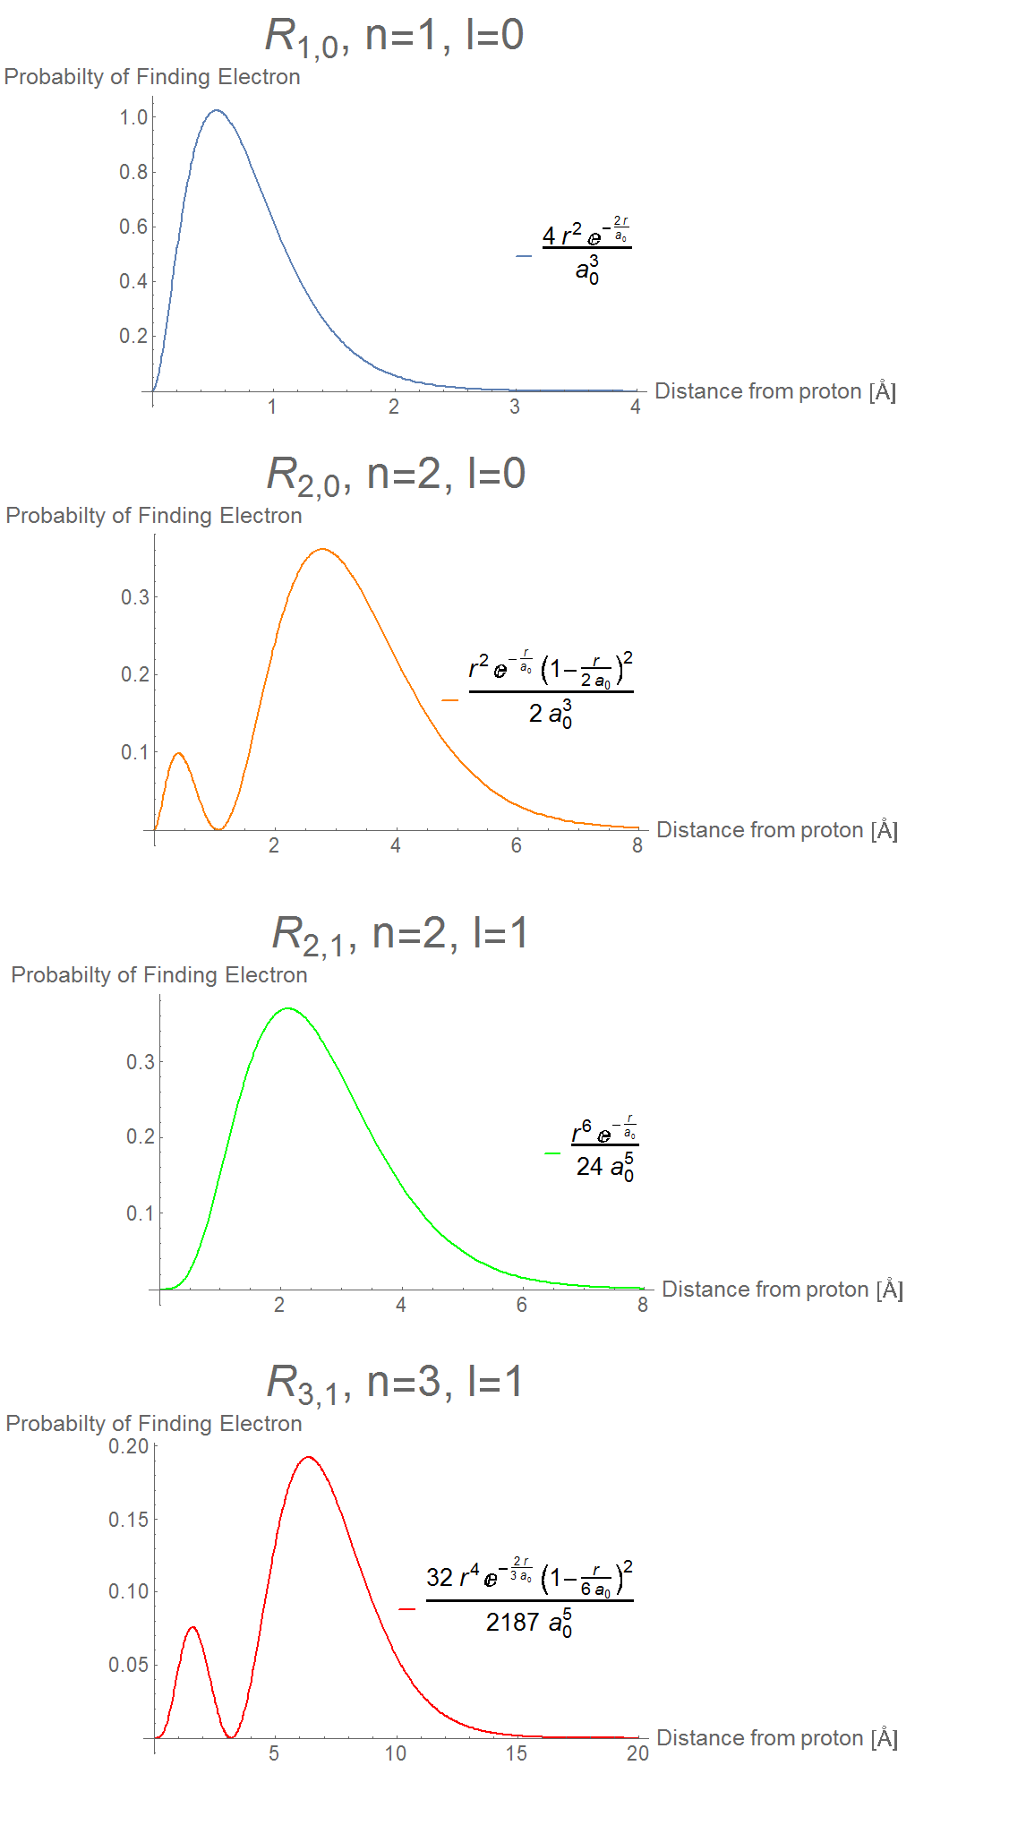
Radial Probability Densities
Kdmeaney, CC BY-SA 3.0 <https://creativecommons.org/licenses/by-sa/3.0>, via Wikimedia Commons

Slide 8
Review of derivation
Setting up coordinate system
Separation of variables for center of mass and internal
Separation of variables for radial and angular
Solution for radial

Slide 9
General Angular Momentum Operators

Slide 10
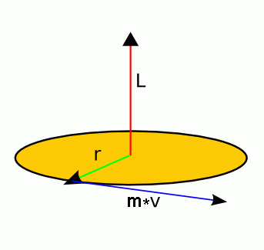
Review: Classical Angular Momentum
$$l=r×p=\left|\begin{matrix}i & j & k \\ x & y & z \\ p_{z} & p_{y} & p_{z}\end{matrix}\right|$$
Components are
$$l_{x}=yp_{z}-zp_{y}$$
$$l_{y}=zp_{x}-xp_{z}$$
$$l_{z}=xp_{y}-yp_{x}$$
$l^{2}=l_{x}^{2}+l_{y}^{2}+l_{z}^{2}$ is the magnitude of the angular momentum
$E=l^{2}/2I$ is the rotational kinetic energy
Classically, there are no restrictions on the magnitude or any of the components, except that none of the components may exceed the magnitude

Slide 11
Review: Angular Momentum Operators
By substitution of the position and momentum operators into the classical expression, we obtain
$${\overset{̂}{l}}_{x}=\frac{ℏ}{i}\left(y\frac{∂}{∂z}-z\frac{∂}{∂y}\right)$$
$${\overset{̂}{l}}_{y}=\frac{ℏ}{i}\left(z\frac{∂}{∂x}-x\frac{∂}{∂z}\right)$$
$${\overset{̂}{l}}_{z}=\frac{ℏ}{i}\left(x\frac{∂}{∂y}-y\frac{∂}{∂x}\right)$$
Previously we focused on ${\overset{̂}{l}}_{z}$
Notably, as I will show soon, components do not commute
Properties of angular momentum may be derived
without a representation.
Results more general

Slide 12
Angular Momentum Commutators
$$\left[{\overset{̂}{l}}_{x},{\overset{̂}{l}}_{y}\right]=\left[yp_{z}-zp_{y},zp_{x}-xp_{z}\right]$$
$$=\left[yp_{z},zp_{x}\right]-\left[yp_{z},xp_{z}\right]-\left[zp_{y},zp_{x}\right]+\left[zp_{y},xp_{z}\right]$$
Note that the middle terms are zero. Position and momenta for different directions commute.
$=\left(yp_{z}zp_{x}-zp_{x}yp_{z}\right)+\left(zp_{y}xp_{z}-xp_{z}zp_{y}\right)$, by expanding commutators
$$=y\left[p_{z},z\right]p_{x}+xp_{y}\left[z,p_{z}\right]$$
$$=iℏ\left(-yp_{x}+xp_{y}\right)=iℏl_{z}$$
Similarly,$\left[{\overset{̂}{l}}_{x},{\overset{̂}{l}}_{y}\right]=iℏ{\overset{̂}{l}}_{z},\left[{\overset{̂}{l}}_{y},{\overset{̂}{l}}_{z}\right]=iℏ{\overset{̂}{l}}_{x},\left[{\overset{̂}{l}}_{z},{\overset{̂}{l}}_{x}\right]=iℏ{\overset{̂}{l}}_{y},\left[{\overset{̂}{l}}^{2},{\overset{̂}{l}}_{q}\right]=0$
An observable is an angular momentum if its operators have these commutators

Slide 13
Shift Operators
The shift operators are defined as,
$${\overset{̂}{l}}_{+}={\overset{̂}{l}}_{x}+i{\overset{̂}{l}}_{y}$$
$${\overset{̂}{l}}_{-}={\overset{̂}{l}}_{x}-i{\overset{̂}{l}}_{y}$$
The corresponding inverse operators are,
$${\overset{̂}{l}}_{x}=\frac{{\overset{̂}{l}}_{+}+{\overset{̂}{l}}_{-}}{2}$$
$${\overset{̂}{l}}_{y}=\frac{{\overset{̂}{l}}_{+}-{\overset{̂}{l}}_{-}}{2i}$$
Several commutators are,
$$\left[{\overset{̂}{l}}_{z},{\overset{̂}{l}}_{+}\right]=\left[{\overset{̂}{l}}_{z},{\overset{̂}{l}}_{x}+i{\overset{̂}{l}}_{y}\right]=\left[{\overset{̂}{l}}_{z},{\overset{̂}{l}}_{x}\right]+\left[{\overset{̂}{l}}_{z},i{\overset{̂}{l}}_{y}\right]=iℏ{\overset{̂}{l}}_{y}-i^{2}ℏ{\overset{̂}{l}}_{x}=ℏ\left(i{\overset{̂}{l}}_{y}+{\overset{̂}{l}}_{x}\right)=ℏ{\overset{̂}{l}}_{+}$$
$$\left[{\overset{̂}{l}}_{z},{\overset{̂}{l}}_{-}\right]=ℏ{\overset{̂}{l}}_{-}$$
$$\left[{\overset{̂}{l}}_{+},{\overset{̂}{l}}_{-}\right]=\left[{\overset{̂}{l}}_{x}+i{\overset{̂}{l}}_{y},{\overset{̂}{l}}_{x}-i{\overset{̂}{l}}_{y}\right]=-i[{\overset{̂}{l}}_{x},{\overset{̂}{l}}_{y}]+i[{\overset{̂}{l}}_{y},{\overset{̂}{l}}_{x}]=-i(iℏ{\overset{̂}{l}}_{z})+i(-iℏ{\overset{̂}{l}}_{z})=2ℏ{\overset{̂}{l}}_{z}$$
$$\left[{\overset{̂}{l}}^{2},{\overset{̂}{l}}_{+}\right]=\left[{\overset{̂}{l}}^{2},{\overset{̂}{l}}_{-}\right]=0$$

Slide 14
Eigenvalues of Angular Momentum Operators
Consider a more general solution than the spherical harmonics. Suppose that $|λ,m_{l}⟩$ is an eigenfunction of both ${\overset{̂}{l}}_{z}$ and ${\overset{̂}{l}}^{2}$ with quantum numbers $λ$ and $m_{l}$.
${\overset{̂}{l}}_{z}|λ,m_{l}⟩=m_{l}ℏ|λ,m_{l}⟩$, where $m_{l}$ is any real number. $ℏ$ has the dimensionality of angular momentum.
${\overset{̂}{l}}^{2}|λ,m_{l}⟩=f(λ,m_{l})ℏ^{2}|λ,m_{l}⟩$, where $f(λ,m_{l})$ is a function that we do not know yet. $ℏ^{2}$ has the dimensionality of squared angular momentum.
What do we know about $f(λ,m_{l})$? Is it real or complex? Is it negative or nonnegative? How do we know?

Slide 15
Effect of Shift Operators
From the definition ${\overset{̂}{l}}^{2}={\overset{̂}{l}}_{x}^{2}+{\overset{̂}{l}}_{y}^{2}+{\overset{̂}{l}}_{z}^{2}$,$\left({\overset{̂}{l}}^{2}-{\overset{̂}{l}}_{z}^{2}\right)|λ,m_{l}⟩=\left({\overset{̂}{l}}_{x}^{2}+{\overset{̂}{l}}_{y}^{2}\right)|λ,m_{l}⟩≥0$
From the eigenvalues, $\left({\overset{̂}{l}}^{2}-{\overset{̂}{l}}_{z}^{2}\right)|λ,m_{l}⟩=\left(f(λ,m_{l})ℏ^{2}-m_{l}^{2}ℏ^{2}\right)|λ,m_{l}⟩≥0$thus $f(λ,m_{l})≥m_{l}^{2}$.
This establishes that $m_{l}$ has a minimum and maximum

Slide 16
Effect of Shift Operators
Does ${\overset{̂}{l}}_{+}$ affect $f(λ,m_{l})$?
${\overset{̂}{l}}^{2}{\overset{̂}{l}}_{+}|λ,m_{l}⟩={\overset{̂}{l}}_{+}{\overset{̂}{l}}^{2}|λ,m_{l}⟩={\overset{̂}{l}}_{+}f(λ,m_{l})ℏ^{2}|λ,m_{l}⟩$
No, it does not.
Does ${\overset{̂}{l}}_{+}$ affect the eigenvalue of $l_{z}$?
$${\overset{̂}{l}}_{z}{\overset{̂}{l}}_{+}|λ,m_{l}⟩=\left({\overset{̂}{l}}_{+}{\overset{̂}{l}}_{z}+\left[{\overset{̂}{l}}_{z},{\overset{̂}{l}}_{+}\right]\right)|λ,m_{l}⟩$$
$$=\left({\overset{̂}{l}}_{+}m_{l}ℏ+ℏ{\overset{̂}{l}}_{+}\right)|λ,m_{l}⟩$$
$$=\left(m_{l}+1\right)ℏ{\overset{̂}{l}}_{+}|λ,m_{l}⟩$$
We also know that ${\overset{̂}{l}}_{+}|λ,m_{l}+1⟩=(m_{l}+1)ℏ|λ,m_{l}+1⟩$
Therefore ${\overset{̂}{l}}_{+}|λ,m_{l}⟩=c_{+}(λ,m_{l})ℏ|λ,m_{l}+1⟩$where $c_{+}(λ,m_{l})$ is a numerical coefficient.
Similarly, we can show that $l_{-}$ lowers $m_{l}$ by one.

Slide 17
Eigenvalues of the angular momentum
We know that there is a maximum value for $m_{l}$. Let us call that $l$.
For this state, ${\overset{̂}{l}}_{+}|λ,l⟩=0$ because there is no eigenstate with larger $m_{l}$
${\overset{̂}{l}}_{-}{\overset{̂}{l}}_{+}|λ,l⟩=0$ because acting on nothing gives nothing
We also know that
$${\overset{̂}{l}}_{-}{\overset{̂}{l}}_{+}=\left({\overset{̂}{l}}_{x}-i{\overset{̂}{l}}_{y}\right)\left({\overset{̂}{l}}_{x}+i{\overset{̂}{l}}_{y}\right)={\overset{̂}{l}}_{x}^{2}+{\overset{̂}{l}}_{y}^{2}+i{\overset{̂}{l}}_{x}{\overset{̂}{l}}_{y}-i{\overset{̂}{l}}_{y}{\overset{̂}{l}}_{x}={\overset{̂}{l}}_{x}^{2}+{\overset{̂}{l}}_{y}^{2}+i\left[{\overset{̂}{l}}_{x},{\overset{̂}{l}}_{y}\right]$$
$$={\overset{̂}{l}}^{2}-{\overset{̂}{l}}_{z}^{2}-ℏl_{z}$$
Therefore, $\left({\overset{̂}{l}}^{2}-{\overset{̂}{l}}_{z}^{2}-ℏl_{z}\right)|λ,l⟩=0$. This means that,
$$f(λ,l)ℏ^{2}-l^{2}ℏ^{2}-lℏ^{2}=0$$
$$f(λ,l)=l^{2}+l=l(l+1)$$
Because ${\overset{̂}{l}}_{-}$ does not affect the eigenvalue of ${\overset{̂}{l}}^{2}$, $f(λ,m_{l})=l(l+1)$ is the same for all $m_{l}$.

Slide 18
Eigenvalues of the angular momentum
Similarly, we know that there is a minimum value for $m_{l}$. Let us call that $k$.
For this state, ${\overset{̂}{l}}_{-}|λ,k⟩=0$
$${\overset{̂}{l}}_{+}{\overset{̂}{l}}_{-}|λ,k⟩=0$$
By analogous logic as the previous slide, we can show that $f(λ,k)=k(k-1)$, and therefore $l(l+1)=k(k-1)$
Solutions are $k=-l$ or $k=l+1$
Only $k=-l$ makes sense, because the lower bound must be less than the upper bound.
Because $m_{l}$ can go in integer steps, $f(λ,m_{l})=l(l+1)$ for $m_{l}=-l,-l+1,...,l$.
What are allowed values of $l$? Any real number? Any integer? Any integer or half integer? Show series of numbers that satisfy or violate the conditions.
So far we have shown that $l=0,\frac{1}{2},1,....$ and $m_{l}=-l,-l+1,...,l$. This differs from the previous treatment because we see half integral values of $l$ are permitted.

Slide 19
Spin

Slide 20
Forms of the Angular Momentum
$$l=r×p=\left|\begin{matrix}i & j & k \\ x & y & z \\ p_{z} & p_{y} & p_{z}\end{matrix}\right|$$
Several types:
Orbital - $|l,m_{l}⟩$ based on spherical harmonics. l is an integer.
Spin - $|s,m_{s}⟩$ has no spatial wave function.
Often depicted as a particle literally spinning around an axis
Spin is an intrinsic property of a particle, unrelated to any sort of motion in space
$s$ is an integer or half integer1
Generally,
$|j,m_{j}⟩$ is an eigenfunction of the angular momentum operators with eigenvalues,
$${\overset{̂}{J}}^{2}|j,m_{j}⟩=j(j+1)ℏ^{2}|j,m_{j}⟩$$
${\overset{̂}{J}}_{z}|j,m_{j}⟩=m_{j}ℏ|j,m_{j}⟩$.
All types of angular momentum have the same commutators

Slide 21
Spin Angular Momentum
Inferred from experiments, such as the Stern-Gerlach experiment
Particles observed to have angular momentum that cannot be accounted for by orbital angular momentum alone.
For an electron, the quantum numbers are $s=\frac{1}{2}$ and $m_{s}=±\frac{1}{2}$.
The two kets are, $α=|\frac{1}{2},\frac{1}{2}⟩$ and $β=|\frac{1}{2},-\frac{1}{2}⟩$.
The effects of operators on these kets are
$${\overset{̂}{s}}_{z}α=\frac{1}{2}ℏα$$
$${\overset{̂}{s}}^{2}α=\frac{1}{2}\left(\frac{1}{2}+1\right)ℏ^{2}α=\frac{3}{4}ℏ^{2}α$$
$${\overset{̂}{s}}_{z}β=-\frac{1}{2}ℏβ$$
$${\overset{̂}{s}}^{2}β=\frac{3}{4}ℏ^{2}β$$
$${\overset{̂}{s}}_{+}α=0,{\overset{̂}{s}}_{+}β=ℏα,{\overset{̂}{s}}_{-}α=ℏβ,{\overset{̂}{s}}_{-}β=0$$

Slide 22
Matrix form of spin
As a reminder $⟨a|\overset{̂}{Ω}|b⟩≡∫Ψ_{a}^{*}\overset{̂}{Ω}Ψ_{b}dτ≡Ω_{a,b}$. In the context of electron spin, the first row and column correspond to $α$. Second row and column are $β$.
For example, ${\overset{̂}{s}}_{z}=\left(\begin{matrix}\frac{1}{2}ℏ & 0 \\ 0 & -\frac{1}{2}ℏ\end{matrix}\right)==\frac{1}{2}ℏ\left(\begin{matrix}1 & 0 \\ 0 & -1\end{matrix}\right)=\frac{1}{2}ℏσ_{z}$, where $σ_{z}=\left(\begin{matrix}1 & 0 \\ 0 & -1\end{matrix}\right)$
Exercise: Write the matrices corresponding to the shift operators for electron spin
Exercise: Use the inverse shift operators ${\overset{̂}{s}}_{x}=\frac{{\overset{̂}{s}}_{+}+{\overset{̂}{s}}_{-}}{2}$ and ${\overset{̂}{s}}_{y}=\frac{{\overset{̂}{s}}_{+}-{\overset{̂}{s}}_{-}}{2i}$ to write the matrix elements for ${\overset{̂}{s}}_{x}$ and ${\overset{̂}{s}}_{y}$.

Slide 23
Review Questions
Besides hydrogen, what is a system that the solution of the hydrogenic atom is applicable to?
Are angular and radial solutions of the hydrogenic atom independent?
How are the eigenvalues of the angular momentum operators more general than those of spherical harmonics?
What is the effect of a raising and lowering operator?
What are the eigenfunctions of the spin operator for an electron?

