Slide 1
10/21/2024
The Hartree-Fock Method
Approximations
The Hartree-Fock equation
The Hartree-Fock-Roothan method
Gaussian Basis Sets
This lecture is designed to help you achieve the following learning objectives
Describe variation theory and the use of basis sets

Slide 2
The Hartree-Fock Method

Slide 3
Motivation
The electronic Hamiltonian for a molecule with $2N$ electrons (closed-shell) and $M$ nuclei is,
$$\overset{̂}{H}=\overset{2N}{\underset{i}{∑}}{\overset{̂}{h}}_{i}+\overset{2N}{\underset{j}{∑}}\underset{j>i}{∑}\frac{1}{r_{ij}}$$
${\overset{̂}{h}}_{i}=-\frac{1}{2}∇_{i}^{2}-\overset{M}{\underset{A}{∑}}\frac{Z_{A}}{r_{iA}}$ is a one-electron Hamiltonian
The electronic Schrodinger equation with this Hamiltonian is very difficult because of the $\frac{1}{r_{ij}}$ terms
This has inspired the Hartree-Fock method

Slide 4
Approximations
HF is based on a number of approximations beyond the Born-Oppenheimer approximation
The wavefunction is a single Slater determinant
Electrons move in the electrostatic field of the nuclei and the average field of the $N_{e}-1$ other electrons

Slide 5
Trial Function
The method is based on a variation calculation where the trial function is a Ne-electron Slater determinant,$Ψ(1,2,...,2N)=\frac{1}{2N!}\left|\begin{matrix}Ψ_{1}(1)α(1) & Ψ_{1}(1)β(1) & ... & Ψ_{N}(1)α(1) & Ψ_{N}(1)β(1) \\ Ψ_{1}(2)α(2) & Ψ_{1}(2)β(2) & ... & Ψ_{N}(2)α(2) & Ψ_{N}(2)β(2) \\ ... & ... & ... & ... & ... \\ Ψ_{1}(2N)α(2N) & Ψ_{1}(2N)β(2N) & ... & Ψ_{N}(2N)α(2N) & Ψ_{N}(2N)β(2N)\end{matrix}\right|$where each $Ψ_{i}$ is a spatial orbital
The determinant is a single molecular orbital
Assumption that electrons can be be described by an antisymmetrized products (Slater determinants) = Assumption that electrons are independent, except for the Coulomb repulsion due to average positions of other electrons

Slide 6
Hartree Fock Energy
The Hartree-Fock energy is the Rayleigh ratio, $E_{HF}=⟨Ψ|\overset{̂}{H}|Ψ⟩$$=2\overset{N}{\underset{j=1}{∑}}I_{j}+\overset{N}{\underset{i=1}{∑}}\overset{N}{\underset{j=1}{∑}}\left(2J_{ij}-K_{ij}\right)$
$I_{j}=∫Ψ_{j}^{*}(r_{1}){\overset{̂}{h}}_{j}(r_{1})Ψ_{j}(r_{1})dr_{1}$ - one-electron integral (kinetic and nuclear potential)
$K_{ij}=∫Ψ_{i}^{*}(r_{1})Ψ_{j}^{*}(r_{2})\frac{1}{r_{12}}Ψ_{i}(r_{2})Ψ_{j}(r_{1})dr_{1}dr_{2}$ - exchange integral, no classical counterpart
$J_{ij}=∫Ψ_{i}^{*}(r_{1})Ψ_{j}^{*}(r_{2})\frac{1}{r_{12}}Ψ_{i}(r_{1})Ψ_{j}(r_{2})dr_{1}dr_{2}$ - Coulomb integral, expectation of the Coulomb energy due to the electron-electron interaction between two spatial orbitals
If $i=j$, $J_{jj}=K_{jj}$

Slide 7
The Hartree-Fock Equation
The energy is then minimized using the method of Lagrange multipliers.
Eventually, we get the Hartree-Fock equation, $\overset{̂}{F}(r_{1})Ψ_{i}(r_{1})=ϵ_{i}Ψ_{i}(r_{1})$ for $i=1,2,...N$
$$\overset{̂}{F}(r_{1})={\overset{̂}{h}}_{1}+\overset{N}{\underset{j}{∑}}\left[2{\overset{̂}{J}}_{j}(r_{1})-{\overset{̂}{K}}_{j}(r_{1})\right]$$
${\overset{̂}{J}}_{j}(r_{1})Ψ_{i}(r_{1})=Ψ_{i}(r_{1})∫Ψ_{j}^{*}(r_{2})\frac{1}{r_{12}}Ψ_{j}(r_{2})dr_{2}$ is the Coulomb operator
${\overset{̂}{K}}_{j}(r_{1})Ψ_{i}(r_{1})=Ψ_{j}(r_{1})∫Ψ_{j}^{*}(r_{2})\frac{1}{r_{12}}Ψ_{i}(r_{2})dr_{2}$ is the exchange operator
The Hartree-Fock equation looks like an eigenvalue equation, just like the Schrodinger equation
Solving this equation means finding a spatial orbital that is an eigenfunction of the Fock operator
The Fock operator, however, has a more complex dependence on the spatial orbitals than the Schrodinger equation

Slide 8
Solving the Hartree-Fock Equation
The Hartree-Fock equation is often solved by the self-consistent field approach
Starting with a guess for $Ψ$,
Evaluate the electron repulsion integrals
Evaluate a new $Ψ$
Repeat

Slide 9
Helium via Perturbation Theory
Let us consider how Hartree-Fock equations compare to perturbation theory in Helium.
For a Helium atom, the full Hamiltonian is, $\overset{̂}{H}=-\frac{1}{2}∇_{1}^{2}-\frac{1}{2}∇_{2}^{2}-\frac{2}{r_{1}}-\frac{2}{r_{2}}+\frac{1}{r_{12}}$
This Hamiltonian can be thought of as a perturbation to sum of two one-electron Hamiltonians ${\overset{̂}{h}}_{1}$ and ${\overset{̂}{h}}_{2}$.
Thus energy is the energy of the hydrogenic energy and a first-order perturbation
$$E^{(0)}=-2\left(\frac{1}{n_{1}^{2}}+\frac{1}{n_{2}^{2}}\right)=I_{1}+I_{2}$$
$$E^{(1)}=⟨n_{1}l_{1}m_{l1};n_{2}l_{2}m_{l2}\left|\frac{1}{r_{12}}\right|n_{1}l_{1}m_{l1};n_{2}l_{2}m_{l2}⟩=J_{11}$$
Thus $E^{(0)}+E^{(1)}=I_{1}+I_{2}+J_{11}$, which is precisely the same as with the Hartree-Fock method.

Slide 10
The Hartree-Fock-Roothan Method
Atomic orbitals are linear combination of functions $ϕ_{ν}$, usually Slater-type orbitals: $Ψ=\overset{K}{\underset{ν=1}{∑}}c_{ν}ϕ_{ν}$
Plugging into the Fock equation, $\overset{̂}{F}(r_{1})\overset{K}{\underset{ν=1}{∑}}c_{ν}ϕ_{ν}(r_{1})=ϵ\overset{K}{\underset{ν=1}{∑}}c_{ν}ϕ_{ν}(r_{1})$
Left-multiply by $ϕ_{μ}^{*}$ and integrate over $r_{1}$ to get,
$$\overset{K}{\underset{ν=1}{∑}}c_{ν}∫ϕ_{μ}(r_{1})^{*}\overset{̂}{F}(r_{1})ϕ_{ν}(r_{1})dr_{1}=ϵ\overset{K}{\underset{ν=1}{∑}}c_{ν}∫ϕ_{μ}^{*}(r_{1})ϕ_{ν}(r_{1})dr_{1}$$
Defining the overlap matrix elements as $S_{μν}=∫ϕ_{μ}^{*}(r_{1})ϕ_{ν}^{*}(r_{1})dr_{1}$ and the Fock matrix elements as $F_{μν}=∫ϕ_{μ}^{*}(r_{1})\overset{̂}{F}(r_{1})ϕ_{ν}(r_{1})$, the above equation may be written as, $\underset{ν}{∑}F_{μν}c_{ν}=ϵ\underset{ν}{∑}S_{μν}c_{ν}$ for $μ=1,2,...,K$
In matrix notation this is, $Fc=ϵSc$, where $F$ and $S$ are $K×K$ and $c$ is a $K×1$ column vector

Slide 11
Gaussian Basis Sets

Slide 12
Slater-type orbitals
As mentioned, hydrogenic atomic orbitals are a natural basis for molecular orbitals
Slater-type orbitals are $S_{nlm_{l}}(r,θ,ϕ)=N_{nl}r^{n-1}e^{-ζr}Y_{l}^{m_{l}}(θ,ϕ)$
Decay exponentially
Mimic hydrogenic atomic orbitals, but no radial nodes
They are difficult to use in the Hartree-Fock Method; Fock matrix elements are, $⟨μν\left|\frac{1}{r_{12}}\right|σλ⟩=∫∫ϕ_{μ}(r_{1})ϕ_{ν}(r_{1})\frac{1}{r_{12}}ϕ_{σ}(r_{2})ϕ_{λ}(r_{2})dr_{1}dr_{2}$
This has two problems:
The number of integrals is approximately ${K^{4}}/8$, where $K$ is the size of the basis set
If $ϕ$ are centered on multiple nuclei, then the integrals are difficult to evaluate

Slide 13
Why Gaussian basis sets?
Using Gaussian basis sets resolve these problems.
Gaussian integrals have straightforward analytical solutions
The product of two Gaussians is a single Gaussian centered at one position
They were introduced by Frank Boys in the 1950s

Slide 14
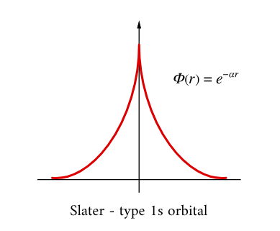
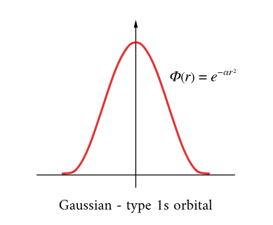
Differences between STO and Gaussian functions
Radial Dependence of Slater and Gaussian Basis Functions. (CC BY 4.0; Ümit Kaya via LibreTexts)

Slide 15
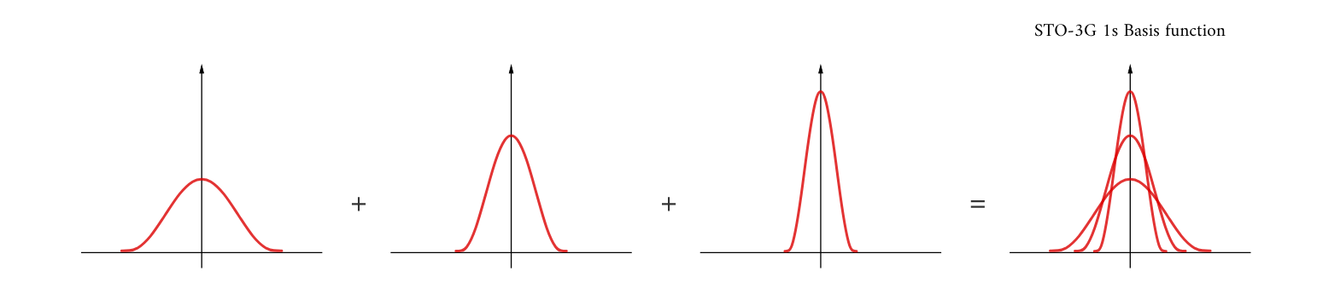
Contracted Gaussian-Type Orbitals
Early on, Gaussians were developed to mimic Slater orbitals (useful for HF calculations of atoms). A contracted Gaussian describes a linear combination of primitive Gaussians used to mimic a Slater orbital, $S_{nlm_{l}}(r,θ,ϕ)=N_{nl}r^{n-1}e^{-ζr}Y_{l}^{m_{l}}(θ,ϕ)$
To better represent the cusp in the electron density at the nuclei, GTO basis sets are constructed from fixed linear-combinations of Gaussian functions, contracted GTOs (CGTO)
Basis sets based on Slater-type orbitals are denoted by STO-NG, where N is the number of primitive Gaussians

Slide 16
Classifications of Basis Sets
“Minimal” basis sets
Technically, the bare minimum number of functions in a basis set is the number of electrons in the system.
The minimal basis set refers to including s and p orbitals for up the valence shell electrons.
H, He: $1s$
Li to Ne: $1s,2s,2p_{x},2p_{y},2p_{z}$
Na to Ar: $1s,2s,2p_{x},2p_{y},2p_{z},3s,3p_{x},3p_{y},3p_{z}$
Extended basis sets
Combining orbital exponents allows for orbitals to contract or expand in different molecular environments.
Double-$ζ$ basis sets - based on Slater orbitals with two $ζ$ parameters, $ϕ_{2ζ}(r)=S_{2s}(r,ζ_{1})+dS_{2s}(r,ζ_{2})$
Split valence basis sets
inner-shell electrons, single $ζ$
valence electrons, double $ζ$

Slide 17
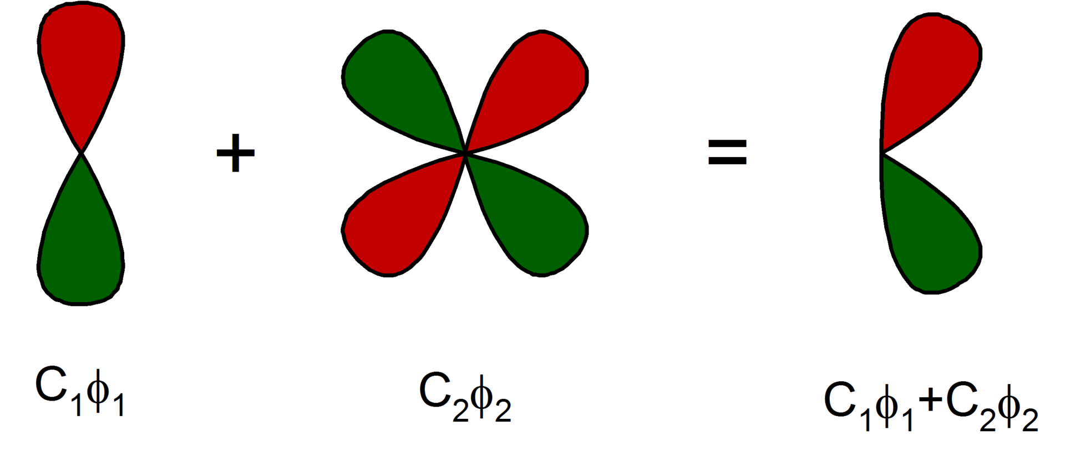
Pople-Type Basis Sets
Not based on Slater orbitals.
Have the form N-MPG
N is the number of primitive Gaussians for the inner shell
- means that it is a split valence basis set
M is the number of primitive Gaussians in a compacted orbital for the valence shell
P is the number of primitive Gaussians in the extended orbital for the valence shell
G means that Gaussians are used
* adds orbital polarization - d to p orbitals
A d-polarization function added to a p orbital. (CC-BY-SA-3.0; Rifleman 82)
** adds orbital polarization - p to s orbitals
+ is a diffuse function
Examples include 3-21G (small) and 6-31G* (moderate)

Slide 18
Basis Set Truncation Error
As the basis set sizes increases, calculations will reach the Hartree-Fock limit
Before reaching this limit, calculations will have an error known as the basis set truncation error

Slide 19
Review Questions
What are the key approximation in the Hartree-Fock method?
The Fock operator comprises the sum of multiple operators. What are they?
What is the difference between the Hartree-Fock-Roothan Method and the Hartree-Fock Method?
What are the advantages of using Gaussian basis sets?
What is basis set truncation error?

