Slide 1
10/09/2024
Brief review of variation theory and the Rayleigh-Ritz method
Molecular Orbital Theory
for ${\text{H}}_{2}^{+}$
energies
wavefunctions
for ${\text{H}}_{2}$
spinorbitals
energy level diagrams
for other molecules
Huckel Theory
This lecture is designed to help you achieve the following learning objectives
Describe variation theory and the use of basis sets

Slide 2
Review

Slide 3
Variation Theory
For any test wavefunction $Ψ_{t}$, the expectation of the energy is greater than the ground state energy $E_{o}$, $E=\frac{∫Ψ_{t}^{*}\overset{̂}{H}Ψ_{t}dτ}{∫Ψ_{t}^{*}Ψ_{t}dτ}=\frac{⟨Ψ_{t}|\overset{̂}{H}|Ψ_{t}⟩}{⟨Ψ_{t}|Ψ_{t}⟩}≥E_{o}$
Approximate wavefunctions can be found by trial and error. They can be tested to see whether they are closer to the true wavefunction.

Slide 4
The Rayleigh-Ritz Method
The method is to find the linear combination of fixed functions that is closest to the ground-state wavefunction
$$Ψ_{t}=\underset{i}{∑}c_{i}Ψ_{i}$$
$c_{i}$ are coefficients, that are allowed to vary
$Ψ_{i}$ are arbitrary functions, not necessarily eigenfunctions of the Hamiltonian operator
With this form of trial function, linear algebra (instead of multivariate calculus) can be used to optimize $Ψ_{t}$

Slide 5
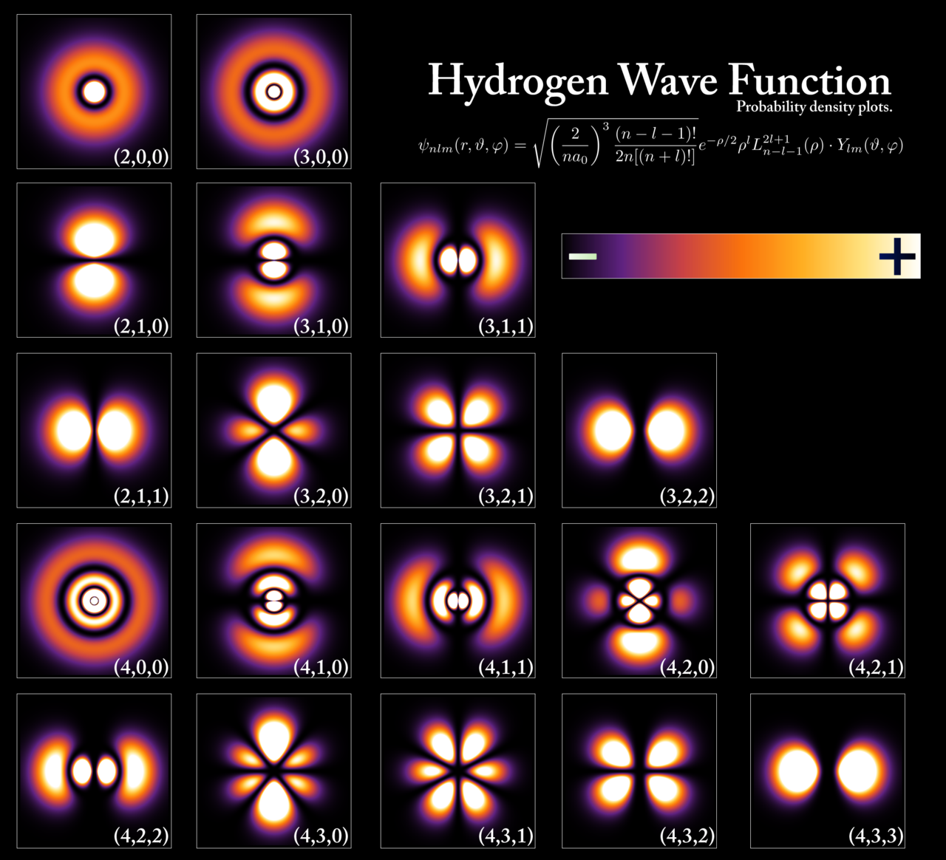
Molecular Orbital Theory
Based on a linear combination of atomic orbitals (LCAO), $Ψ=\underset{r}{∑}c_{r}χ_{r}$
Qualitatively similar to exact solution of ${\text{H}}_{2}^{+}$
Near an nucleus, $\overset{̂}{H}$ is similar to atomic $\overset{̂}{H}$
Ground-state energy is based on the variation theorem and can be found using the Rayleigh-Ritz method
By PoorLeno (talk) - the English language Wikipedia (log).Original text: I created this work entirely by myself.

Slide 6
MO Theory for ${\text{H}}_{2}^{+}$

Slide 7
${\text{H}}_{2}^{+}$ energies
For ${\text{H}}_{2}^{+}$, the minimum basis set (enclosing both nuclei) is $Ψ=c_{A}1s_{A}+c_{B}1s_{B}$, where $1s_{n}$ is a $1s$ orbital enclosing nucleus $n$
The secular determinant is $\left|\begin{matrix}H_{AA}-E & H_{AB}-ES \\ H_{BA}-ES & H_{BB}-E\end{matrix}\right|=0$
$H_{AA}=⟨1s_{A}|\overset{̂}{H}|1s_{A}⟩$$=⟨1s_{B}|\overset{̂}{H}|1s_{B}⟩=H_{BB}$ are atomic integrals, centered around one nucleus
$H_{AB}=⟨1s_{A}|\overset{̂}{H}|1s_{B}⟩=H_{BA}$ are exchange integrals, dependent on two nuclei
$S=⟨1s_{A}|1s_{B}⟩$ is the overlap integral
Near one if the atoms are close
Falls to zero as the distance between atoms increases

Slide 8
Matrix elements of Slater-type orbitals
Instead of the actual hydrogen orbital, we will use Slater-type orbitals, $S_{nlm_{l}}(r,θ,ϕ)=N_{nl}r^{n-1}e^{-ζr}Y_{l}^{m_{l}}(θ,ϕ)$
These decay exponentially
Unlike hydrogenic orbitals, they have no radial nodes
For these orbitals, the matrix elements are
$H_{AA}=⟨1s_{A}\left|-\frac{1}{2}∇^{2}-\frac{1}{r_{A}}-\frac{1}{r_{B}}+\frac{1}{R}\right|1s_{A}⟩=-\frac{1}{2}+J(R)+\frac{1}{R}$ is called the Coulomb integral
$H_{AB}=⟨1s_{A}\left|-\frac{1}{2}∇^{2}-\frac{1}{r_{A}}-\frac{1}{r_{B}}+\frac{1}{R}\right|1s_{B}⟩=-\frac{S(R)}{2}+K(R)+\frac{S(R)}{R}$ is called the resonance integral
$S(R)=e^{-R}\left(1+R+\frac{R^{2}}{3}\right)$ is overlap integral
$J(R)=⟨1s_{A}\left|-\frac{1}{r_{B}}\right|1s_{A}⟩$$=e^{-2R}\left(1+\frac{1}{R}\right)-\frac{1}{R}$; $K(R)=-e^{-R}\left(1+R\right)$

Slide 9
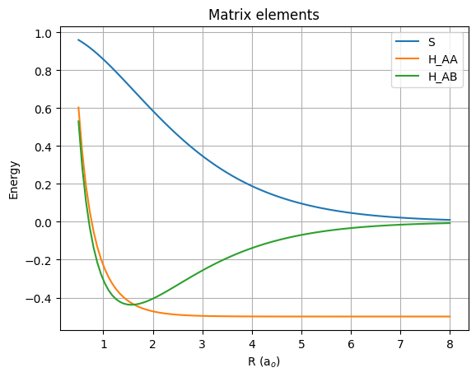
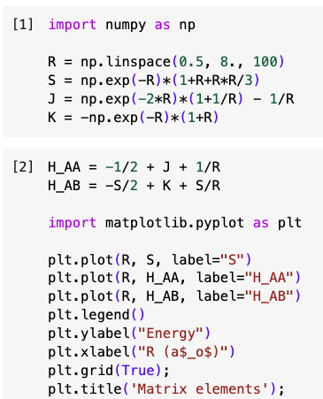
Distance dependence of matrix elements

Slide 10
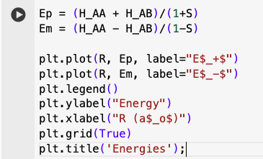
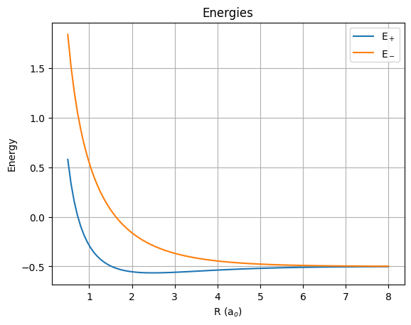
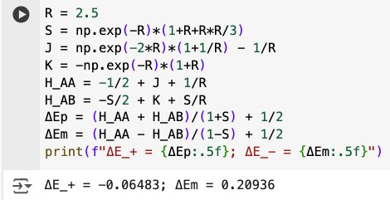
${\text{H}}_{2}^{+}$ energies
Expanding the secular determinant $\left|\begin{matrix}H_{AA}-E & H_{AB}-ES \\ H_{BA}-ES & H_{BB}-E\end{matrix}\right|=0$ leads to ${\left(H_{AA}-E\right)}^{2}-{\left(H_{AB}-ES\right)}^{2}=0$
Based on the quadratic equation, $E_{±}=\frac{H_{AA}±H_{AB}}{1±S}$ are the MO energies
$E_{+}$ is the ground state
$E_{-}$ is the first excited state.
$ΔE_{±}=E_{±}-E_{1s}$ is the energy relative to the separated proton and hydrogen atom

Slide 11
Assessment of MO energies
MO vs exact energies
 | LCAO (minimum basis set) | Exact
Minimum energy | -0.06483 Eh | -0.10264 Eh
Bond length | 2.493 ao = 132 pm | 2 ao = 106 pm
Not that close, but qualitatively similar

Slide 12
${\text{H}}_{2}^{+}$ wavefunction
The secular equations are
$$c_{A}\left(H_{AA}-E\right)+c_{B}\left(H_{AB}-ES\right)=0$$
$$c_{A}\left(H_{AB}-ES\right)+c_{B}\left(H_{BB}-E\right)=0$$
Substituting $E_{+}$ into the first equation and using $H_{AA}=H_{BB}$ and $H_{AB}=H_{BA}$, we get,
$$c_{A}\left(H_{AA}-\frac{H_{AA}+H_{AB}}{1+S}\right)+c_{B}\left(H_{AB}-\frac{H_{AA}+H_{AB}}{1+S}S\right)=0$$
$$c_{A}\left(\frac{H_{AA}S-H_{AB}}{1+S}\right)+c_{B}\left(\frac{H_{AB}-H_{AA}S}{1+S}\right)=0$$
Thus $c_{A}=c_{B}$.
After normalizing, we find $Ψ_{+}=\frac{1}{\sqrt{2(1+S)}}\left(1s_{A}+1s_{B}\right)$
Likewise, $Ψ_{-}=\frac{1}{\sqrt{2(1-S)}}\left(1s_{A}-1s_{B}\right)$
$Ψ_{+}$ is stable and is called the bonding orbital
$Ψ_{-}$ is unstable and is called the antibonding orbital

Slide 13
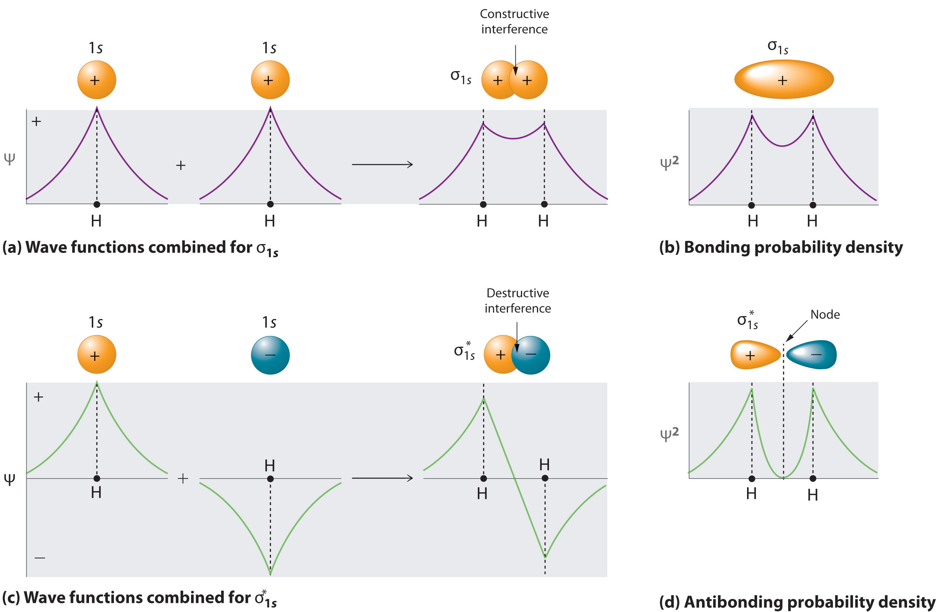
Molecular Orbitals for the H2 Molecule. (a) The formation of a bonding σ1s molecular orbital for H2 as the sum of the wave functions (Ψ) of two H 1s atomic orbitals. (b) This plot of the square of the wave function (Ψ2) for the bonding σ1s molecular orbital illustrates the increased electron probability density between the two hydrogen nuclei. (c) The formation of an antibonding molecular orbital for H2 as the difference of the wavefunctions (Ψ) of two H 1s atomic orbitals. (d) This plot of the square of the wave function (Ψ2) for the antibonding molecular orbital illustrates the node corresponding to zero electron probability density between the two hydrogen nuclei. https://chem.libretexts.org/Courses/Knox_College/Chem_321%3A_Physical_Chemistry_I/03%3A_Chemical_Bond/3.04%3A_Molecular_Orbital_Theory

Slide 14
MO theory for ${\text{H}}_{2}$

Slide 15
Electronic wavefunctions for ${\text{H}}_{2}$
LCAO leads to one-electron spatial molecular orbitals $Ψ_{+}$ and $Ψ_{-}$
Most molecules have more than one electron
${\text{H}}_{2}$ has two protons and two electrons
For the electronic Schrodinger equation, its Hamiltonian is,$\overset{̂}{H}=-\frac{1}{2}∇_{1}^{2}-\frac{1}{2}∇_{2}^{2}-\frac{1}{r_{A1}}-\frac{1}{r_{B1}}-\frac{1}{r_{A2}}-\frac{1}{r_{B2}}+\frac{1}{r_{12}}+\frac{1}{R}$, only slightly different than for ${\text{H}}_{2}^{+}$
What is a two-electron wavefunction using $Ψ_{+}(n)$ for $n∈\left\{1,2\right\}$that satisfies the Pauli principle?

Slide 16
Assessment of MO energies
MO vs experimental energies
 | LCAO (minimum basis set) | Experimental
Minimum energy | -1.0991 Eh | -1.174 Eh
Bond length | 1.603 ao | 1.401 ao

Slide 17
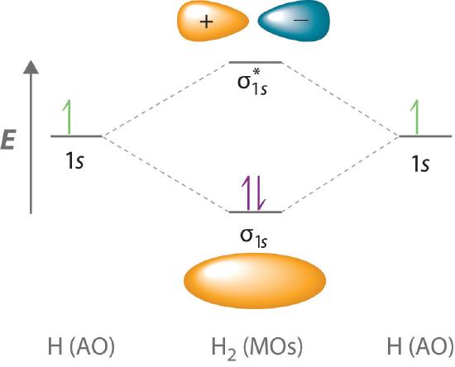
${\text{H}}_{2}$ energy level diagram
An energy level diagram compares the energies of MOs with the those of the parent atomic orbitals
$σ_{1s}$ - sum of 1s orbitals
$σ_{1s}^{*}$ - difference of 1s orbitals
Valence electrons are inserted into diagram according to
Pauli principle - each orbital can accommodate a maximum of two electrons with opposite spins
Hund’s rule - orbitals are filled in order of increasing energy
Molecular Orbital Energy-Level Diagram for H2
https://chem.libretexts.org/Courses/Knox_College/Chem_321%3A_Physical_Chemistry_I/03%3A_Chemical_Bond/3.04%3A_Molecular_Orbital_Theory

Slide 18
Orbital occupancy
Bond order is $b=\frac{1}{2}\left(N_{bonding}-N_{antibonding}\right)$
Electrons in antibonding orbitals cancel effect of bonding orbitals
Predicts stability of species
Classifications of MOs
HOMO - Highest occupied molecular orbital
LUMO - Lowest unoccupied molecular orbital
The HOMO and LUMO are frontier orbitals, where most of the reactive and spectroscopic activity occurs
Virtual orbitals are not occupied by any electrons

Slide 19
MO theory for other molecules
Can also apply LCAO-MO description
Criteria for bond formation
Non-negligible overlap, which implies valence shell orbitals are involved in bonding
Similar energies, as they lead to larger energy changes upon bonding
For a heteronuclear diatomic molecules, if atom A is more electronegative than atom B, then in the wavefunction $Ψ=c_{A}χ_{A}+c_{B}χ_{B}$
$|c_{A}|^{2}>|c_{B}|^{2}$ for bonding MOs
$|c_{A}|^{2}<|c_{B}|^{2}$ for antibonding MOs
In polyatomic molecules, $Ψ=\underset{o}{∑}c_{o}χ_{o}$, where $χ_{o}$ exist for every atom

Slide 20
Huckel Theory

Slide 21

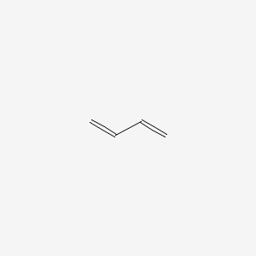


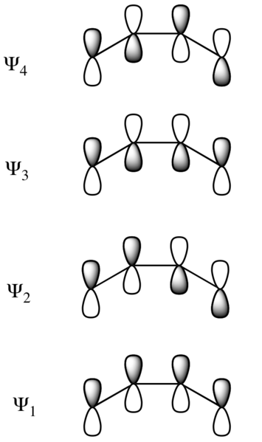
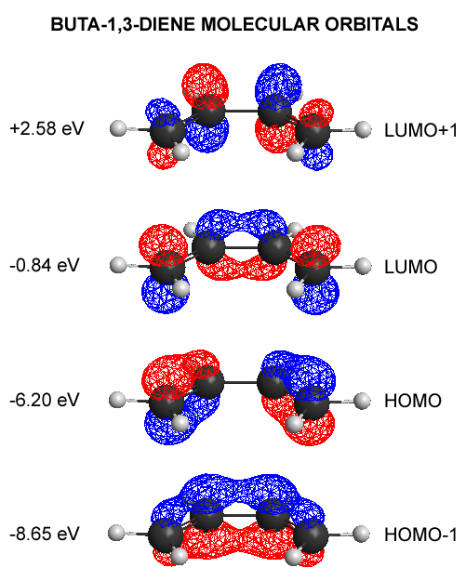
Basics
Specific type of MO theory with approximations
For planar conjugated molecules with alternating single and double bonds, e.g.
butadiene
cyclobutadiene
benzene
ethylene
Based on LCAO, with AOs being p orbitals
1,3-butadiene
Atomic Orbitals (p orbitals)
Molecular Orbitals

Slide 22
Approximations and Examples
Approximations
Separate treatment of $σ$ and $π$ orbitals
Orthonormality, $S_{rs}=δ_{rs}$
$$H=\{\begin{matrix}α & \text{for diagonal elements} \\ β & \text{for neighboring elements} \\ 0 & \text{otherwise}\end{matrix}$$
Examples
For butadiene,$|H-ES|=\left|\begin{matrix}α-E & β & 0 & 0 \\ β & α-E & β & 0 \\ 0 & β & α-E & β \\ 0 & 0 & β & α-E\end{matrix}\right|$
For benzene, $|H-ES|=\left|\begin{matrix}α-E & β & 0 & 0 & 0 & β \\ β & α-E & β & 0 & 0 & 0 \\ 0 & β & α-E & β & 0 & 0 \\ 0 & 0 & β & α-E & β & 0 \\ 0 & 0 & 0 & β & α-E & β \\ β & 0 & 0 & 0 & β & α-E\end{matrix}\right|$

Slide 23
Benefits
What does Huckel theory give you?
Energy levels, including degeneracy in terms of $\alpha$ and $\beta$.
Charge density per atom
Bond order
Dipole moment
As a caveat, the Huckel method generally gives correct orders for energies, but not necessarily the right absolute values

Slide 24
Review Questions
How does MO theory relate to variation theory and the Rayleigh-Ritz method?
How can MO theory be used to predict bond distances and energies?
What is a bonding and a nonbonding orbital?
What causes a MO to have a node?
How are Slater determinants helpful for MOs?
Explain the purpose of Huckel theory, its approximations, and its relationship with MO theory

