Slide 1
10/02/2024
Review Midterm 1
Many-electron atoms
Helium, by variation and perturbation
The Pauli principle
Slater determinants
The Born-Oppenheimer Approximation
Hydrogen molecule ion on a single axis
Potential energy surfaces
This lecture is designed to help you achieve the following learning objectives
Use perturbation theory to extend the models to more realistic situations
Describe variation theory and the use of basis sets

Slide 2
Helium
The full Schrodinger equation is $\left(-\frac{ℏ^{2}}{2M}∇^{2}-\frac{ℏ^{2}}{2m_{e}}∇_{1}^{2}-\frac{ℏ^{2}}{2m_{e}}∇_{2}^{2}\right)Ψ(R,r_{1},r_{2})$$+\left(-\frac{2e^{2}}{4πϵ_{o}|R-r_{1}|}-\frac{2e^{2}}{4πϵ_{o}|R-r_{2}|}+\frac{e^{2}}{4πϵ_{o}|r_{1}-r_{2}|}\right)Ψ(R,r_{1},r_{2})$ $=EΨ(R,r_{1},r_{2})$
$R$ - Position of nucleus
$r_{1}$ and $r_{2}$ - Positions of electrons
$M$ - Mass of nucleus
$m_{e}$ - Mass of electron
$∇^{2}$ - Laplacian w.r.t. position of nucleus
$∇_{1}^{2}$ and $∇_{2}^{2}$ - Laplacian w.r.t. position of electrons

Slide 3
If the nucleus is fixed relative to the electrons, $-\frac{ℏ^{2}}{2m_{e}}\left(∇_{1}^{2}+∇_{2}^{2}\right)Ψ(r_{1},r_{2})-\frac{2e^{2}}{4πϵ_{o}}\left(\frac{1}{r_{1}}+\frac{1}{r_{2}}\right)Ψ(r_{1},r_{2})+\frac{e^{2}}{4πϵ_{o}|r_{1}-r_{2}|}Ψ(r_{1},r_{2})=EΨ(r_{1},r_{2})$
The interelectronic repulsion is
$$\frac{e^{2}}{4πϵ_{o}|r_{1}-r_{2}|}Ψ(r_{1},r_{2})$$
the reason that we cannot obtain an exact solution and need to approximate

Slide 4
Atomic Units
$a_{o}=\frac{4πϵ_{o}ℏ^{2}}{m_{e}e^{2}}$ is the Bohr radius
$E_{h}=\frac{m_{e}e^{4}}{16π^{2}ϵ_{o}^{2}ℏ^{2}}$ is a Hartree
In atomic units, the Hamiltonian for the Helium atom is much simpler, $\overset{̂}{H}=-\frac{1}{2}{\overset{̂}{∇}}_{1}^{2}-\frac{1}{2}{\overset{̂}{∇}}_{2}^{2}-\frac{2}{r_{1}}-\frac{2}{r_{2}}+\frac{1}{r_{12}}$

Slide 5
Perturbation Theory
$$\overset{̂}{H}=-\frac{1}{2}{\overset{̂}{∇}}_{1}^{2}-\frac{1}{2}{\overset{̂}{∇}}_{2}^{2}-\frac{2}{r_{1}}-\frac{2}{r_{2}}+\frac{1}{r_{12}}$$
What is ${\overset{̂}{H}}^{(0)}$ and what is ${\overset{̂}{H}}^{(1)}$?
$$E^{(1)}=⟨0|\frac{1}{r_{12}}|0⟩=\frac{5Z}{8}$$
$E=E^{(0)}+E^{(1)}$$=-\frac{1}{2}Z^{2}-\frac{1}{2}Z^{2}+\frac{5}{8}Z$$=-Z^{2}+\frac{5}{8}Z$ = -2.750 Hartrees

Slide 6
Variation Theory
As a reminder, the ground state wavefunction of hydrogen is $Ψ_{1s}(r_{j})=2{\left(\frac{Z^{3}}{π}\right)}^{\frac{1}{2}}e^{-Zr_{j}}$
Choose the trial function $ϕ_{0}(r_{1},r_{2})=Ψ_{1s}(r_{1})Ψ_{1s}(r_{2})$ where $Ψ_{1s}(r_{j})={\left(\frac{ζ^{3}}{π}\right)}^{1/2}e^{-ζr_{j}}$
By varying $ζ$, we obtain the Rayleigh ratio is $E(ζ)=ζ^{2}-\frac{27}{8}ζ$ in atomic units
The minimum energy is achieved with $ζ_{min}=27/16≈1.68$, compared to $Z=2$ for the reference system.
With this variational parameter, $E_{min}=-{\left(\frac{27}{16}\right)}^{2}$= -2.8477 Hartrees.

Slide 7
Assessment of approximations
Variational and perturbation results are within a few percent of experiment
Good as an absolute number
Not that good for ionization energies and other properties
How to improve?
For variation theory, use more basis functions
For perturbation theory, use higher-order terms
Method | Energy (Hartrees)
Perturbation (1st order) | -2.750
Variation (Exponential decay) | -2.8477
Experimental | -2.9033

Slide 8
The Pauli Principle
A sixth postulate: the total wavefunction (including spin) must be antisymmetric, $Ψ(1,2)=-Ψ(2,1)$, with respect to the interchange of any pair of fermions (particles with odd half-integer spin), e.g. electrons.
We have focused on spatial orbitals. To satisfy the Pauli principle we need to consider spinorbitals that incorporate both space and spin, e.g. $Ψ_{1s}^{α}(m)=Ψ_{1s}(r_{m})α(m)$ and $Ψ_{1s}^{β}(n)=Ψ_{1s}(r_{n})β(n)$.
Exercise: construct a linear combination $Ψ(1,2)$ of spinorbitals, $Ψ_{1s}^{α}(m)$ and $Ψ_{1s}^{β}(n)$ that satisfies the Pauli Principle for two electrons. ($m∈\{1,2\}$ and $n∈\{1,2\}$).
The Pauli exclusion principle: No two electrons can occupy the same state.
It is a consequence of the Pauli principle.

Slide 9
Slater Determinants
$Ψ(1,2,...,N)=\sqrt{\frac{1}{N!}}\left|\begin{matrix}u_{1}(1) & u_{2}(1) & ... & u_{N}(1) \\ u_{1}(2) & u_{2}(2) & ... & u_{N}(2) \\ ... & ... & ... & ... \\ u_{1}(N) & u_{2}(N) & ... & u_{N}(N)\end{matrix}\right|$, where $u_{n}(m)$ is a spinorbital for electron $m$
$Ψ(1,2,...,N)=\sqrt{\frac{1}{N!}}\left|\begin{aligned}u_{1}(1)u_{2}(2)...u_{N}(N)\end{aligned}\right|$ is a shorthand notation
Changes sign upon interchange any two rows or columns; determinants are antisymmetric, satisfying the Pauli principle
If columns are identical, occupying the same orbital, the Slater determinant is zero

Slide 10
The Born-Oppenheimer Approximation
Nuclei are much heavier than electrons and move much more slowly.
In the Born-Oppenheimer approximation, one solves an approximate Schrodinger equation for a given nuclear arrangement.
Basis of most computational chemistry calculations

Slide 11

Hydrogen molecule ion on a single axis
$$Z_{1}$$
$$z$$
$$Z_{2}$$
Let’s look at an example of the BO approximation
$\overset{̂}{H}=-\frac{ℏ^{2}}{2m_{e}}\frac{∂^{2}}{∂z^{2}}-\overset{2}{\underset{I=1}{∑}}\frac{ℏ^{2}}{2m_{I}}\frac{∂^{2}}{∂Z_{I}^{2}}+V(z,Z_{1},Z_{2})$ is the full Hamiltonian
$\overset{̂}{H}=T_{e}+T_{N}+V$ is a simplification in terms of kinetic and potential energies
What is included in $V$ that is not part of the hydrogen atom?

Slide 12
Separation of variables
$\overset{̂}{H}Ψ(z,Z_{1},Z_{2})=EΨ(z,Z_{1},Z_{2})$ is the Schrodinger equation
We will try to separate the wavefunction into,$Ψ(z,Z_{1},Z_{2})≈Ψ(z;Z_{1},Z_{2})Ψ(Z_{1},Z_{2})=ΨΨ_{N}$
$\overset{̂}{H}ΨΨ_{N}={\overset{̂}{T}}_{e}ΨΨ_{N}+{\overset{̂}{T}}_{N}ΨΨ_{N}+\overset{̂}{V}ΨΨ_{N}$ uses the separated wavefunction$=Ψ_{N}{\overset{̂}{T}}_{e}Ψ+Ψ{\overset{̂}{T}}_{N}Ψ_{N}+\overset{̂}{W}+\overset{̂}{V}ΨΨ_{N}=EΨΨ_{N}$
$\overset{̂}{W}$ comes from the nuclear kinetic energy operator

Slide 13
$$\overset{̂}{W}$$
$\overset{̂}{W}$ comes from the nuclear kinetic energy operator
$$\frac{∂^{2}}{∂Z_{I}^{2}}\left(ΨΨ_{N}\right)=\frac{∂}{∂Z_{I}}\left[Ψ_{N}\frac{∂Ψ}{∂Z_{I}}+Ψ\frac{∂Ψ_{N}}{∂Z_{I}}\right]$$$$=\frac{∂Ψ_{N}}{∂Z_{I}}\frac{∂Ψ}{∂Z_{I}}+Ψ_{N}\frac{∂^{2}Ψ}{∂Z_{I}^{2}}+\frac{∂Ψ}{∂Z_{I}}\frac{∂Ψ_{N}}{∂Z_{I}}+Ψ\frac{∂^{2}Ψ_{N}}{∂Z_{I}^{2}}$$
$$W=\overset{2}{\underset{I=1}{∑}}\frac{ℏ^{2}}{2m_{I}}\left(2\frac{∂Ψ}{∂Z_{I}}\frac{∂Ψ_{N}}{∂Z_{I}}+Ψ_{N}\frac{∂^{2}Ψ}{∂Z_{I}^{2}}\right)$$
Is non-zero, but small compared to other terms. $m_{I}<<m_{e}$ is in the denominator

Slide 14
Completing the separation
In the BO approximation we drop $\overset{̂}{W}$ such that,$\overset{̂}{H}ΨΨ_{N}≈Ψ_{N}{\overset{̂}{T}}_{e}Ψ+Ψ{\overset{̂}{T}}_{N}Ψ_{N}+\overset{̂}{V}ΨΨ_{N}=EΨΨ_{N}$
$$Ψ{\overset{̂}{T}}_{N}Ψ_{N}+\left({\overset{̂}{T}}_{e}Ψ+\overset{̂}{V}Ψ\right)Ψ_{N}=EΨΨ_{N}$$
If nuclear positions are fixed, then the electronic Schrodinger equation is,${\overset{̂}{T}}_{e}Ψ+\overset{̂}{V}Ψ=E_{e}(T_{1},T_{2})Ψ$
It is exactly solvable, even in 3D, but very complicated.
If we solve this equation, then we can substitute the solution $Ψ{\overset{̂}{T}}_{N}Ψ_{N}+E_{e}ΨΨ_{N}=EΨΨ_{N}$ and can divide by $Ψ$ to get the a nuclear Schrodinger equation, ${\overset{̂}{T}}_{N}Ψ_{N}+E_{e}Ψ_{N}=EΨ_{N}$, that depends on the electronic wavefunction.

Slide 15
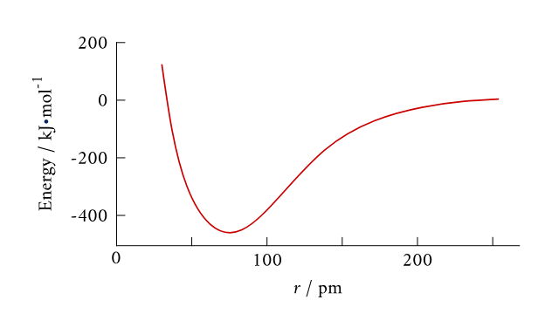
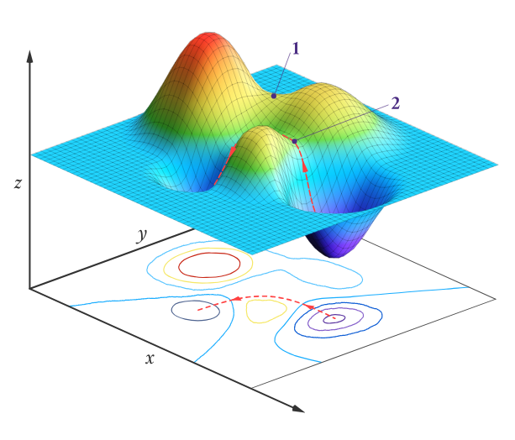
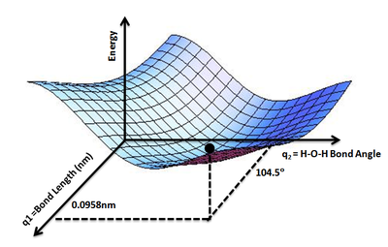
Potential energy surfaces
The ground-state energy as a function of one or two order parameters
A potential energy curve for the covalent bond in a H2 molecule. The distance r is the distance between the nuclei of the two H atoms. (CC BY-NC Ümit Kaya via LibreTexts)
A 2-D contour map and corresponding Potential Energy Surface for a hypothetical endothermic reaction.(CC BY-NC; Ümit Kaya via LibreTexts)
PES for water molecule showing the energy minimum corresponding to optimized molecular structure for water- O-H bond lengths of 0.0958 nm and H-O-H bond angle of 104.5° of Wikipedia (Credit: Aimnature)
https://chem.libretexts.org/Bookshelves/Physical_and_Theoretical_Chemistry_Textbook_Maps/Physical_Chemistry_%28LibreTexts%29/30%3A_Gas-Phase_Reaction_Dynamics/30.10%3A_The_Potential-Energy_Surface_Can_Be_Calculated_Using_Quantum_Mechanics

Slide 16
Review Questions
What term makes the Schrodinger equation for helium difficult to solve?
How does the Pauli exclusion principle follow from the Pauli principle?
Why are Slater determinants helpful for constructing wavefunctions that satisfy the Pauli principle?
How does the Born-Oppenheimer approximation simplify the Schrodinger equation?
What is a potential energy surface and how can they be interpreted?

