Slide 1
9/9/2024
Review by example
General Uncertainty Principle
Harmonic Oscillator
Infrared Spectroscopy
Google Drive Folder Link Setup
Exercise 1: Introduction to Google Colab
This lecture and exercise is designed to help you achieve the following learning objectives
Use the general uncertainty principle to evaluate limits on the simultaneous specification of a pair of quantities
Describe how analytical models help interpret various experimental spectra
Use Google Colab to run python computer code and to annotate results

Slide 2
Review by Example

Slide 3
GUT example
Using the general uncertainty principle $ΔAΔB≥\frac{1}{2}\left|⟨[\overset{̂}{A},\overset{̂}{B}]⟩\right|$, evaluate the limitation on the simultaneous specification of kinetic energy and potential energy
$$\left[\overset{̂}{T},\overset{̂}{V}\right]f=\overset{̂}{T}\overset{̂}{V}f-\overset{̂}{V}\overset{̂}{T}f=-\frac{ℏ^{2}}{2m}\frac{d^{2}Vf}{dx}+V\frac{ℏ^{2}}{2m}\frac{df}{dx}$$
$$\frac{d^{2}Vf}{dx^{2}}=\frac{d}{dx}\left[f\frac{dV}{dx}+V\frac{df}{dx}\right]=f\frac{d^{2}V}{dx^{2}}+2\frac{df}{dx}\frac{dV}{dx}+V\frac{d^{2}f}{dx^{2}}$$
$$\left[\overset{̂}{T},\overset{̂}{V}\right]f=-\frac{ℏ^{2}}{2m}\left[f\frac{d^{2}V}{dx^{2}}+2\frac{df}{dx}\frac{dV}{dx}\right]=i\overset{̂}{C}f$$
Therefore, $ΔTΔV≥\frac{ℏ^{2}}{4m}\left|⟨\frac{d^{2}V}{dx^{2}}+2\frac{dV}{dx}\frac{d}{dx}⟩\right|$

Slide 4
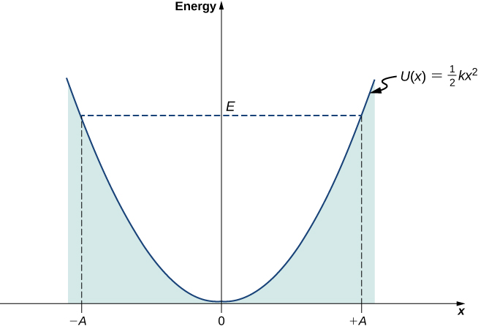
Harmonic Oscillator
$$V(x)=\frac{1}{2}kx^{2}$$
The Hamiltonian is $\overset{̂}{H}=-\frac{ℏ^{2}}{2m}\frac{d^{2}}{dx^{2}}+\frac{1}{2}k_{f}x^{2}$
The energies are $E_{ν}=\left(ν+\frac{1}{2}\right)ℏω$, where $ν=0,1,2,...$
$$ω=\sqrt{\frac{k_{f}}{m}}$$
$ν$ starts at 0, not 1
Spacings between energy levels are constant
https://phys.libretexts.org/Bookshelves/University_Physics/University_Physics_(OpenStax)/University_Physics_III_-_Optics_and_Modern_Physics_(OpenStax)/07%3A_Quantum_Mechanics/7.06%3A_The_Quantum_Harmonic_Oscillator

Slide 5
HO Example
The oscillation of the atoms around their equilibrium positions in the molecule HI can be modeled as a harmonic oscillator of mass $m≈m_{H}$ (the iodine atom is almost stationary) and force constant $k_{f}=313.8Nm^{-1}$. Evaluate the separation of energy levels and predict the wavelength of light needed to induce a transition between neighboring levels.
$$m=1.008×{10}^{-3}{\text{kg mol}}^{-1}/6.022×{10}^{23}\text{particles/mol}=1.674×{10}^{-27}\text{kg}$$
$$ω=\sqrt{\frac{k_{f}}{m}}=\sqrt{\frac{313.8{\text{N m}}^{-1}}{1.674×{10}^{-27}\text{kg}}}=4.33×{10}^{14}{\text{s}}^{-1}$$
$$λ=\frac{hc}{ΔE}=\frac{hc}{ℏω}=\frac{2πc}{ω}=4.35μm$$

Slide 6
Infrared Spectroscopy

Slide 7
Dipoles
Molecules with permanent dipole moments will generate oscillating dipoles when they vibrate.
Which of the following diatomic molecules will exhibit an infrared spectrum?
HBr
H2
CO
I2
HBr and CO

Slide 8
Identification by IR
In the HO model, $ΔE=ℏν_{obs}$ or $ΔE=hν_{m}$
$ν_{obs}=\sqrt{\frac{k}{μ}}$ or $ν_{m}=\frac{1}{2π}\sqrt{\frac{k}{μ}}$ and $μ=\frac{m_{1}m_{2}}{m_{1}+m_{2}}$
An unknown diatomic oxide has a vibrational frequency of ω = 1904 cm⁻¹ and a force constant of 1607 N m⁻¹. Identify the molecule. (a) CO (b) BrO (c) NO (d) ¹³CO
$$ν_{m}=ωc=(1904{\text{cm}}^{-1})(2.99×{10}^{10}{\text{cm s}}^{-1})=5.706×{10}^{13}{\text{s}}^{-1}$$
$μ=\frac{(2π)^{2}k}{ν_{m}^{2}}=\frac{(2π)^{2}(1607{\text{N m}}^{-1})}{(5.706×{10}^{13}{\text{s}}^{-1})^{2}}=1.250×{10}^{-26}\text{kg}$ for a single molecule
$μ=(1.250×{10}^{-23}\text{g})(6.022×{10}^{23}{\text{mol}}^{-1})=7.528{\text{g mol}}^{-1}$ for a mol of particles
For NO, $\frac{m_{1}m_{2}}{m_{1}+m_{2}}=\frac{14×16}{14+16}{\text{g mol}}^{-1}=7.5{\text{g mol}}^{-1}$

Slide 9
Review
What is necessary for a transition between vibrational states to be observed in infrared spectroscopy?
What is the difference between mass and reduced mass?

Slide 10
Google Drive Folder Setup

Slide 11
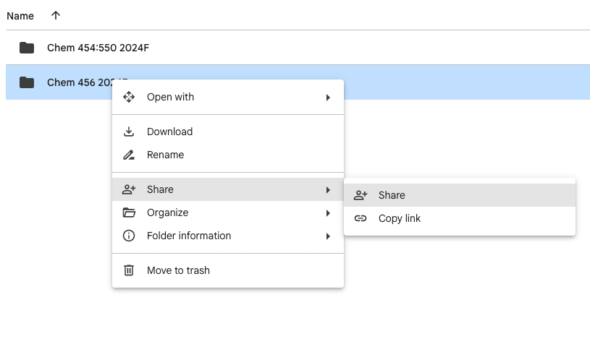
Log in to Google Drive. This can be a school account or a personal account.
Create a folder for this class called “Chem550-2024F”
Create the subfolder “exercises”. This should be exactly correct, including lowercase.
Right click on the folder.
Select “Share”
Share the folder with me, dminh@iit.edu, and the TA, tnguyen48@hawk.iit.edu.

Slide 12
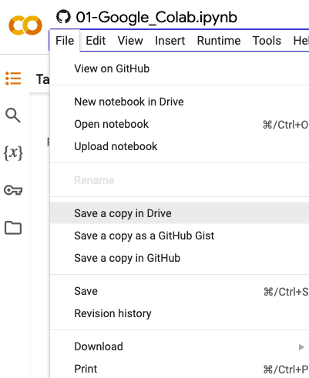
Exercise 1: Introduction to Google Colab
https://colab.research.google.com/github/daveminh/Chem550-2024F/blob/main/exercises/01-Google_Colab.ipynb
After following this link, you should
save a copy of the notebook to Google Drive
rename it to 01-Google_Colab.ipynb
move it to your class folder under the “exercises” folder
work on and save the notebook

