Slide 1
9/11/2024
Particle on a ring
Polar Coordinates
Laplacian and Hamiltonian operator
General solutions
Angular momentum
Particle on a sphere
Spherical Coordinates
Laplacian and Hamiltonian operator
Spherical harmonics
Angular momentum
This lecture is designed to help you achieve the following learning objectives
Obtain and interpret solutions of the Schrodinger equation for tractable systems including the particle in a box, harmonic oscillator, rigid rotor, and hydrogen atom
Describe how analytical models help interpret various experimental spectra

Slide 2
Particle on a Ring
1D Particle in a box, confined to a specific range of $x$.
Hamiltonian is $\overset{̂}{H}=-\frac{ℏ^{2}}{2m}\frac{∂^{2}}{∂x}$.
2D Particle in a box, confined to a specific range of $x$ and $y$.
Hamiltonian is $\overset{̂}{H}=-\frac{ℏ^{2}}{2m}\left(\frac{∂^{2}}{∂x}+\frac{∂^{2}}{∂y}\right)$
Alternatively, $\overset{̂}{H}=-\frac{ℏ^{2}}{2m}∇^{2}$, where $∇^{2}$ is the Laplacian operator.
Particle on a ring, confined to a specific value of $r$. What is the kinetic energy?

Slide 3
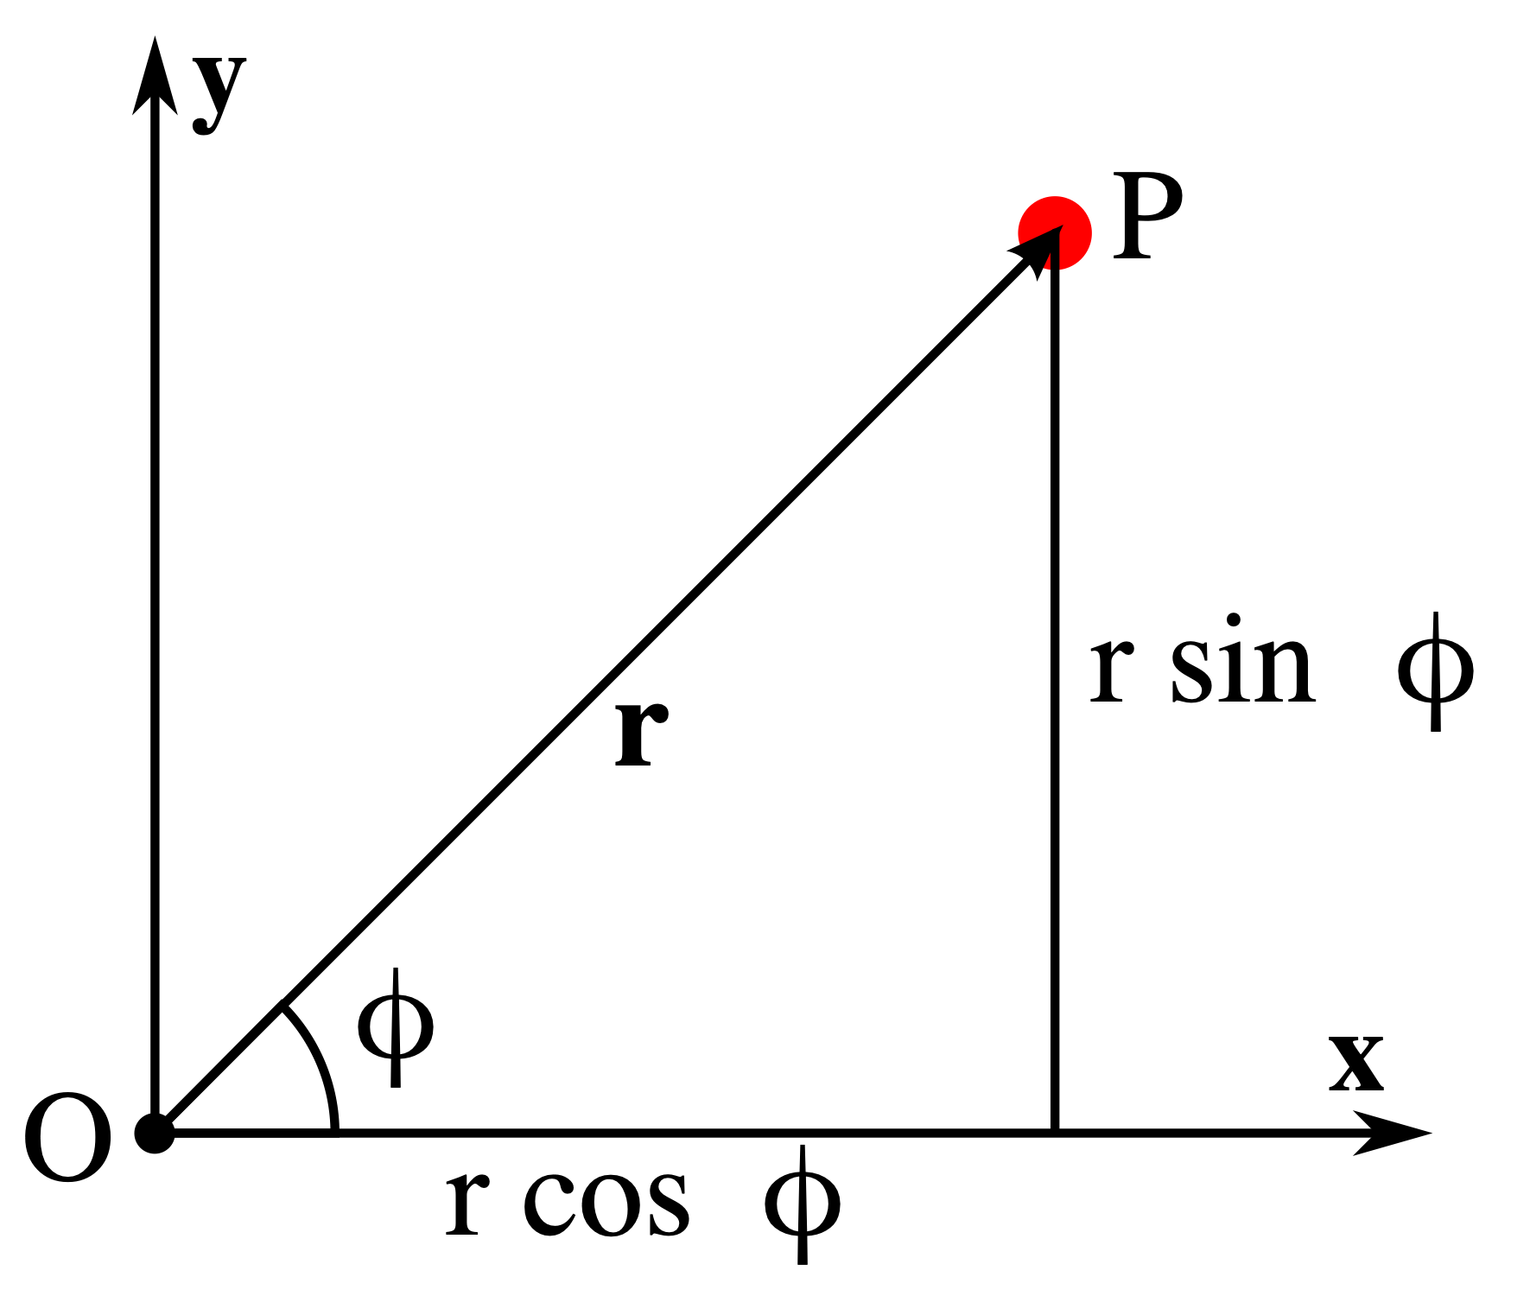
Polar Coordinates
$$x=rcosϕ$$
$$y=rsinϕ$$
$$r=\sqrt{x^{2}+y^{2}}$$
$$ϕ=arctan\left(\frac{y}{x}\right)$$

Slide 4
The Chain Rule
$u(x,y)$ is a function that depends on x and y
$δu(x,y)=\frac{∂u}{∂x}δx+\frac{∂u}{∂y}δy$ is differential for u
Now let’s say that $x=x(s,t)$ and $y=y(s,t)$. The chain rule says that,$\frac{∂u}{∂s}=\frac{∂u}{∂x}\frac{∂x}{∂s}+\frac{∂u}{∂y}\frac{∂y}{∂s}$.
What about $\frac{∂u}{∂t}$?
$$\frac{∂u}{∂t}=\frac{∂u}{∂x}\frac{∂x}{∂t}+\frac{∂u}{∂y}\frac{∂y}{∂t}$$

Slide 5
Hamiltonian of POR
Using the chain rule, one can obtain the Laplacian in polar coordinates as $\frac{∂^{2}}{∂x^{2}}+\frac{∂^{2}}{∂y^{2}}=\frac{∂^{2}}{∂r^{2}}+\frac{1}{r}\frac{∂}{∂r}+\frac{1}{r^{2}}\frac{∂^{2}}{∂ϕ^{2}}$
$$\overset{̂}{H}=\frac{-ℏ^{2}}{2m}\left(\frac{∂^{2}}{∂x^{2}}+\frac{∂^{2}}{∂y^{2}}\right)=\frac{-ℏ^{2}}{2m}\left(\frac{∂^{2}}{∂r^{2}}+\frac{1}{r}\frac{∂}{∂r}+\frac{1}{r^{2}}\frac{∂^{2}}{∂ϕ^{2}}\right)$$
For a particle on a ring, r is constant, so $\overset{̂}{H}=\frac{-ℏ^{2}}{2m}\left(\frac{1}{r^{2}}\frac{d^{2}}{dϕ^{2}}\right)$

Slide 6
Schrodinger Equation
$\frac{-ℏ^{2}}{2m}\left(\frac{1}{r^{2}}\frac{d^{2}}{dϕ^{2}}\right)Ψ=EΨ$ is the Schrodinger equation for the system
$\frac{d^{2}Φ}{dϕ^{2}}=-\frac{2IE}{ℏ^{2}}Φ$ (using $I=mr^{2}$ and swapping notation for the wavefunction)
The general solution is $Φ=Ae^{im_{l}ϕ}+Be^{-im_{l}ϕ}$, where $m_{l}=\sqrt{\frac{2IE}{ℏ^{2}}}$.

Slide 7
Schrodinger Equation Solutions
$Φ=Ae^{im_{l}ϕ}+Be^{-im_{l}ϕ}$, where $m_{l}=\sqrt{\frac{2IE}{ℏ^{2}}}$.
The boundary conditions are $Φ(ϕ+2π)=Φ(ϕ)$, or $Ae^{im_{l}ϕ}e^{2πim_{l}}+Be^{-im_{l}ϕ}e^{2πim_{l}}=Ae^{im_{l}ϕ}+Be^{-im_{l}ϕ}$
Thus, $e^{2πim_{l}}=cos(2πm_{l})+isin(2πm_{l})=1$ must be true.
When is this true?
If $m_{l}$ is an integer, $m_{l}=0,±1,±2,...$
Given $m_{l}=\sqrt{\frac{2IE}{ℏ^{2}}}$, what are the energy levels of a particle on a ring?
$$E_{m_{l}}=\frac{m_{l}^{2}ℏ^{2}}{2I}$$
Are there degenerate states (states with the same energy)?
Yes

Slide 8
Normalization
If B = 0, then $Φ=Ae^{im_{l}ϕ}$
What is A?
$$∫_{0}^{2π}Φ^{*}Φdϕ=|A|^{2}∫_{0}^{2π}e^{-im_{l}ϕ}e^{im_{l}ϕ}dϕ=|A|^{2}∫_{0}^{2π}dϕ=|A|^{2}2π$$
$$|A|=\sqrt{\frac{1}{2π}}$$

Slide 9
Angular Momentum
In classical mechanics, angular momentum is the cross product of the position $r$ and momentum vectors $p$, $l=r×p=\left|\begin{matrix}i & j & k \\ x & y & z \\ p_{z} & p_{y} & p_{z}\end{matrix}\right|$
The z component is $l_{z}=xp_{y}-yp_{x}$
Using the momentum operator in the position representation, ${\overset{̂}{l}}_{z}=\frac{ℏ}{i}\left(x\frac{∂}{∂y}+y\frac{∂}{∂x}\right)=\frac{ℏ}{i}\frac{∂}{∂ϕ}$
If $Φ=Ae^{im_{l}ϕ}$, what is the angular momentum?
Applying the operator to the wavefunction gives ${\overset{̂}{l}}_{z}Φ=\frac{ℏ}{i}im_{l}Φ=m_{l}ℏΦ$
Thus the momentum is $m_{l}ℏ$

Slide 10
Postulate 3 Self-Test
$$Φ=\sqrt{\frac{1}{3}}\sqrt{\frac{1}{2π}}-\sqrt{\frac{2}{3}}\sqrt{\frac{1}{2π}}e^{-2iϕ}$$
What are the angular momentum quantum numbers?
What are the normalized wavefunctions $ϕ_{n}$?
What the the coefficients $c_{n}$?
Probability | Energy | Angular Momentum
Expectation

Slide 11
Particle on a Sphere

Slide 12
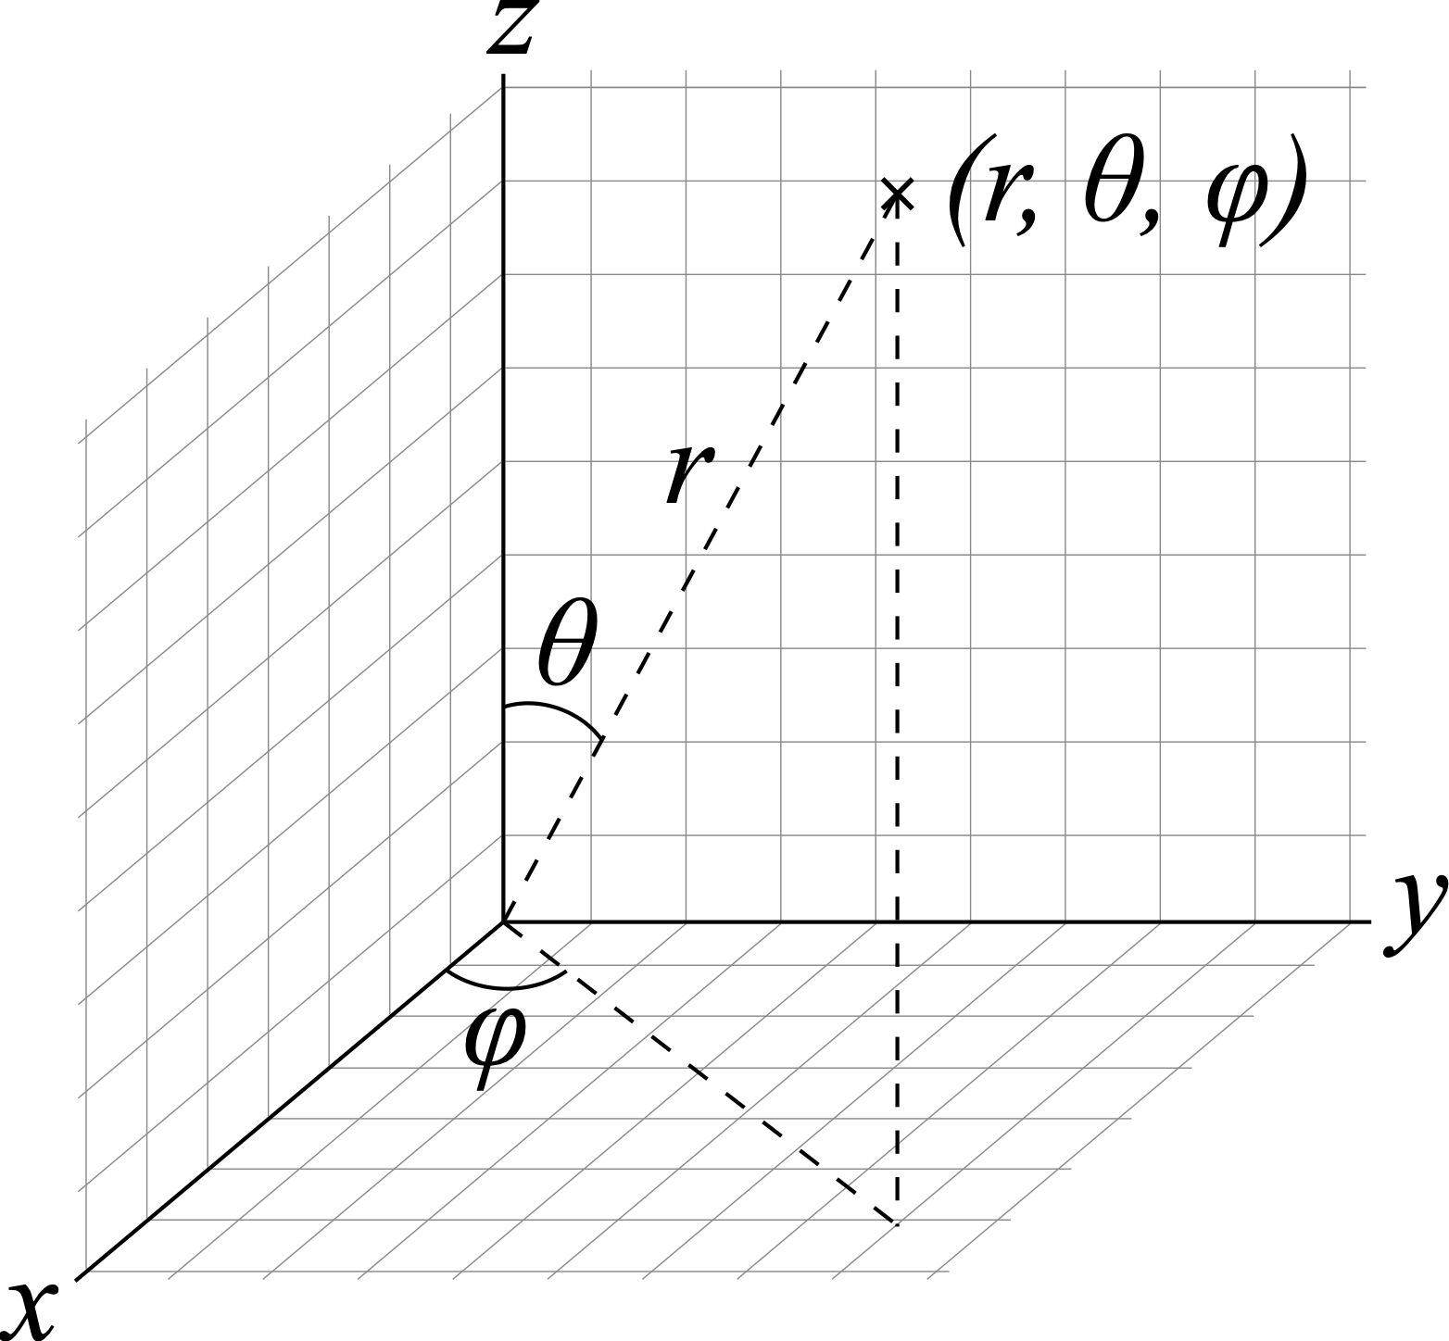
Spherical Polar Coordinates
The mapping from spherical polar to Cartesian coordinates is,
$$x=rsinθcosϕ$$
$$y=rsinθsinϕ$$
$$z=rcosθ$$
The Laplacian is,
$${\overset{̂}{∇}}^{2}=\frac{1}{r}\frac{∂^{2}}{∂r^{2}}r+\frac{1}{r^{2}}{\overset{̂}{Λ}}^{2}$$
${\overset{̂}{Λ}}^{2}=\frac{1}{\sin^{2}θ}\frac{∂^{2}}{∂ϕ^{2}}+\frac{1}{sinθ}\frac{∂}{∂θ}sinθ\frac{∂}{∂θ}$ is called the Legendrian
azimuth
colatitude

Slide 13
Schrodinger Equation
$\overset{̂}{H}=\frac{-ℏ^{2}}{2m}{\overset{̂}{∇}}^{2}=\frac{-ℏ^{2}}{2mr^{2}}{\overset{̂}{Λ}}^{2}$ is the Hamiltonian if $r$ is constant
${\overset{̂}{Λ}}^{2}Ψ=-\frac{2IE}{ℏ^{2}}Ψ$ is the Schrodinger equation
$${\overset{̂}{Λ}}^{2}=\frac{1}{\sin^{2}θ}\frac{∂^{2}}{∂ϕ^{2}}+\frac{1}{sinθ}\frac{∂}{∂θ}sinθ\frac{∂}{∂θ}$$

Slide 14
Separation of Variables
Applying the Legendrian to $Ψ(θ,ϕ)=Θ(θ)Φ(ϕ)$ gives
$${\overset{̂}{Λ}}^{2}ΘΦ=Θ\frac{1}{\sin^{2}θ}\frac{∂^{2}}{∂ϕ^{2}}Φ+Φ\frac{1}{sinθ}\frac{∂}{∂θ}sinθ\frac{∂}{∂θ}Θ=-\frac{2IE}{ℏ^{2}}ΘΦ$$
$\frac{1}{Φ}\frac{∂^{2}}{∂ϕ^{2}}Φ+\frac{1}{Θ}sinθ\frac{∂}{∂θ}sinθ\frac{∂}{∂θ}Θ=-\frac{2IE}{ℏ^{2}}\sin^{2}θ$ by rearrangement
For $Φ$, this has the form $\frac{d^{2}}{dϕ^{2}}Φ=kΦ$, the same as the particle on the ring
For $Θ$, the solutions are known as Spherical Harmonics

Slide 15
Spherical Harmonics
The spherical harmonics, $Y_{lm_{l}}(θ,ϕ)=Θ_{lm_{l}}(θ)Φ_{m_{l}}(ϕ)$, are separable solutions to the Schrodinger equation
For these equations, applying the Legendrian operator yields
${\overset{̂}{Λ}}^{2}Y_{lm_{l}}=-l(l+1)Y_{lm_{l}}$, where $Y_{lm_{l}}$ are spherical harmonics
$$l=0,1,2,...$$
$m_{l}=l,l-1,l-2,...,-l$
Be rearranging $\frac{2IE_{lm_{l}}}{ℏ^{2}}=-l(l+1)$, we see that the allowed energy levels are,$E_{lm_{l}}=\frac{ℏ^{2}l(l+1)}{2I}$. Notably, this does not depend on $m_{l}$.

Slide 16
Visualizing Spherical Harmonics
http://demonstrations.wolfram.com/SphericalHarmonics/
What is the relationship between $l$, $m_{l}$, and the number of angular nodes?

Slide 17
Angular Momentum: Components
Recall that the z component of angular momentum is ${\overset{̂}{l}}_{z}=\frac{ℏ}{i}\left(x\frac{∂}{∂y}+y\frac{∂}{∂x}\right)=\frac{ℏ}{i}\frac{∂}{∂ϕ}$
${\overset{̂}{l}}_{z}Y_{lm_{l}}=m_{l}ℏY_{lm_{l}}$, the same as a particle on a ring
Due to the uncertainty principle, x and y components cannot be simultaneously determined

Slide 18
Angular Momentum: Magnitude
Classical energy
Linear momentum: $E=\frac{1}{2}mv^{2}$. $p=mv$. $E=\frac{p^{2}}{2m}$.
Angular momentum: $E=\frac{1}{2}Iω^{2}$. $L=Iω$. $E=\frac{L^{2}}{2I}$.
${\overset{̂}{L}}^{2}=2I\overset{̂}{H}=2I\frac{-ℏ^{2}}{2I}{\overset{̂}{Λ}}^{2}=-ℏ^{2}{\overset{̂}{Λ}}^{2}$ is the square magnitude of the linear momentum
Since ${\overset{̂}{L}}^{2}Y_{lm_{l}}=l(l+1)ℏ^{2}$, the angular momentum is quantized as $\sqrt{l(l+1)}ℏ$, where $l=0,1,2,...$ is the angular momentum quantum number

Slide 19
Diatomic Rigid Rotor
The mathematics of this model, two particles a specific distance apart, can be posed the same way as a Particle on a Sphere
For two free particles, the Hamiltonian is $\overset{̂}{H}=-\frac{ℏ^{2}}{2m_{1}}{\overset{̂}{∇_{1}}}^{2}--\frac{ℏ^{2}}{2m_{1}}{\overset{̂}{∇_{1}}}^{2}$.
To consider a rigid rotor, we will simply the expression using,$\frac{1}{m_{1}}∇_{1}^{2}+\frac{1}{m_{2}}∇_{2}^{2}=\frac{1}{m}∇_{cm}^{2}+\frac{1}{μ}∇^{2}$, where
$m=m_{1}+m_{2}$ is the total mass of the system
$\frac{1}{μ}=\frac{1}{m_{1}}+\frac{1}{m_{2}}$ is the reduced mass (also seen for harmonic oscillator)
$∇^{2}$ pertains to relative coordinates of the two atoms.

Slide 20
Solutions to the RR
$-\frac{ℏ^{2}}{2m}{\overset{̂}{∇}}_{cm}^{2}Ψ-\frac{ℏ^{2}}{2μ}{\overset{̂}{∇}}^{2}Ψ=E_{total}Ψ$ is the Schrodinger equation
Separation of variables $Ψ=Ψ_{cm}Ψ$ leads to
$-\frac{ℏ^{2}}{2m}∇_{cm}^{2}Ψ_{cm}=E_{cm}Ψ_{cm}$, which is a free particle
$$-\frac{ℏ^{2}}{2μ}∇^{2}Ψ=EΨ$$
$$E_{total}=E+E_{cm}$$
Since the separation between particles, $a$, is constant, $-\frac{ℏ^{2}}{2μa^{2}}Λ^{2}Ψ=EΨ$. With $I=μa^{2}$, this is a particle on the sphere!
Solutions are spherical harmonics
Energy levels $E_{JM_{J}}=J(J+1)\frac{ℏ^{2}}{2I}$
Model for microwave spectroscopy

Slide 21
Review
Compare the allowed quantum numbers, energy levels, and energy gaps for a particle in a box, harmonic oscillator, particle on a ring, and particle on a sphere
What are spherical harmonics?
What is the relationship between $l$, $m_{l}$, and the number of angular nodes?
Which analytical systems are models for infrared and microwave spectroscopy?

