Slide 1
ETL: Extracción, Transformación y Carga de datos
David Rodríguez González
Santander, 13-16 de diciembre de 2019

Slide 2
Contenido
Introducción
Extracción de datos
Limpieza de datos
Transformación de datos
Carga de datos
Herramientas ETL

Slide 3
Contenido
Introducción
Extracción de datos
Limpieza de datos
Transformación de datos
Carga de datos
Herramientas ETL

Slide 4
ETL
Acrónimo ingles de: Extract, Transform, Load.
Se hizo popular en los años 70.
Debido al incremento en el uso de diferentes almacenes de datos dentro de la misma organización.
Es un termino usado en la industria para referirse al movimiento de datos y su transformación.
Procesos estandarizados.
Se suele ejecutar como trabajos batch.
Frecuentemente en paralelo.
Existen herramientas ETL para simplificar la tarea.
Puede ser configurada y ejecutada por personas sin grandes conocimientos técnicos.

Slide 5
Usos de ETL
Creación de:
Almacenes de datos (Data Warehouses)
Almacenes de datos operacionales (Operational Data Stores)
Data Marts
Data Hubs
Data Lakes
Integración de datos ad hoc
Migración de datos
Master data management

Slide 6
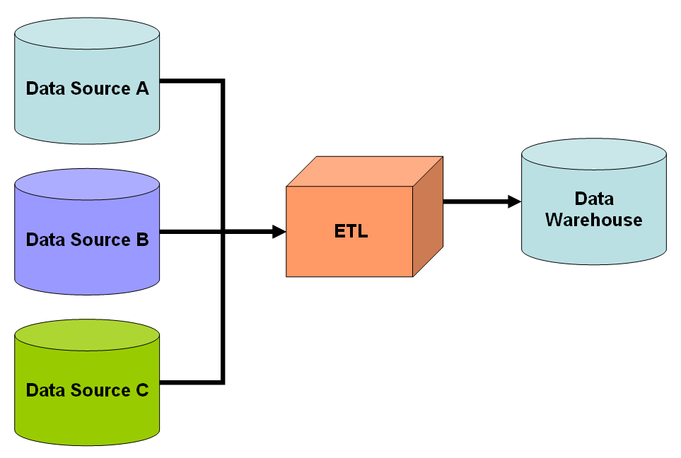
ETL
Public Domain, https://en.wikipedia.org/w/index.php?curid=4780404

Slide 7
Steps
Data Extraction: process of extracting raw data from one or more homogenous or heterogeneous sources.
Data Transformation: series of processes that manipulate the data in order to make it fit for the intended destination and use.
Some people prefer ECTL giving the data cleaning task the same importance as the others.
Data Load: process of loading the data to the final destination.
Those three steps can be run sequentially or in parallel depending on the situation (infrastructure, need for human intervention,...)
Processes are usually group and run as batch jobs
They often use a Staging area that allows to temporally store intermediate data and work on it in the Transform step.

Slide 8
Extract
Load
Transform

Slide 9
Ciclo ETL
Inicio ciclo
Construcción datos de referencia
Extracción de datos de las fuentes
Almacenar en ara temporal
Validación
Limpieza
Transformación
Almacenamiento temporal
Auditoria
Carga en tablas destino
Archivo

Slide 10
Transformation functions
EXTRACTION
LOADING
Relational Database
Source
Target
Non-Relational Source
Staging

Slide 11
Simplified ETL
Target Database
Source 1
Source 2
Source 3
When all sources use the same schema and the data is independent the transform step can be skipped.
For example, a distributed organisation using the same database schema for the source and target databases.
If the datasets acquired in each location are independent the data from each source can be inserted directly in the target database.

Slide 12
Contenido
Introducción
Extracción de datos
Limpieza de datos
Transformación de datos
Carga de datos
Herramientas ETL

Slide 13
Extract
Load
Transform

Slide 14
Data Extraction
The main objective of the extract step is to retrieve all the required data from the source system with as little resources as possible.
The extract step should be designed in a way that it does not negatively affect the source system in terms or performance, response time or any kind of locking.
Common data-source formats include relational databases, XML, flat files (CSV), Excel spreadsheets, but may also include non-relational database structures.

Slide 15
Reasons for using a Staging Area
The source systems are only available for a specific period of time to extract data.
This period of time is less than the total data-load time.
A staging area allows you to extract the data from the source system before the time slot ends.
You want to get the data from multiple sources together or you want to join data from two or more systems.
For example, you will not be able to perform a SQL query joining two tables from two physically different databases.
Data extractions’ time slots for different systems vary as per the time zone and operational hours.
Data extracted from source systems can be reused in multiple data warehouse system, Operation Data stores, etc.
You need to perform complex transformations.

Slide 16
Extracting Data to Staging Area
Data is first extracted from the source system and placed in a staging area.
This staging area is typically formatted like the source system.
Keeping data in the same format as the source makes the first extract simple and avoids bogging the source system down.
You most likely will want to process only changed data, to avoid the overhead of reprocessing the entire set of data.
This could be done by extracting data based on date/time information on the source system, mining change logs or by examining the data to determine what changed.
Tip 1: Make sure the source system date/time information is consistently available. Use data profiling to validate.
Tip 2: Store a copy of the prior version of data in the staging area so that it can be compared to the current version to determine what changed.
Tip 3: Calculate check sums for both current and prior versions, then compare check sums rather than multiple columns. This speeds up processing.
Tip 4: Add a source system prefix to table names in the staging area. This helps to keep data logically segregated.

Slide 17
Data Extraction Strategies
Update notification - if the source system is able to provide a notification that a record has been changed and describe the change, this is the easiest way to get the data.
Incremental extract - some systems may not be able to provide notification that an update has occurred, but they are able to identify which records have been modified and provide an extract of such records. During further ETL steps, the system needs to identify changes and propagate it down. Note, that by using daily extract, we may not be able to handle deleted records properly.
Full extract - some systems are not able to identify which data has been changed at all, so a full extract is the only way one can get the data out of the system. The full extract requires keeping a copy of the last extract in the same format in order to be able to identify changes. Full extract handles deletions as well.

Slide 18
Extract
Load
Transform

Slide 19
Data Transformation
In data transformation, you apply a set of functions on extracted data to load it into the target system.
Data, which does not require any transformation is known as direct move or pass through data.
Data cleaning is a particularly important part of this, it assures the quality of the data, and it is sometimes counted as a separated step.

Slide 20
Contenido
Introducción
Extracción de datos
Limpieza de datos
Transformación de datos
Carga de datos
Herramientas ETL

Slide 21
Extract
Load
Transform
Clean

Slide 22
Calidad de datos: criterios
Validez: el grado de conformidad con el que satisfacen las restricciones o reglas de negocio.
Tipo.
Rango.
Necesidad.
Unicidad.
Cumplimiento de un patrón.
Exactitud: como se ajusta el valor a un valor estándar o verdadero.
Puede requerir fuentes de datos externas para comprobarlo.
Completitud: el grado de conocimiento de todos los valores.
Consistencia: el grado de coincidencia de los valores en dos o más sistemas distintos.
Uniformidad: el grado de coincidencia en el uso del mismo sistema de unidades o equivalente.

Slide 23
Clasificación problemas de calidad en las fuentes
Fuente única
De esquema
De instancia
Múltiples fuentes
De esquema
De instancia
Integridad referencial
Unicidad
Redundancia/duplicados
Erratas
Valores contradictorios
Conflicto de nombres
Conflictos estructurales
Agregación inconsistente
Sincronización

Slide 24
Limpieza de datos
Se utiliza para asegurar la calidad de los datos
Se trata de descubrir registros de datos erróneos en una base de datos
Corregir
O eliminar el registro erróneo.
Cuando integramos datos debemos asegurar la correcta asociación de la información proveniente de distintas fuentes

Slide 25
Ejemplos
Utilización de identificadores de forma coherente
Sexo: (Hombre/Mujer/Desconocido),(H/M/F),(Masculino/Femenino/NE),(M/F/D)
Boolean: Si/No, Verdadero/Falseo,1/0
Convertir valores null en formas estandarizadas (No Especificad/No Disponible)
Convertir direcciones, códigos postales y teléfonos a formas estandarizadas
Ejemplo: guardar todos los teléfonos con el prefijo internacional
Validar nombres de las calles
Y convertir a una convención, por ejemplo, expandir las abreviaturas Avda -> Avenida
Validar los indicadores geográficos unos con respecto a otros
Que el código postal corresponde a la dirección

Slide 26
Métodos
Análisis: detección de errores de sintaxis.
Un analizador gramatical decide si una cadena de datos es aceptable en el contexto.
Mapeado de Datos: crear un mapa de datos, en el formato esperado. Esto incluye conversiones de valor o funciones de traducción así como normalización de valores numéricos para conformarse a valores mínimos y máximos.
Eliminación de duplicados: La detección de duplicados requiere un algoritmo para determinar si los datos contienen representaciones dobles de la misma entidad. Por lo general, los datos son ordenados por un dato "llave" o "pivote" que permite la identificación más rápida.
Método Estadístico: Incluye analizar los datos usando promedios, desviación estándar, rangos, o algoritmos de cluster, este análisis se realiza por expertos que identifican errores.

Slide 27
Incompletitud e inconsistencia
Datos incompletos son los que para una entidad dada no contienen toda la información definida en el esquema global.
En tal caso los datos pueden ser rechazados o no, depende de las reglas que tengamos para nuestro caso de uso.
Posibles remedios:
Si se espera que los datos sean completos, buscar el origen del fallo.
Datos inconsistentes
Cuando los datos referidos a la misma entidad presentan valores distintos para el mismo atributo
O informaciones inconsistentes en distintos atributos
Nuevos datos médicos para individuo fallecido según otra fuente

Slide 28
Missing, Incomplete and Wrongly Formatted Data
Common problems that may require correction are missing data, incomplete data and wrongly formatted data.
In the case of missing data, a complete column such as zip code or first name is empty.
A tool could correct the zip code based on look up of address lines, city and state. Incomplete data is partially missing such as the case where an address contains the name of a street without the building number.
Tools are available that can correct some of these problems.
Finally, data may be in the wrong format. We may want telephone numbers to contain hyphens. A tool could consistently format telephone numbers.

Slide 29
Contenido
Introducción
Extracción de datos
Limpieza de datos
Transformación de datos
Carga de datos
Herramientas ETL

Slide 30
Extract
Load
Transform

Slide 31
Data Transformation
In data transformation, you apply a set of functions on extracted data to load it into the target system.
Data, which does not require any transformation is known as direct move or pass through data.
Data cleaning is a particularly important part of this, it assures the quality of the data, and it is sometimes is counted as a separated step.
You can apply different transformations on extracted data from the source system.
Customised calculations.
For example, if you have the first name and the last name in a table in different columns, you can use concatenate before loading.
Conversion of measured data to the same dimension (i.e. conformed dimension) using the same units so that they can later be joined.
The transformation step also requires joining data from several sources, generating aggregates, generating surrogate keys, sorting, deriving new calculated values, and applying advanced validation rules.

Slide 32
Transformation operations
Data validation.
Coding values.
Translating coded values to homogenous code.
Deriving new calculated values.
Aggregating.
Generating surrogate key values.
Splitting a column into multiple columns. Disaggregating repeating columns
Looking up and validating the relevant data from tables or referential files

Slide 33
Contenido
Introducción
Extracción de datos
Limpieza de datos
Transformación de datos
Carga de datos
Herramientas ETL

Slide 34
Extract
Load
Transform

Slide 35
Data Load
During Load phase, data is loaded into the end-target system that can be
a flat file
a database
a Data Warehouse system.
It is necessary to ensure that the load is performed correctly and with as little resources as possible.
The target of the Load process is often a database. In order to make the load process efficient, it is helpful to disable any constraints and indexes before the load and enable them back only after the load completes. The referential integrity needs to be maintained by ETL tool to ensure consistency.

Slide 36
ETL uses
Creation of:
Data Warehouses
Operational Data Stores
Data Marts
Data hubs
Data lakes
Data integration
Data migration
Master data management

Slide 37
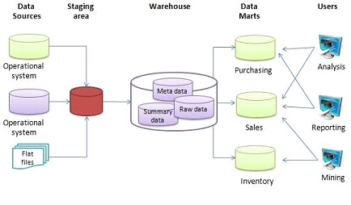
Data Warehouse
In the late 1980s and early 1990s, data warehouses came onto the scene.
A distinct type of database, data warehouses provided integrated access to data from multiple systems – mainframe computers, minicomputers, personal computers and spreadsheets.

Slide 38
Operational Data Stores
An operational data store is used for operational reporting and as a source of data for the enterprise data warehouse.
An operational data store will take transactional data from one or more production system and loosely integrate it
An operational data store (or "ODS") is a database designed to integrate data from multiple sources for additional operations on the data, for reporting, controls and operational decision support. Unlike a production master data store, the data is not passed back to operational systems. It may be passed for further operations and to the data warehouse for reporting.
Because the data originate from multiple sources, the integration often involves cleaning, resolving redundancy and checking against business rules for integrity. An ODS is usually designed to contain low-level or atomic (indivisible) data (such as transactions and prices) with limited history that is captured "real time" or "near real time" as opposed to the much greater volumes of data stored in the data warehouse generally on a less-frequent basis.

Slide 39
Data Marts
A data mart is the access layer of the data warehouse environment that is used to get data out to the users. The data mart is a subset of the data warehouse and is usually oriented to a specific business line or team.
Often holds only one subject area- for example, Finance, or Sales
May hold more summarized data (although may hold full detail)
Concentrates on integrating information from a given subject area or set of source systems
Is built focused on a dimensional model using a star schema.

Slide 40
Data Hub
A data hub is a collection of data from multiple sources organized for distribution, sharing, and often subsetting and sharing. Generally this data distribution is in the form of a hub and spoke architecture.
A data hub differs from a data warehouse in that it is generally unintegrated and often at different grains. It differs from an operational data store because a data hub does not need to be limited to operational data.
A data hub differs from a data lake by homogenizing data and possibly serving data in multiple desired formats, rather than simply storing it in one place, and by adding other value to the data such as de-duplication, quality, security, and a standardized set of query services. A Data Lake tends to store data in one place for availability, and allow/require the consumer to process or add value to the data.

Slide 41
Data Lake
A data lake is a storage repository that holds a vast amount of raw data in its native format until it is needed. While a hierarchical data warehouse stores data in files or folders, a data lake uses a flat architecture to store data.
The idea of data lake is to have a single store of all data in the enterprise ranging from raw data (which implies exact copy of source system data) to transformed data which is used for various tasks including reporting, visualization, analytics and machine learning. The data lake includes structured data from relational databases (rows and columns), semi-structured data (CSV, logs, XML, JSON), unstructured data (emails, documents, PDFs) and even binary data (images, audio, video) thus creating a centralized data store accommodating all forms of data
A data swamp is a deteriorated data lake

Slide 42
Contenido
Introducción
Extracción de datos
Limpieza de datos
Transformación de datos
Carga de datos
Herramientas ETL

Slide 43
Herramientas ETL
Una herramienta ETL es una aplicación o conjunto de aplicaciones
Extrae datos de varias fuentes de datos
Bases de datos
Otro tipo de fuentes, dependiendo de la herramientas
Transforma los datos
Realiza cálculos
Concatena o separa cadenas de caracteres
Etc.
Carga los datos al Sistema destino
Proporcionan una vista consolidad para soporte de decisiones y otras aplicaciones
Codifican y reúsan procesos que mueven y transforman datos sin requerir escribir código o scripts

Slide 44
Commercial ETL Tools
Ab Initio.
IBM InfoSphere DataStage.Informatica.
Oracle Data Integrator.
SAP Data Integrator.

Slide 45
Open source ETL Tools
Apatar
CloverETL
Pentaho Data Integration (Kettle)
Talend
Scriptella
Jaspersoft ETL

Slide 46
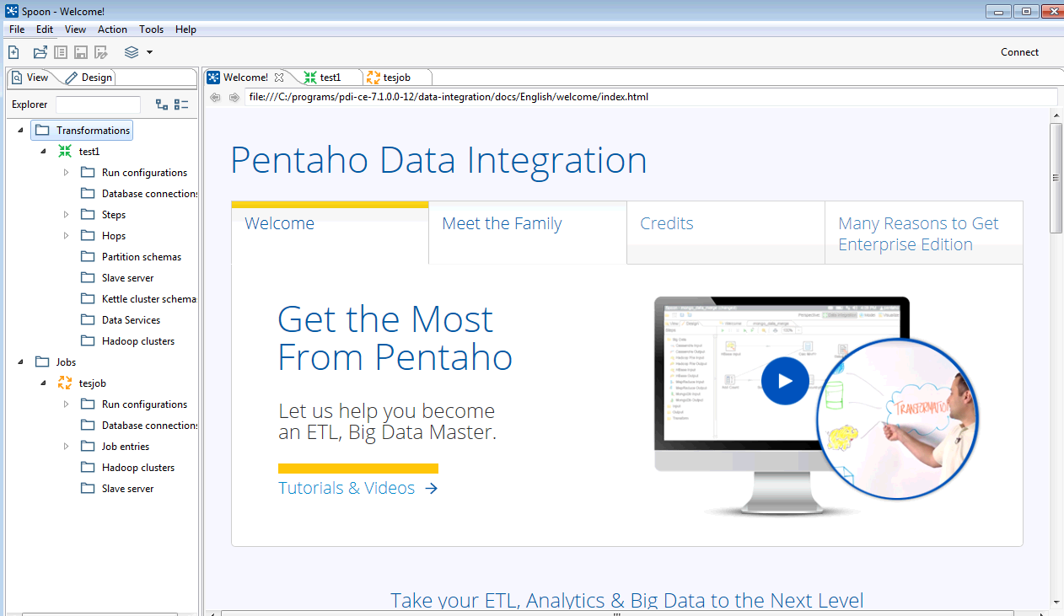
Kettle Spoon

Slide 47
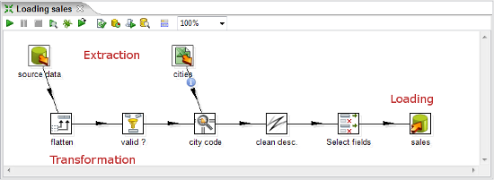
ETL

Slide 48
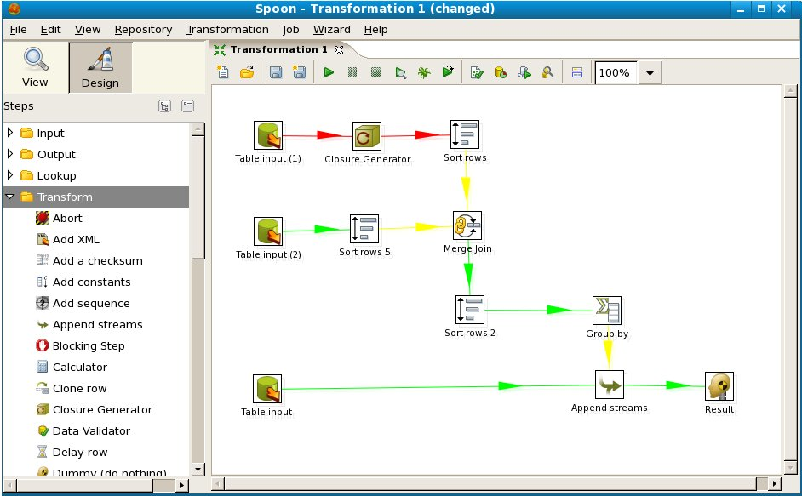

Slide 49
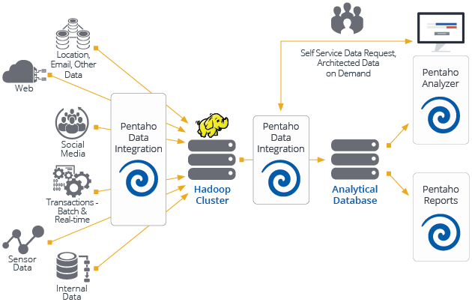
https://www.rowellbelen.com/sdr-with-pentaho-data-integration/

