Slide 1

AVOCADO Horse Racing

Slide 2
Using Excel to Analyse Horseraces
Odds:
x to 1 of a horse
Number of runners
Number of horses running per race
Favourites
The first favourite of every race
Extension
Looked at Grand National Results
Notes:
For 300 races, we were given the data of the first five positions. Each race with a favourite horse. Using this data, we could add analyse the odds, number of runners and if a horse is a favourite will affect its chance of winning. For the extension, we looked at the Grand National results to see if they follow the same patterns we’ve found.

Slide 3
Odds of a horse
Starting Prices/Odds
Position:
Winning horses peaked at 1≤x<3 , only one horse had x≥50.
Higher positions tend to have lower starting prices.
Linear relationship.
Standard deviation:
Winning and second position horses has the smallest spread of data.
As the position increases, the standard deviation also increases. 🐘
Favourite:
Won 39.67% of the time with 1<=x<2 being the most frequent

Slide 4
Number of Runners
6 runners per race has the most frequency and proportion of wins.
Frequency of wins generally decrease as runners increase but proportion acts differently.

Slide 5
Does the favourite win more often?
Win 39.67% of the time.
More likely to finish in a higher position within the race.
Has not finished any later than 11th.
Win 2 or 3 races per meeting more frequently than others.
On average, they won 2.38 times per meeting.

Slide 6
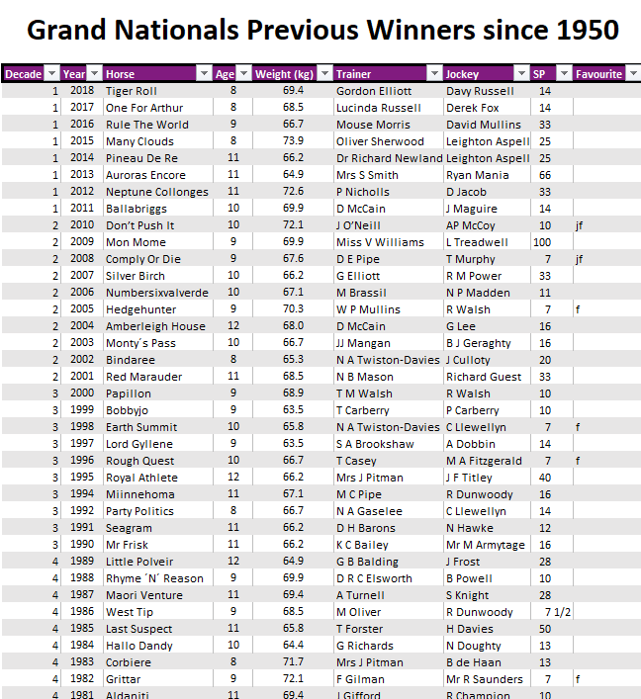
The Grand National Results https://www.grandnational.org.uk/previous-winners.php
Notes:
As said by Jenny, we’ve decided to expand our research into the Grand National Results,
The results gave us 8 variables in which we can form comparative and descriptive statistics.
In this extension we’ve decided to focus more towards these 3 sections : Age, Starting Price and Weight.

Slide 7
Age
Fig 1
Fig 2
Fig 3
Notes:
So, the first variable was Age
This is where we found the distribution between the age and the win frequency of the horses.
As seen from fig(1) 9 is the modal age group with a total of 22 wins
From figure isn't really a visible trend between win frequency and age due to the lack of age groups, however from what we’ve attained we can only assume that as the age tends to a higher number, the win frequency of the horse decreases (as seen from 10, 11 and 12.
To further extend on age we’ve decided to find the distribution between the win frequency within the decade and the age of horses (as seen from fig(3), and our findings determined that the majority of the wins of the horses happens to be between age 9 and 10.
From this we can conclude that the punters (bettors) should generally bet on horses that are aged between 9-10 in order to maximise their profits based on previous winnings and our statistical findings

Slide 8
Starting Price
Notes:
So, the second variable we’ve looked at was the starting prices.
This is where we found the distribution between the starting price and the win frequency of the horses.
Similarly with our previous analysis with odds, the win frequency tends to decrease as the starting prices increases, thus further supporting our findings which Jenny stated.

Slide 9
Weight Class
Fig 1
Fig 2
Class No. | Winning weight classes (kg) |  |  |  |  | Frequency
1 |  |  | x | < | 60 | 0
2 | 60 | ≤ | x | < | 62.5 | 0
3 | 62.5 | ≤ | x | < | 65 | 14
4 | 65 | ≤ | x | < | 67.5 | 18
5 | 67.5 | ≤ | x | < | 70 | 20
6 | 70 | ≤ | x | < | 72.5 | 9
7 | 72.5 | ≤ | x | < | 75 | 6
8 | 75 | ≤ | x | < | 77.5 | 1
9 | 77.5 | ≤ | x | < | 80 | 0
10 | 80 | ≤ | x |  |  | 0
total |  |  |  |  |  | 68
average weight |  |  |  |  |  | 68.052195
Fig 3
Notes:
The third variable we’ve decided to study was weight.
Where we’ve found the distribution between weight classes and win frequency.
From figure 3 we can see that the modal weight class is 5 that being between 67.5kg and 70kg with an overall 20 wins.
Weight class 65 ≤ kg<70 makes up 55% of the overall wins.
From this we can conclude that the punters (bettors) should generally bet on horses weighing within class 5 in order to maximise their profits based on previous winnings and our statistical findings

