Slide 1
Updates 3/29
Rachel Holman, Grace Davenport, Lily Jarrett, Hana Nur
Notes:
Predicting Land-Suitability by County for Various CO2 Removal Technologies

Slide 2
Meeting Agenda
Review df
Scaled data
Aggregated by year
Unsupervised Learning
Clustering
Supervised Learning
Random Forest
KNN
Neural Net
Logistic Regression
Naive Bayes
Gradient Boosting

Slide 3
Dataframe

Slide 4
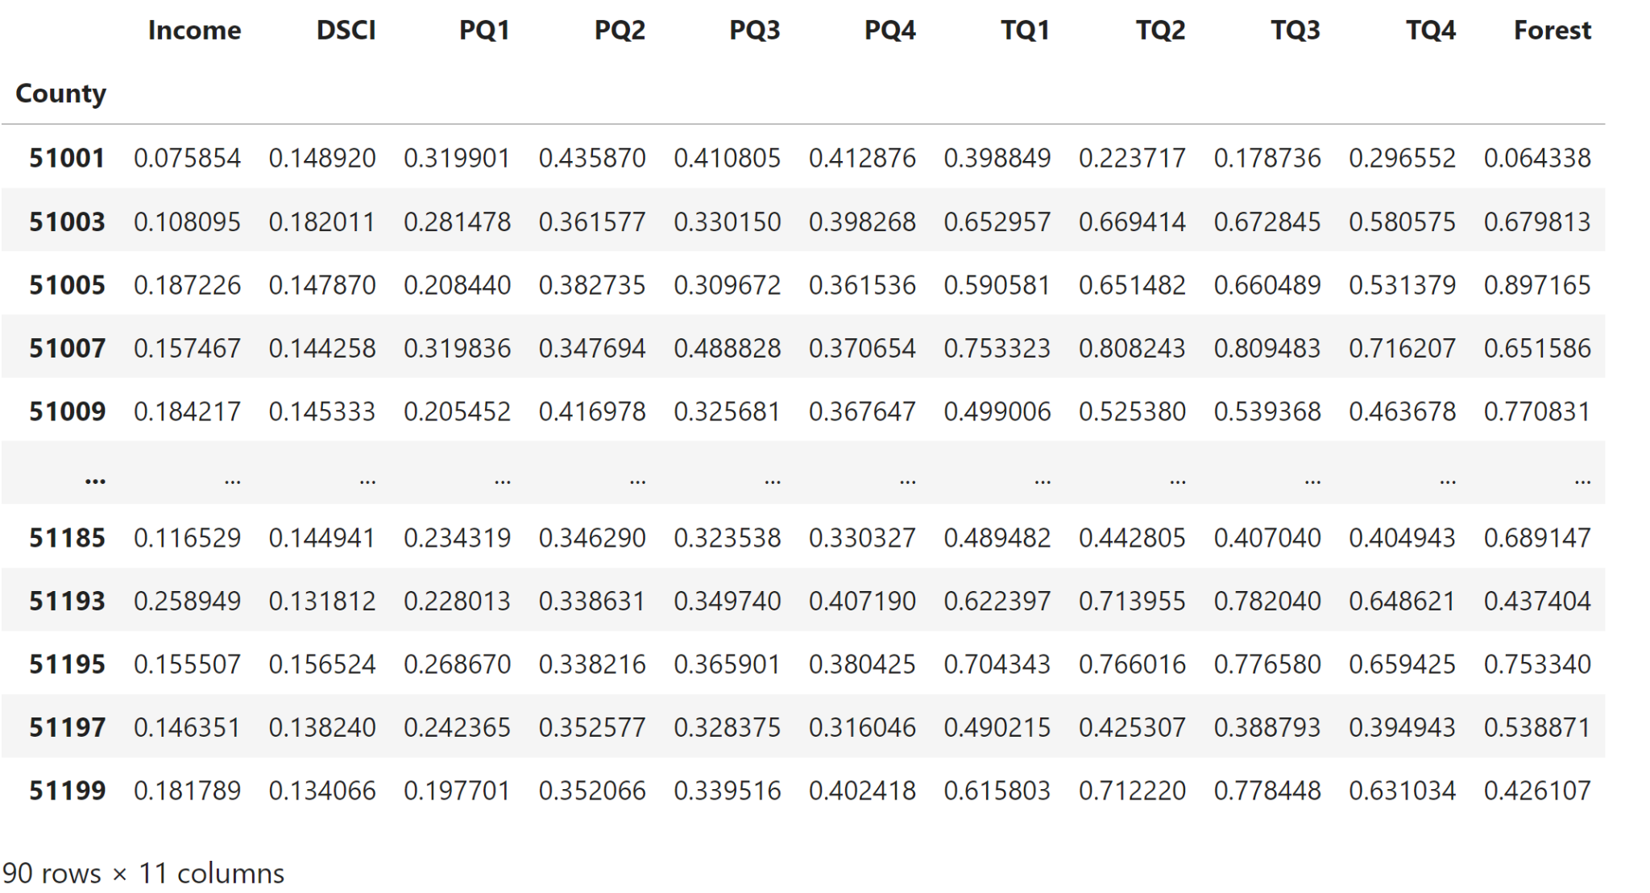

Slide 5
Unsupervised Learning

Slide 6
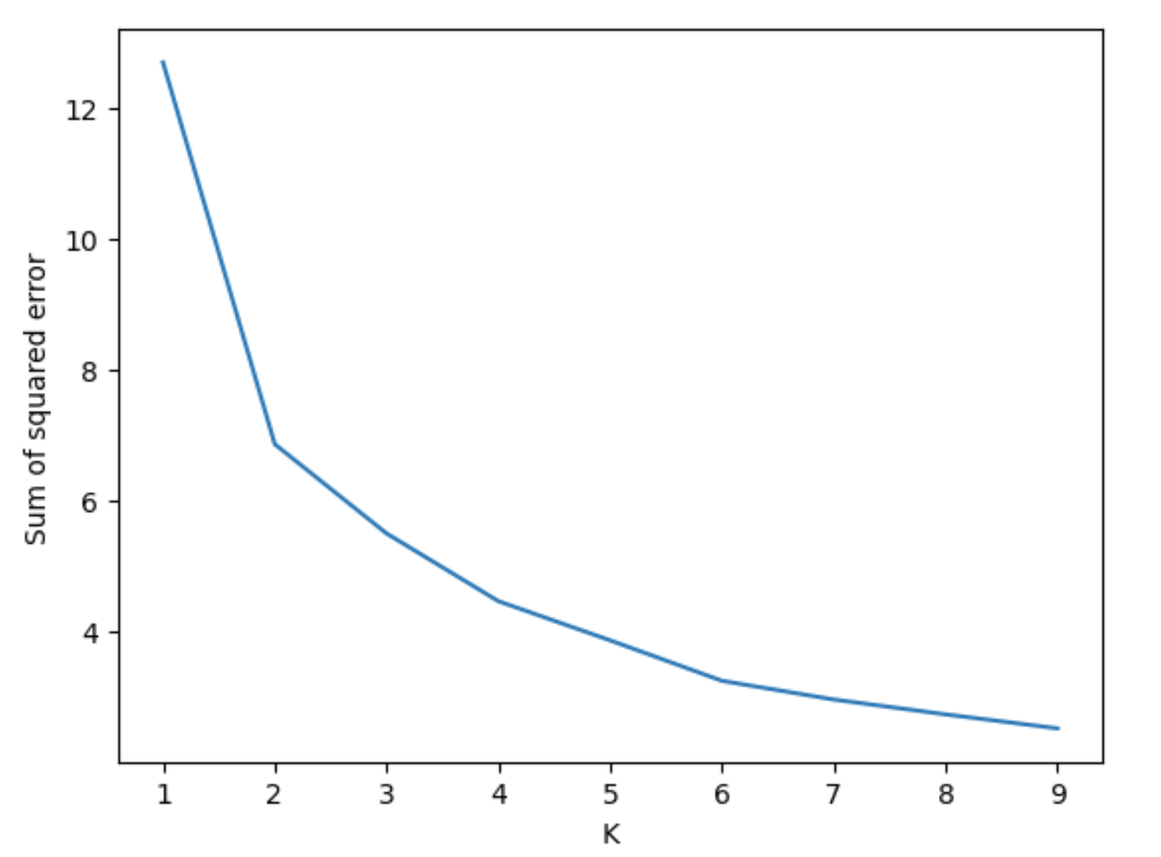
Clustering
k_rng = range(1, 10)
sse = []
for k in k_rng:
km = KMeans(n_clusters=k, n_init=10)
km.fit(df)
sse.append(km.inertia_)
hc = Agglomerative Clustering(n_clusters=4, affinity = 'euclidean', linkage = 'ward')
Notes:
the SSE (Sum of Squared Errors) is computed by summing the squared distances of each data point to its assigned cluster centroid.

Slide 7
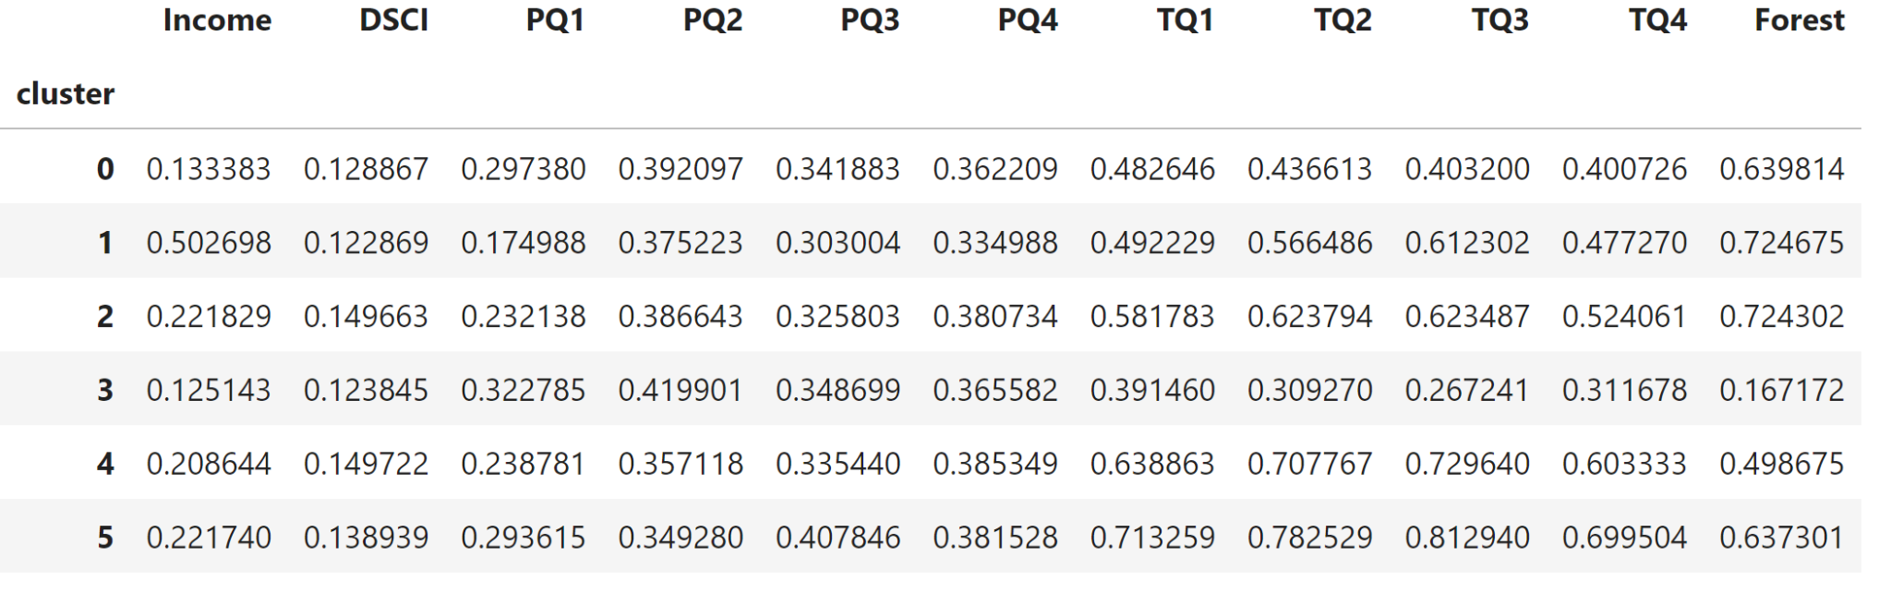
Clustering Cont.

Slide 8
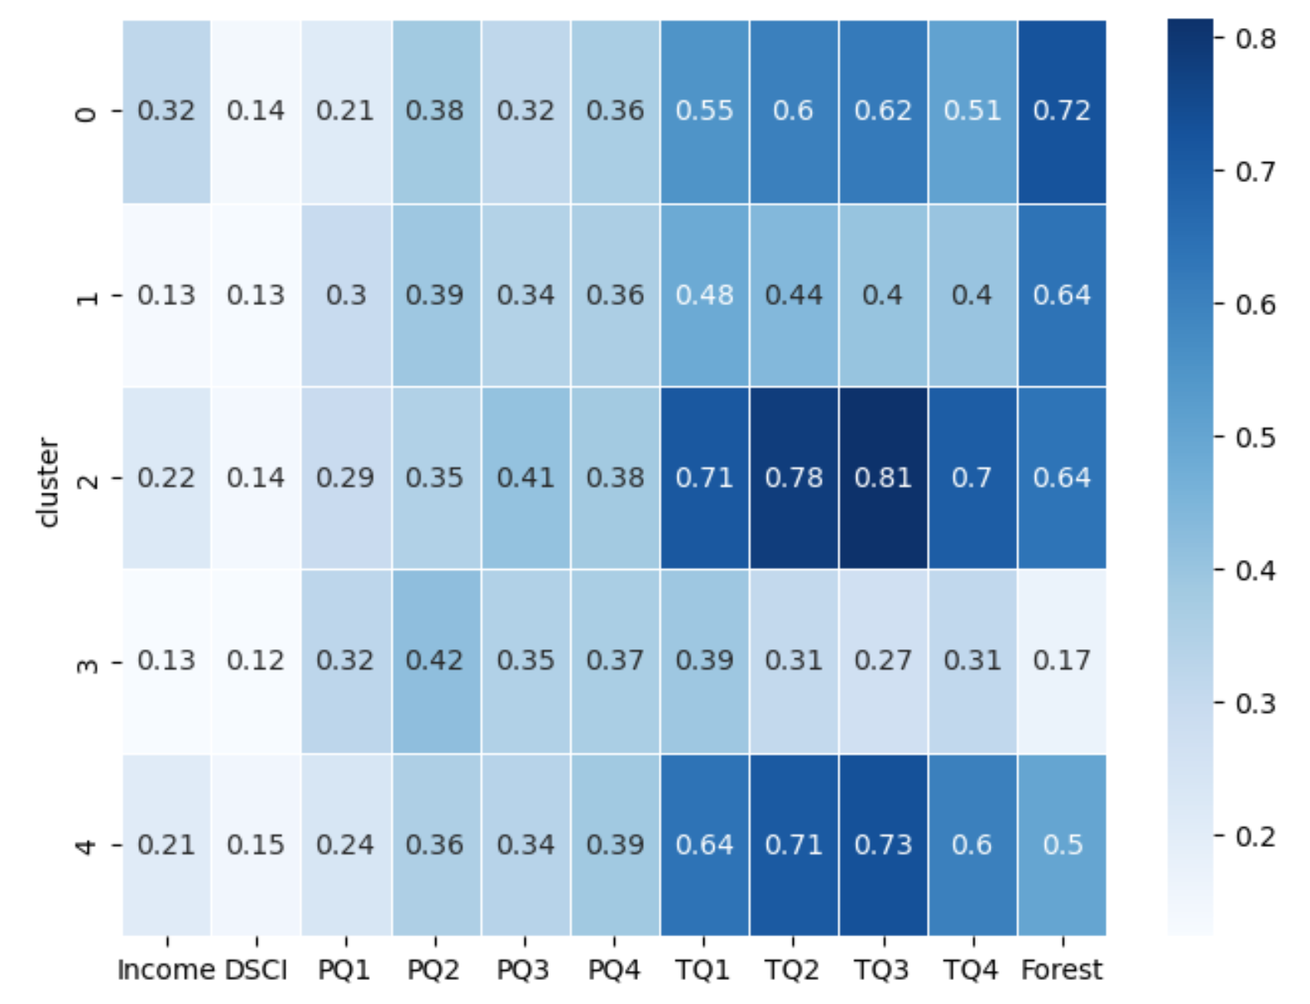
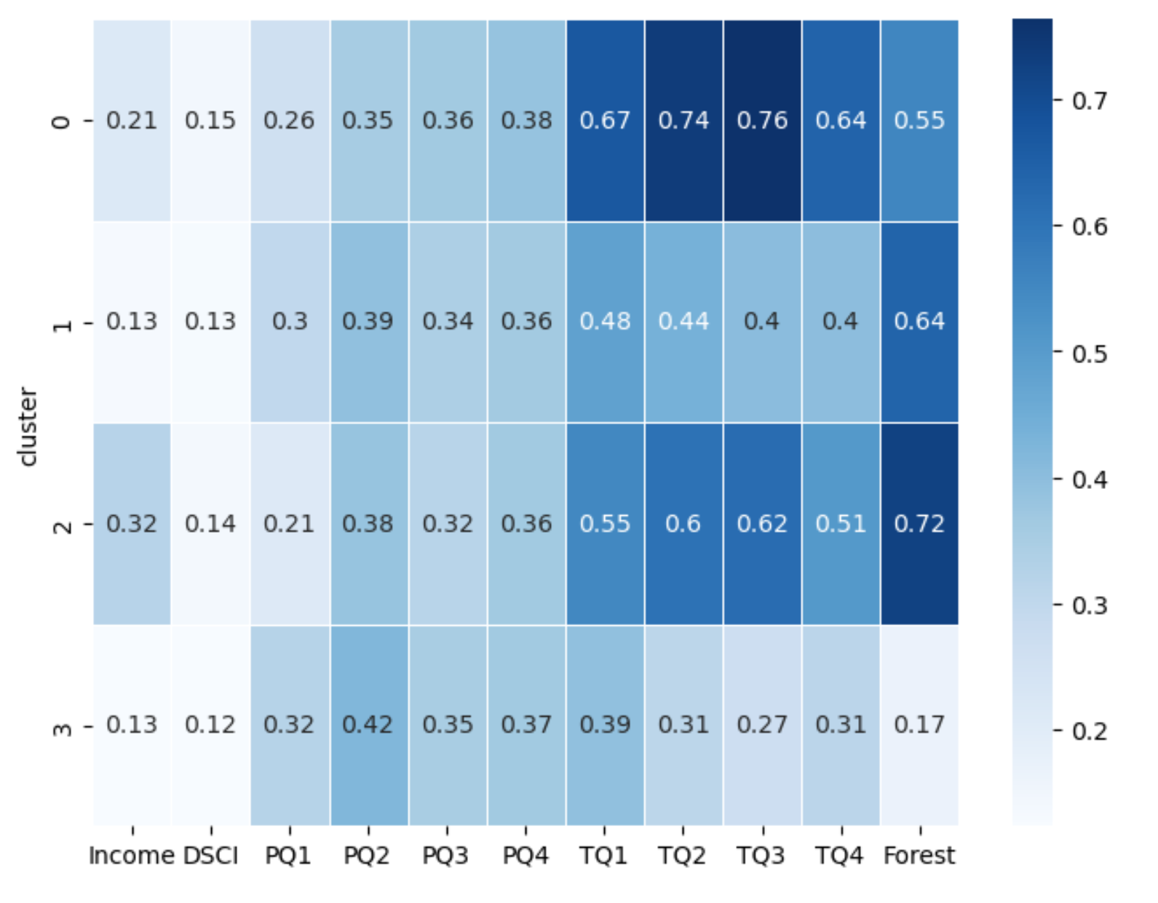
k = 5
k = 4
Possible
Suitable
Highly Suitable
Unsuitable
sns.heatmap(df_cluster, annot=True, cmap="Blues", linewidths=.5)

Slide 9
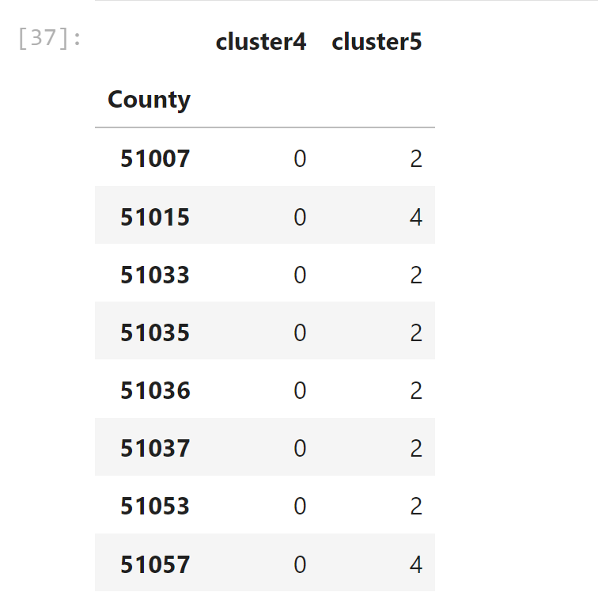
Change from 4 clusters to 5 clusters
Cluster 0 is being split into 2 clusters (2 and 4)
All other clusters remain distinct

Slide 10
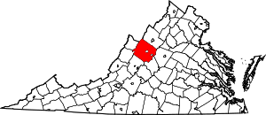
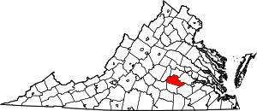
4 Clusters
5 Clusters
Augusta County
Amelia County

Slide 11
Supervised Learning

Slide 12
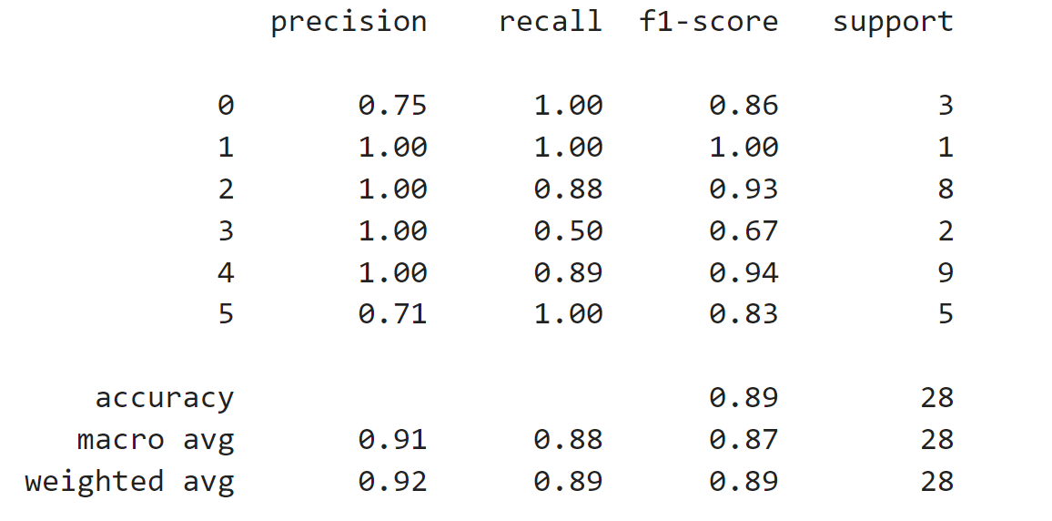
Random Forest

Slide 13
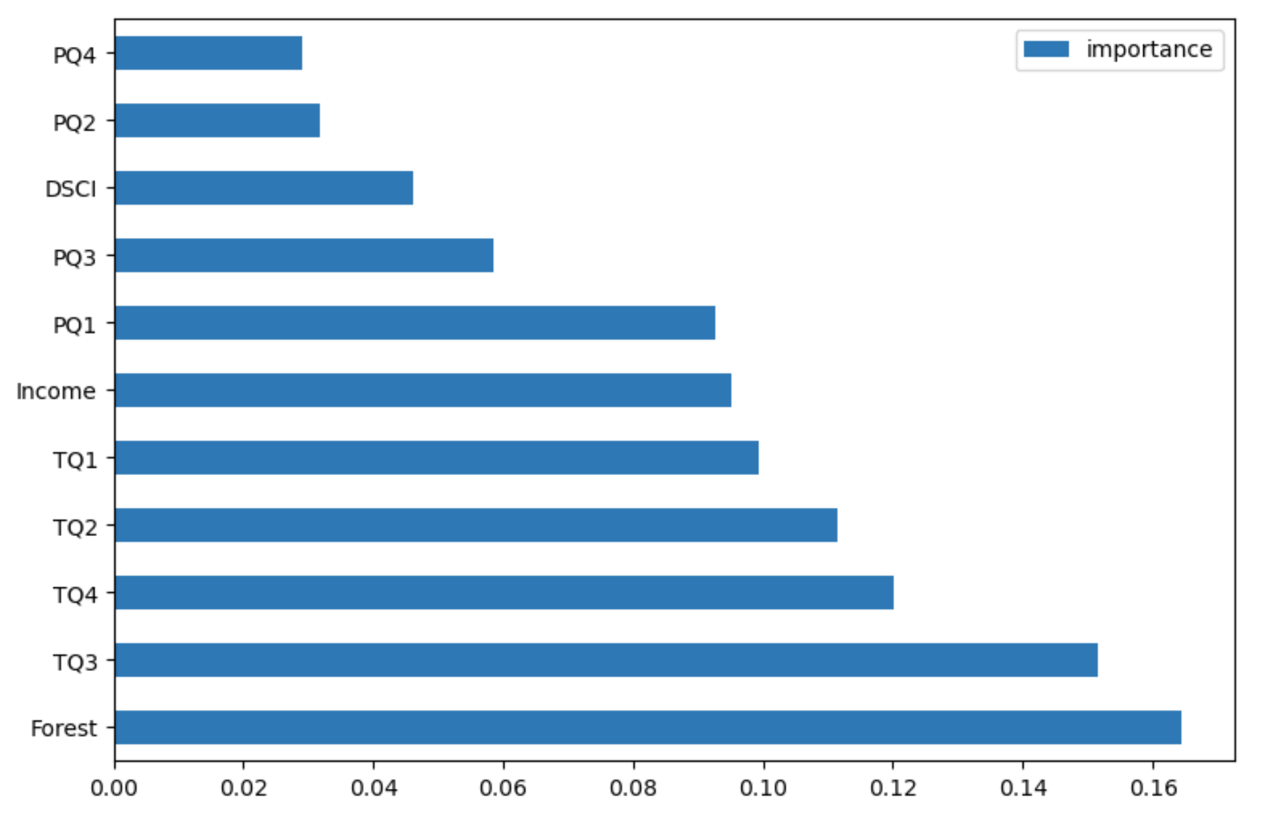
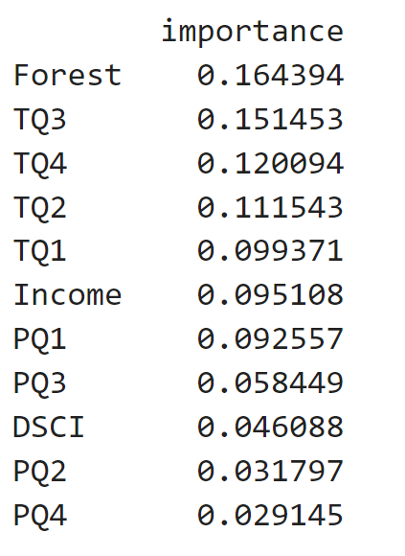
feature_imp = pd.DataFrame(rf.feature_importances_,index= X_train.columns, columns=['importance']).sort_values('importance',ascending=False)

Slide 14
Gradient Boosting
clf = GradientBoostingClassifier(n_estimators=100,learning_rate=1.0, max_depth=1, random_state=0).fit(X_train, y_train)
clf.score(X_test, y_test)
0.7857142857142857

Slide 15
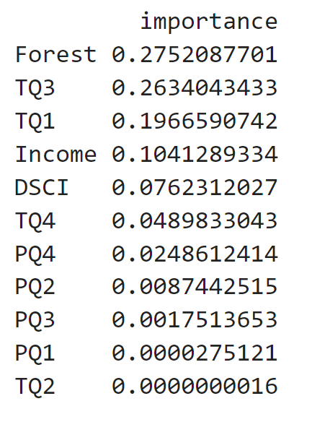
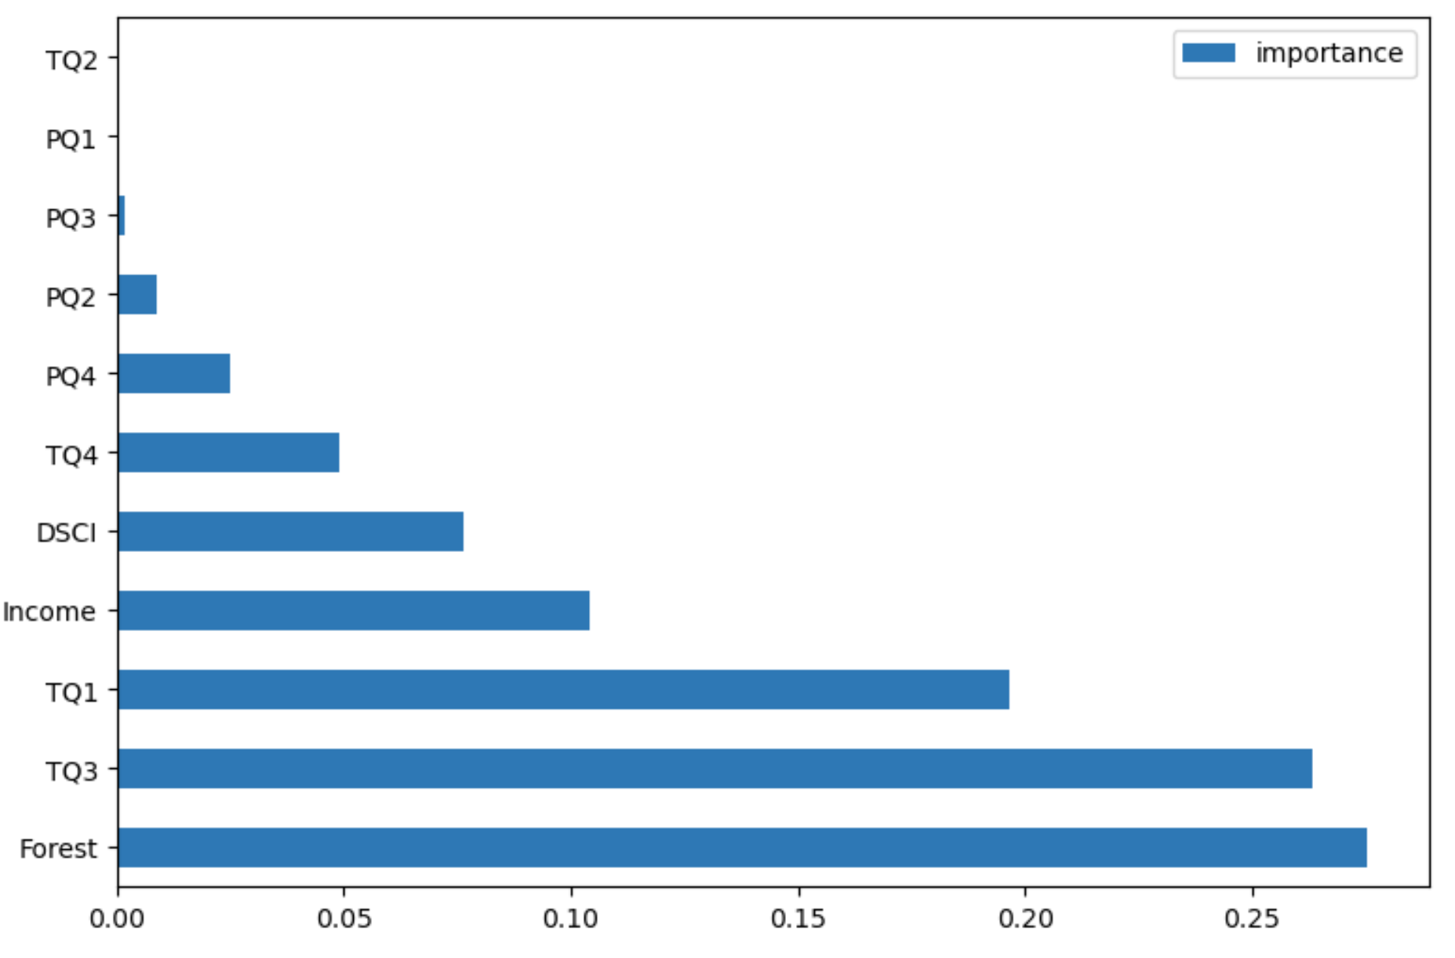
feature_imp = pd.DataFrame(clf.feature_importances_,index= X_train.columns,columns=['importance']).sort_values('importance',ascending = False)

Slide 16
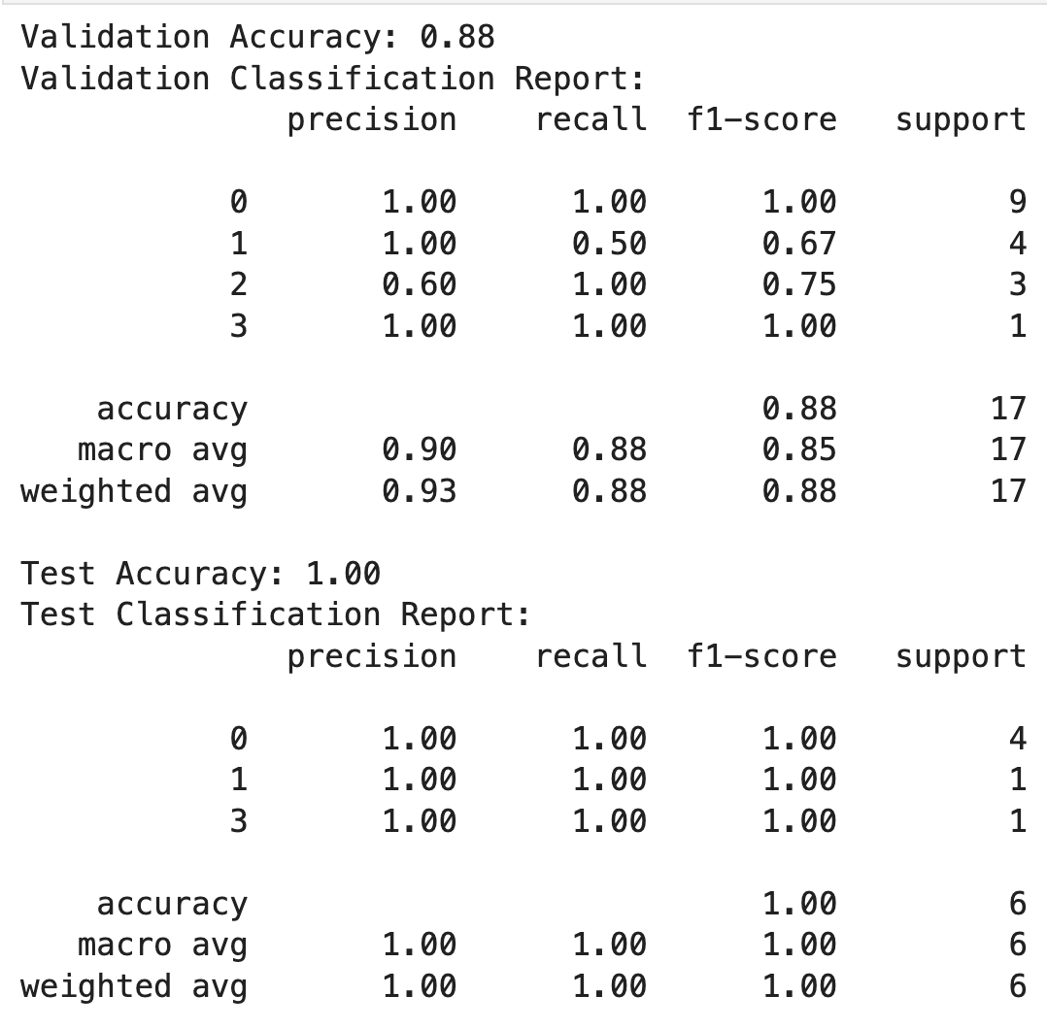
KNN

Slide 17
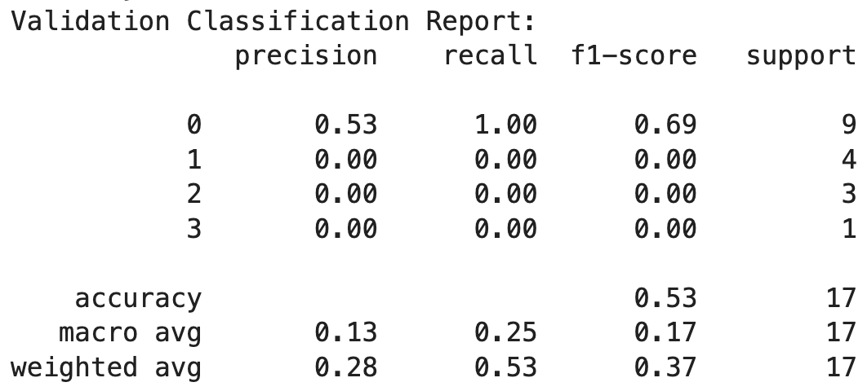
Naive Bayes

Slide 18
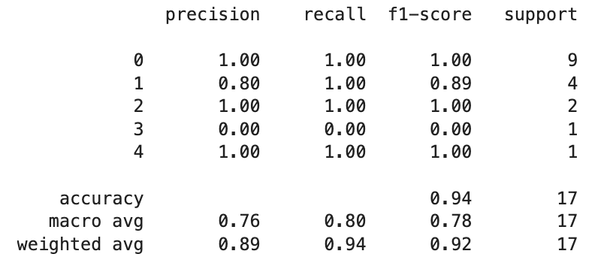
Feed-Forward ANN
(sklearn MLPClassifier)
clf = MLPClassifier(random_state=1, max_iter=300).fit(X_train, y_train)
clf.score(X_val, y_val)
0.9411764705882353

Slide 19
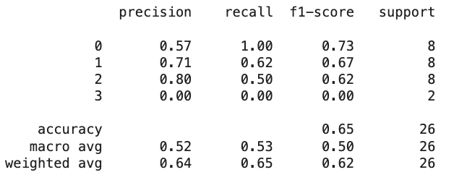
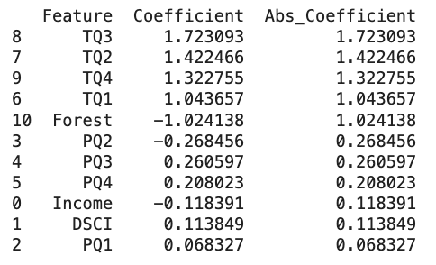

Logistic Regression
Notes:
In progress

Slide 20
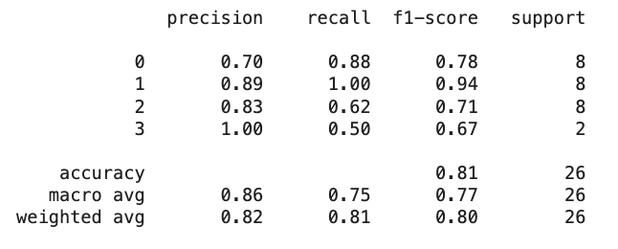

Decision Tree
(sklearn DecisionTreeClassifier)

