Slide 1

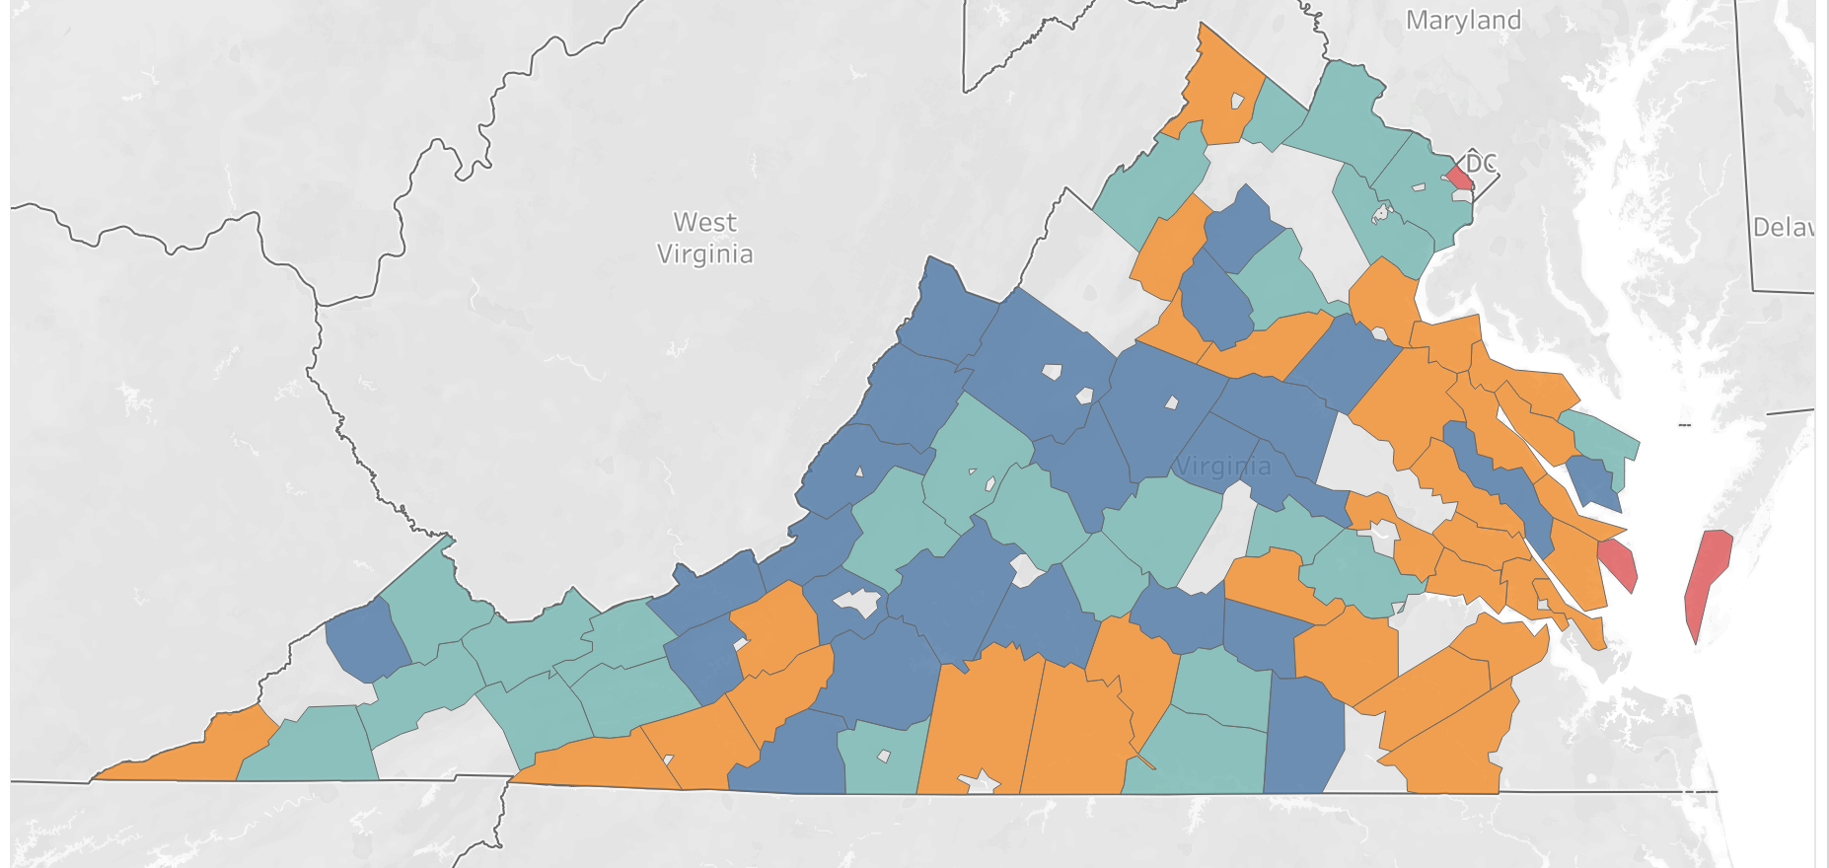
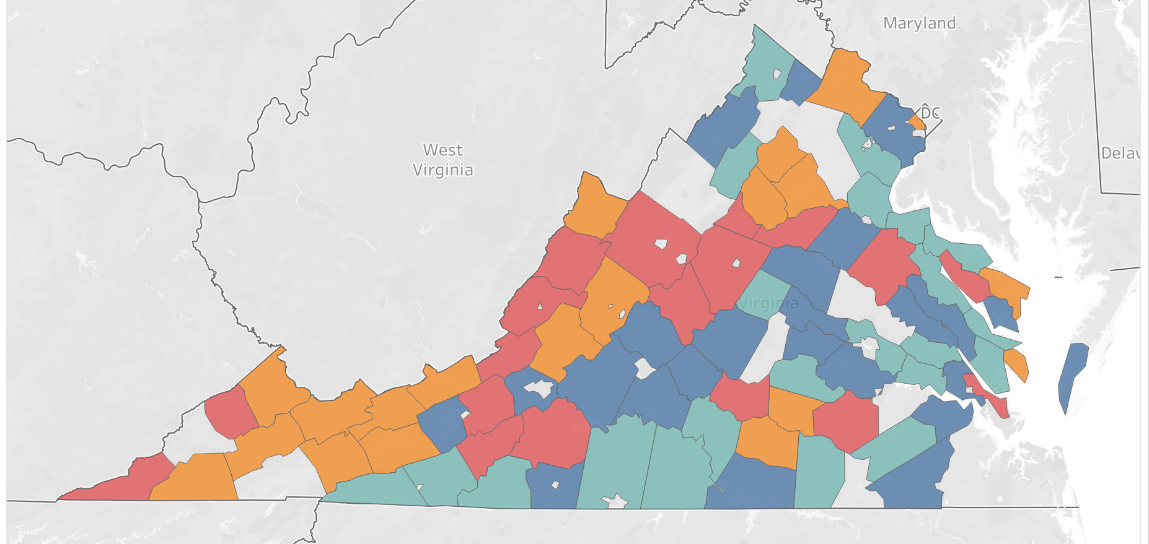
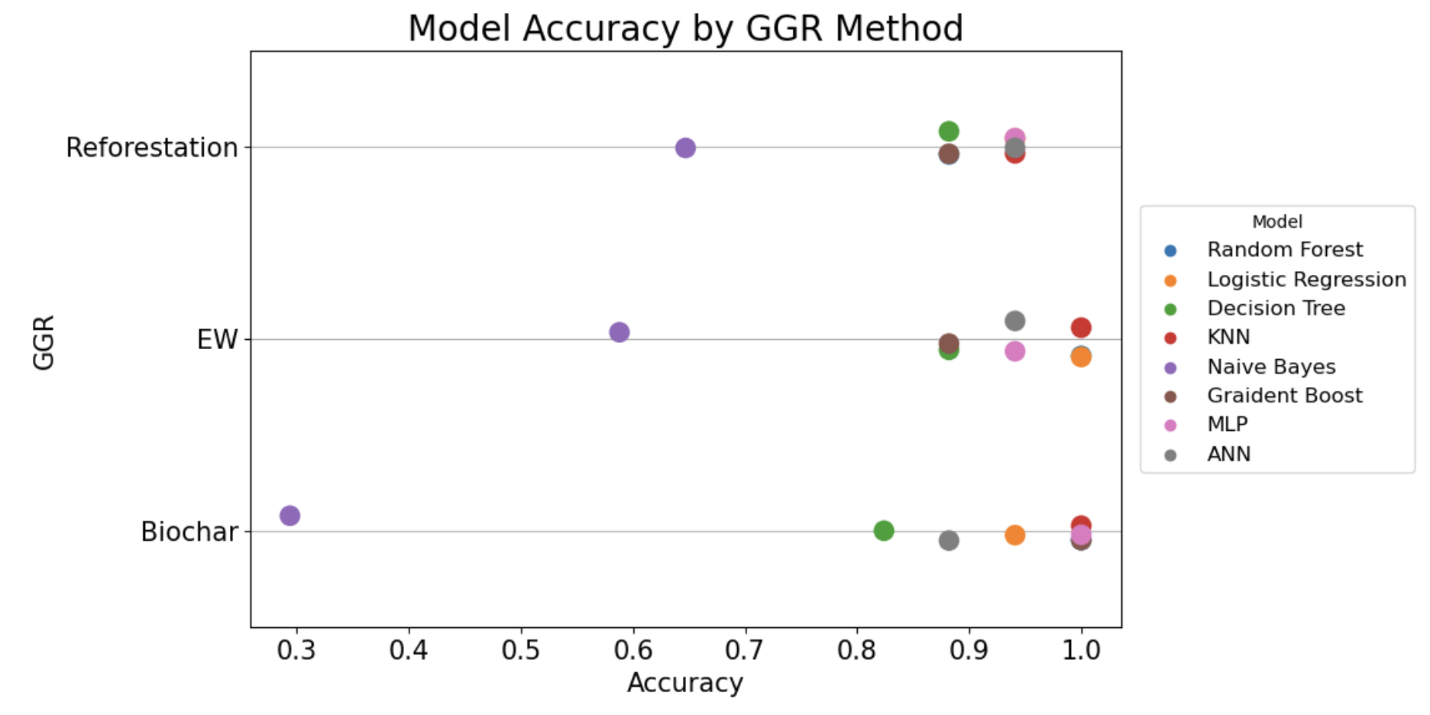
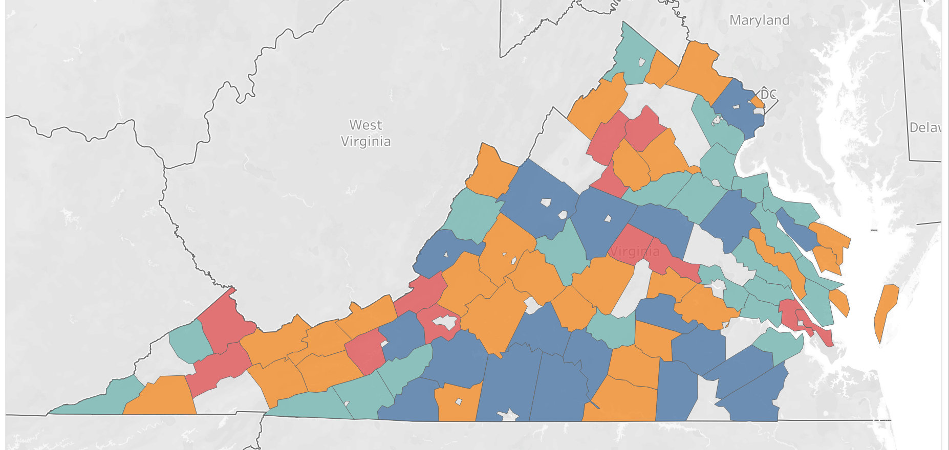
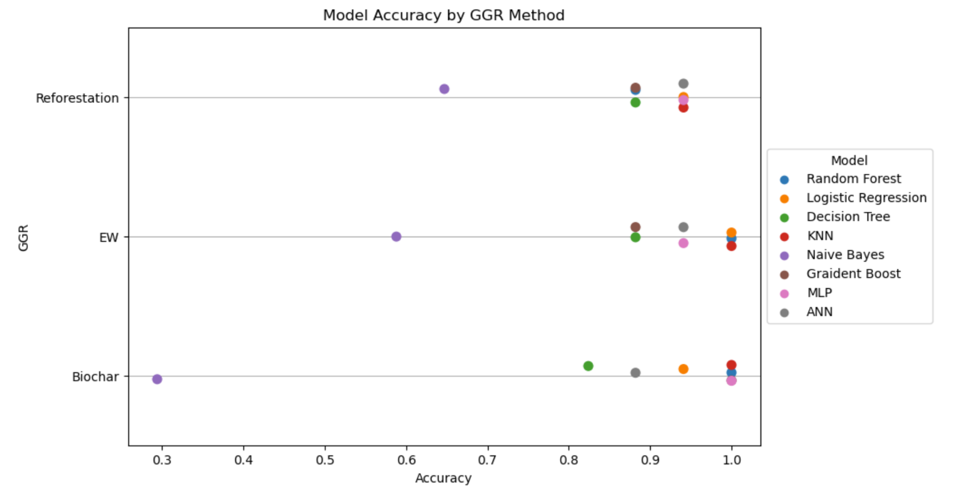
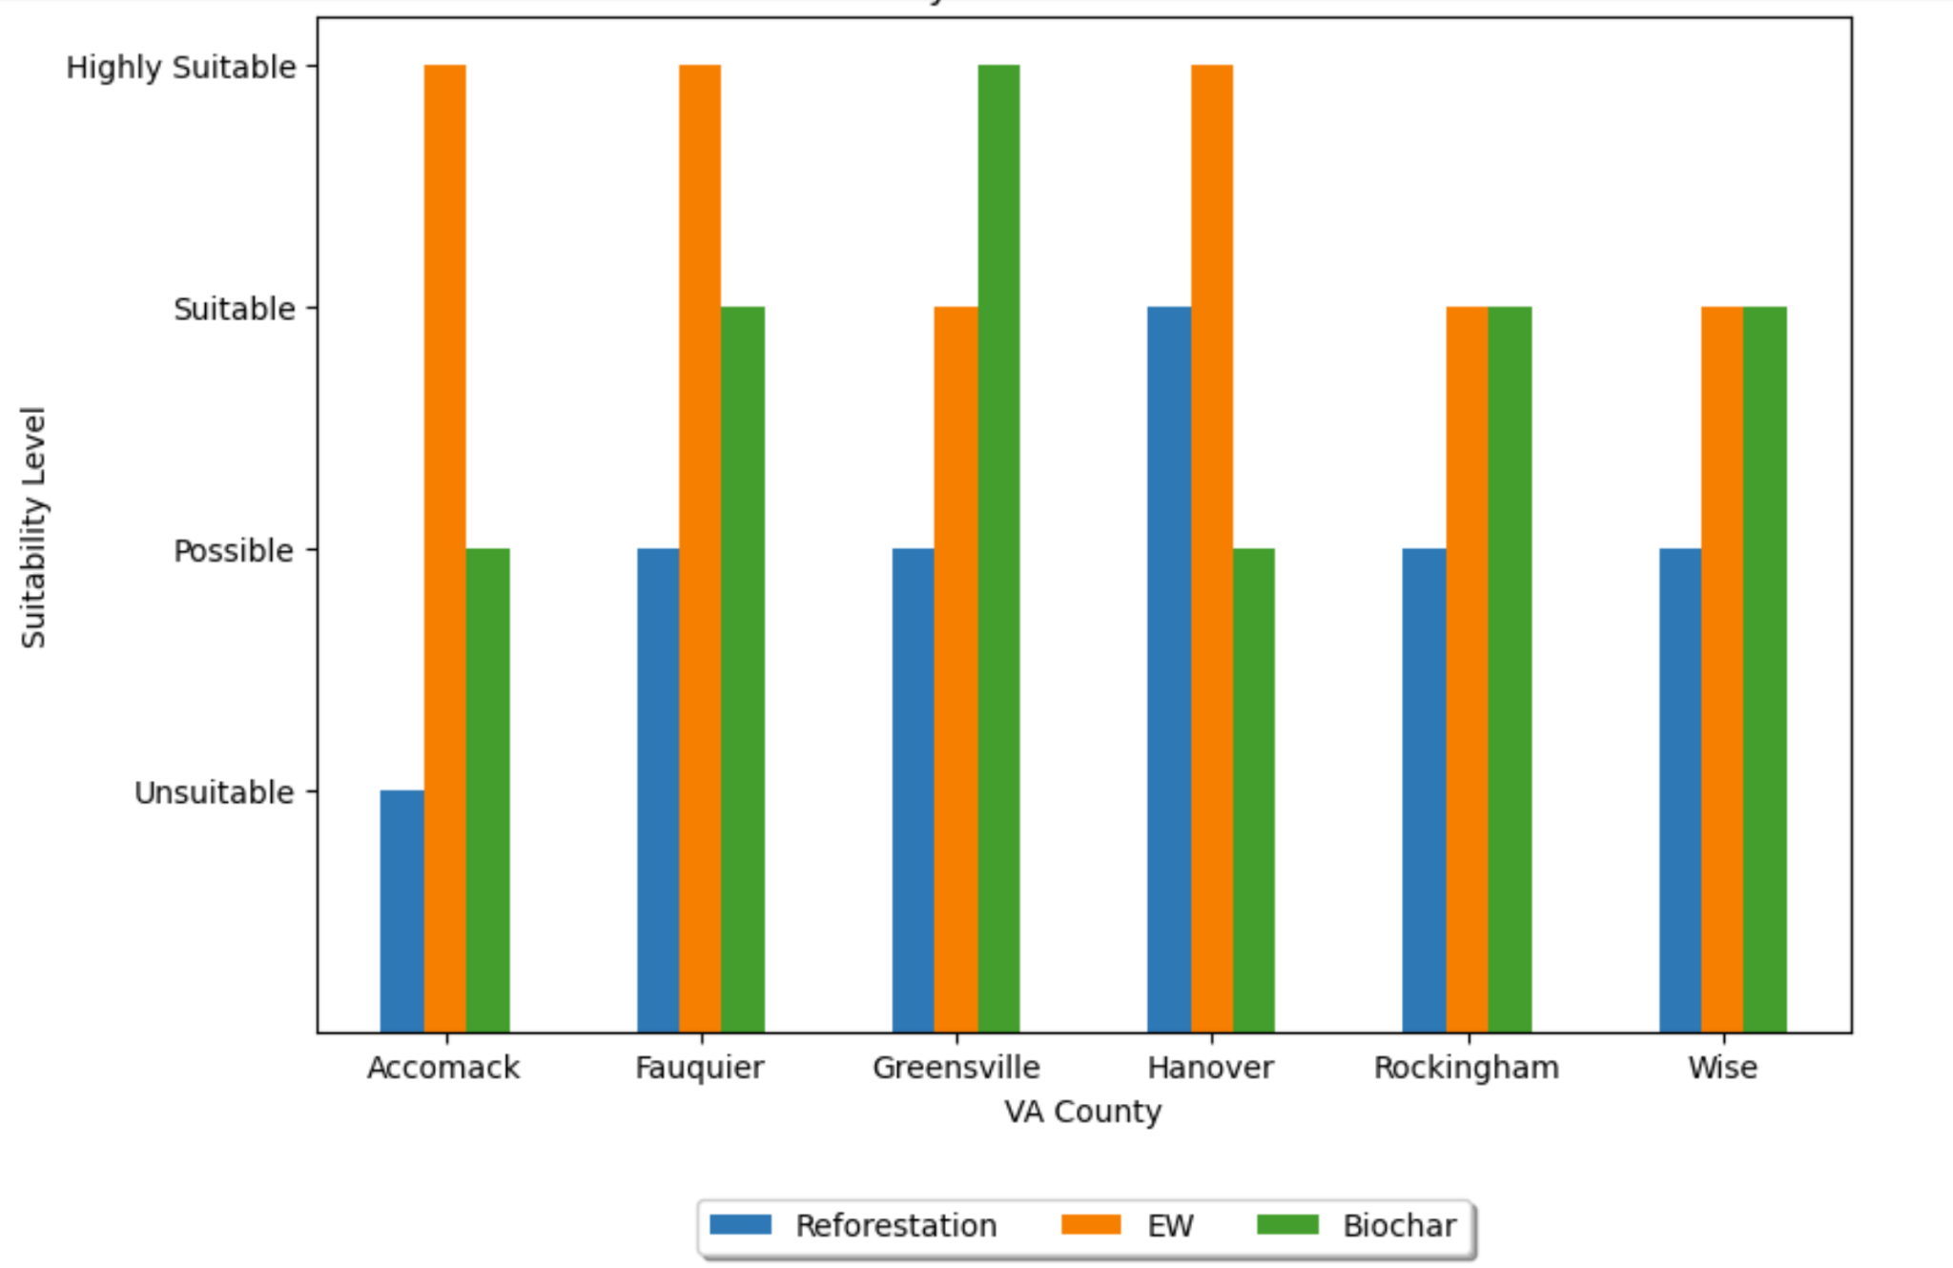

PREDICTING LAND SUITABILITY IN VIRGINIA COUNTIES
Implementing Greenhouse Gas Removal Technologies
Grace Davenport, Rachel Holman, Lillian Jarrett, and Hana Nur
INTRODUCTION
CO2 is the most abundant greenhouse gas, at 79.4%, followed by methane
Greenhouse gas effect: CO2 releases heat by vibration when hit with infrared rays
The Earth’s temperature has increased by 0.11 degrees Fahrenheit per decade
Greenhouse gas removal (GGR) technologies:
Reforestation: adding trees back to forested lands
Enhanced Weathering (EW): rock cations react with bicarbonate ions, forming carbonate minerals
Biochar: burning biomass in an oxygen deficient environment
RESULTS
Performance accuracies ranged from 82.4-100%, excluding Naive Bayes
Random Forest, Logistic Regression, KNN, and MLPClassifier had highest accuracies
Performance accuracies highest for EW
Temperature high importance score for all three GGR techniques
Income and agricultural land high importance score for EW and biochar, not reforestation
Water availability high importance for reforestation, but not for EW and biochar
6 counties of interest:
Hanover suitable for reforestation
Accomack, Fauquier, and Hanover highly suitable for EW
Greensville highly suitable for biochar
REFORESTATION
Table 1: Major and minor input variables for each GGR method from Asibor et al.
ENHANCED WEATHERING
Model Accuracy by GGR Method
GGR method | Requirements
Reforestation | Climatic factors (temp and precip) Forest land use (FLu) Water Availability
EW | Low Carbon Energy Available Income Climate factors Agricultural land use (AgLu)
Biochar | Biomass Availability Climate factors Income AgLu
BIOCHAR
Figure 2: Comparison of eight ML algorithms performance per CO2 removal method. The neural network had the highest accuracy for all three GGR methods.
Figure 1: Suitability levels of VA counties for each GGR method. Blank spaces represent the the six counties placed in the validation set.
Suitability Level By County Of Interest
METHODOLOGY
Select CO2 Removal Methods
DATA ANALYSIS
Data Collection & Preprocessing
Considered 90 major counties in Virginia
Over a 14 year time span (2008-2022)
Aggregated county data by mean
Project modeled in two stages after Asibor et al.
Stage 1: Unsupervised ML Modeling
Implemented hierarchical clustering establish four distinct groups of Virginia counties (k = 4 based on ELBO plot)
For each GGR method, considering the specific requirements referenced in Table 1, sorted clusters into four levels: highly suitable, suitable, possible, and unsuitable
For each GGR method, the 84 counties were assigned four separate suitability labels
Stage 2: Supervised ML Modeling
Removed the 6 counties of interest: Accomack, Fauquier, Greensville, Hanover, Rockingham, and Wise from dataset for validation
Split the data into train/test (80:20)
Models (sklearn) repeated for each GGR technology:
Random Forest, Logistic Regression, Decision Tree, KNN, Naive Bayes, Gradient Boost, MLPClassifier, ANN
Data Collection and Preprocessing
Figure 3: Suitability levels of the six counties in our validation set, separated by GGR method: Reforestation (blue), EW (orange) and Biochar (green)
Unsupervised ML Output
Asibor, J. O., Clough, P. T., Nabavi, S. A., & Manovic, V. (2023). A machine learning approach for resource mapping analysis of greenhouse gas removal technologies. Energy and Climate Change, 4, 100112. https://doi.org/10.1016/j.egycc.2023.100112
Favero, A., Sohngen, B., Huang, Y., & Jin, Y. (2018). Global cost estimates of forest climate mitigation with albedo: A new integrative policy approach. Environmental Research Letters, 13(12), 125002. https://doi.org/10.1088/1748-9326/aaeaa2
Fuss, S., et al. (2018). Negative emissions—Part 2: Costs, potentials and side effects. Environmental Research Letters, 13(6), 063002. https://doi.org/10.1088/1748-9326/aabf9f
Lashof, D. A., & Ahuja, D. R. (1990). Relative contributions of greenhouse gas emissions to global warming. Nature, 344(6266), 529–531. https://doi.org/10.1038/344529a0
Schuiling, R. D., & Krijgsman, P. (2006). Enhanced Weathering: An Effective and Cheap Tool to Sequester Co2. Climatic Change, 74(1–3), 349–354. https://doi.org/10.1007/s10584-005-3485-y
Smith P. (2016). Soil carbon sequestration and biochar as negative emission technologies. Glob Chang Biol. 22(3):1315-24. doi: 10.1111/gcb.13178.
Smith, P., et al. (2016). Biophysical and economic limits to negative CO2 emissions. Nature Climate Change, 6(1), 42–50. https://doi.org/10.1038/nclimate2870
Apply Supervised ML
ML Accuracy Assessment
Case Study Analysis

