Slide 1
DEVELOPING A PATH TO NET-ZERO CARBON EMISSIONS IN VIRGINIA
Rachel Holman, Grace Davenport, Lily Jarrett, Hana Nur

Slide 2
Stakeholders
Rachel Holman | Team member
Grace Davenport | Team member
Hana Nur | Team member
Lily Jarrett | Team member
Andrés Clarens | Sponsor
Majid Shafiee-Jood | Sponsor
Adam Tashman | Mentor

Slide 3
Table of Contents
Project purpose and background
Data discussion
Project plan
Potential concerns and blockers
Notes:
3. (can mention helpful resources, areas to investigate)

Slide 4
purpose and background
Carbon Removal: a broad set of approaches used to remove harmful CO2 gases from the atmosphere
Ex. reforestation, bioenergy crops
Historical environmental policy impact on land use patterns, specifically renewable resources
Solar panels, wind turbines, etc.
Predict future land-use patterns with ML model

Slide 5
Previous Research + Modeling
Departments at UVA:
Environmental Engineering: Modeling CO2 sequestration techniques
Biology: Reforestation modeling with i-Tree suite
Politics: Public policy differences between VA counties
Architecture: Socioeconomic status based on building materials
Finance: Cost of biofuels implementation across public/private sector

Slide 6
Success Criteria
SC1 | Effectively model land use changes in the past 10-20 years, to predict land use in the future (crop, forest, etc.)
SC2 | Compiling an accurate timeline of environmental policy changes to assess correlation between policy and land use.
SC3 | Visualizations in land use change to aid environmentalists in creating a path to net-zero carbon emissions

Slide 7
Data Discussion
Public ArcGIS land use datasets from Multi-Resolution Land Characteristics (MRLC) Consortium and USDA
Environment policy data researched and consolidated to create a policy timeline
ArcGIS .shp and .tif files will be converted to csv files for analysis in Python
Some years must be supplemented with open source environmental data
Environmental policy data limited to state-level
County-level policy data is inconsistent and difficult to obtain

Slide 8
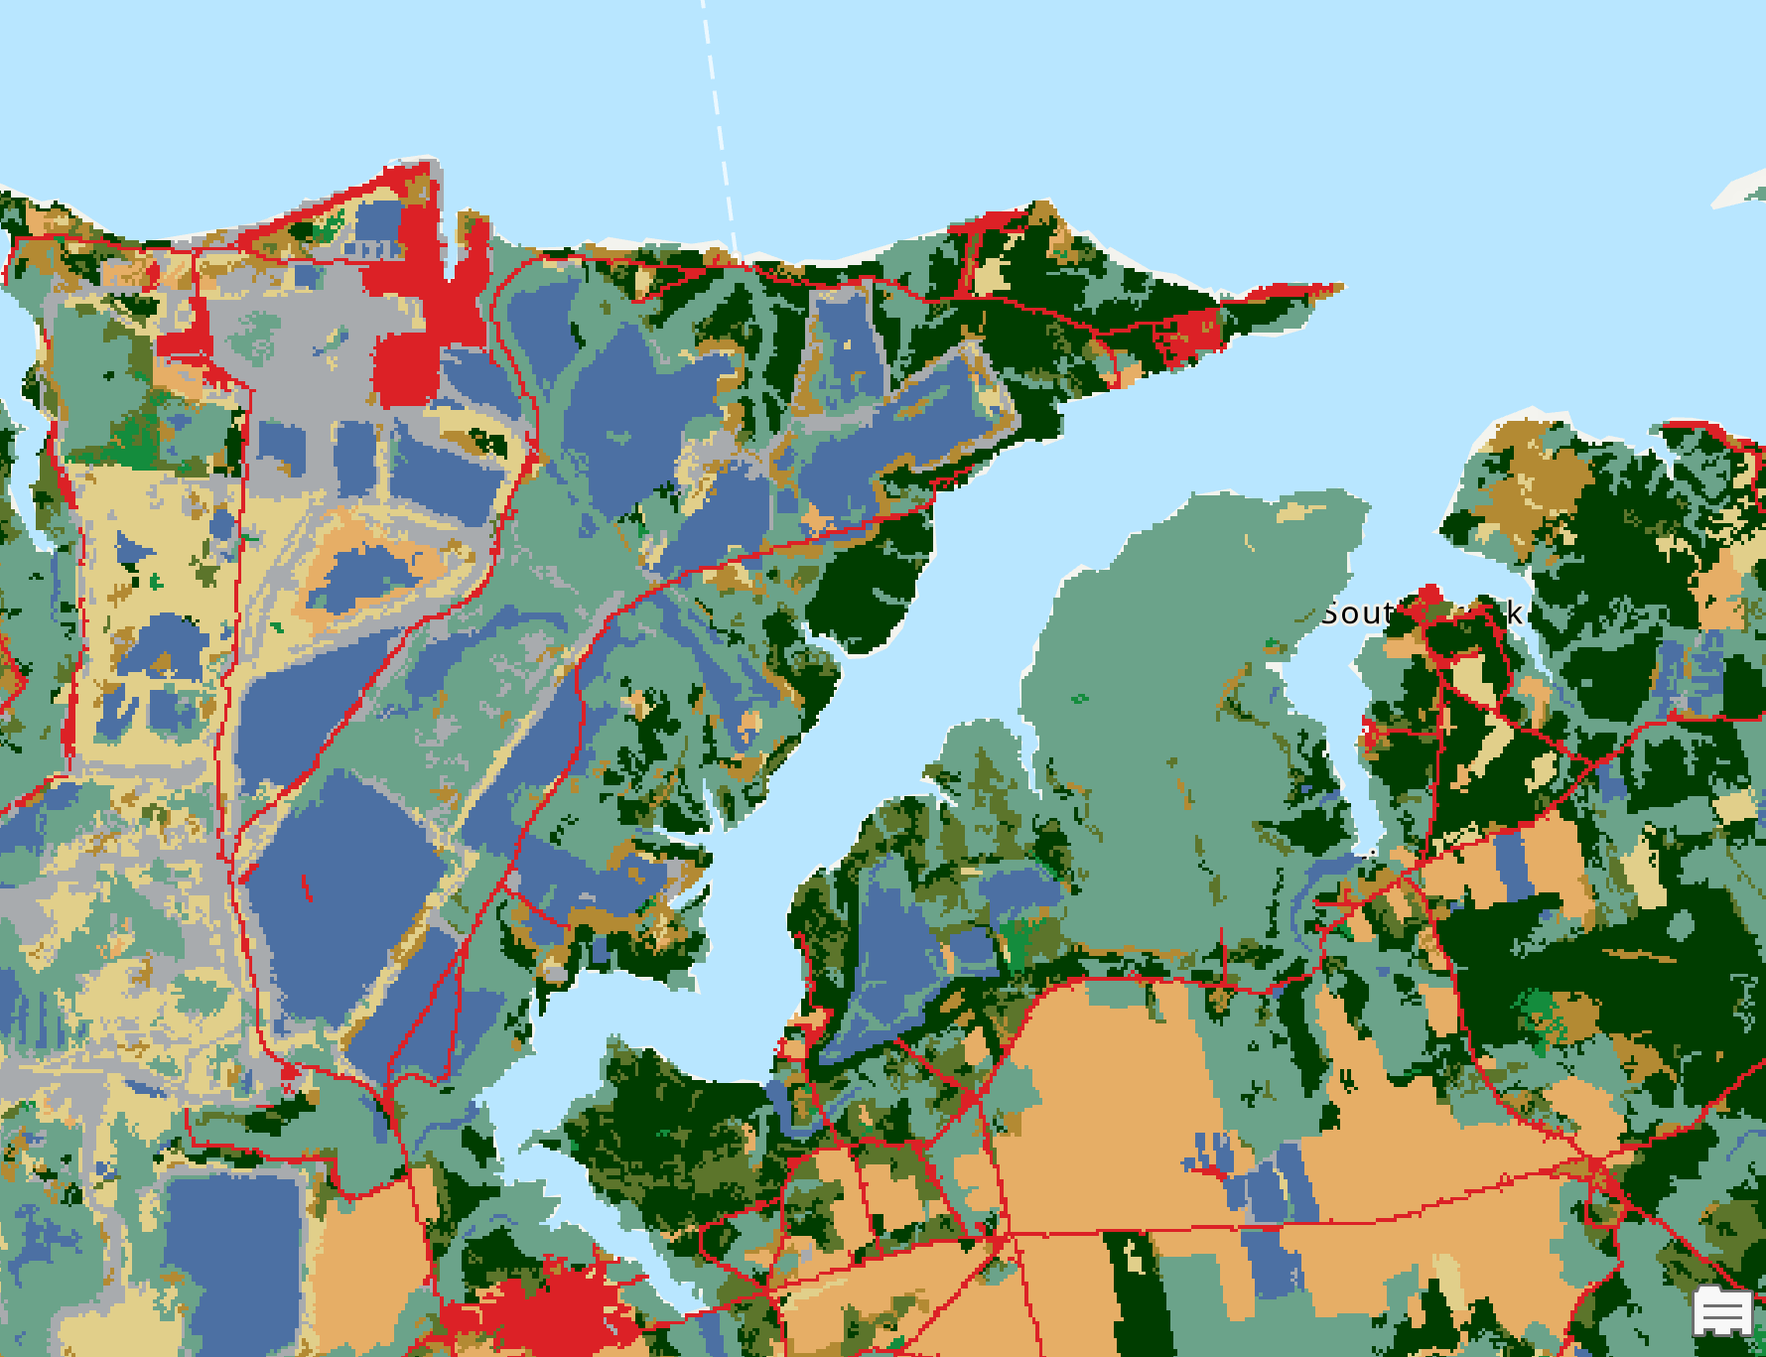
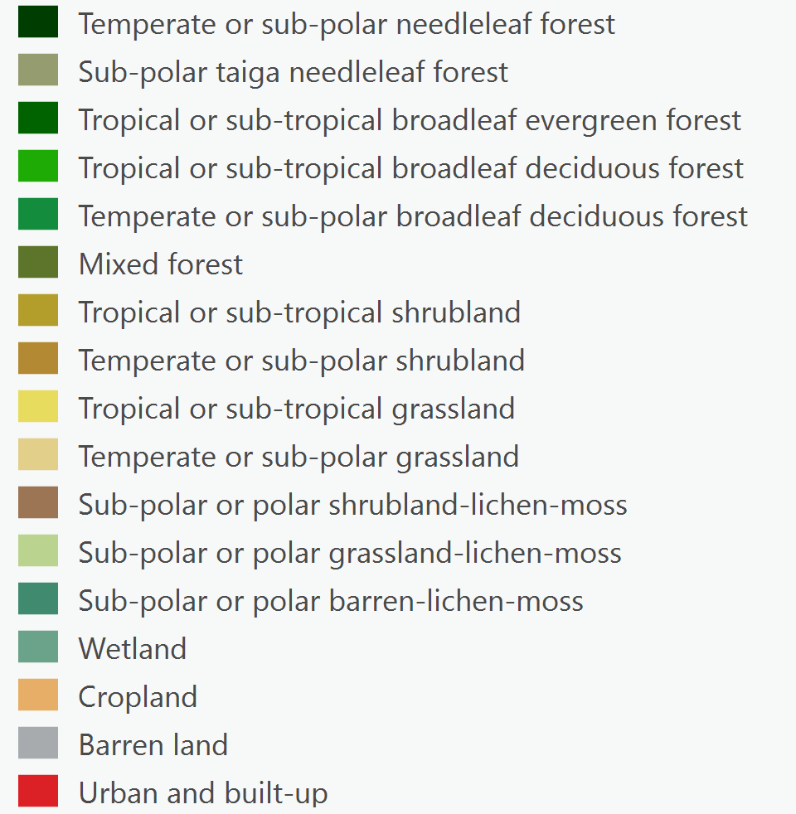
North American Land Cover, 2020 (Landsat, 30m)
https://www.mrlc.gov/

Slide 9
Project plan
Review research articles that implement ML techniques to assess carbon emissions and land use
Carbon removal, reforestation, renewable energy sources
Learn and use ArcGIS to visualize and aggregate data
Establish Virginia Policy Timeline (2002-2023) for reference
Develop a Machine Learning Tool to forecast potential land use patterns for the next 10 years at the county scale
Notes:
Discuss how you might tackle the project
This can be high level
What new things will you need to learn?

Slide 10
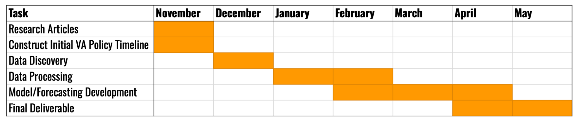
GANTT CHART

Slide 11
Potential concerns and blockers
Concerns:
ArcGIS is not compatible with Mac computers
Can be navigated using online browser version
Data is in .shp and .tif form which makes for complicated combination and downloading as .csv
Policy change data is not documented in one location- requires tedious researching

Slide 12
Additional considerations
Scope:
Very specific goals which could prove more complex than time allows for, but can be narrowed after the data acquisition and preprocessing steps
Project Clarity:
Some confusion around the outcome and deliverables clients expect
Data Sufficiency:
We will need to supplement data to allow for more modeling variables
Sponsor Side:
The right people seem to be involved!

