Slide 1
Meeting Agenda 2-19
Data dictionary
Resources
Precipitation/Temperature resolution
Potential solutions (slide 5)
Land use percentages
Removing CO2 emissions from the model?
Potential models
Are there any models you’re interested in?
Policy data updates

Slide 2
Data Dictionary
county-data columns
Column Name | Description | Observations
County | County name | 18411
Year | Year | 18411
Income | Income per capita in given county (in dollars) | 18411
DSCI | Drought Severity and Coverage Index measures drought level, possible values from 0 to 500. Zero means that none of the area is abnormally dry or in drought, and 500 means that all of the area is in D4, exceptional drought. | 18411
Precip | Average precipitation for given county (inches) | 18411
Temp | Average temperature for given county (Fahrenheit) | 18411
Count | Crop count | 18411
Percentage | Percentage of land use | 18411
Crop | Type of crop produced by county | 18334
Coal | CO2 emissions (in million metric tons) from coal in given sector | 18150
Petroleum Products | CO2 emissions (in million metric tons) from petroleum products in given sector | 18150
Natural Gas | CO2 emissions (in million metric tons) from natural gas in given sector | 18150
Total | Total CO2 emissions (in million metric tons) in given sector | 18150
Sector | Sector for CO2 emissions | 18150
Population | Resident Population from US Census bureau | 18411

Slide 3
Data Resources
Data | Resource | Link
Population | Census | https://www.census.gov/data/tables/time-series/demo/popest/2010s-counties-total.html
CO2 Emissions | EIA | https://www.eia.gov/state/?sid=VA#tabs-1
Precipitation, Temperature | NOAA | https://www.ncei.noaa.gov/access/monitoring/climate-at-a-glance/county/time-series/VA-195/pcp/12/12/2008-2022?base_prd=true&begbaseyear=1901&endbaseyear=2000
DSCI | Drought Monitor (edu) | https://droughtmonitor.unl.edu/DmData/DataTables.aspx
Income | Fred, Economic Data | https://fred.stlouisfed.org/release/tables?eid=268980&rid=175
Crop | MRLC | https://www.mrlc.gov/

Slide 4
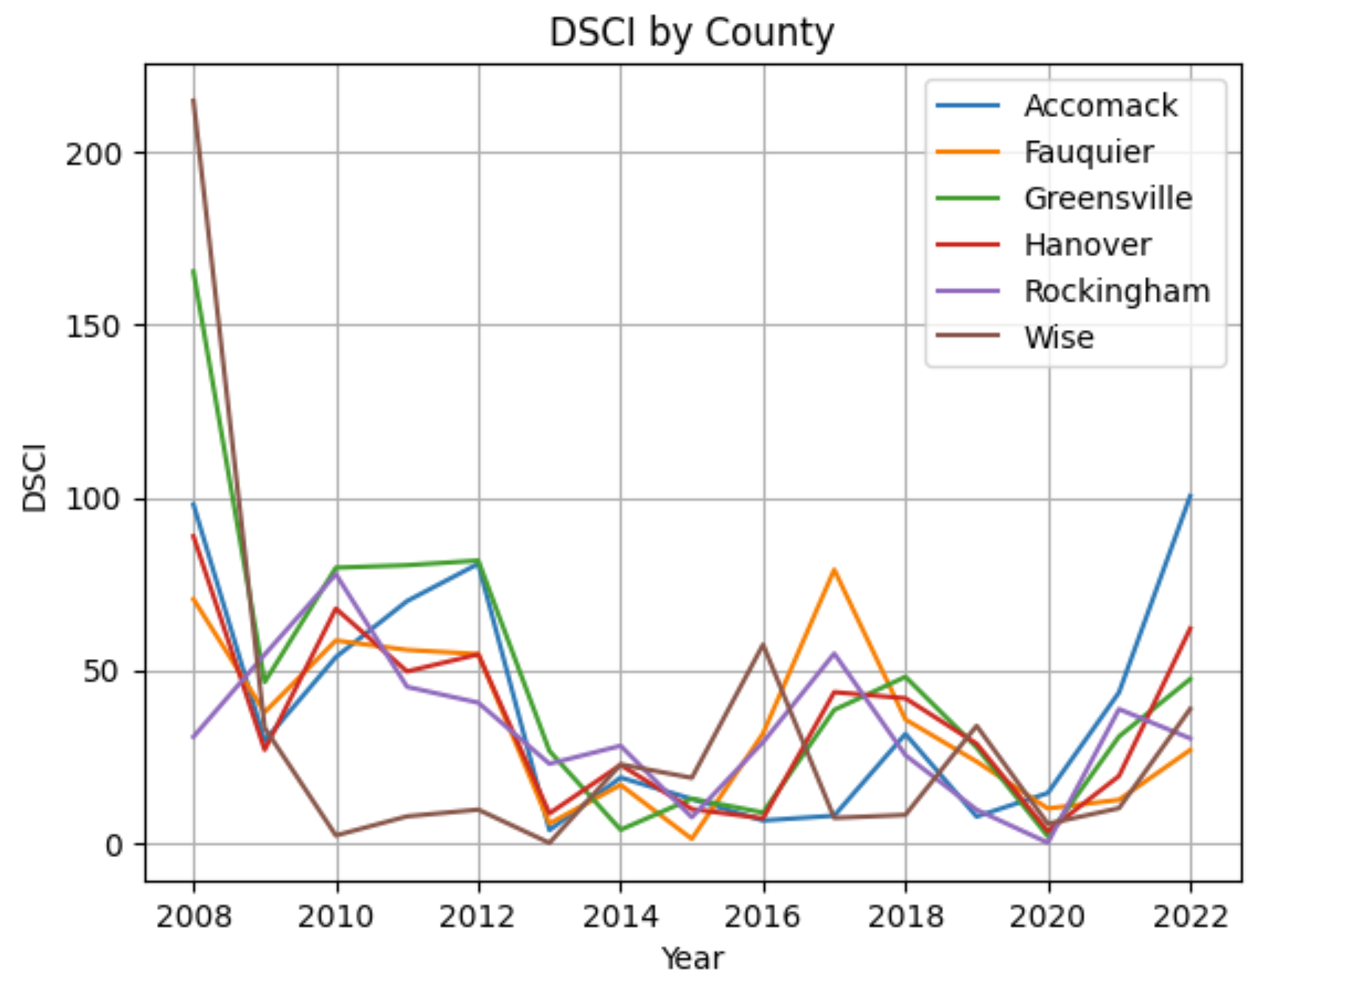
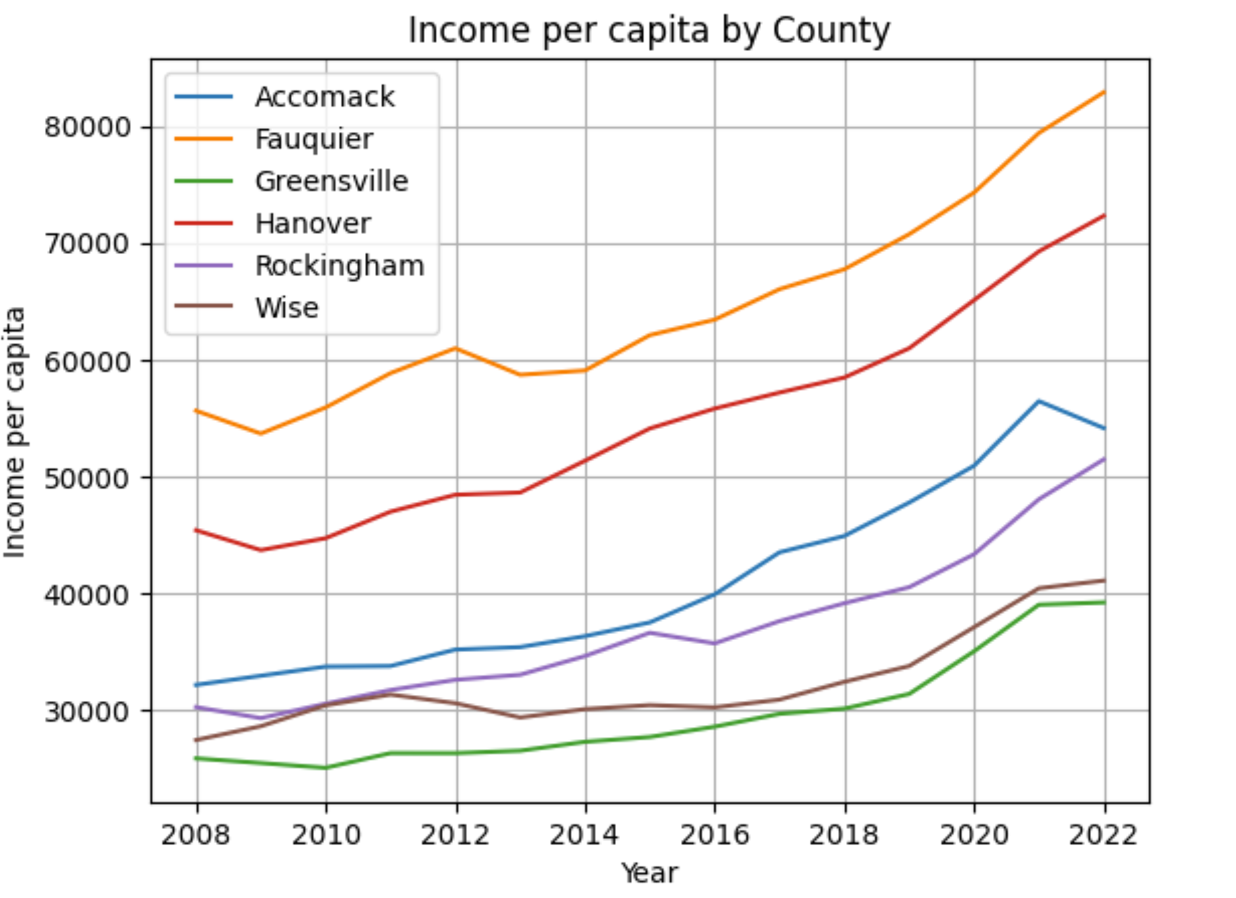
DSCI & Income

Slide 5
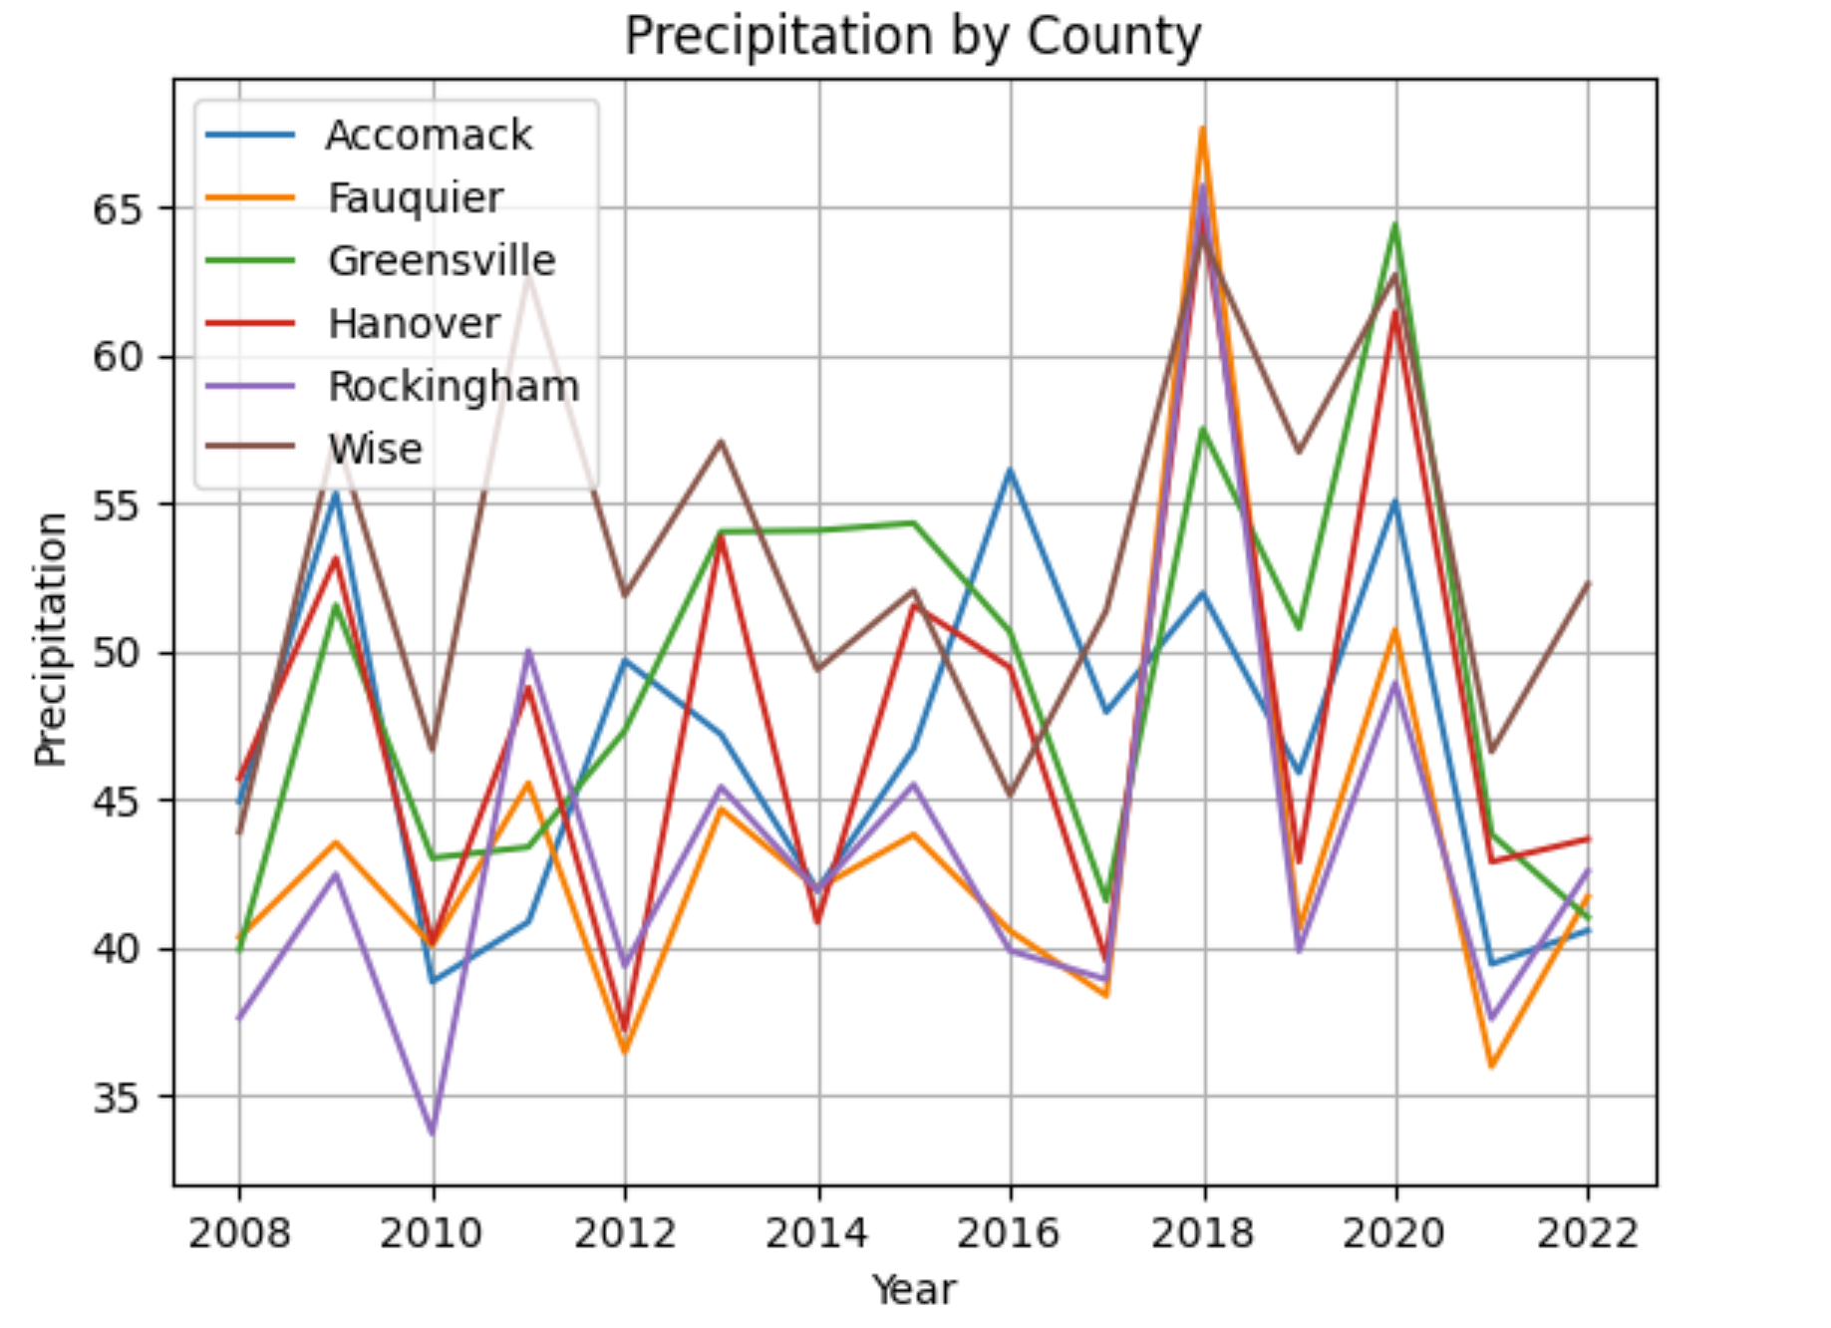
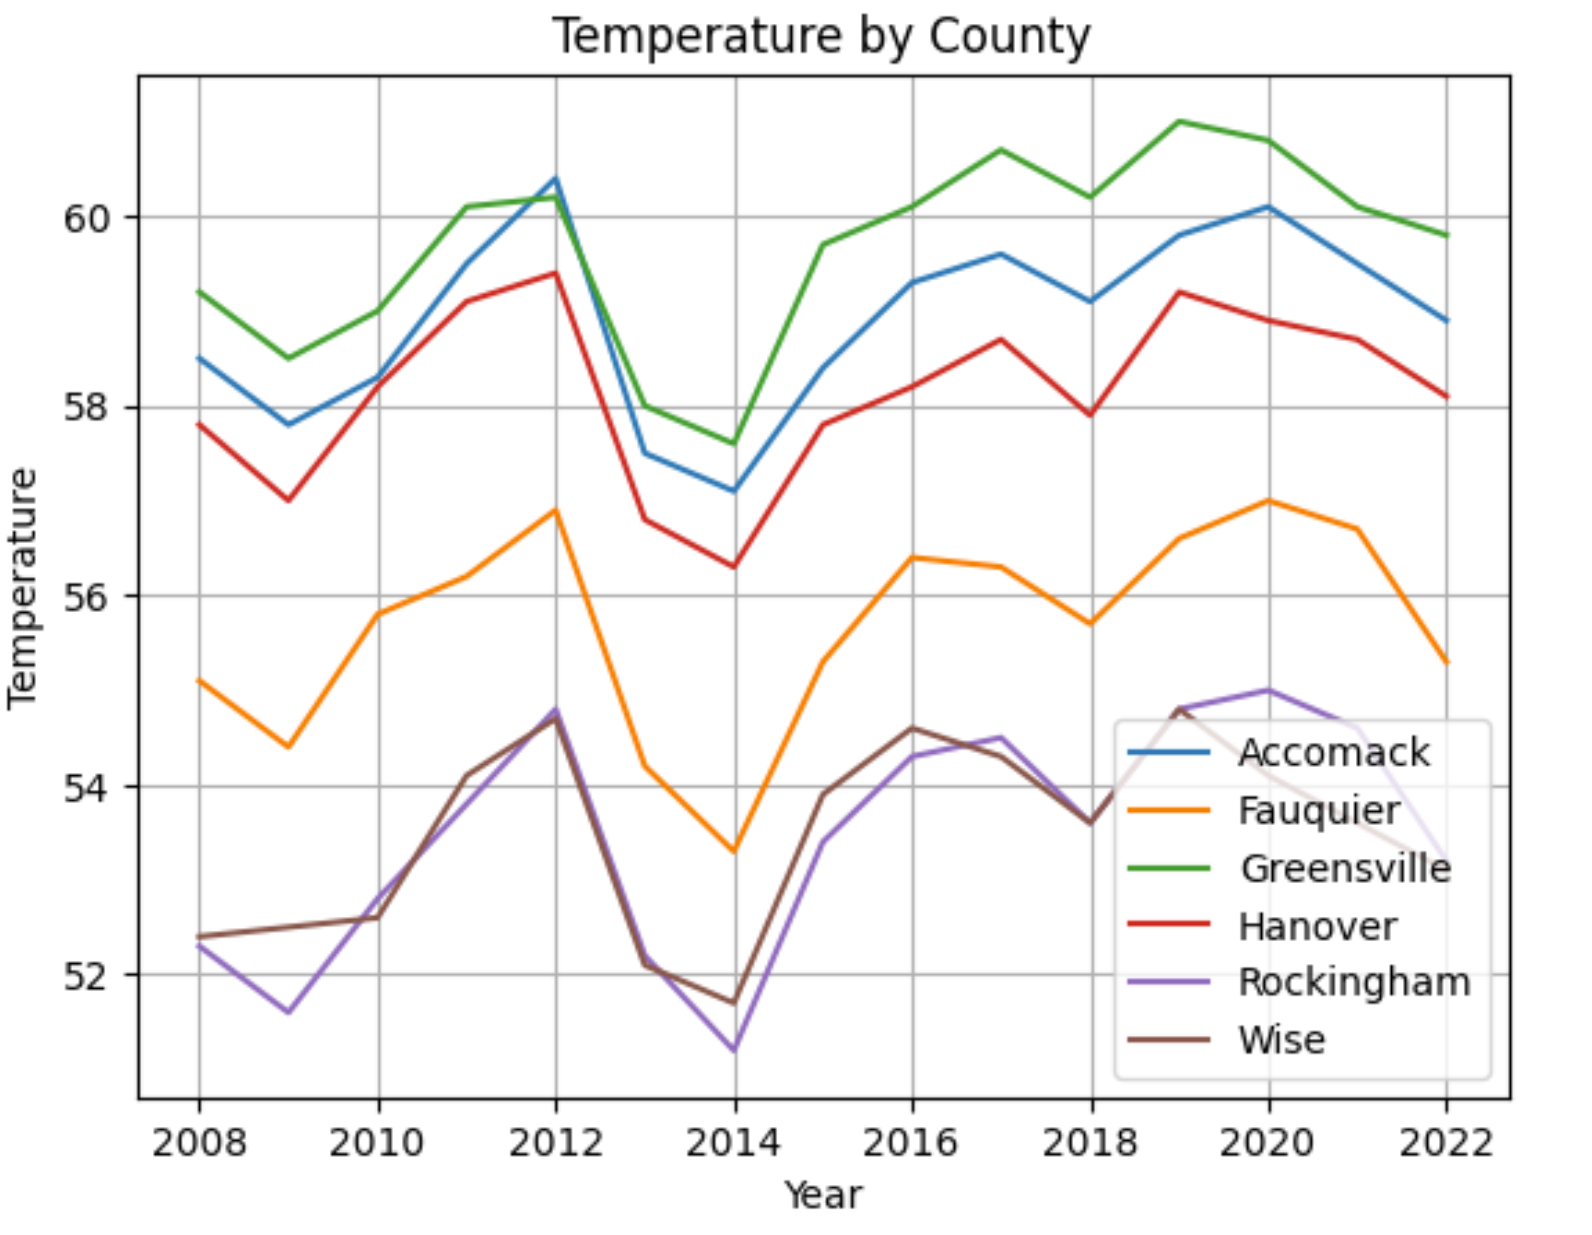
Precipitation & Temperature
Temperature:
We used temperature/year to align with the GIS data and streamline our model.
One possible solution is to create a column for each month, identifying average temperature to include in our model.
Can be max, min, etc. as well

Slide 6
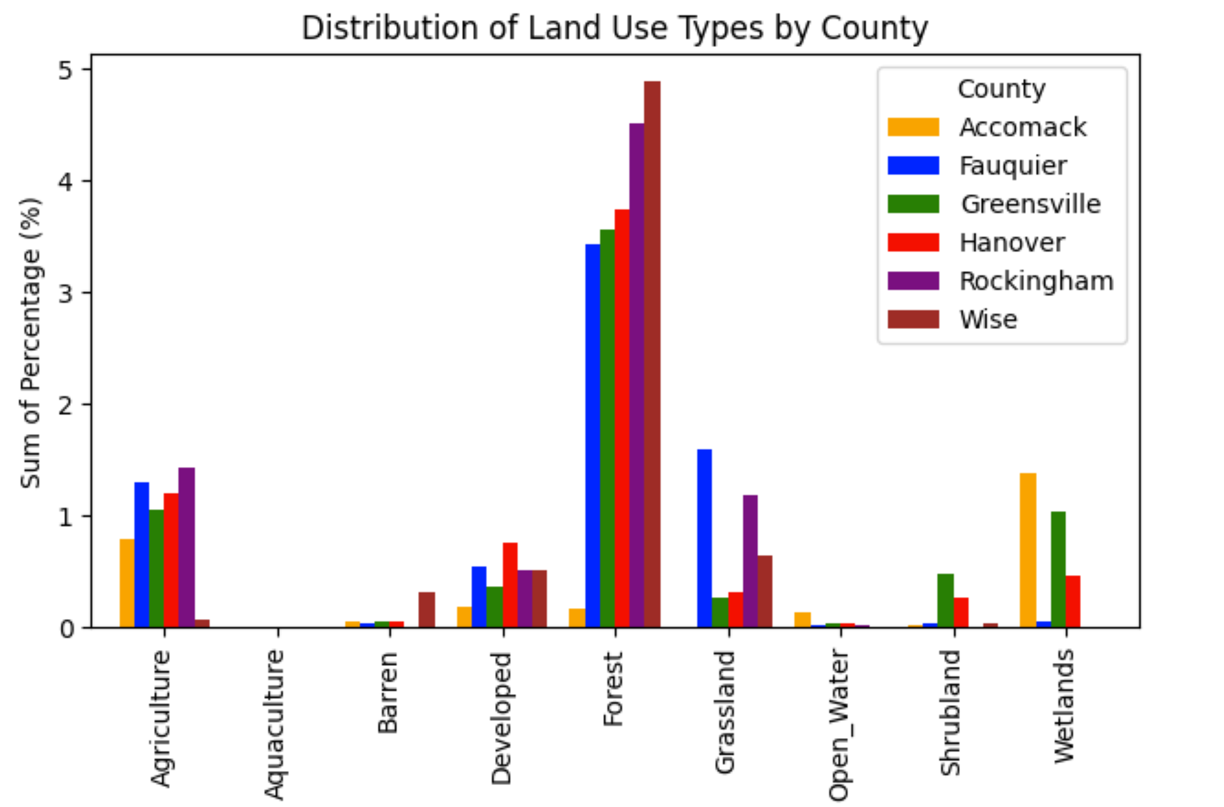
From the ‘Crop’ column we created a new column, ‘land_use’, which categorizes each row into one of these land use types. Converted the count column into a percentage. This is a percentage sum overtime so we could create a separate graph for each year.

Slide 7
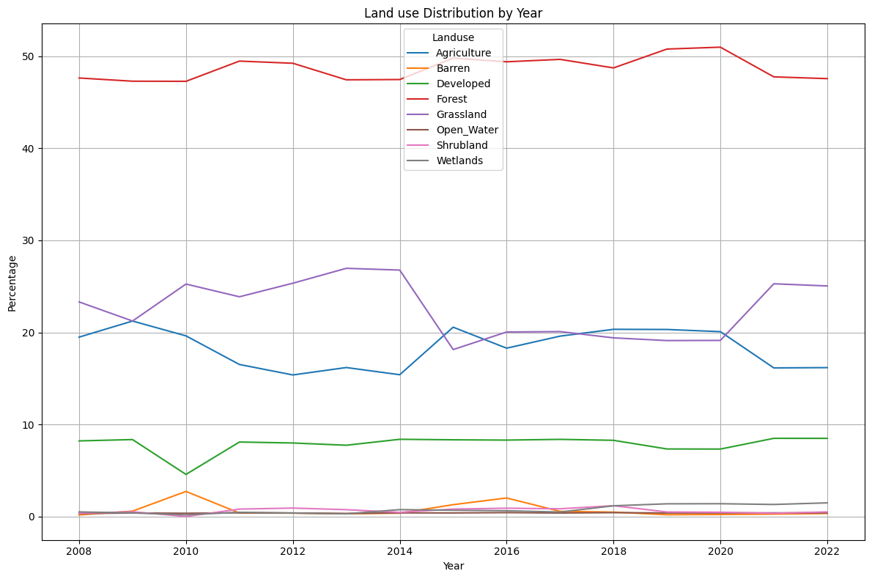
Land use changes across 6 counties

Slide 8
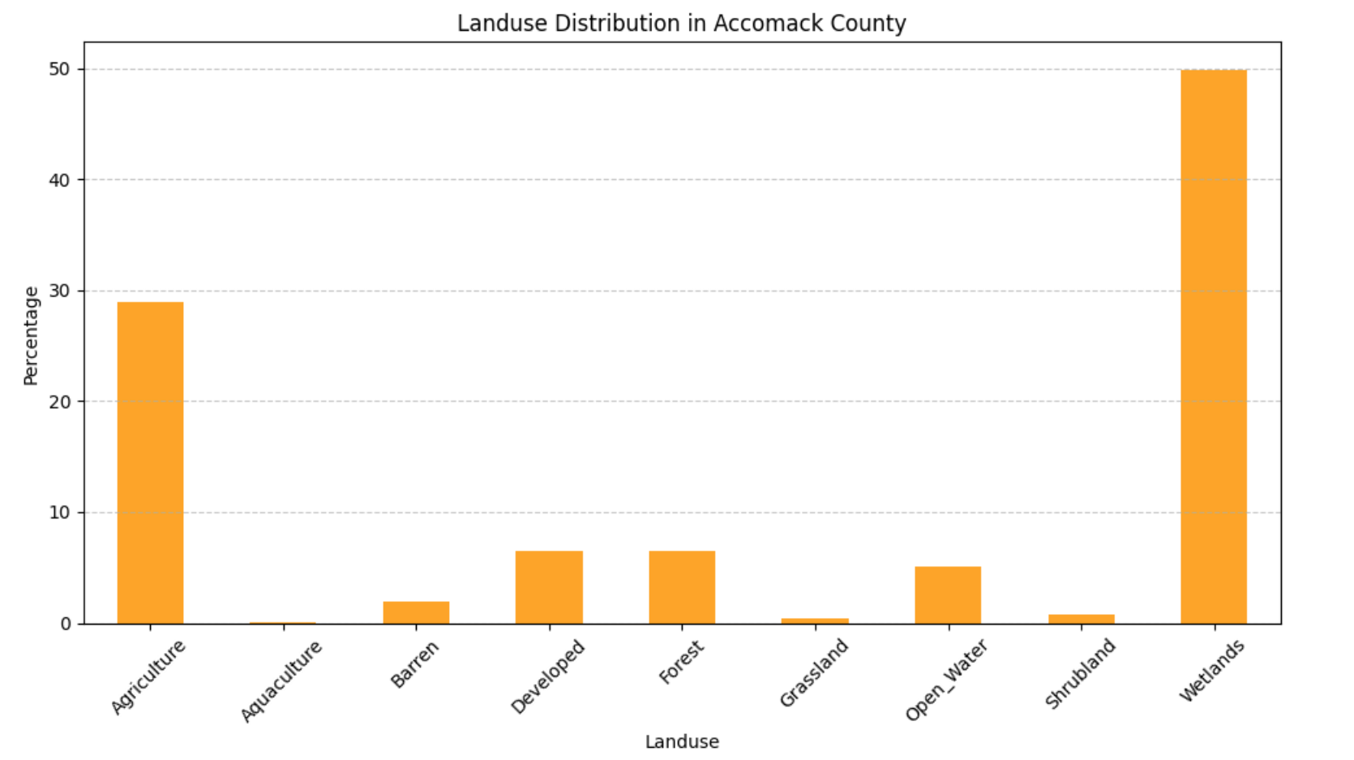
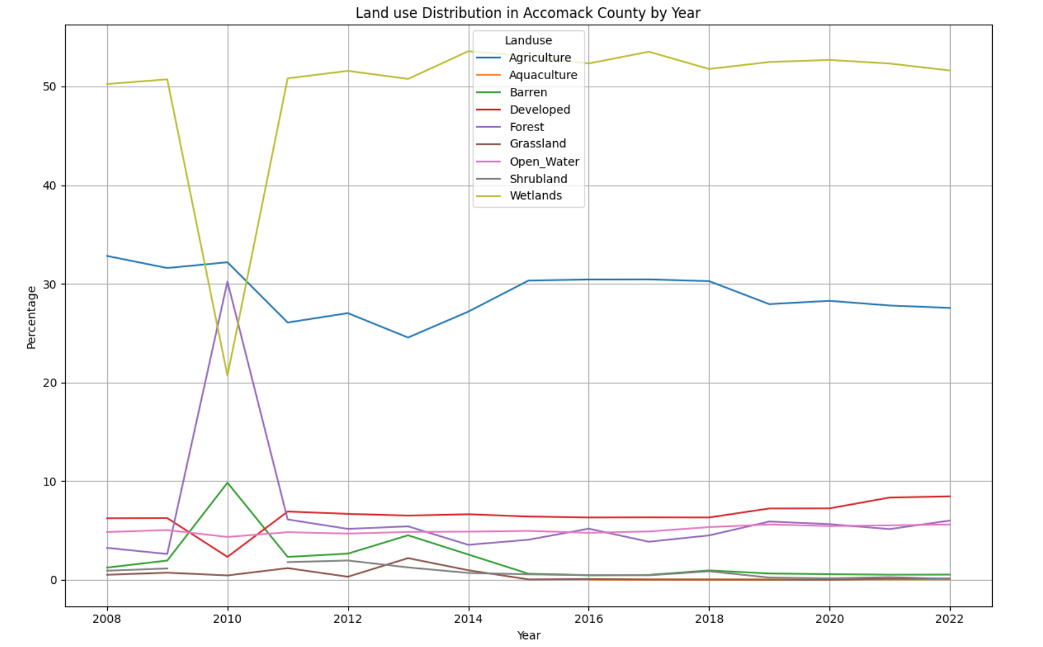
Land Use in Accomack County
Data filtered to Accomack county, but we have plots for all 6. Bar plot (left) shows the distribution of land use and the line plot (right) is change in land use percentage over time.

Slide 9
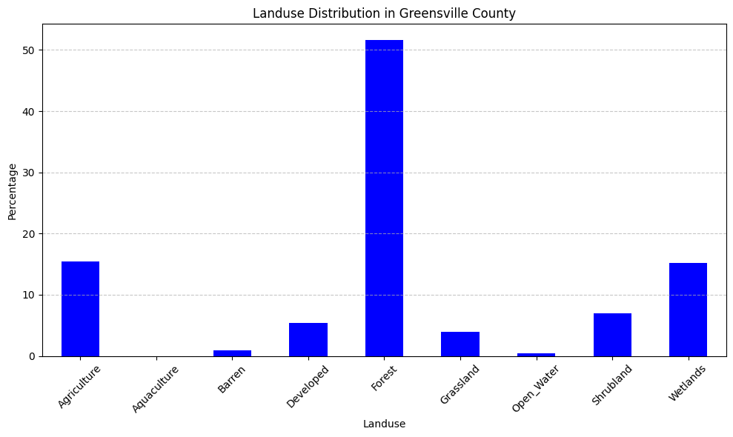
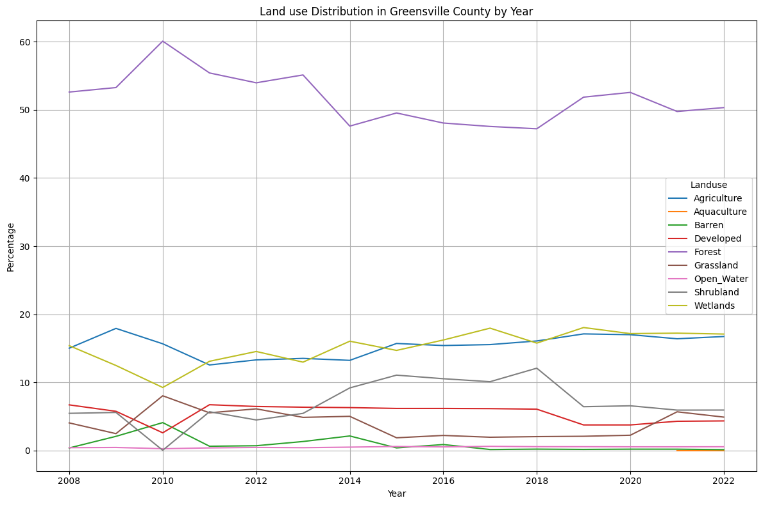
Greensville

Slide 10
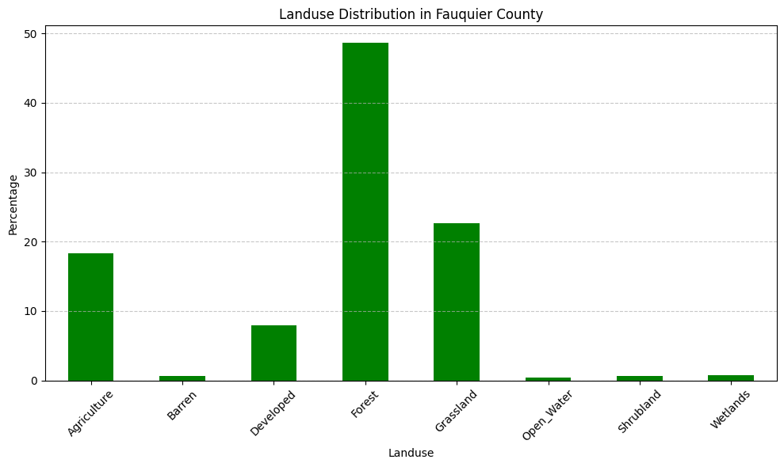
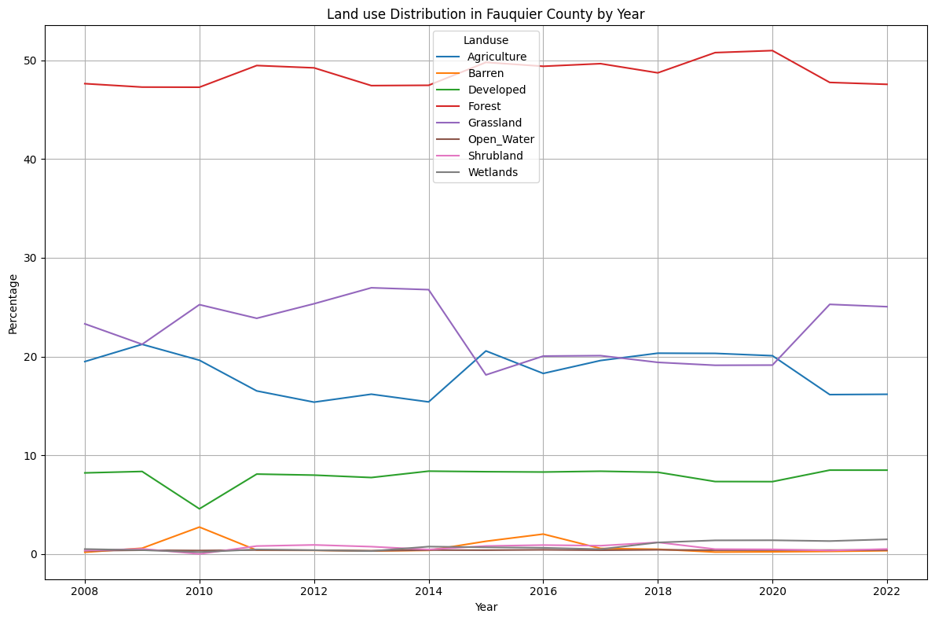
Fauquier

Slide 11
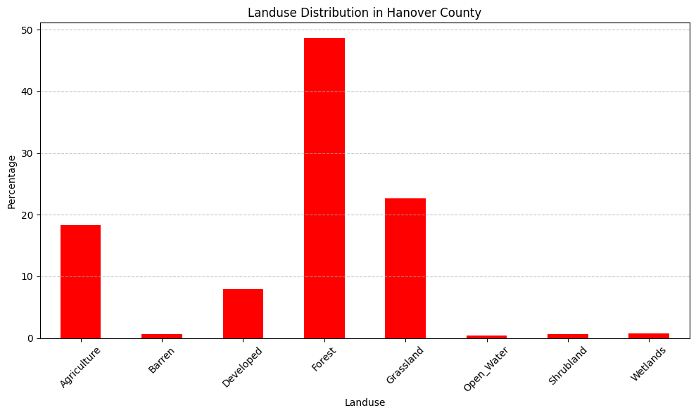
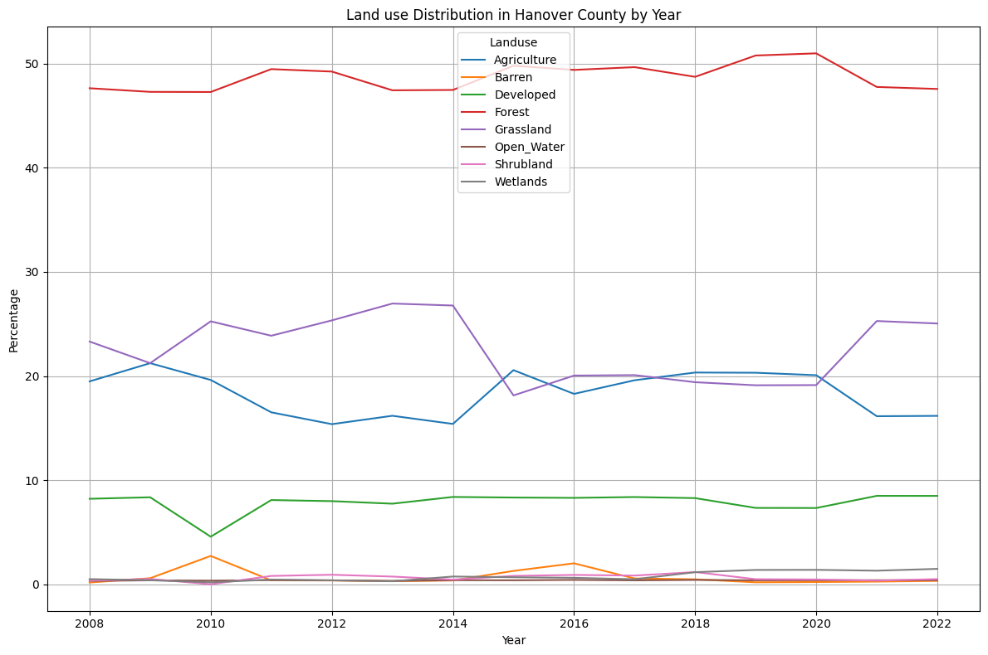
Hanover

Slide 12
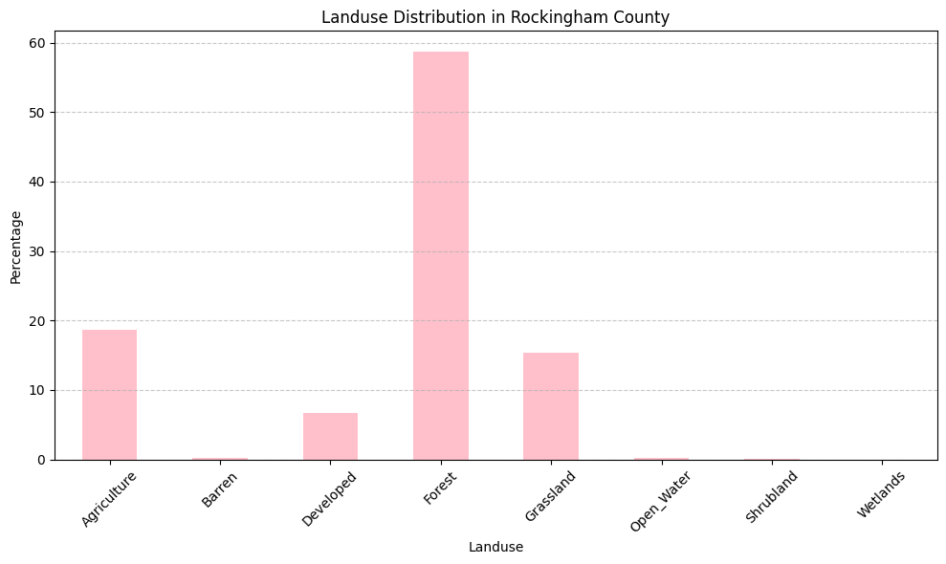
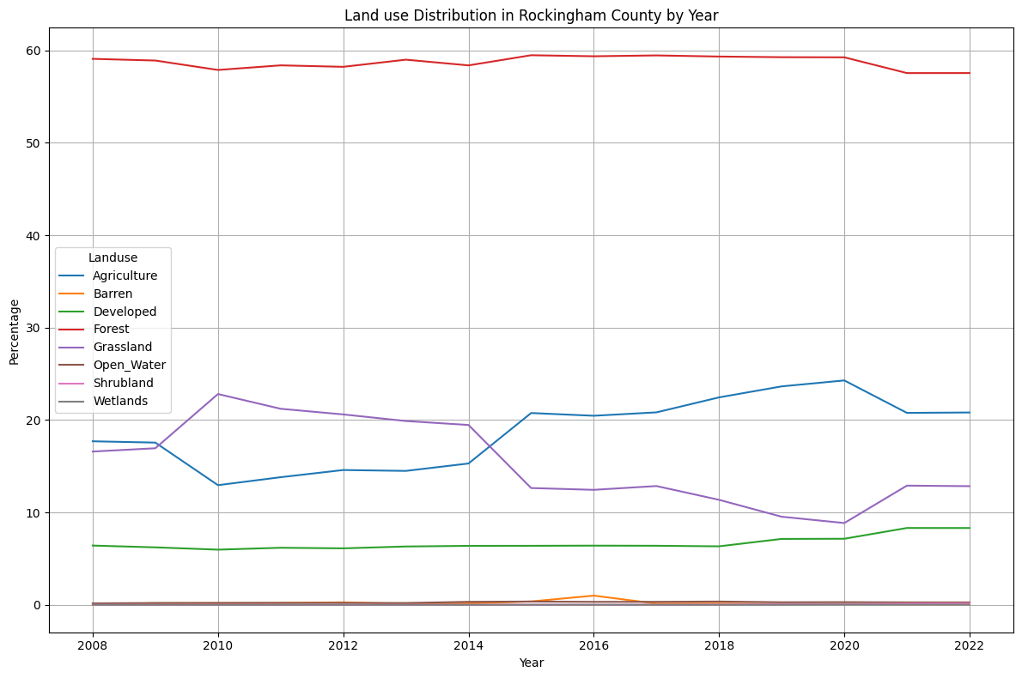
Rockingham

Slide 13
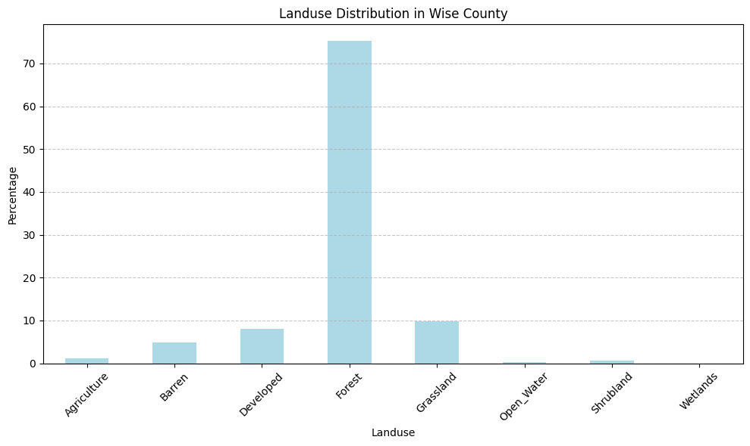
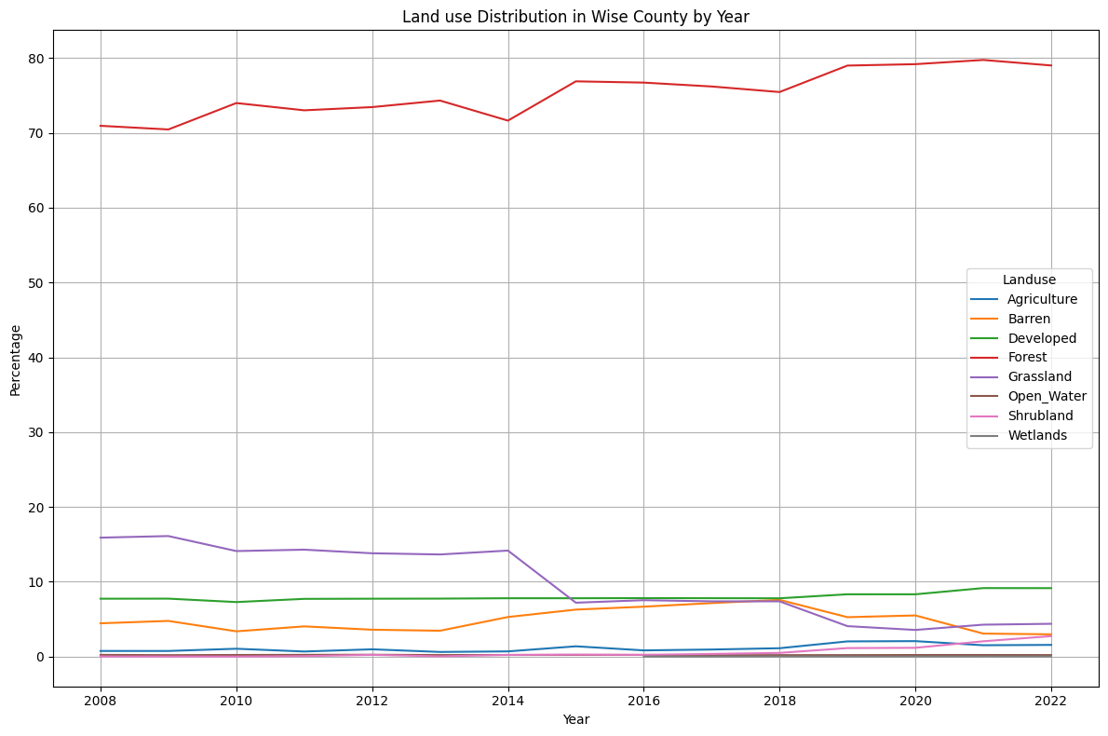
Wise

Slide 14
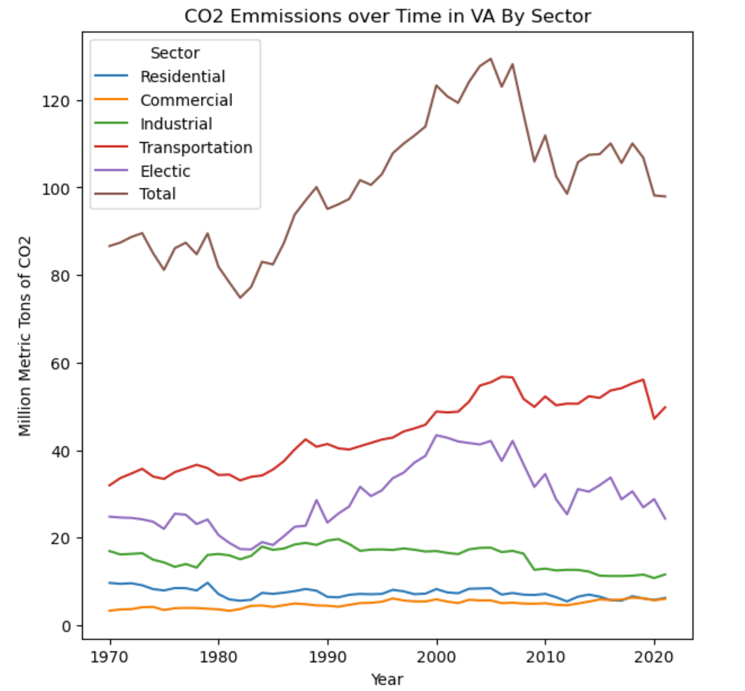
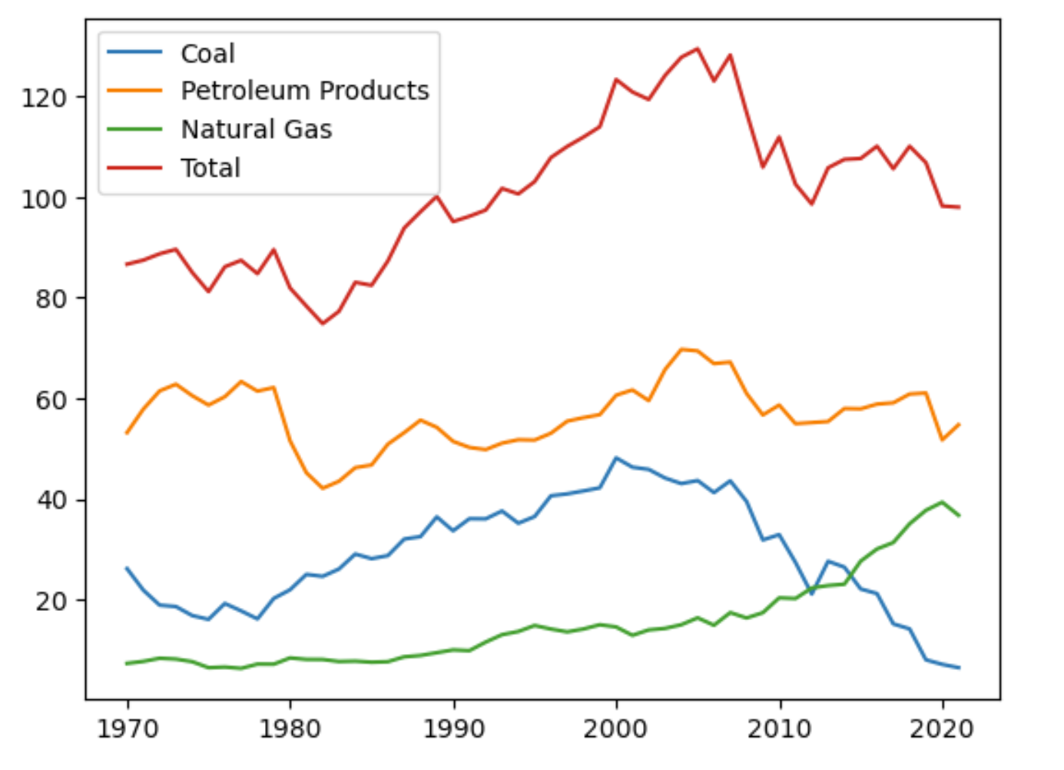
CO2 Emissions in Virginia
CO2 Emissions over Time in VA by Type

Slide 15
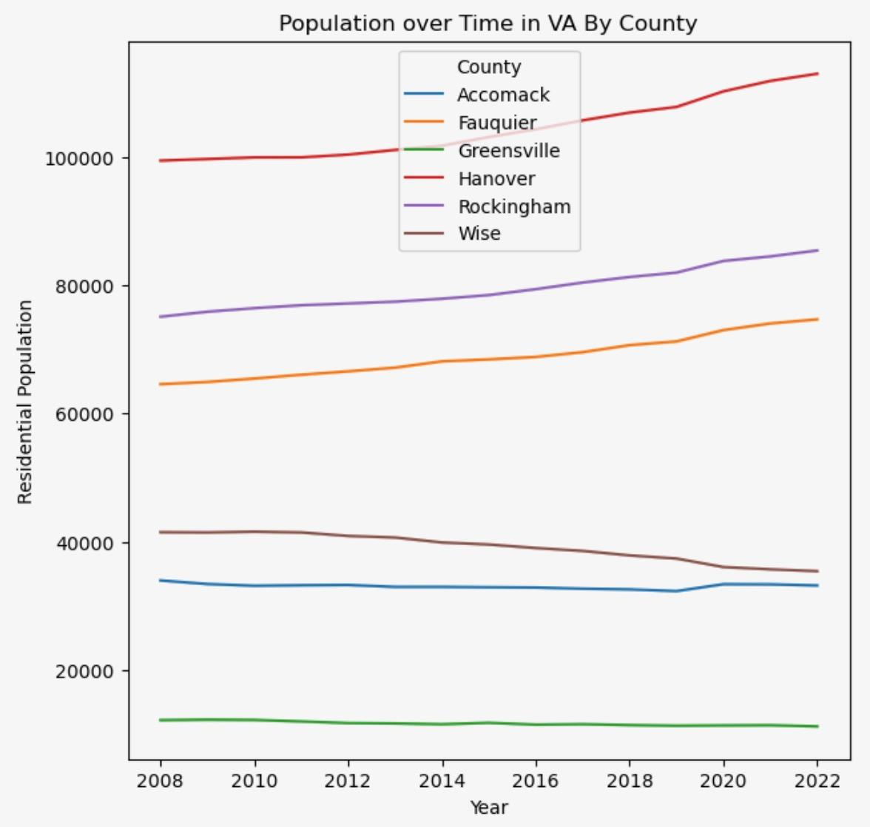
Population

