Slide 1

Predicting Customer Churn for SyriaTel
Dave Omondi

Slide 2
Business Problem
SyriaTel has been experiencing a high churn rate leading to significant losses. This project aims to create a predictive model that accurately identifies customers at risk of churning. The objective is to decrease customer attrition, retain a higher number of customers, and ultimately reduce financial losses while improving overall retention rates and business strategies.

Slide 3
Objectives
1. Identify Key Predictors of Customer Churn
2. Develop and Evaluate Predictive Models
3. Provide Actionable Insights for Customer Retention

Slide 4
Data Understanding
The dataset contains information on 3,333 customers from SyriaTel, with 21 features including demographic data, service usage, and customer interaction metrics. The target variable is churn, indicating whether a customer has left the company.

Slide 5
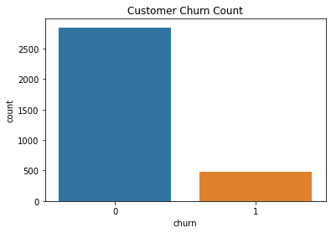
Exploratory Data Analysis
We observed a class imbalance in the churn data, with significantly more customers not churning compared to those who did.

Slide 6
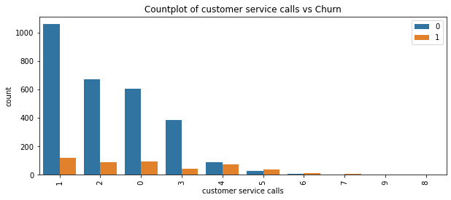
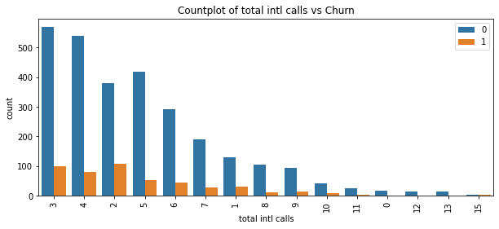
Exploratory Data Analysis
The analysis revealed that the frequency of customer service calls and the subscription status to international plans were significant factors influencing customer churn.

Slide 7
Feature Engineering
Feature engineering involved creating combined features, ratios, and flags to enhance the predictive power of the model. Redundant features were dropped to simplify the model.

Slide 8
Modeling
Three models were developed: Logistic Regression, Decision Trees, and Random Forests. The models were optimized with hyperparameter tuning. Each model was evaluated using metrics such as precision, recall, accuracy, and F1-score.

Slide 9
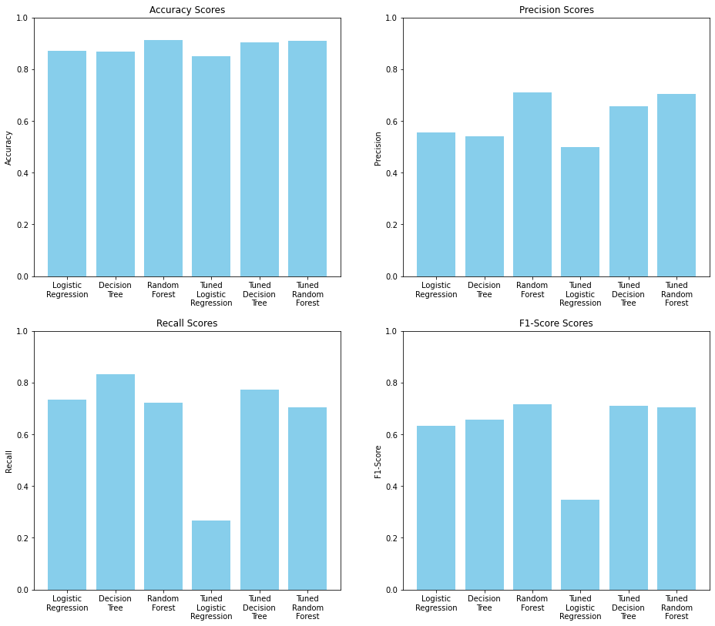
Model Evaluation
The tuned decision tree model offers a good balance between precision, recall, accuracy, and F1-score on the testing set, indicating that it generalizes better to new data compared to the other two models.

Slide 10
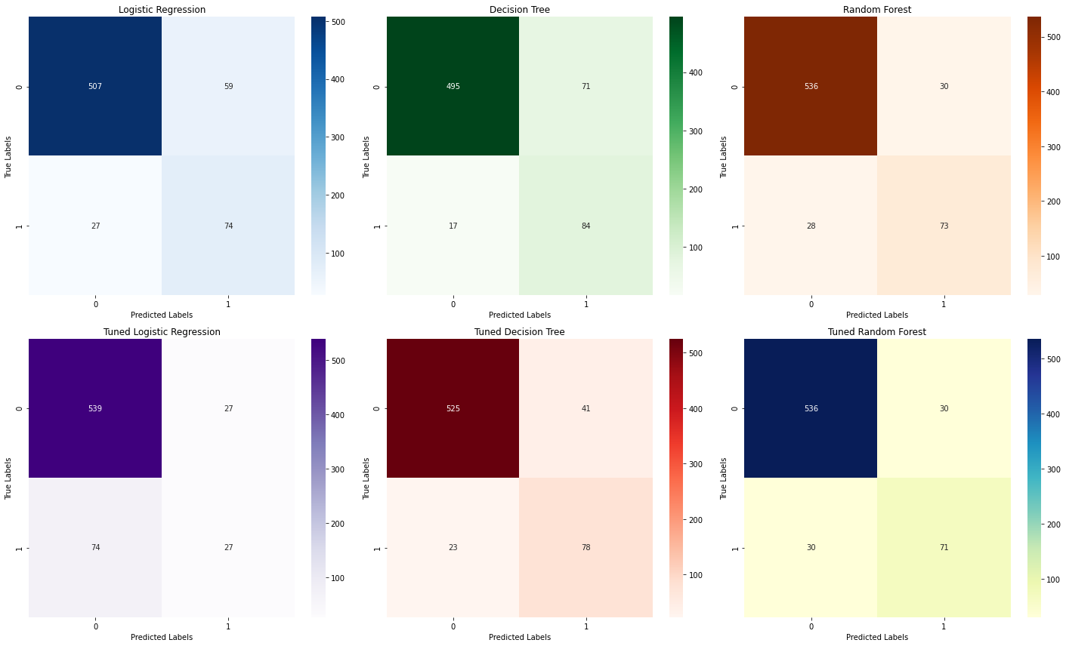
Model Evaluation
The decision tree model indicates effective identification while minimizing false negatives

Slide 11
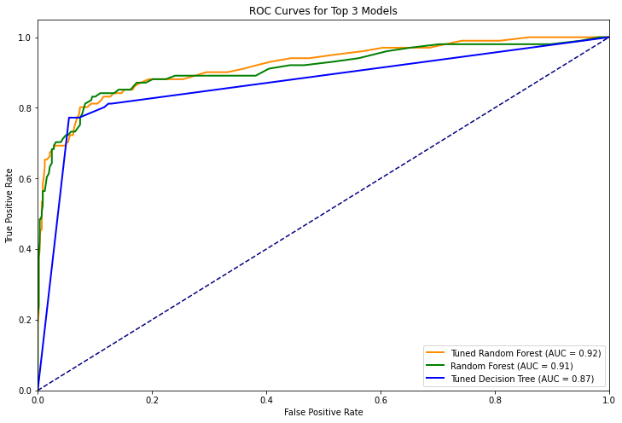
Model Evaluation
The tuned random forest model performs well, the significant overfitting and slightly lower generalization performance makes it less desirable. The tuned logistic regression model is not recommended due to its poor recall and F1-score on the testing data.

Slide 12
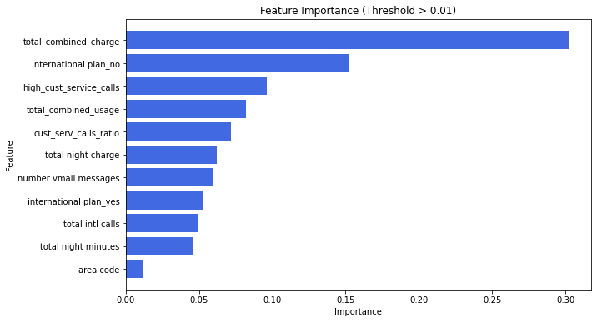
Feature Importance
The Decision Tree model identified the most important features influencing churn, including:
1. Total Combined Charge
2. International Plan (No)
High Customer Service Calls
3. Total Combined Usage

Slide 13
Key Findings
1. Total Combined Charge is the most critical factor in predicting customer churn.
2. Customers without an international plan are more likely to churn.
3. High customer service call frequency is a strong indicator of potential churn.

Slide 14
Recommendation
Target High-Value Customers: Focus on customers with high total charges, offering discounts or personalized plans to increase retention.
Improve Customer Service: Enhance customer service efficiency to reduce churn.
Reassess International Plans: Ensure international plans meet customer needs and are competitively priced.

Slide 15
Future Work
In-Depth Analysis of Churn Causes: Conducting a more detailed examination of the factors leading to customer churn could be valuable. This might include gathering insights through surveys or interviews with customers who have left to better understand their reasons for discontinuing the service.
Early Churn Prediction: Beyond predicting which customers are likely to churn, it would be advantageous to forecast when they are most likely to leave. This would enable SyriaTel to proactively deploy retention strategies well before customers reach the point of churning.

Slide 16
Thank you

