Slide 1

Exploratory Data Analysis for Microsoft's New Movie Studio
Dave Omondi

Slide 2

Overview and Business Problem
Microsoft wants to join the original video content market but lacks experience in movie production. Our task is to identify the top-performing film types at the box office and provide insights to guide Microsoft's new movie studio.
We will perform exploratory data analysis (EDA) to help Microsoft decide what types of films to create for their new movie studio. Using various movie datasets, we will analyze trends and provide actionable recommendations.

Slide 3
Objectives
The objectives of this project are to:
Compare budget to profitability.
Identify the top-performing genres.
Assess profitability by genre.

Slide 4





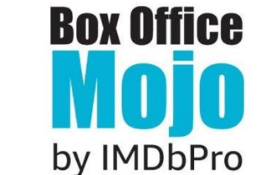
Data Sources

Slide 5
Data Analysis
We analyzed the distribution of key variables such as production budgets, domestic gross, worldwide gross, and IMDb ratings.
We also compared these variables using scatter plots and performed a correlation analysis using a heatmap.

Slide 6

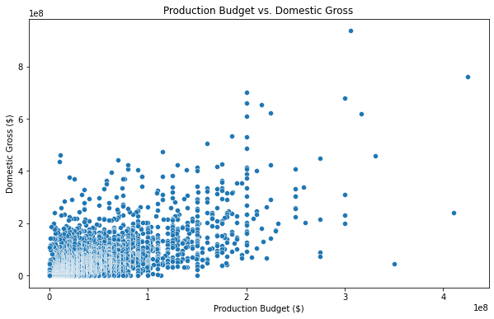
Production Budget vs. Domestic Gross
The scatter plot shows that as budgets increase, domestic revenues also tend to go up.

Slide 7
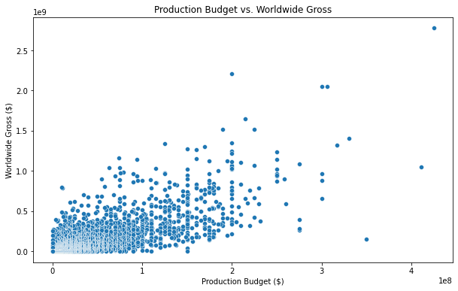
Production Budget vs. Worldwide Gross
The scatter plot suggests that as budgets increase, worldwide revenues also tend to go up.

Slide 8
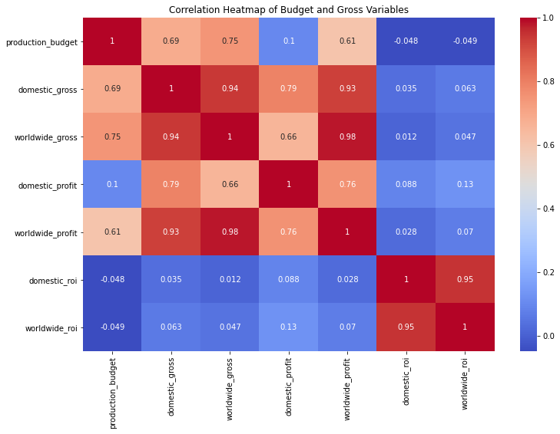
Correlation Heatmap of Budget and Gross Variables
There is a strong positive correlation between production budget and gross revenues for both domestic and worldwide, and between gross revenues and profits.

Slide 9
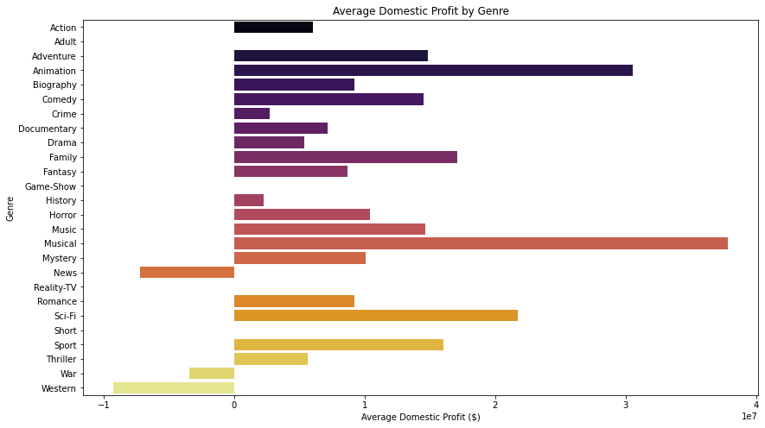
Identifying the Most Profitable Genres Domestically
Animations and musicals generate the highest average domestic profits.

Slide 10
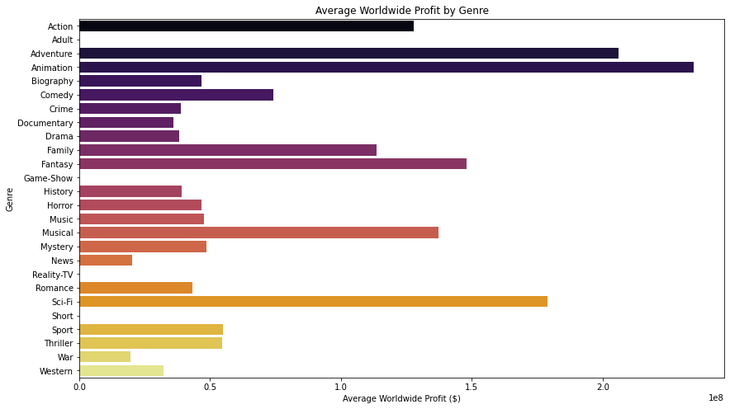
Identifying the Most Profitable Genres Worldwide
Animation, adventure and Sci-Fi have the tallest bars.
These genres generate the highest average worldwide profits.

Slide 11
Conclusion
The analysis reveals that certain genres consistently perform better both domestically and worldwide.
Action, Science Fiction, and Adventure films generally generate the highest average revenues and profits.
Mid-range to high-range budgets often result in the most profitable movies.

Slide 12
Recommendations
Prioritize profitable genres: Focus on developing films within the Action, Science Fiction, and Adventure genres.
Strategic budget management: Allocate budgets in the mid-range for film productions.

Slide 13

Questions and Answers

