Slide 1
Myrinet High-speed Interconnect

Slide 2
Myrinet Overview
User Buffer
On-board LANai μP.
SRAM holds control program (MCP) and data.
Three independent DMA engines.
160+160 MB/s link:
  low latency & high b/w
Scalable via switches.
Popular with Academic community.
Sun is Myricom’s reference platform.
Limited support for Alpha.
PCI Bus
Myrinet
card
Host DMA
SRAM
To Net
DMA
LANai
Processor
From Net
DMA

Slide 3
Goals
Modify CLF:
  Add Myrinet as transport.
  Copy-free.
Create an independent fast messaging API.
Learn how high performance servers interact with intelligent network interfaces.
Stampede App(s)
Other CLF Client(s)
Stampede
Cluster Language Facility
(CLF)
Other API
Client(s)
SHM
UDP
MC
Myrinet API
PCI Bus
Myrinet MCP

Slide 4
MCP/API Features
Multiple channels to support multiple concurrent Myrinet users.
Cut-through packet transmission:
  DMA to network can begin before DMA from host completes.
Concurrent DMA engine operation.
Pipelined data flow.
Interrupt driven network receive.
Data/variable caching/shadowing in host memory to reduce PCI traffic.
DMA receive notification reduces PCI traffic.

Slide 5
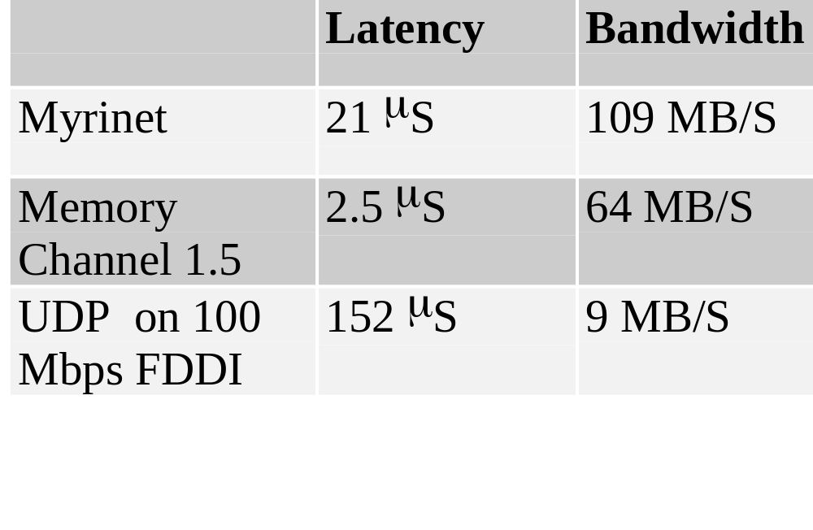
Interconnect Performance

Slide 6

CLF Copy-free Operation
User access
User access
User access
User access
Send
buffer
Recv
buffer
memcopy
Transport
specific buffer,
e.g.: SHMEM
Transport
specific buffer,
e.g.: SHMEM
memcopy
Copy-free portion

Slide 7
CLF Results
CLF used to copy a packet at least twice: once on transmit and once on receive.
Copy-free system can attain zero copy operation if transport specific buffers are not exhausted.
System falls back to using malloc’d packets when necessary. These packets require copying.

Slide 8
Future Work
Tech report on MCP and API.
Software distribution of API and MCP???
Investigate feasibility, benefits of supporting remote Get/Put, remote Fetch-and-Op, barriers, Cray T3D/T3E library, etc.
Look into other interconnects:
  Memory Channel II
  MIT Arctic network
  Quadrics network (Myrinet lessons useful).

Slide 9
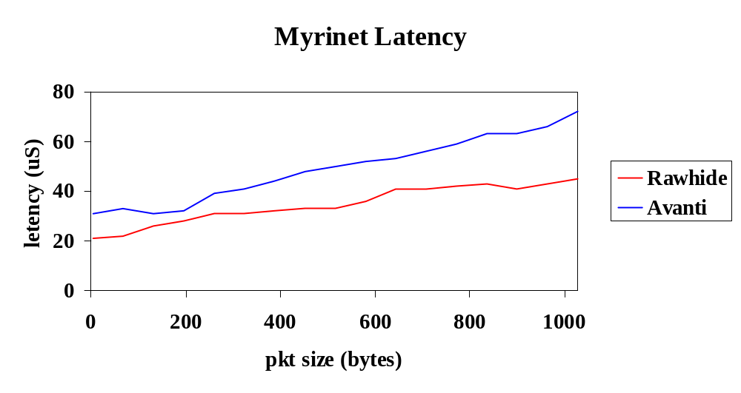
Myrinet MCP/API Latency

Slide 10
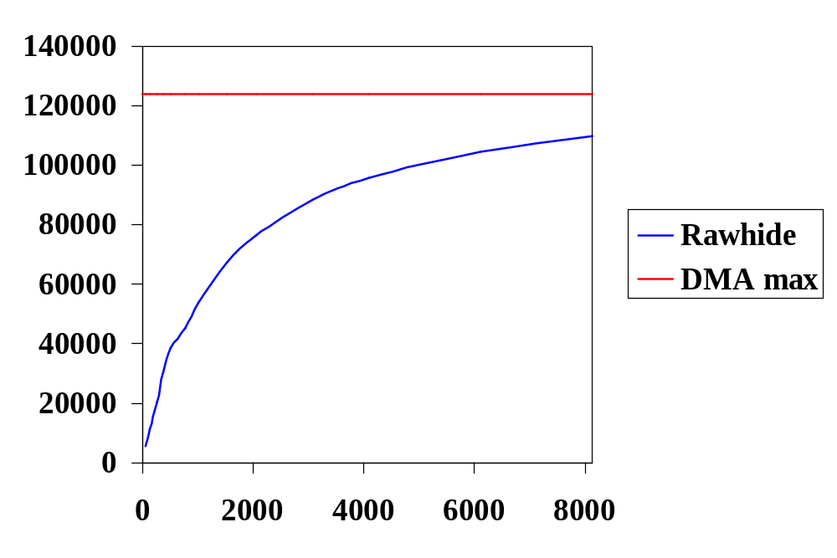
Myrinet MCP/API Bandwidth

