Slide 1
Google Analytics Customer Revenue Prediction
Samantha Werdel and Dave Palazzo

Slide 2
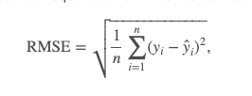

Data
Kaggle dataset from Google online merchandise store
Data consists of a time-series of individual visits to the website
Competition: Predict natural log sum of all transactions per user.
Evaluation criteria

Slide 3
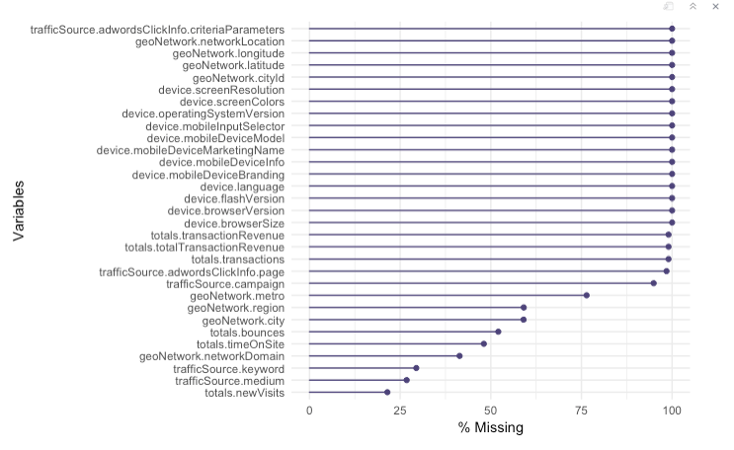
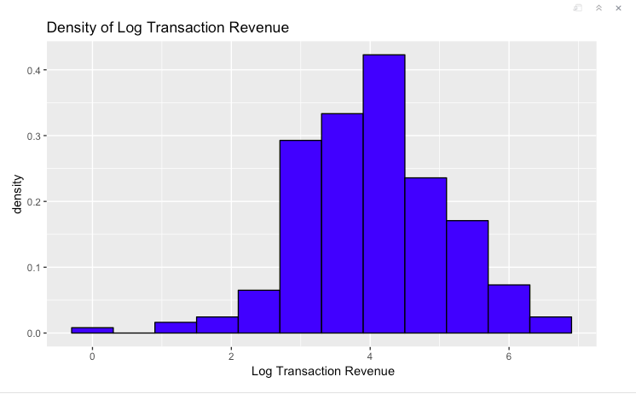
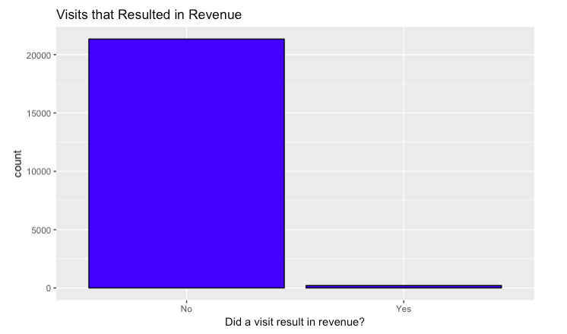
Exploratory Data Analysis
Missing values
Normal Distribution of Response variable
Objective: Build a model that predicts total transaction revenue per customer.
Research Question: Which variables are important predictors for customer revenue

Slide 4
Method: Gradient Boosting
Introduce Method, explain

Slide 5

XGBoost
Non-parametric method
Robust to non-normality
Assumes all predictor columns are numeric
One-hot encoding
Application in R
Library(xgboost)

Slide 6
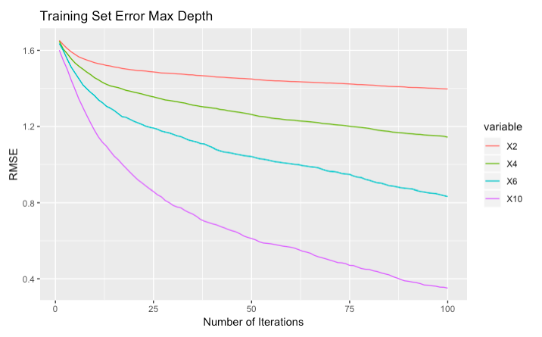
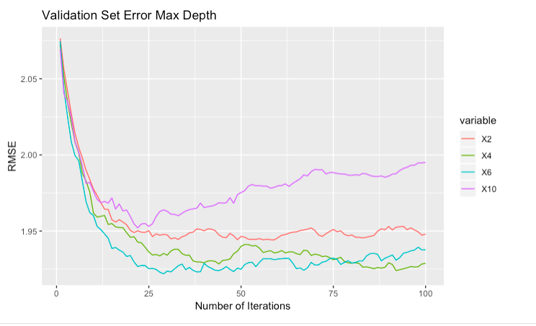
Effect of Max Depth Parameter on Training and Validation Error

Slide 7
Conclusion

