Slide 1
Economic Forecasting from S&P 500 Sentiment Analysis
Samantha Werdel and Dave Palazzo

Slide 2
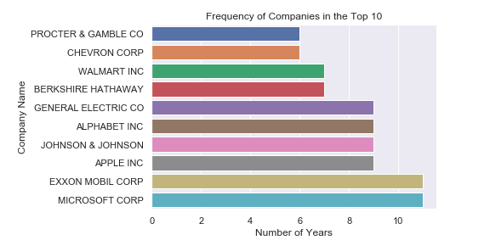
Data
Predictor Variable: Sentiment extracted from 10-K financial statements.
Top 10 companies per year measured by market capitalization.
Management Disclosure and Analysis (MD&A)
Source: SEC.org

Slide 3
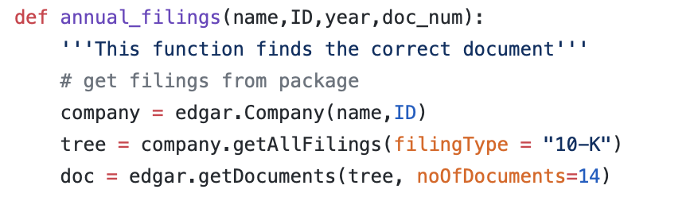
Gathering Text Data
Edgar package: Used to scrape the text from SEC

Slide 4
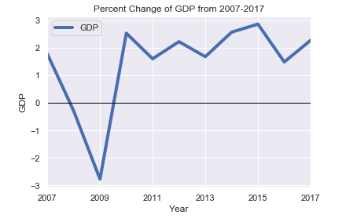
Data and Research Question
Response Variable: U.S. Annual percentage growth rate of GDP
WorldBank.org
Does the sentiment extracted from the top 10 public U.S. companies financial statements have predictive capabilities on GDP?

Slide 5

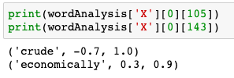
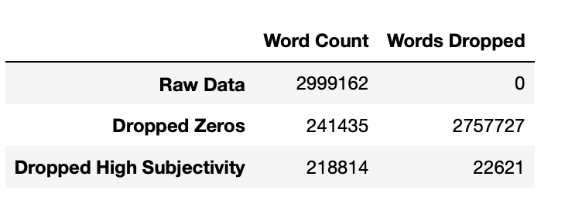
Data Transformation
Sentiment Analysis
TextBlob library
Polarity Score: -1 – 1, where -1 is very negative, 1 is very positive
Subjectivity Score: 0-1, where 0 is objective and 1 is subjective
Model excludes high subjectivity scores and 0 polarity scores

Slide 6
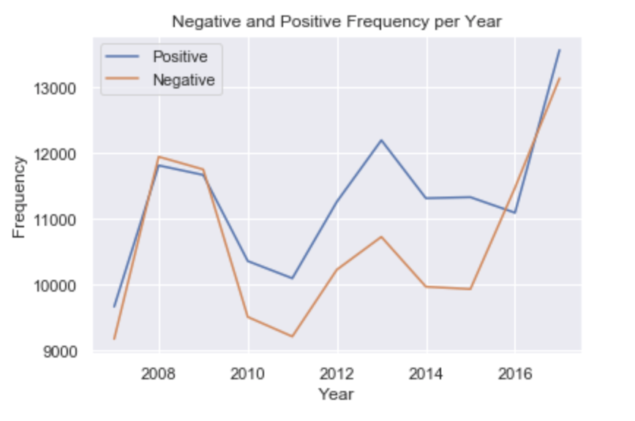
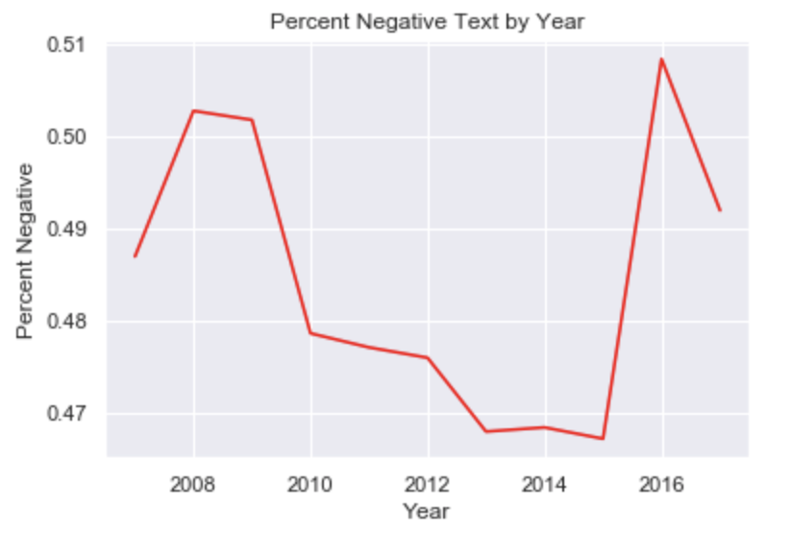
Summary Statistics

Slide 7
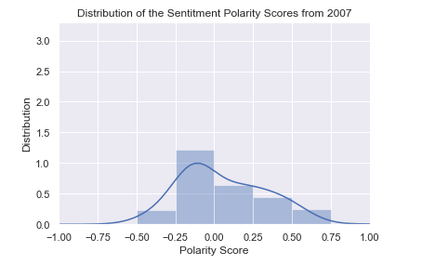
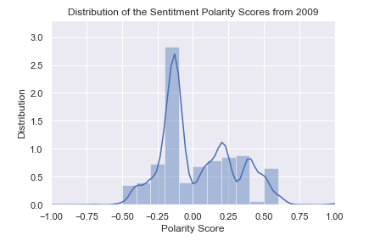
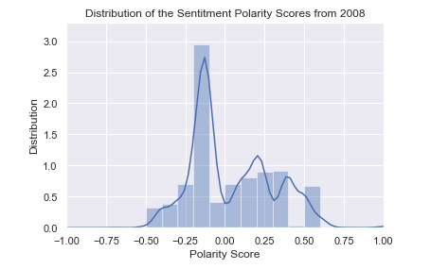
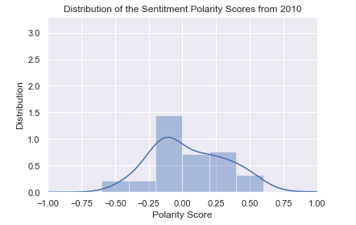
Distribution of Polarity Scores from 2007 through 2010

Slide 8
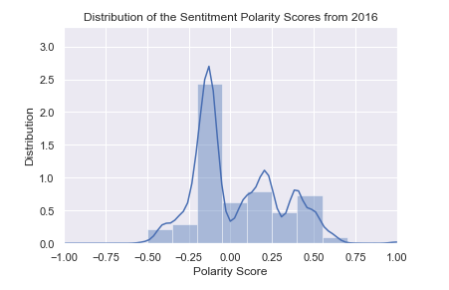
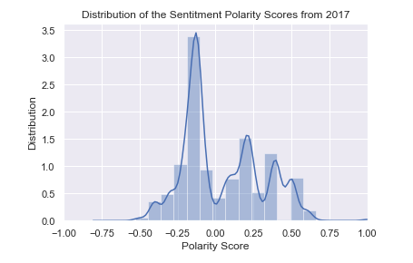
Distribution of Polarity Scores from 2016 and 2017

Slide 9
Model
Model Selection: SGD Regression, Linear Regression, XGBoost
XGBoost performed best
Parameter tuning:
K-fold Cross Validation
max_depth: Max depth of tree
Min_child_weight: Minimum weight required to create a new node

Slide 10
Model Evaluation
R-squared score: 0.488
Mean Absolute Error : 0.17
 | 2015 | 2017
Predicted GDP | 2.57 | 2.22
Actual GDP | 2.86 | 2.27

Slide 11
Conclusion
Limiting Factors
Volume of data low
Number of companies
Number of years in analysis
Cautiously optimistic of the predictive capability of sentiment analysis of financial statements

Slide 12
Citations

