Slide 1
Economic Forecasting from S&P 500 Sentiment Analysis
Samantha Werdel and Dave Palazzo

Slide 2
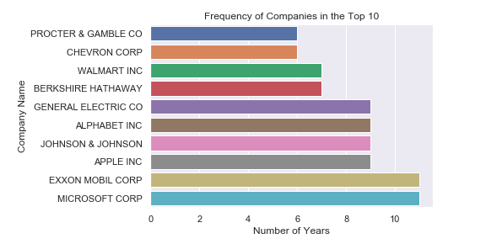
Data
Predictor Variable: Sentiment extracted from 10-K financial statements.
Top 10 companies per year measured by market capitalization.
Management Disclosure and Analysis (MD&A)
Source: SEC.org

Slide 3
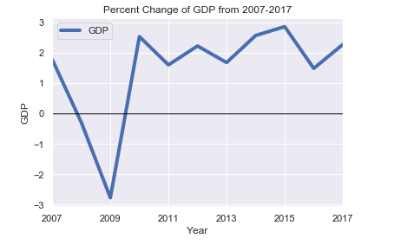
Data and Research Question
Response Variable: U.S. Annual percentage growth rate of GDP
WorldBank.org
Does the sentiment extracted from the top 10 companies financial statements in the United States have predictive capabilities

Slide 4

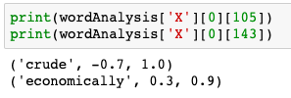
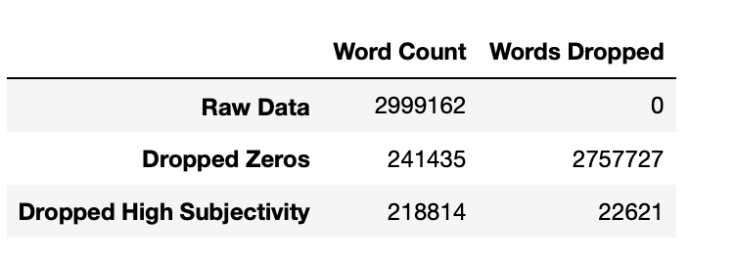
Data Transformation
Sentiment Analysis
TextBlob library
Polarity Score: -1 – 1, where -1 is very negative, 1 is very positive
Subjectivity Score: 0-1, where 0 is objective and 1 is subjective
Model excludes high subjectivity scores and 0 polarity scores

Slide 5
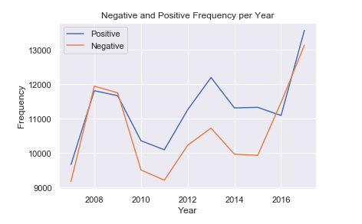
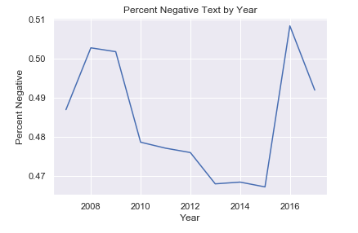
Summary Statistics

Slide 6
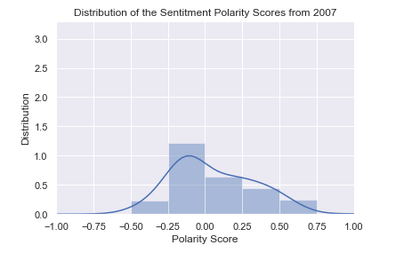
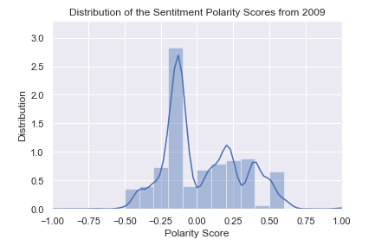
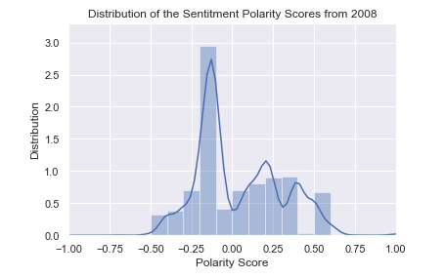
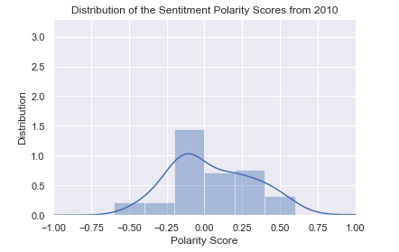
Distribution of Polarity Scores from 2007 through 2010

Slide 7
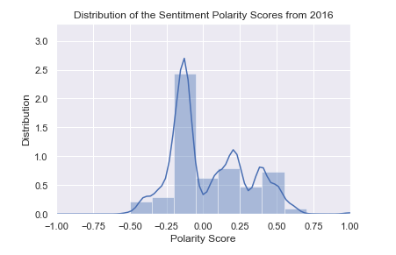
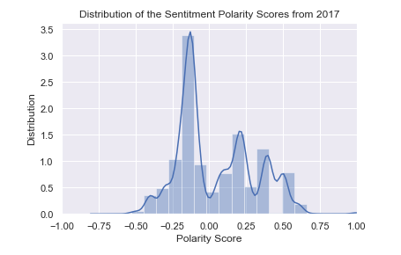
Distribution of Polarity Scores from 2016 and 2017

Slide 8
Model and Evaluation
Hypothesis:

Slide 9
Model Evaluation

