Slide 1
Economic Forecasting from S&P 500 Sentiment Analysis
Samantha Werdel and Dave Palazzo

Slide 2
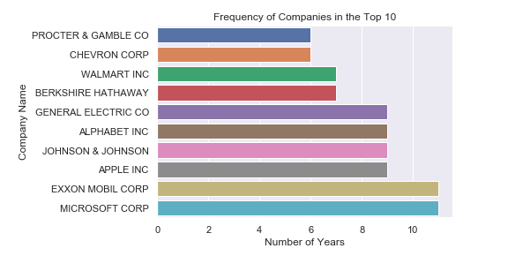
Data
Predictor Variable: Sentiment extracted from 10-K financial statements.
Top 10 companies per year measured by market capitalization.
Management Disclosure and Analysis (MD&A)
Source: SEC.org

Slide 3
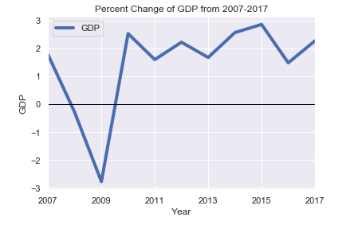
Data and Research Question
Response Variable: U.S. Annual percentage growth rate of GDP
WorldBank.org
Does the sentiment extracted from the top 10 companies financial statements in the United States have predictive capabilities

Slide 4
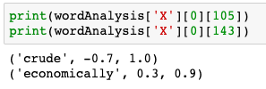
Data Transformation
Sentiment Analysis
TextBlob library

