Slide 1

ECE 322 LAB 1
SOFTWARE TESTING METHODOLOGIES
Author: Avik Mandal
Modified by: Yuan Feng

Slide 2
Outline
Canvas
Lab Safety: Lab 0 (Complete lab safety quiz)
Office hours: Timings displayed on eClass
Lab Reports
Introduction to Software Testing
What is Black-Box Testing?
Black-Box Testing Techniques
Failure Testing / Dirty Testing
Error Guessing
Partition-Based Testing
Equivalence Partitioning
Boundary Value Analysis

Slide 3
Canvas
This is the first year for Canvas
Please let us know if you notice any issue

Slide 4
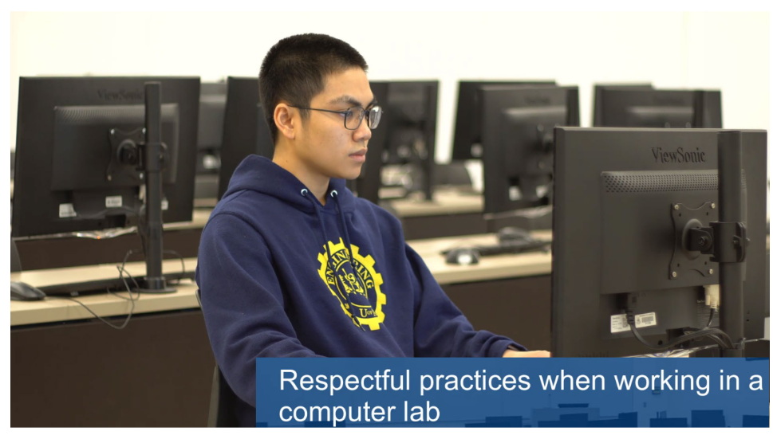
Lab Safety
Complete lab safety quiz

Slide 5

Office Hours
[TBD]
Lab Team:
  Roy Sun (rsun11@ualberta.ca)
  Yuyao Wang (yuyao16@ualberta.ca)
  Yuan Feng (yfeng3@ualberta.ca)
Office Hours
Office hours online via Zoom
Links available on eClass
4

Slide 6
Lab Reports
One report for each lab
Submit via Canvas
Last report will have a shorter due date (university grading requirement)
5

Slide 7
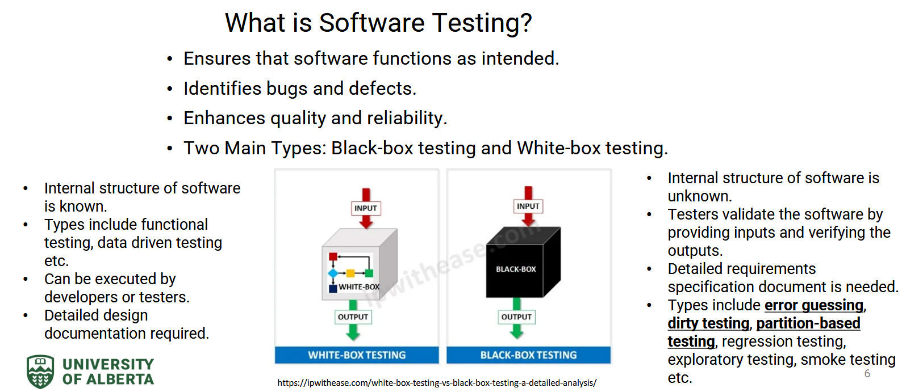
Introduction to Software Testing
6

Slide 8
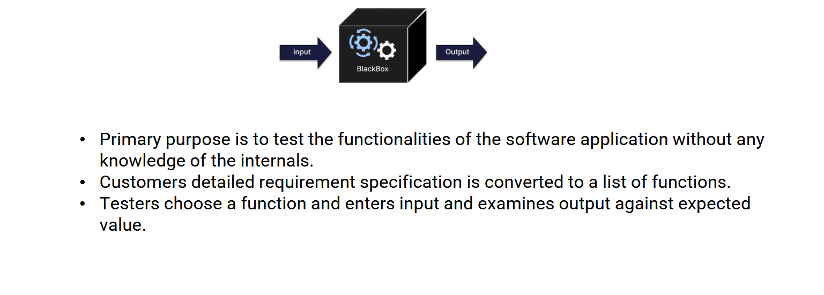
Black-Box Testing Techniques
Test functionalities without internal knowledge.
Convert requirements to list of functions.
Provide inputs and verify outputs.
7

Slide 9
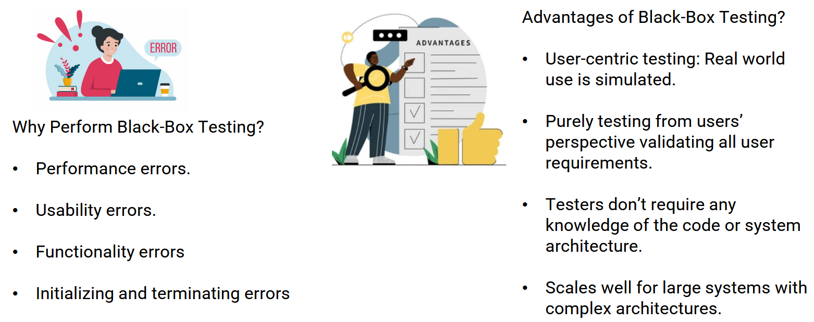
Black-Box Testing Advantages
Detects performance, usability, functionality errors.
User-centric: simulates real use.
No code knowledge required.
Scales well for large systems.
8

Slide 10
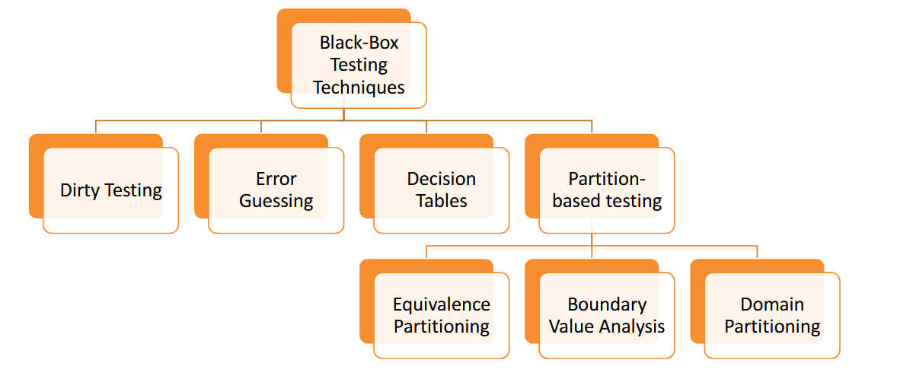
Black-Box Testing Advantages
Detects performance, usability, functionality errors.
User-centric: simulates real use.
No code knowledge required.
Scales well for large systems.
8

Slide 11
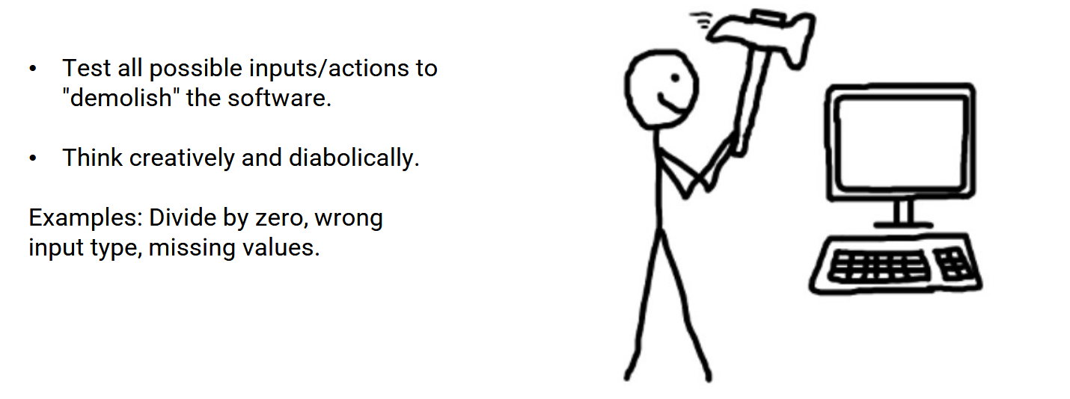
Failure or Dirty Testing
Test all possible inputs/actions to break the software.
Think creatively and diabolically.
Examples: Divide by zero, wrong input type, missing values.
9

Slide 12
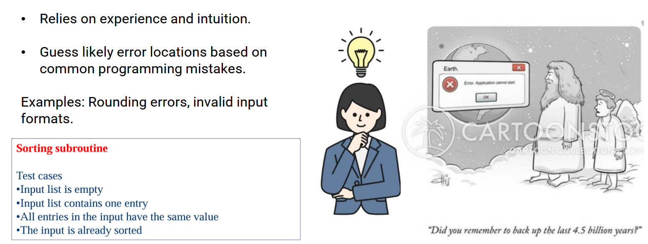
Error Guessing
Based on tester experience and intuition.
Guess error-prone areas from common mistakes.
Examples: rounding errors, invalid input formats.
10

Slide 13
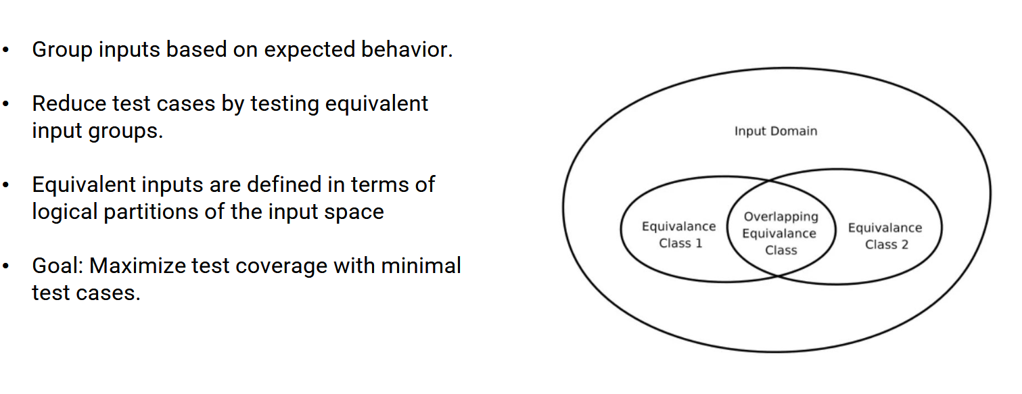
Partition-Based Testing
Group inputs by expected behavior.
Reduce test cases by testing equivalent groups.
Maximize coverage with minimal cases.
11

Slide 14
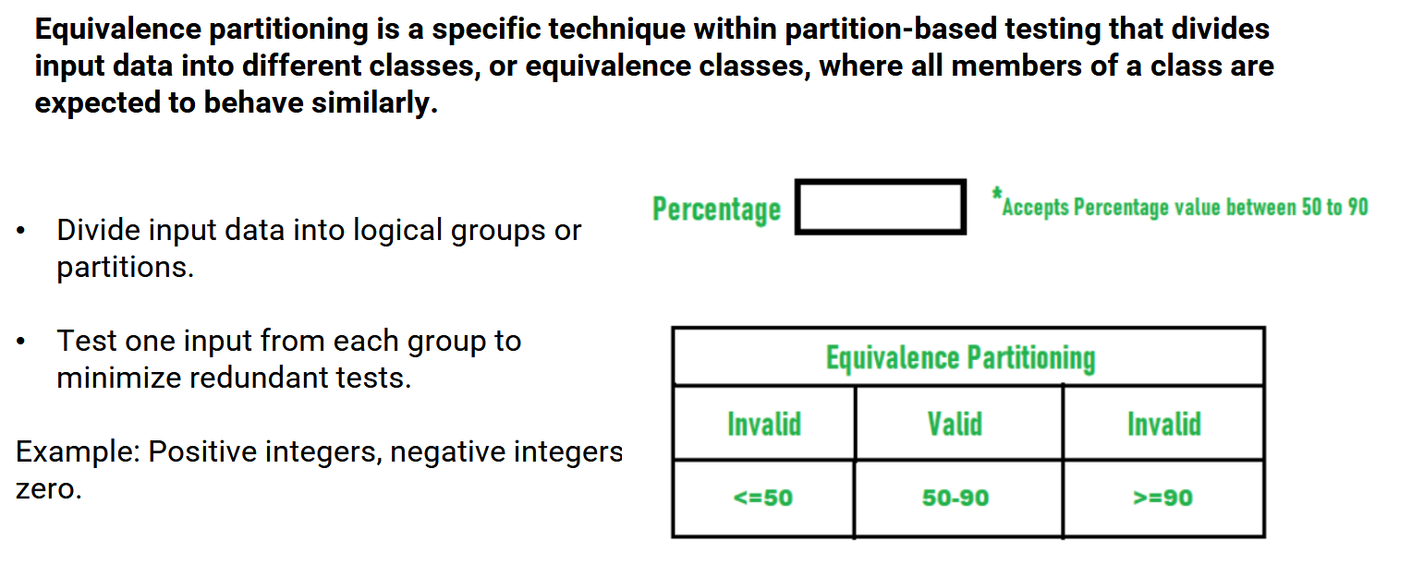
Equivalence Partitioning
Divide inputs into logical groups.
Test one input per group.
Example: Positive, negative, zero integers.
12

Slide 15
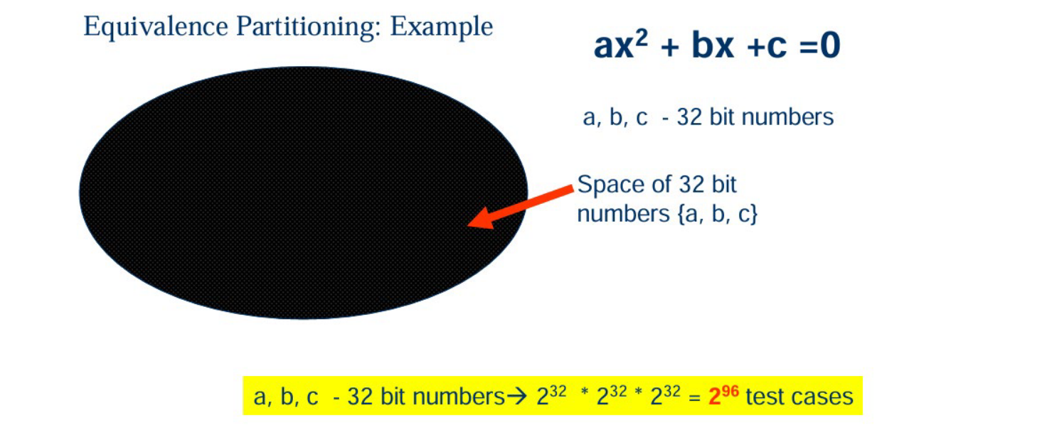
Equivalence Partitioning: Example
Divide inputs into logical groups.
Test one input per group.
Example: Positive, negative, zero integers.
12

Slide 16
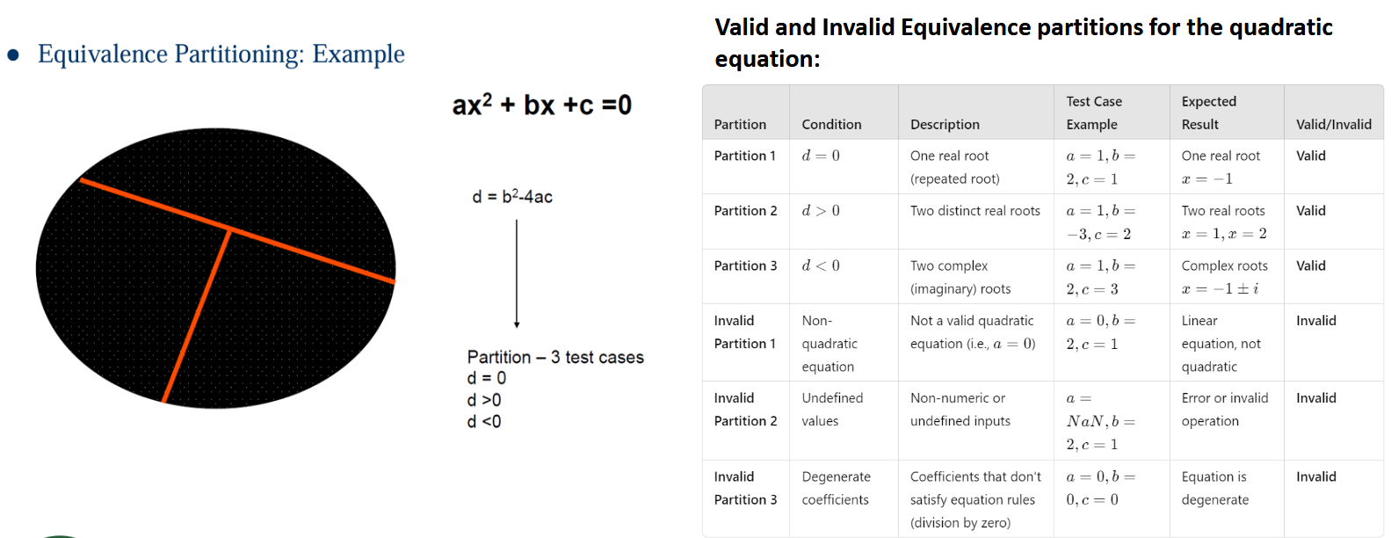
Equivalence Partitioning: Example
Divide inputs into logical groups.
Test one input per group.
Example: Positive, negative, zero integers.
12

Slide 17
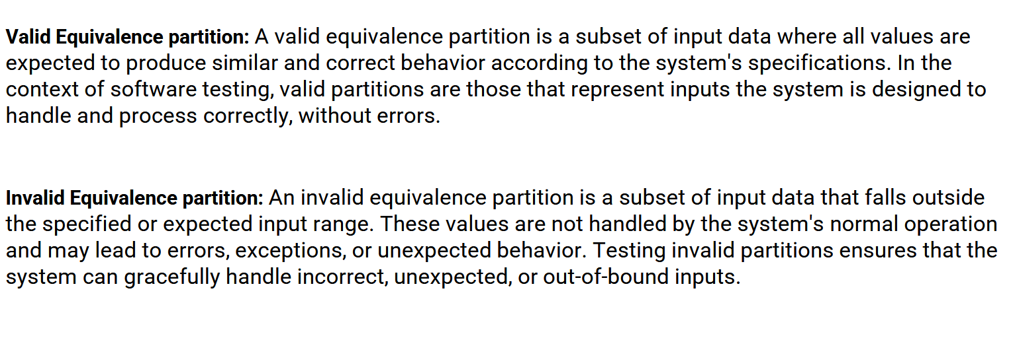
Valid vs Invalid Equivalence
Valid: Inputs within expected range, correct behavior.
Invalid: Inputs outside range, may cause errors.
13

Slide 18
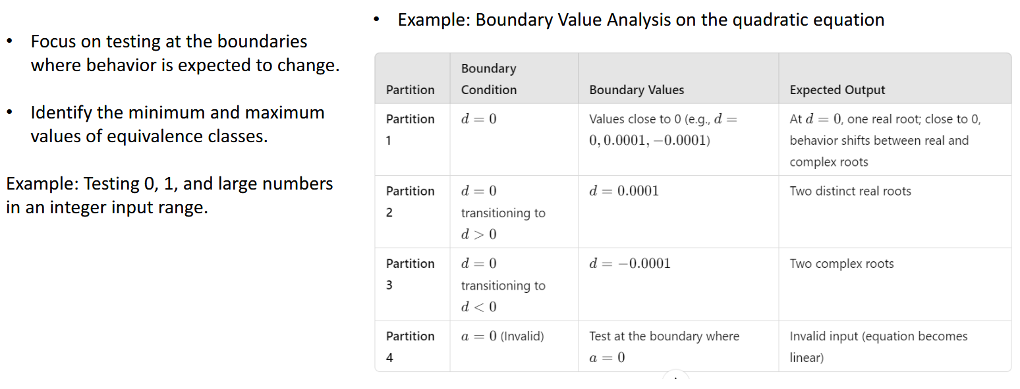
Boundary Value Analysis
Test at input boundaries where behavior changes.
Check min/max values of partitions.
Example: Test 0, 1, and large numbers.
14

Slide 19
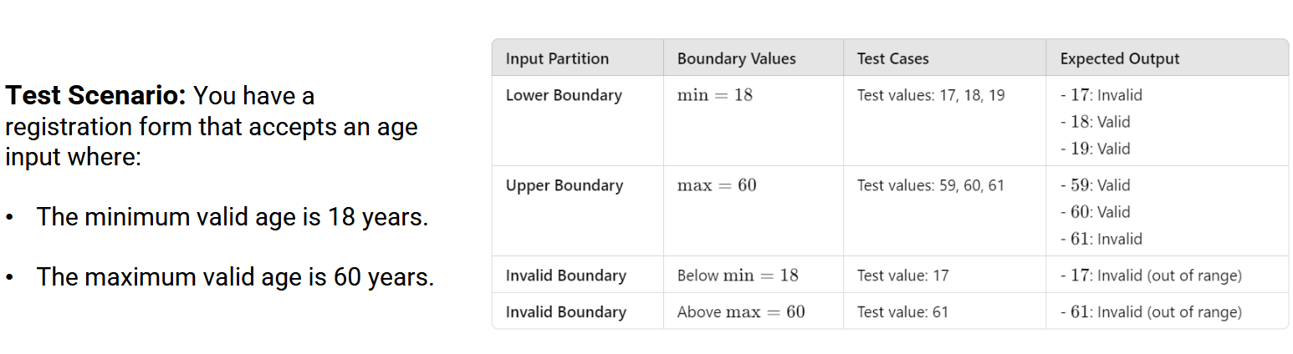
Boundary Value Analysis Example
Registration form age input:
Valid range: 18–60.
Boundary tests: 17 (invalid), 18 (valid), 60 (valid), 61 (invalid).
15

Slide 20
Questions?

