Slide 1

ECE 322 LAB 2
Black-box testing 2
Author: Avik Mandal
Modified by: Yuan Feng

Slide 2

Lab Safety
No food and drink

Slide 3
Outline
Extreme point combination (EPC)
Weak nx1 Strategy
Examples covering each technique

Slide 4
Extreme Point Combination
Divide inputs into logical groups.
Test one input per group.
Example: Positive, negative, zero integers.
Definition: It involves selecting the minimum, maximum, zero, null, or
other critical values for each input parameter and creating test cases that
combine these extreme values.
Objective: The primary goal is to identify issues that may not surface
during normal testing but occur when inputs are at their extreme limits.
This includes detecting boundary-related defects and errors due to
interactions between parameters at their extremes.
12

Slide 5
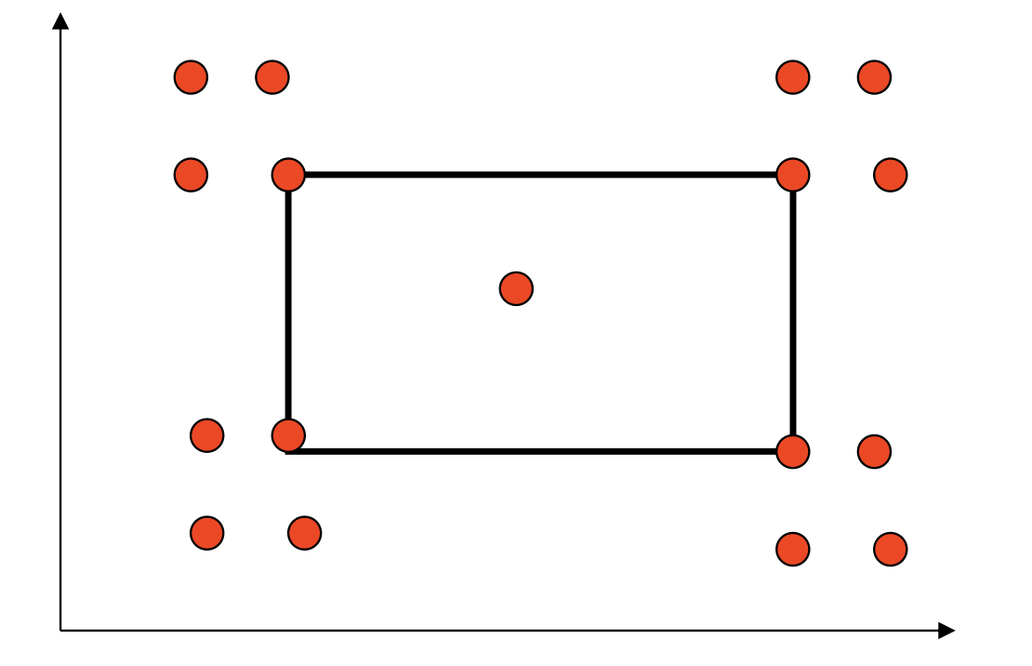
Extreme Point Combination
Sample from lecture:
Identify boundaries -> 4
x: min, <min, max, >max
Y: same as above
4*4 + 1 (inside) =17 points
Divide inputs into logical groups.
Test one input per group.
Example: Positive, negative, zero integers.
12

Slide 6
Extreme Point Combination
Divide inputs into logical groups.
Test one input per group.
Example: Positive, negative, zero integers.
Benefits:
• Effective Detection: Uncovers boundary-related defects efficiently.
• Risk Mitigation: Focuses on high-risk input combinations.
Limitations:
• Not Exhaustive: May miss defects in non-extreme scenarios.
• Complexity: With many parameters, combinations can grow exponentially.
Conclusion:
• Extreme Point Combination Testing is a valuable technique.
• Should be used alongside other testing methods for comprehensive coverage.
12

Slide 7
Weak nx1Strategy
Divide inputs into logical groups.
Test one input per group.
Example: Positive, negative, zero integers.
•Definition: A testing technique where each of the 'n' input parameters
is tested individually at its extreme values while all other parameters
are held at their nominal (normal) values.
•Objective: To identify defects that occur when individual parameters
are at their extreme values, without considering interactions between
parameters.
•Characteristics:
Tests each parameter in isolation.
Reduces the number of test cases compared to exhaustive testing.
Focuses on boundary values for each parameter.
12

Slide 8
Weak nx1Strategy: Key Differences
Divide inputs into logical groups.
Test one input per group.
Example: Positive, negative, zero integers.
Parameter Interactions:
•EPC Testing: Considers the interactions between multiple parameters at their extreme values. It is designed to uncover defects that only appear when certain combinations of extremes occur.
•Weak n x 1 Testing: Does not consider parameter interactions. It tests the impact of each parameter's extreme value in isolation.
Defect Detection Capability:
•EPC Testing: More effective at finding defects caused by interactions between parameters at their extreme values.
•Weak n x 1 Testing: Efficient at detecting defects related to individual parameters but may miss defects due to parameter interactions.
12

Slide 9
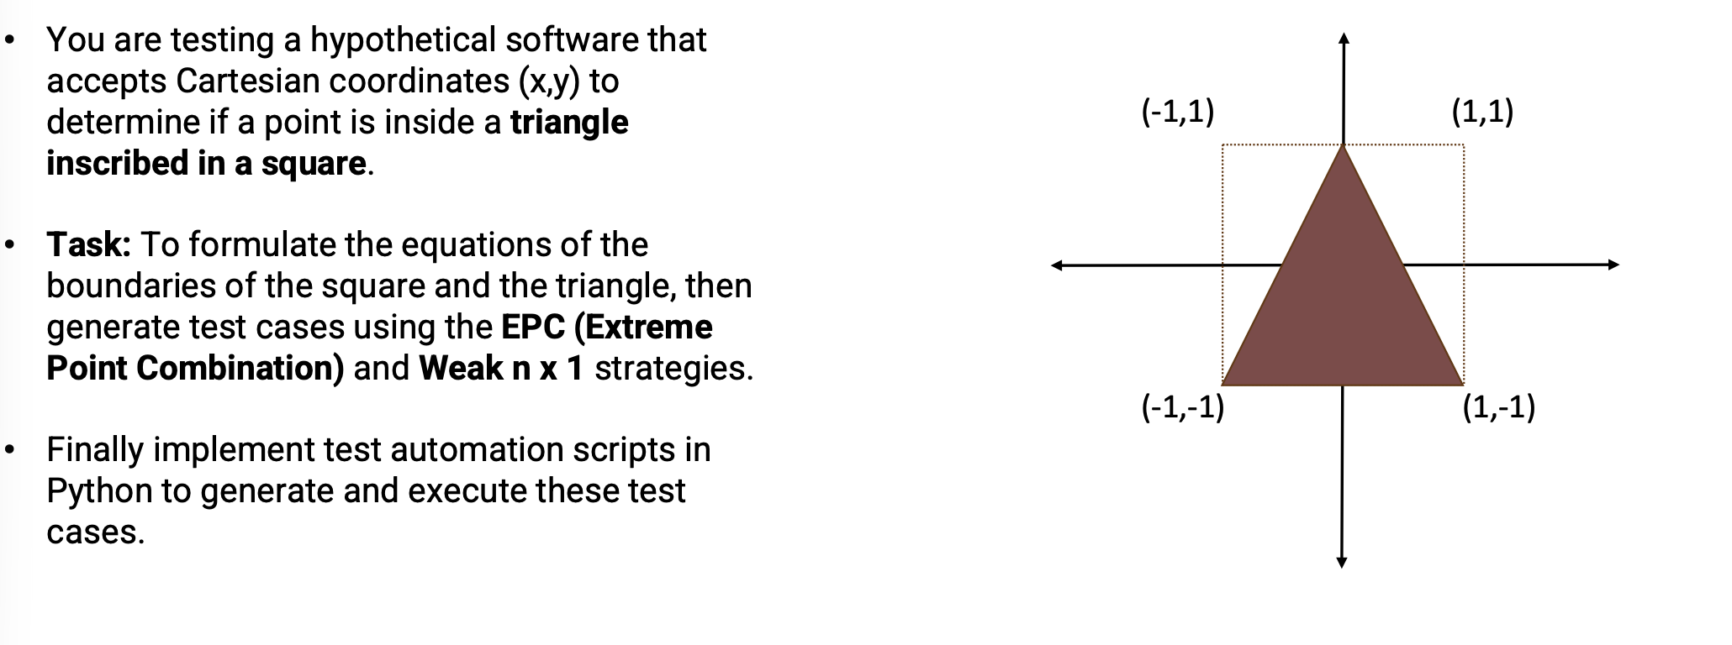
Example
Divide inputs into logical groups.
Test one input per group.
Example: Positive, negative, zero integers.
12

Slide 10
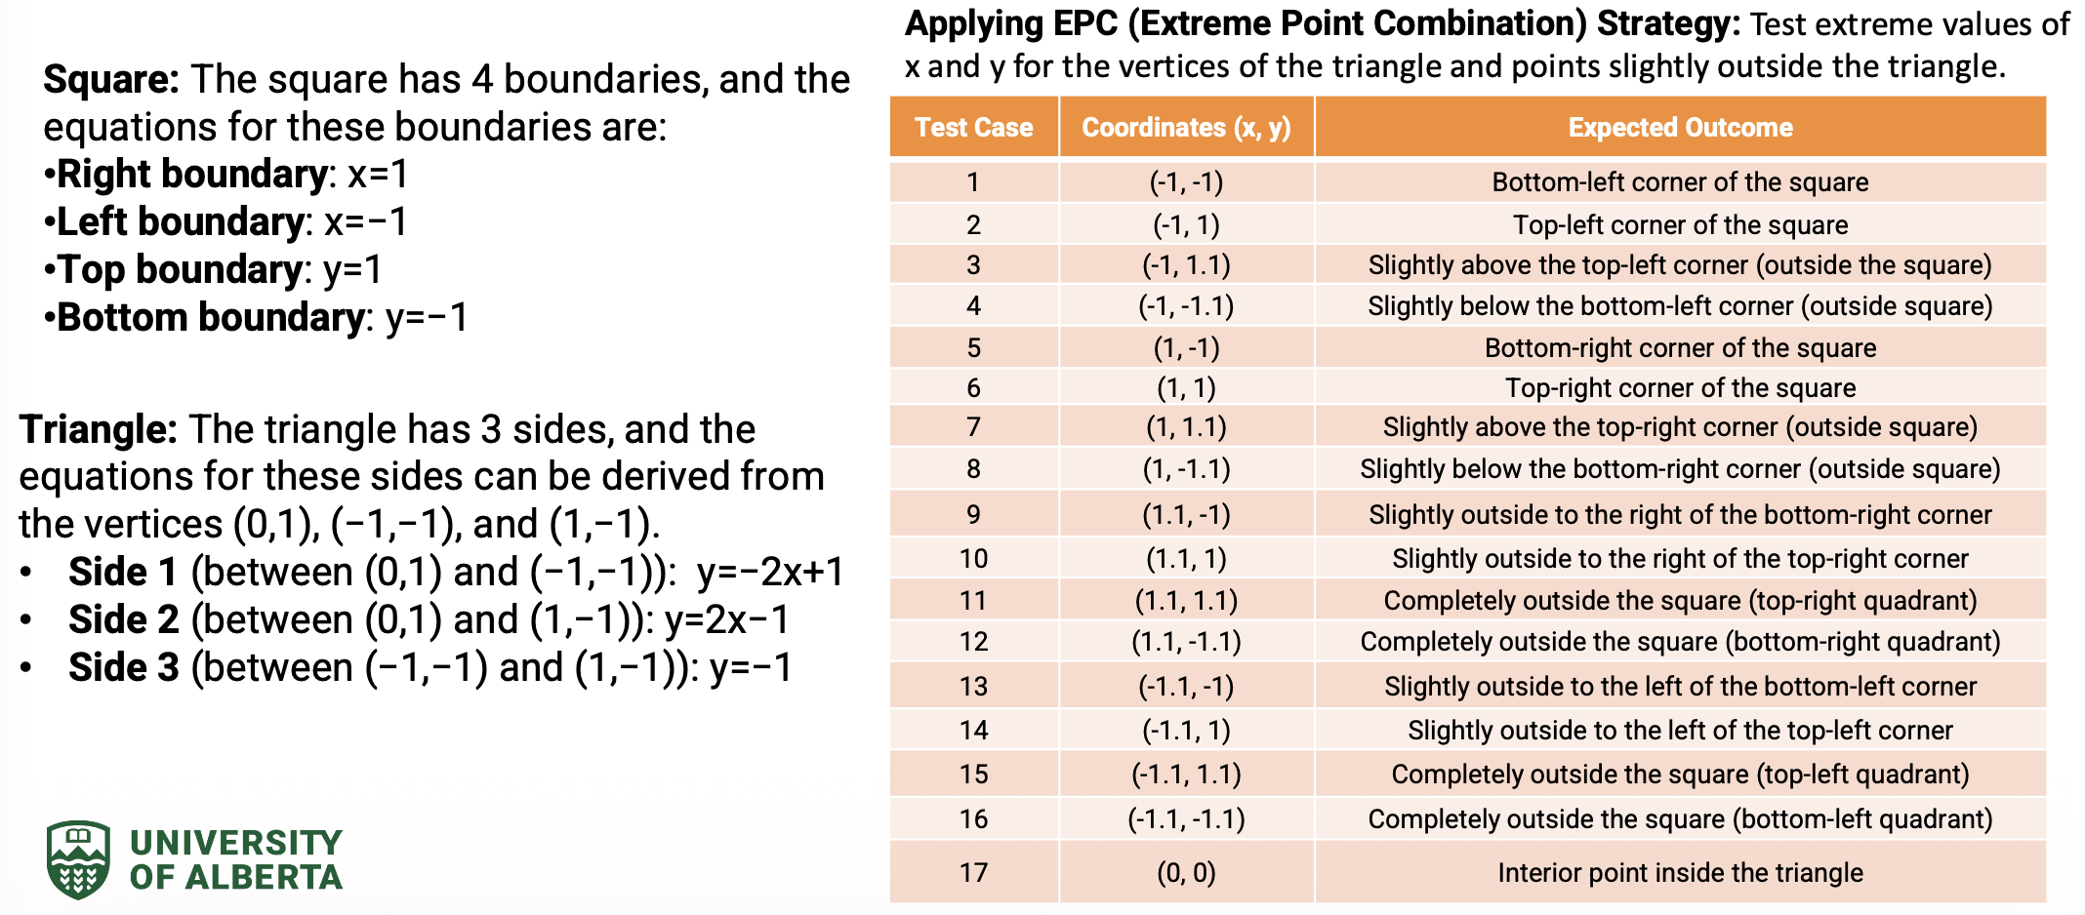
Example
Divide inputs into logical groups.
Test one input per group.
Example: Positive, negative, zero integers.
12

Slide 11
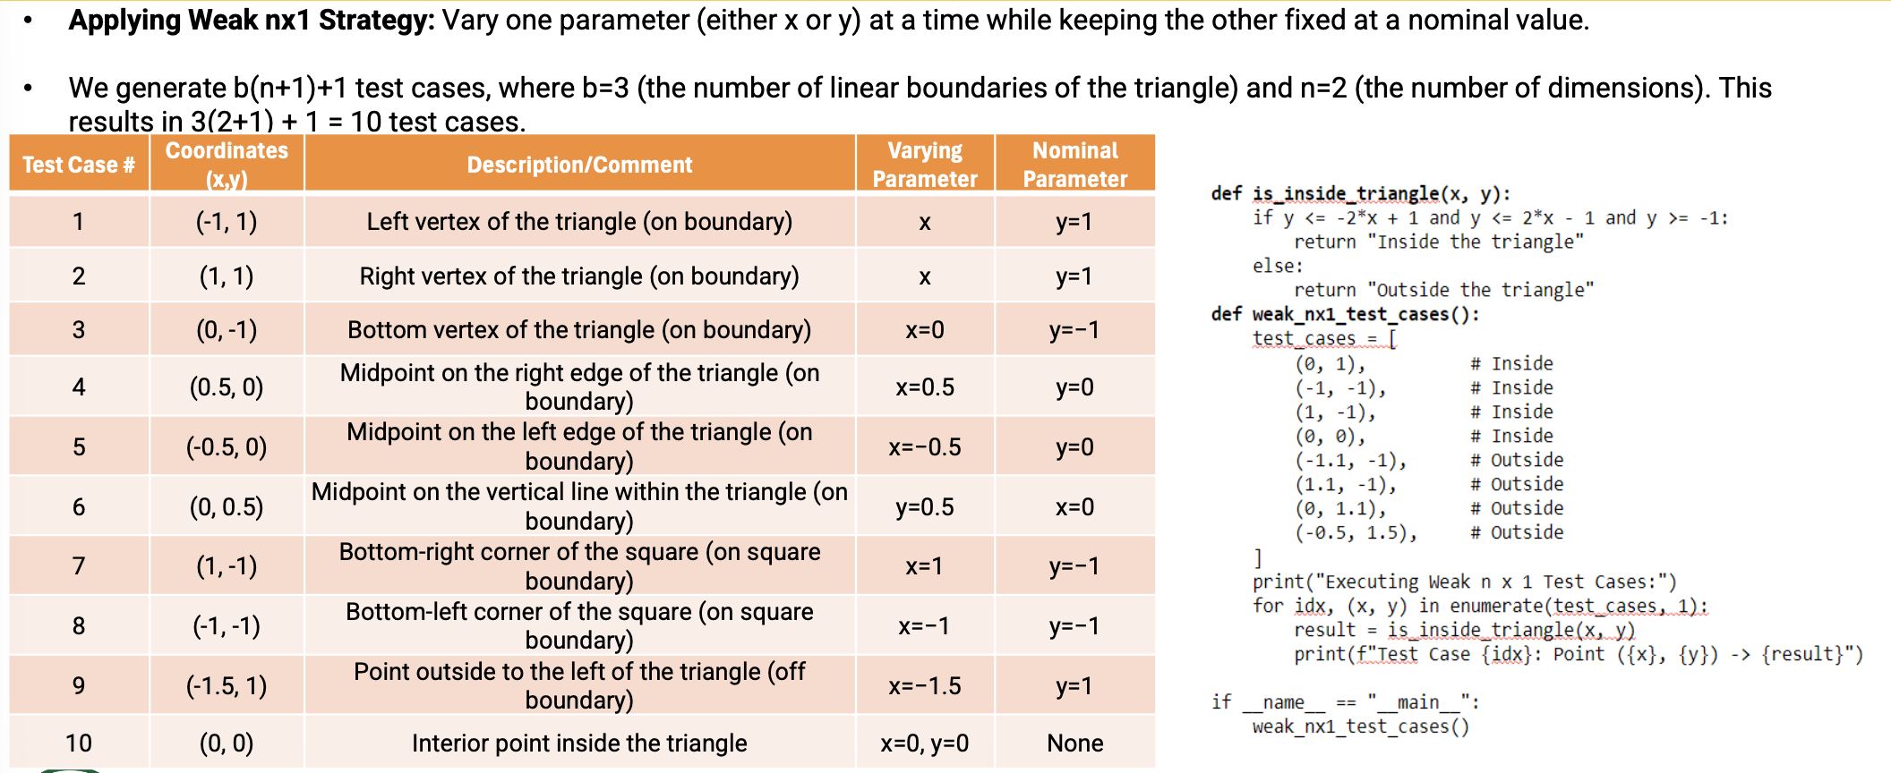
Example
Divide inputs into logical groups.
Test one input per group.
Example: Positive, negative, zero integers.
12

Slide 12
Questions?

