Slide 1

ECE 322 White Box testing
Author: Avik Mandal
Modified by: Yuan Feng

Slide 2
Outline
Pairwise testing
Unit testing
Control flow graph
Mock Object Library

Slide 3
Academic Accommodation
Lectures may be audio recorded for the purpose of a student’s individual study as part of an approved academic accommodation

Slide 4
Overview
Divide inputs into logical groups.
Test one input per group.
Example: Positive, negative, zero integers.
Definition: White Box Testing is a software testing technique in which the internal
structure, design, and implementation of the software are known to the Tester.
Objective: The primary goal is to verify that the internal operations of the software work
as expected according to the design and implementation.
Key Techniques:
Control flow testing
Data flow testing
Branch testing
Pairwise Testing
12

Slide 5
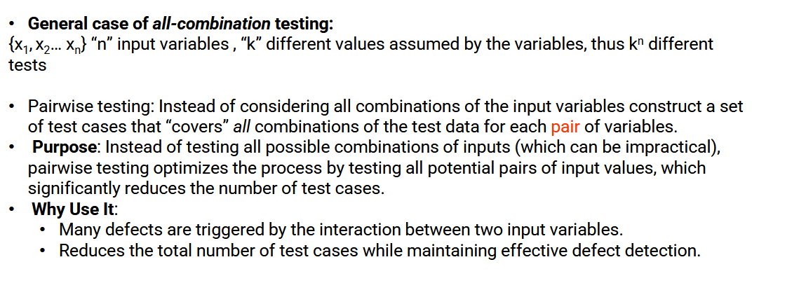
Pairwise Testing
12

Slide 6
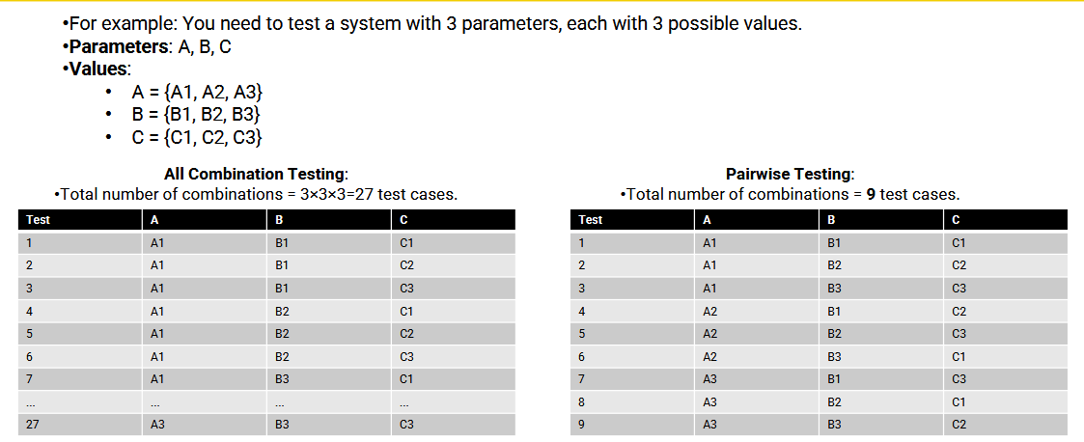
Pairwise Testing
12

Slide 7
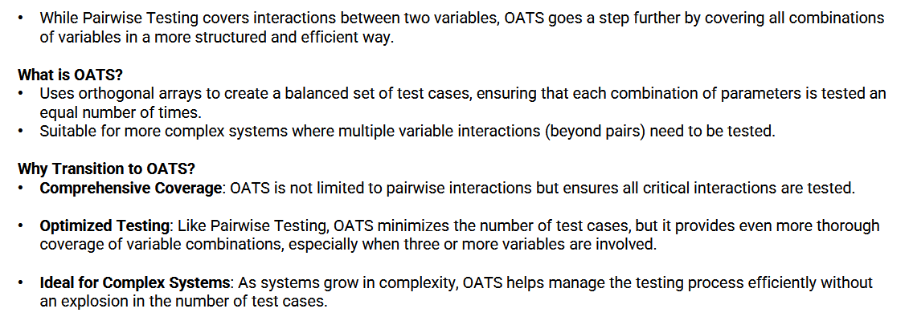
Orthogonal Array Test Strategy
12

Slide 8
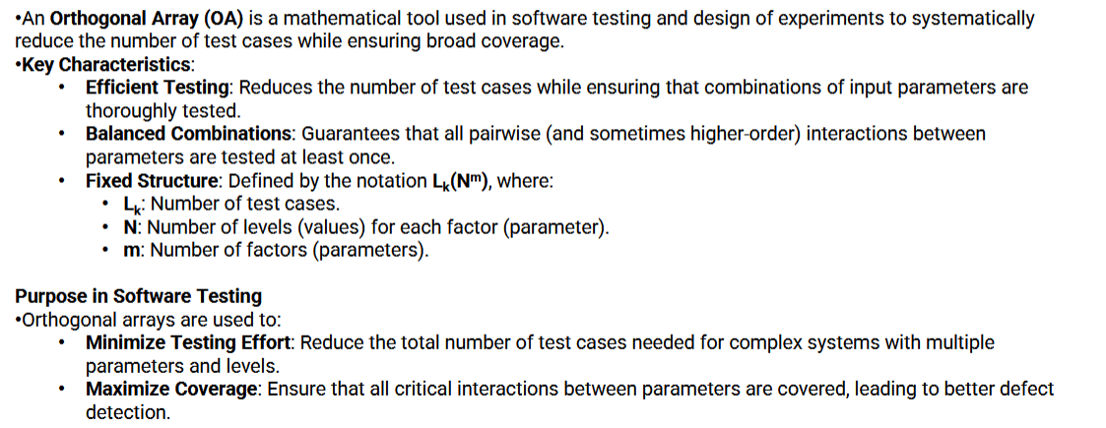
Orthogonal Array Test Strategy
12

Slide 9
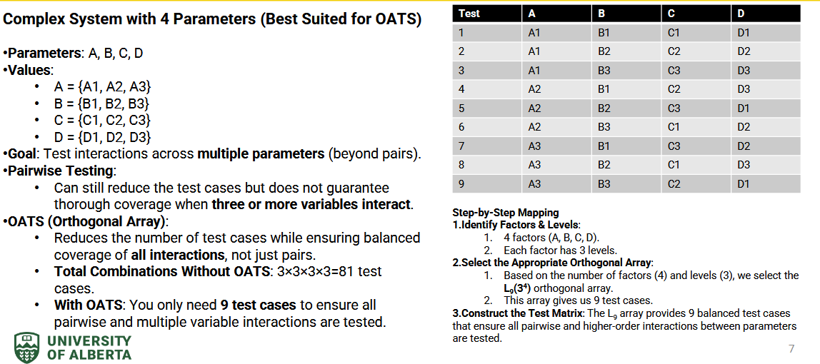
Orthogonal Array Test Strategy
12

Slide 10
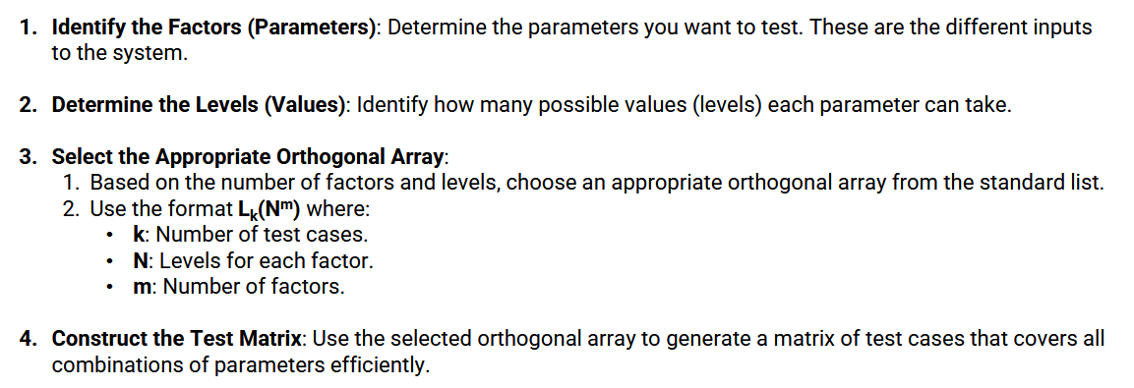
Orthogonal Array Test Strategy
How to construct an orthogonal array:
12

Slide 11

Divide inputs into logical groups.
Test one input per group.
Example: Positive, negative, zero integers.
12

Slide 12
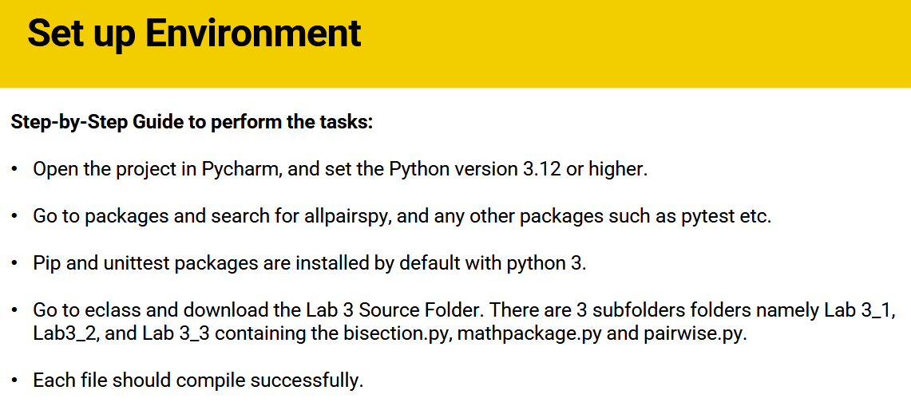
Divide inputs into logical groups.
Test one input per group.
Example: Positive, negative, zero integers.
12

Slide 13
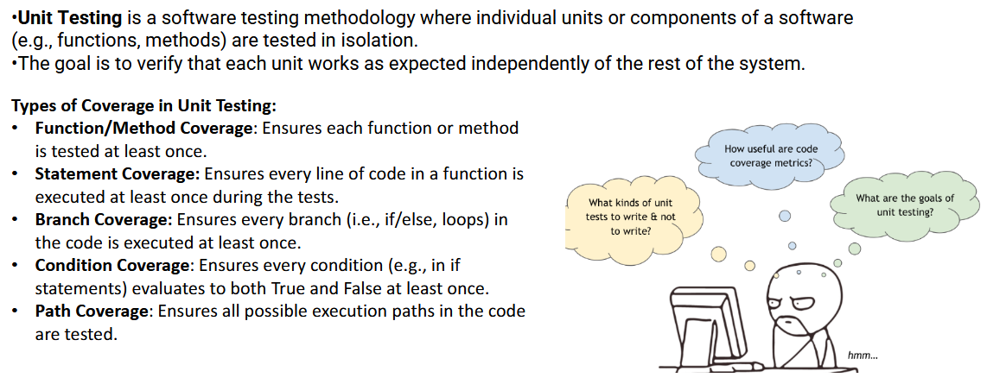
Unit Testing
Divide inputs into logical groups.
Test one input per group.
Example: Positive, negative, zero integers.
12

Slide 14
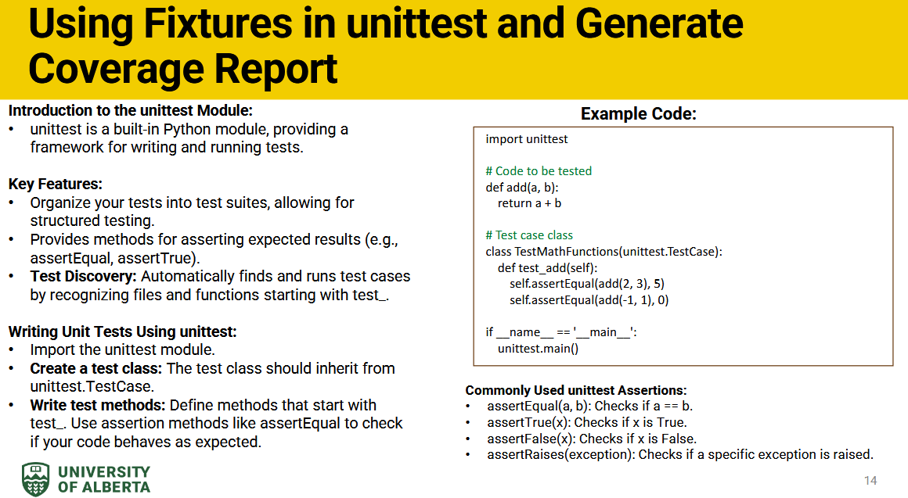
Divide inputs into logical groups.
Test one input per group.
Example: Positive, negative, zero integers.
12

Slide 15
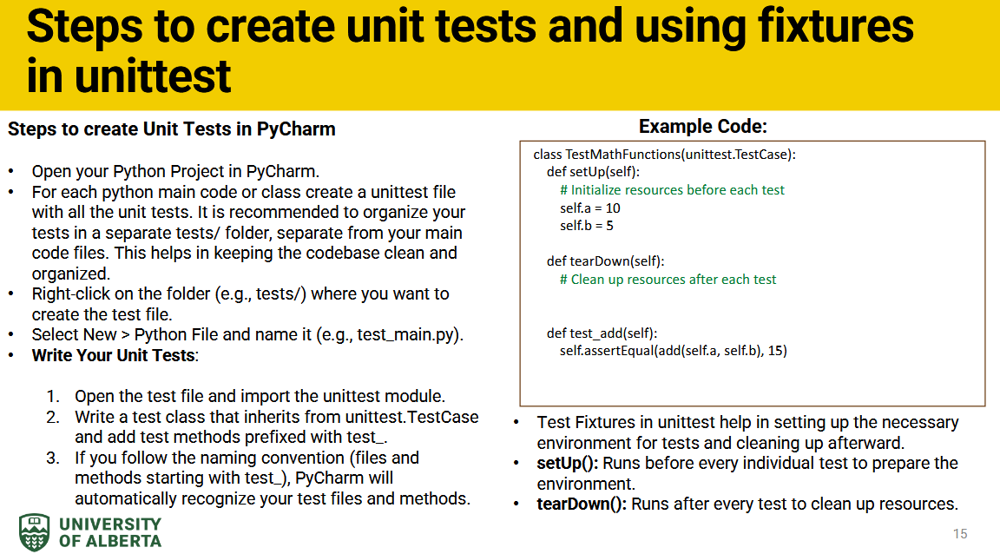
Divide inputs into logical groups.
Test one input per group.
Example: Positive, negative, zero integers.
12

Slide 16
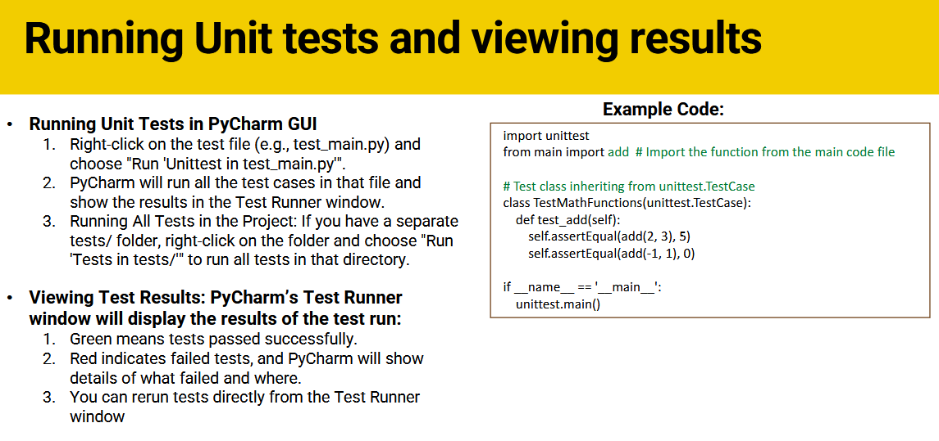
Divide inputs into logical groups.
Test one input per group.
Example: Positive, negative, zero integers.
12

Slide 17

Divide inputs into logical groups.
Test one input per group.
Example: Positive, negative, zero integers.
12

Slide 18
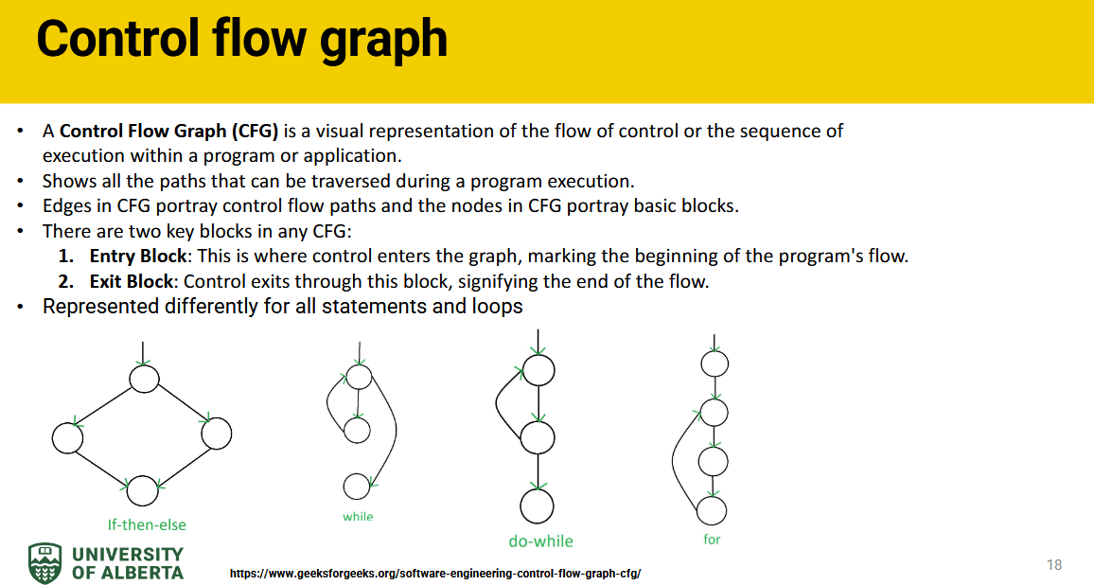
Divide inputs into logical groups.
Test one input per group.
Example: Positive, negative, zero integers.
12

Slide 19

Divide inputs into logical groups.
Test one input per group.
Example: Positive, negative, zero integers.
12

Slide 20
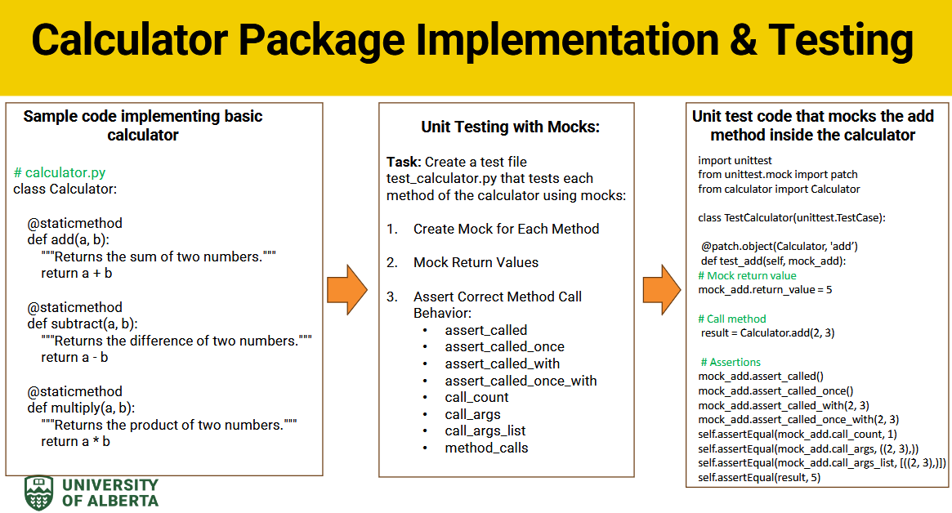
Divide inputs into logical groups.
Test one input per group.
Example: Positive, negative, zero integers.
12

Slide 21
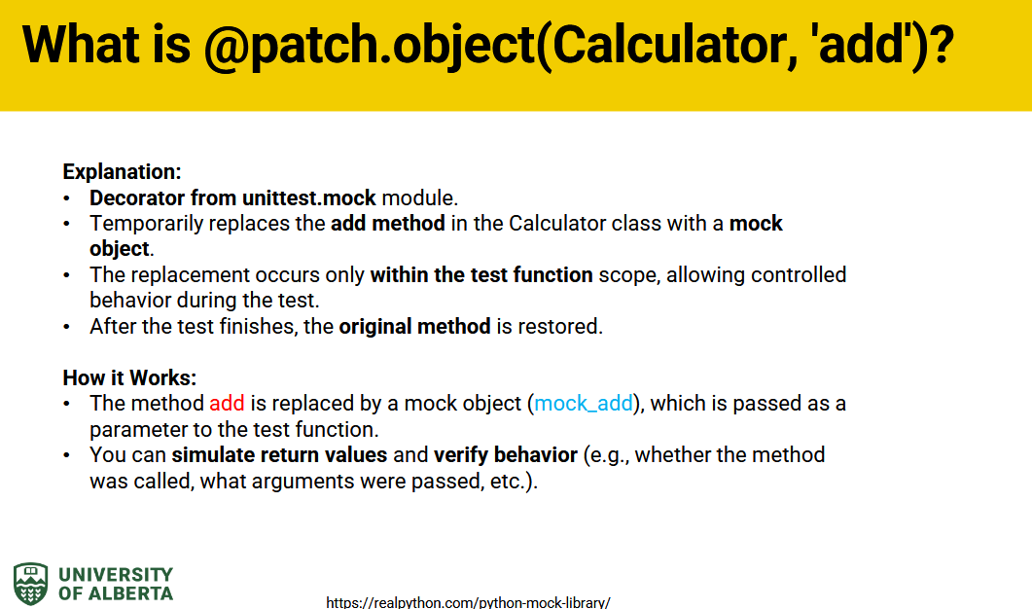
Divide inputs into logical groups.
Test one input per group.
Example: Positive, negative, zero integers.
12

Slide 22
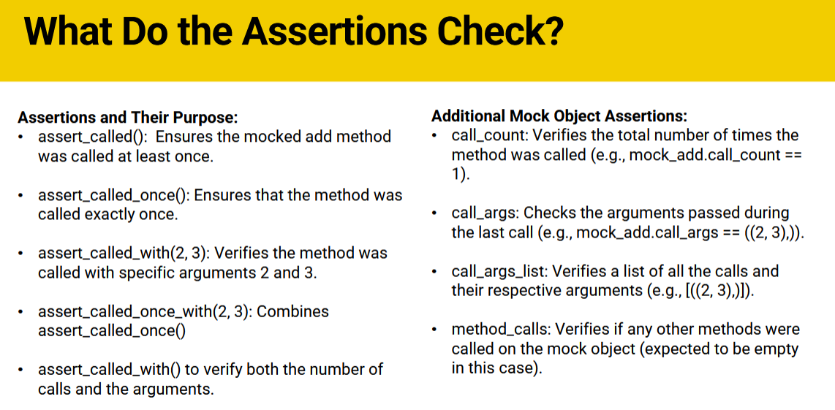
Divide inputs into logical groups.
Test one input per group.
Example: Positive, negative, zero integers.
12

Slide 23
Questions?

