Slide 1

ECE 322 INTEGRATION
TESTING
Author: Avik Mandal
Modified by: Yuan Feng

Slide 2
Outline
Integration testing
Big-bang Testing (non-incremental)
Incremental Testing

Slide 3
Integration Testing
Divide inputs into logical groups.
Test one input per group.
Example: Positive, negative, zero integers.
Definition: Integration testing examines the interactions between software modules to ensure they work together as expected.
When: After unit testing, when individual components have been validated but need to be tested in combination.
12

Slide 4
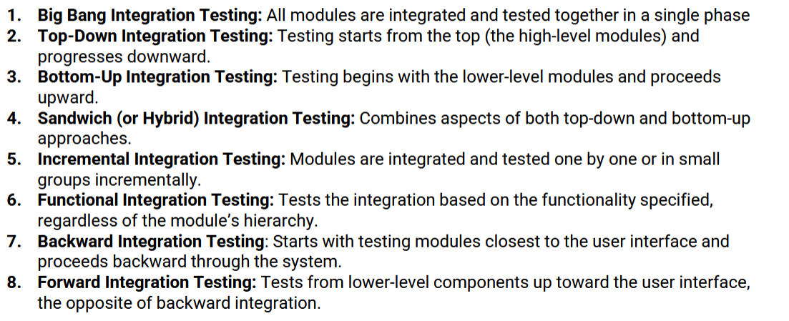
Types of Integration Testing
12

Slide 5
Big Bang Testing
Definition: All (or most) modules are integrated simultaneously, and the system is tested as a whole.
When used: Small projects or when incremental integration is impractical.
Pros: Simple and quick
Cons: Fault isolation is hard, high debugging effort
12

Slide 6
Incremental Testing: Top-Down vs Bottom-Up
Top-Down Integration
Approach: Integrate and test higher-level modules first, then move down the hierarchy.
Test Double: Use stubs to simulate lower-level modules not yet built.
Good for: Early stage when lower layers aren’t ready.
Drawbacks: Low-level utilities get tested later
12

Slide 7
Incremental Testing: Top-Down vs Bottom-Up
Stubs: A small code to replace called functions
12

Slide 8
Incremental Testing
Bottom-Up Integration
Approach: Integrate and test lower-level modules first, then assemble upwards.
Test Double: Use drivers to simulate higher-level callers.
Good for: Early stage when top layers aren’t ready.
Drawbacks: System-level behavior seen late; many drivers may be needed.
12

Slide 9
Incremental Testing: Top-Down vs Bottom-Up
Driver: A small code to replace caller functions
12

Slide 10
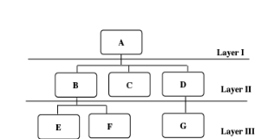
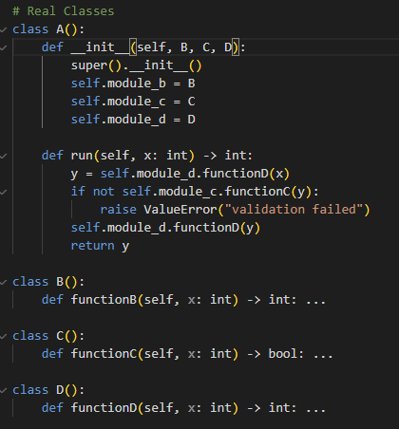
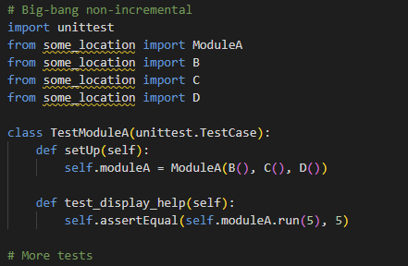
Sample
A 3-layer application
Big Bang testing:
12

Slide 11
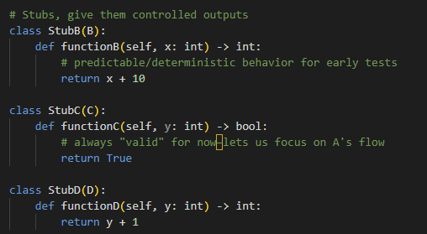
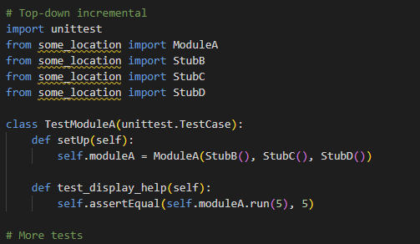
Sample
A 3-layer application
Top-down testing:
12

Slide 12
Questions?

