Slide 1
Shopify Email Product Analysis & Pricing Strategy
Key Findings & Recommendations

Slide 2
Agenda / Overview
Dataset insights and merchant email performance.
Analysis of the pay‑as‑you‑go cost distribution and the potential unlimited plan.
Competitor pricing and industry benchmarks.
Recommendations for product improvement and pricing.

Slide 3
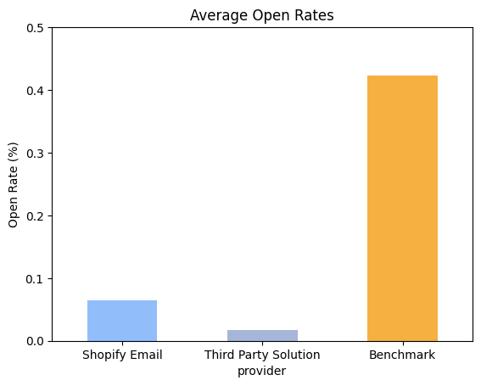
Dataset Insights
Number of merchants, share using Shopify Email (≈40%) and third‑party providers.
Average emails sent per month (Shopify ~15k vs. third‑party ~60k).
Open rates (Shopify ~6.5% vs. third‑party ~1.2%) and benchmark (~42%)
Revenue per email ($0.68 vs $0.77) and revenue per subscriber ($0.62 vs $3.12)

Slide 4
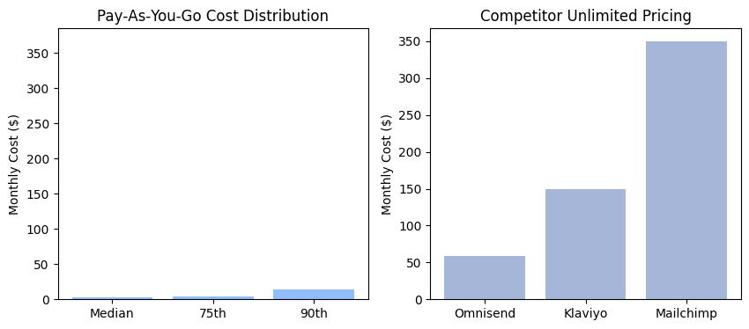
Unlimited Plan Analysis

Slide 5
Competitor Pricing & Industry Benchmarks
Provider | Free Tier | Entry Paid Tier | Higher Tier / Scaling
Klaviyo | Up to 250 profiles / 500 emails | $20/mo for 251–500 profiles / 5K emails | ~$150/mo at 10K profiles (scales with size)
Omnisend | Up to 250 contacts / 500 emails | $16/mo for 500 contacts / 6K emails | $59/mo for unlimited emails up to 2.5K contacts
Mailchimp | Up to 500 contacts / 1K emails | $13–$20/mo for basic plans | $350+/mo for premium with unlimited emails
Open Rate: ~42% (range: 22.5% – 59.7%)
Click-Through Rate (CTR): ~2%
Click-to-Open Rate (CTOR): ~5.6%
Unsubscribe Rate: 0.08% – 0.50%
Bounce Rate: <2%

Slide 6
Recommendations
Launch an affordable unlimited plan: Suggest a monthly fee around $10–15 to capture most merchants without undercutting margins.
Tiered pricing by subscriber count: Align plans with competitor models (e.g., up to 2.5k, 2.5k–10k, >10k contacts).
Improve deliverability & engagement: Introduce segmentation, predictive send‑time, A/B testing and better templates to move toward benchmark open rates.
Support seasonal spikes: Offer temporary unlimited or bonus credits for Black‑Friday/Cyber‑Monday periods when merchants send 4× more emails.
Provide benchmarking dashboards: Give merchants visibility into how their metrics compare with industry averages.

