Slide 1
Interpolation and Smoothing
Applied Statistics for Geoinformatics

Slide 2
Outline
Interpolation
Why interpolate?
Linear
Spline interpolation
Smoothing of time series
Why smooth?
Running means
Overview of assigment

Slide 3
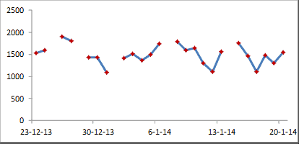
Why interpolate?

Slide 4
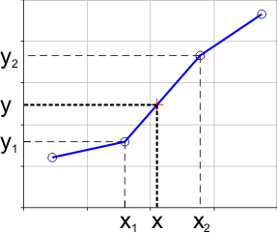
Linear Interpolation

Slide 5
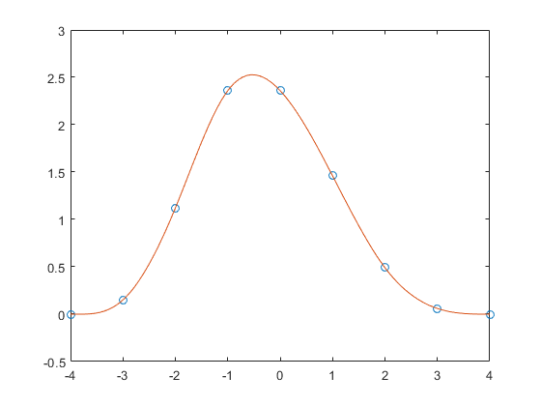
Spline interpolation

Slide 6
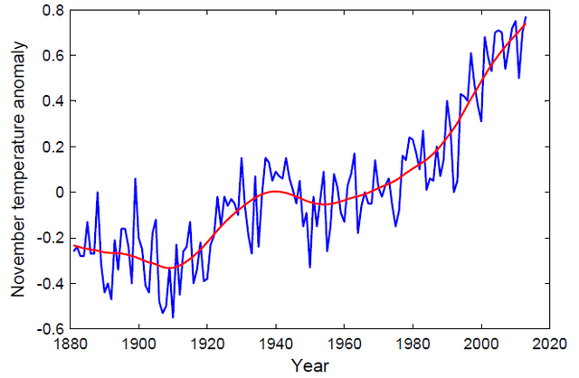
Why smooth?

Slide 7
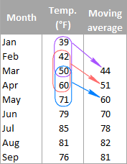
Smoothing using running means

Slide 8
Overview of assignment
Use Matlab and Gulf of Mexico satellite Chlorophyll data to perform:
Linear interpolation
Spline interpolation
3-point smoothing
7-point smoothing

