Slide 1
Tactile Smoke-Detector Interface
David Burson
Supervised by Dr Barry McMullin
B. Eng Electronic Engineering 2013

Slide 2
Project Brief
Tactile Smoke-Detector Interface
Fires are an added danger to people who are deaf/hard of hearing as they may fail to hear a smoke detector.
Design a solution that will provide a mobile, tactile danger warning to a user in the case of a smoke detection.

Slide 3
Breakdown of Problems
Tactile Smoke-Detector Interface
Method of sensing a danger?
Investigate common smoke detection methods.
Choose one.
How to process danger?
How to handle multiple detection points?
How to communicate danger to user?
Develop portable device or adapt existing?
How to handle multiple detectors in a location?

Slide 4
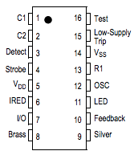
Problem Solving
Tactile Smoke-Detector Interface
Method of sensing a danger
The most common household fire detection method is a ceiling mounted smoke-detector.
Operate in two ways; Ionization or Photoelectric
Smoke Detectors’ IC can be adapted using designated
I/O Pin to interface with a microcontroller.

Slide 5
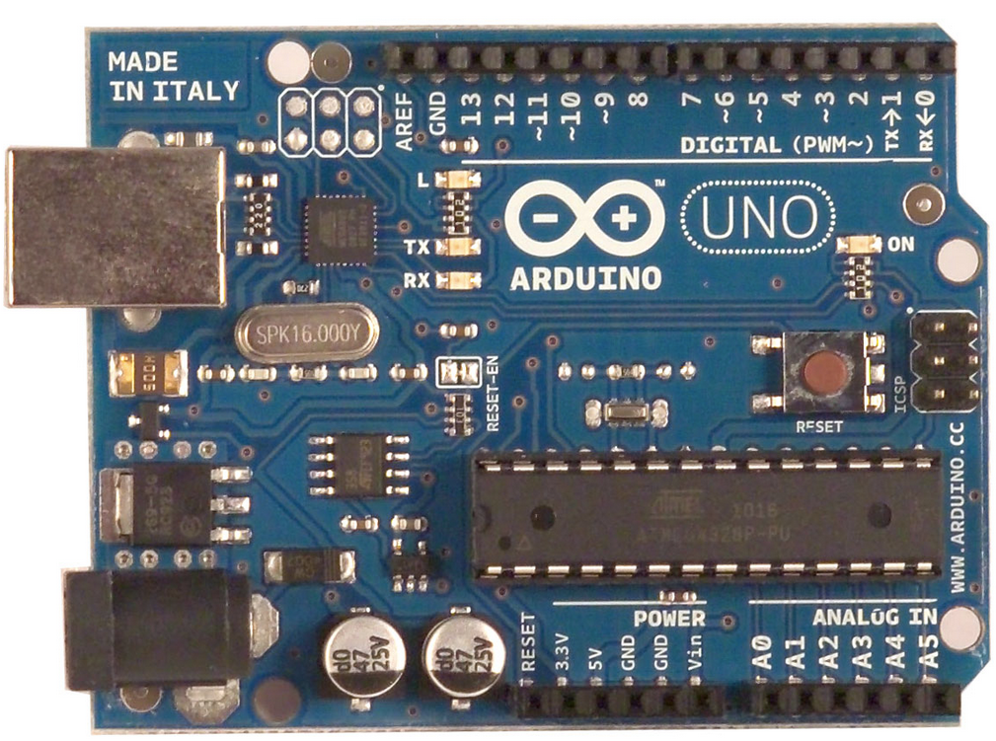
Problem Solving
Tactile Smoke-Detector Interface
How to Process Danger
Select a microcontroller
PIC or Arduino?
Arduino UNO, compact & practical for early prototyping
Multiple Analog, Digital and Power I/O Pins
Serial Interface

Slide 6
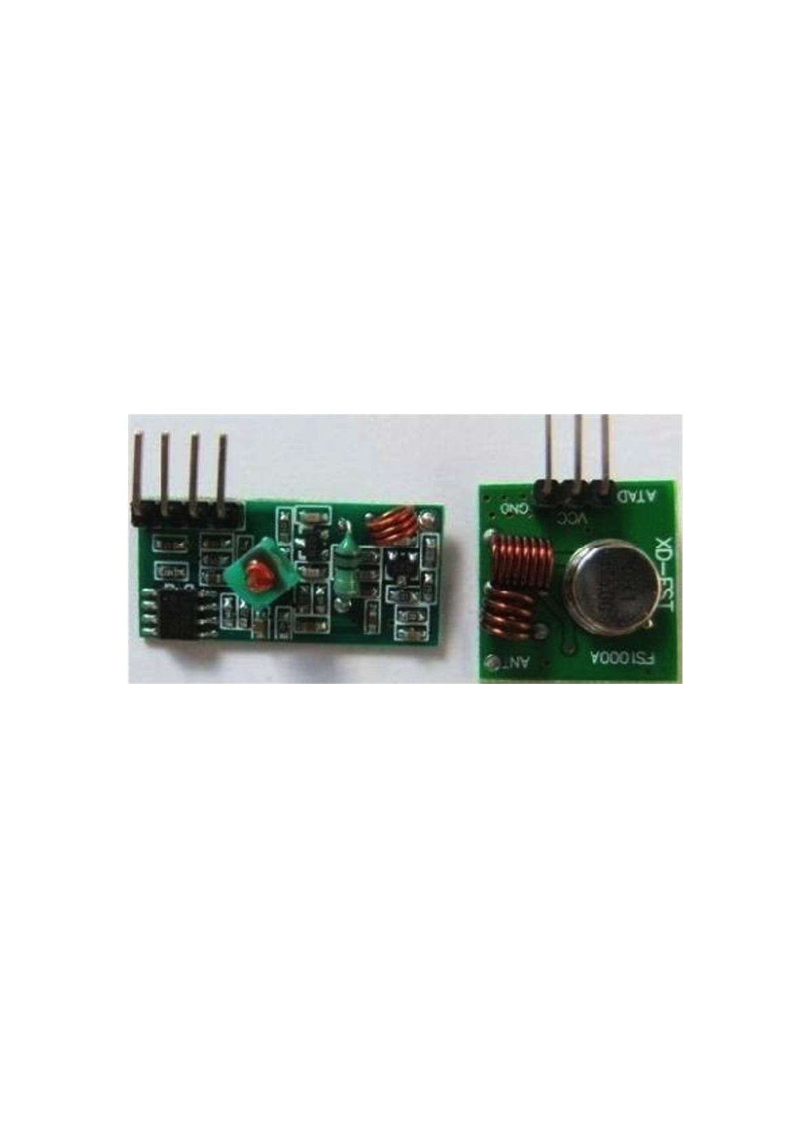
Problem Solving
Tactile Smoke-Detector Interface
How to Communicate Danger?
How to handle multiple detectors in a home
433 MHz RF Transmitter interfaced with microcontroller on each smoke-detector.
RF Receiver at central ‘server’ receives signal and processed by microcontroller.

Slide 7
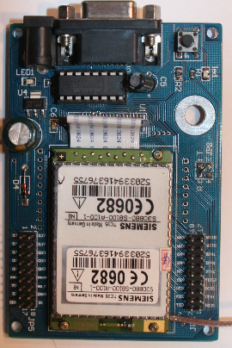
Problem Solving
Tactile Smoke-Detector Interface
How to Alert Hearing-Impaired User?
Mobile alert method
A mobile phone is a ready-made portable device, danger alert can be achieved by sending a warning call or SMS.
Incorporate a GSM module into the receiver circuit in order to transmit calls or SMS’.
Chose the SIEMENS TC35 GSM Module Development Board.

Slide 8
Problem Solving
Tactile Smoke-Detector Interface
How to Alert Sleeping User?
Under pillow vibrator.
When warning signal is received, vibration motor pulses in plastic encasement to wake sleeping user.
If user chooses to keep phone by bedside, provides two alternating vibrating alerts.

Slide 9
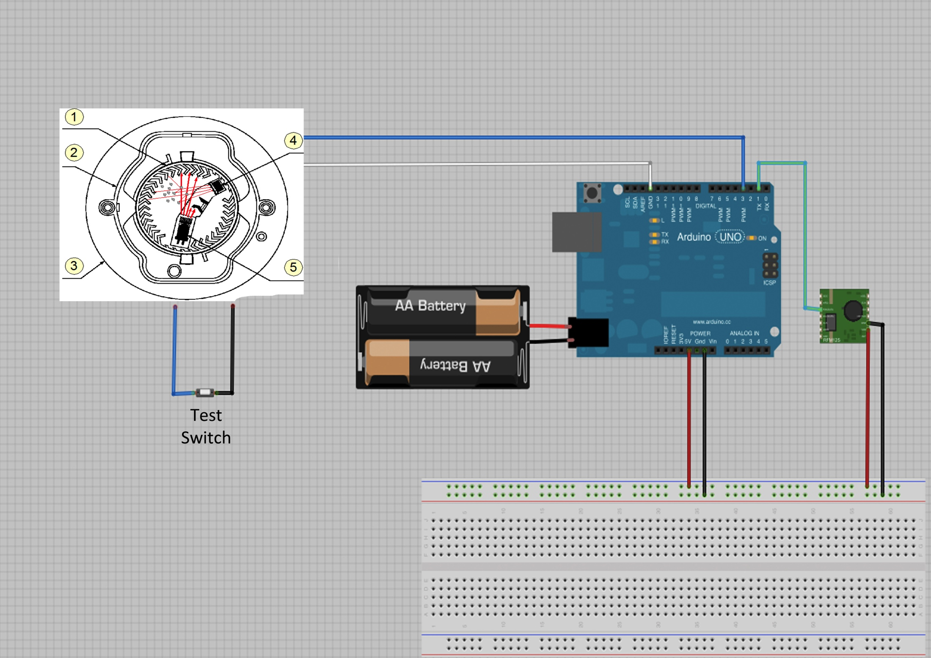
Progress
Tactile Smoke-Detector Interface
Smoke-Detection/Transmitter Circuit
I/0 pin sends analog voltage signal to microcontroller when activated.
Program detects high input, transmits RF signal.
Test Push Button.
Battery Powered.

Slide 10
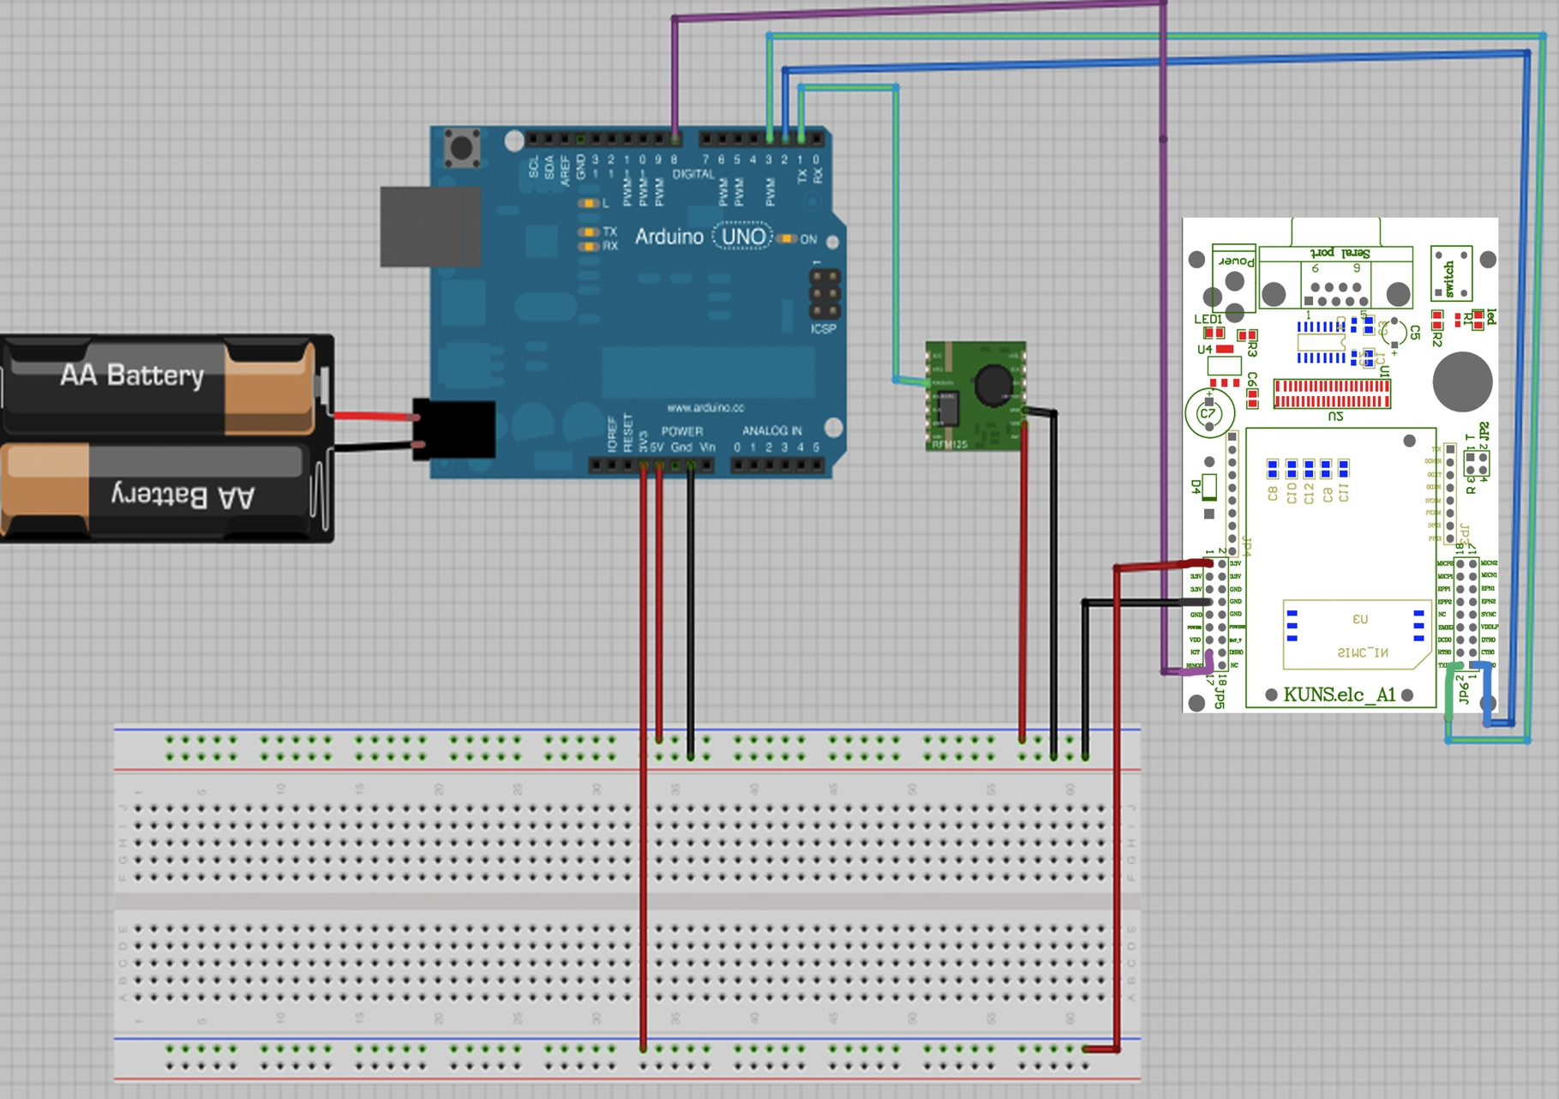
Progress
Tactile Smoke-Detector Interface
Receiver/Warning Circuit
RF Receiver collects signal.
Signal processed by microcontroller.
Program sends AT commands to GSM module in order to transmit warning call or SMS.

Slide 11
To Do
Tactile Smoke-Detector Interface
Develop code in order to remotely program the call-out number via SMS
Proving difficult due to serial connection between TC35 and GSM Module.
Develop suitable and safe under-pillow vibrator.
Package project in user-friendly and aesthetically suitable way.

Slide 12
Conclusion
Tactile Smoke-Detector Interface
Smoke detectors with a small and inexpensive pairing of a RF transmitter and microcontroller transmit a warning
Received via RF Receiver, processed by controller
Warning phone call is made via the GSM module to users mobile phone
Pillow shaker/vibrator is switched on in a pulse loop to wake a sleeping individual
I now invite questions from the audience.

