Slide 1
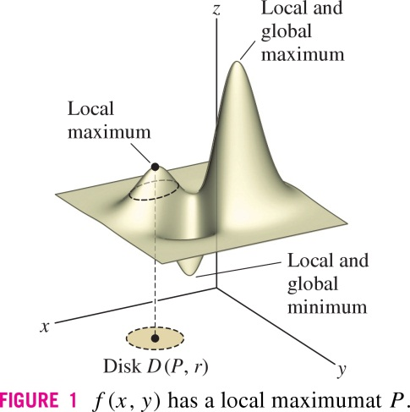
Rogawski Calculus, Second Edition
Copyright © 2012 W. H. Freeman and Company

Slide 2
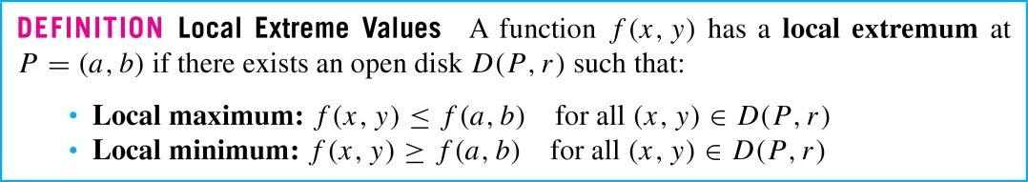
Rogawski Calculus, Second Edition
Copyright © 2012 W. H. Freeman and Company

Slide 3
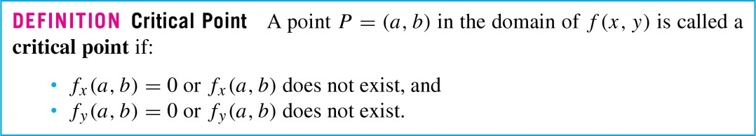
Rogawski Calculus, Second Edition
Copyright © 2012 W. H. Freeman and Company

Slide 4
Rogawski Calculus, Second Edition
Copyright © 2012 W. H. Freeman and Company

Slide 5
Rogawski Calculus, Second Edition
Copyright © 2012 W. H. Freeman and Company

Slide 6
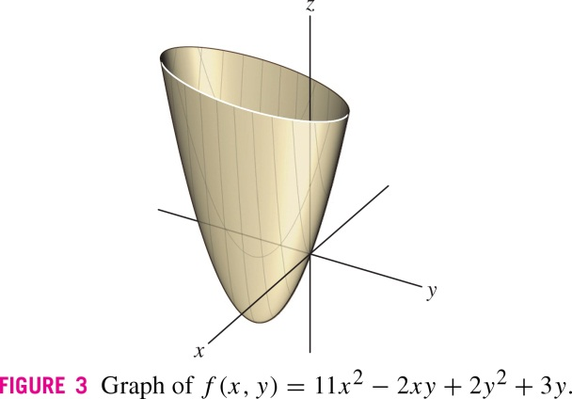
Rogawski Calculus, Second Edition
Copyright © 2012 W. H. Freeman and Company

Slide 7
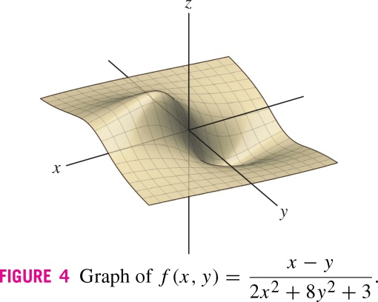
Rogawski Calculus, Second Edition
Copyright © 2012 W. H. Freeman and Company

Slide 8
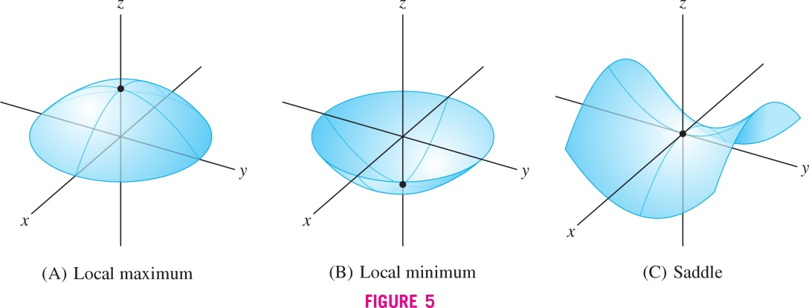
Rogawski Calculus, Second Edition
Copyright © 2012 W. H. Freeman and Company

Slide 9

Rogawski Calculus, Second Edition
Copyright © 2012 W. H. Freeman and Company

Slide 10
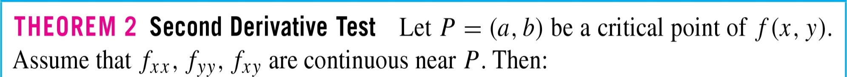
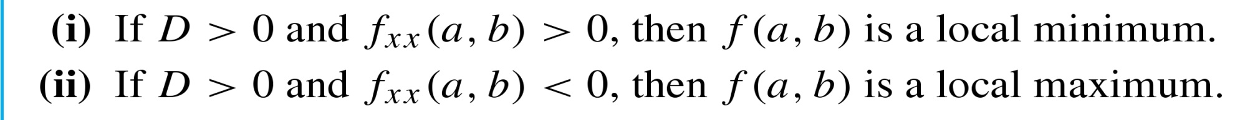

Rogawski Calculus, Second Edition
Copyright © 2012 W. H. Freeman and Company

Slide 11
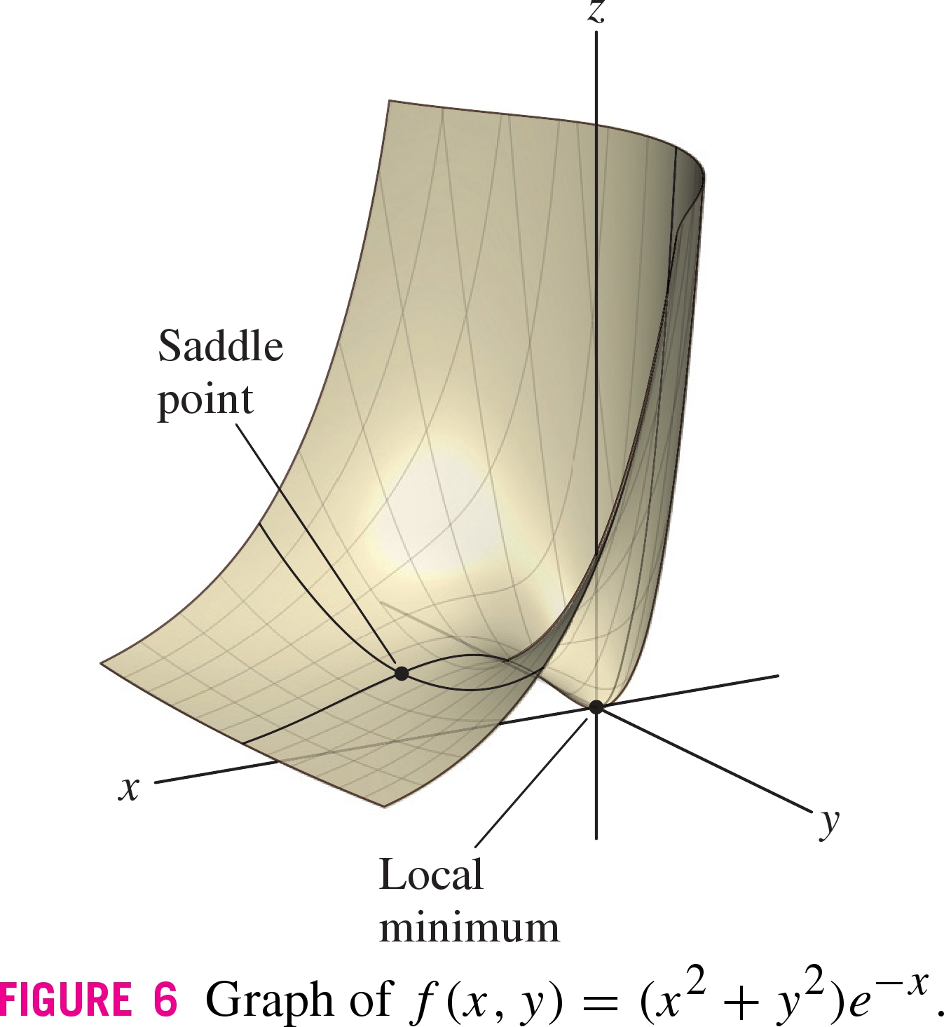
Rogawski Calculus, Second Edition
Copyright © 2012 W. H. Freeman and Company

Slide 12
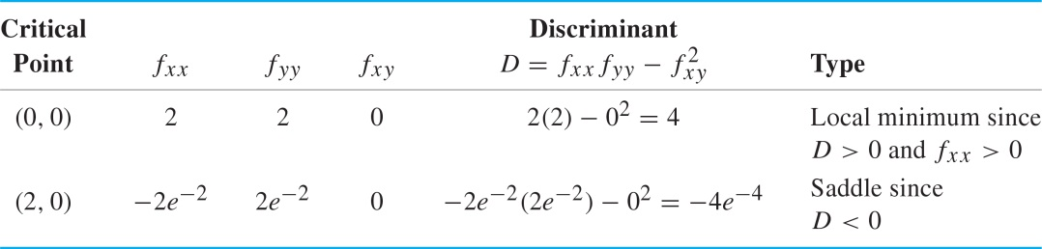
Rogawski Calculus, Second Edition
Copyright © 2012 W. H. Freeman and Company

Slide 13
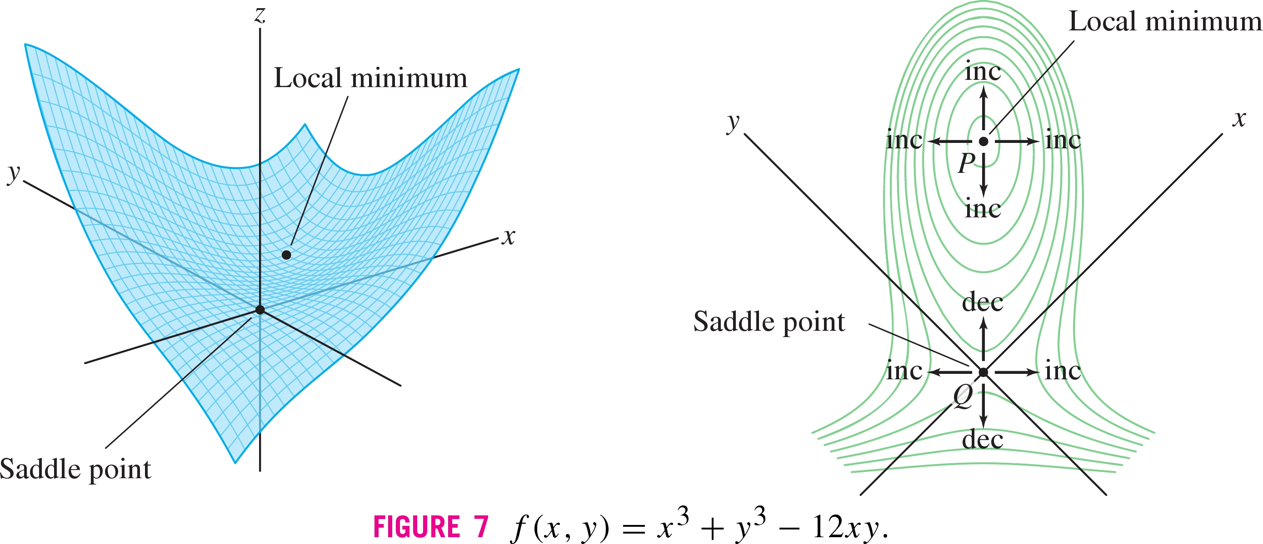
Rogawski Calculus, Second Edition
Copyright © 2012 W. H. Freeman and Company

Slide 14
Rogawski Calculus
Copyright © 2008 W. H. Freeman and Company

Slide 15
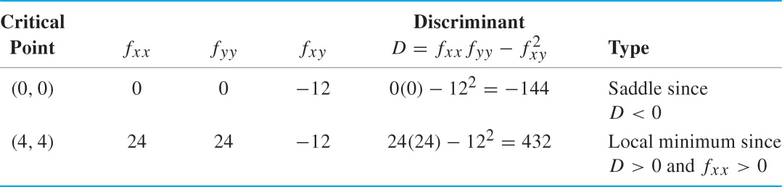
Rogawski Calculus, Second Edition
Copyright © 2012 W. H. Freeman and Company

Slide 16
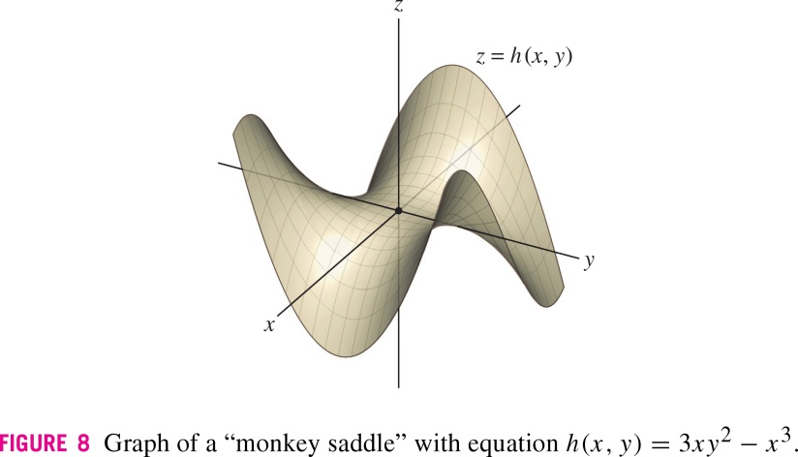
Rogawski Calculus, Second Edition
Copyright © 2012 W. H. Freeman and Company

Slide 17
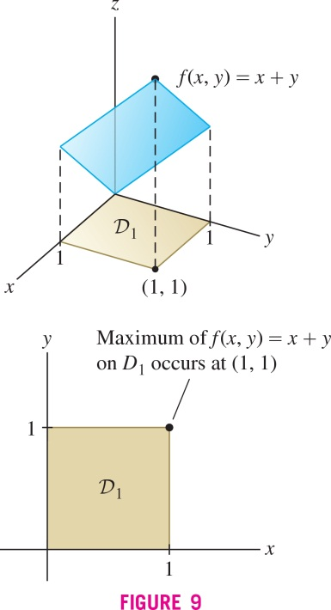
Rogawski Calculus, Second Edition
Copyright © 2012 W. H. Freeman and Company

Slide 18
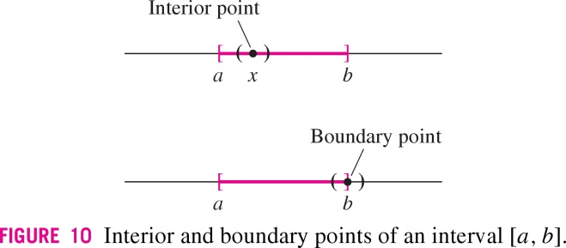
Rogawski Calculus, Second Edition
Copyright © 2012 W. H. Freeman and Company

Slide 19
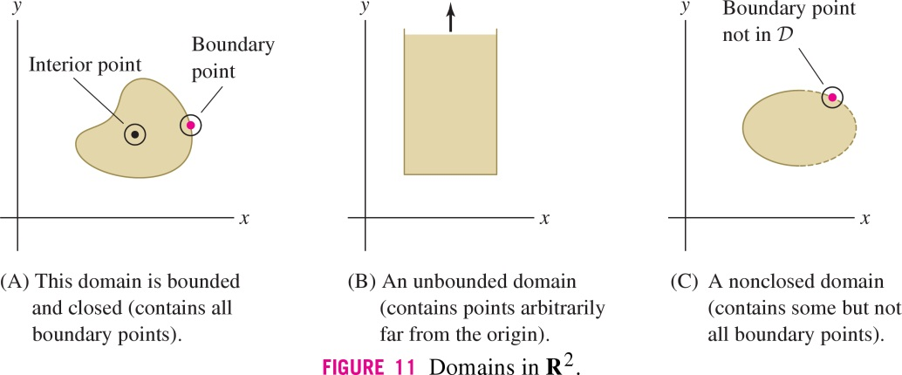
Rogawski Calculus, Second Edition
Copyright © 2012 W. H. Freeman and Company

Slide 20
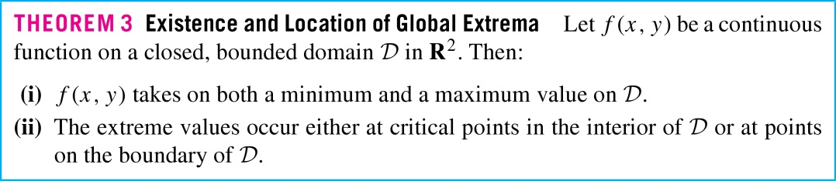
Rogawski Calculus, Second Edition
Copyright © 2012 W. H. Freeman and Company

Slide 21
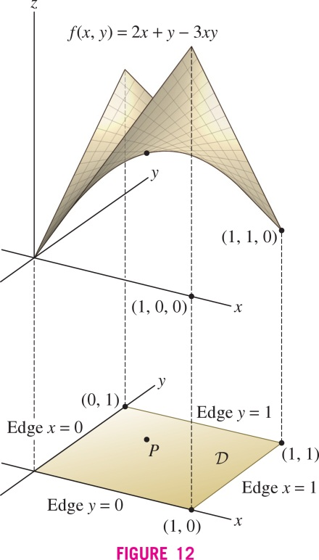
Rogawski Calculus, Second Edition
Copyright © 2012 W. H. Freeman and Company

Slide 22
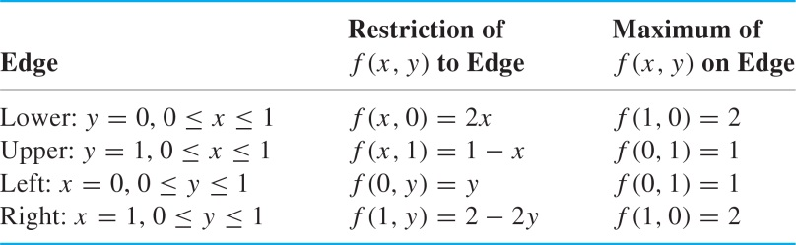
Rogawski Calculus, Second Edition
Copyright © 2012 W. H. Freeman and Company

Slide 23
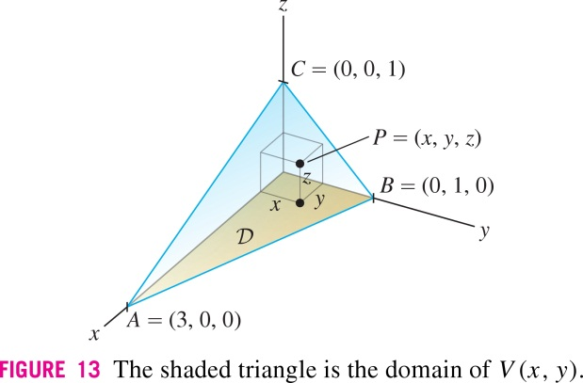
Rogawski Calculus, Second Edition
Copyright © 2012 W. H. Freeman and Company

Slide 24

Rogawski Calculus, Second Edition
Copyright © 2012 W. H. Freeman and Company

Slide 25

Rogawski Calculus, Second Edition
Copyright © 2012 W. H. Freeman and Company

Slide 26
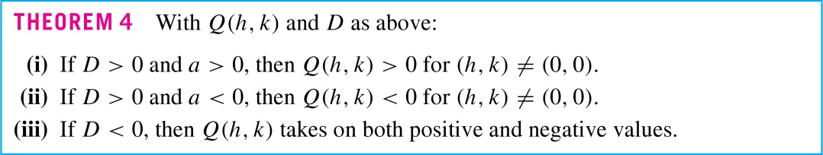
Rogawski Calculus, Second Edition
Copyright © 2012 W. H. Freeman and Company

Slide 27
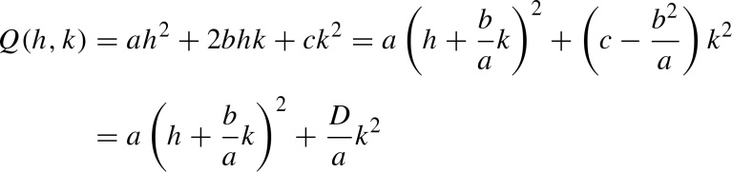
Rogawski Calculus, Second Edition
Copyright © 2012 W. H. Freeman and Company

Slide 28
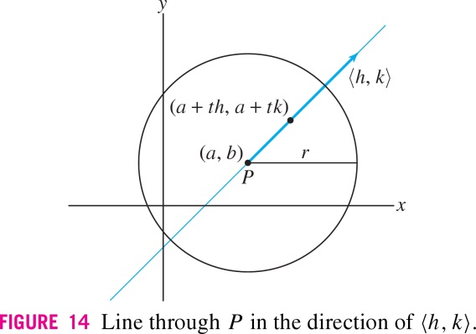
Rogawski Calculus, Second Edition
Copyright © 2012 W. H. Freeman and Company

Slide 29
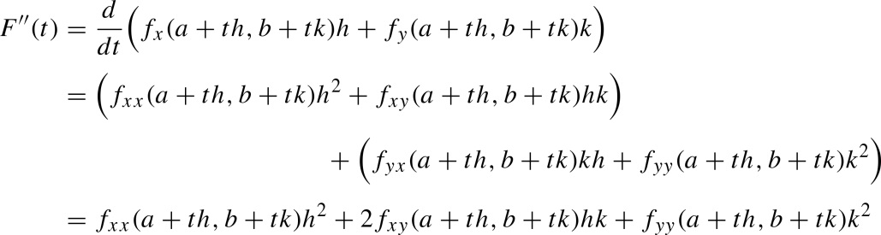
Rogawski Calculus, Second Edition
Copyright © 2012 W. H. Freeman and Company

