Slide 1
ECE1718H: ASSIGNMENT #1
Group #8: Juan Fuentes, Irfan Khan and David Chakkuthara

Slide 2
Problem Statement
Create an Encoder that will encode multiple luminance only frames.
Create a Decoder that will then decode the encoded frames and generate a sequence of luminance pictures to be played.

Slide 3
Design Approach
YUV Pre-processor (C++)
Extract luminance from existing YUV to create Y only frame
Break up the picture into ixi blocks and align the frame. If the frame is not aligned to the block size ixi, pad with grey values (128)
Encoder (C++)
Read in current Y frame to be encoded
Generate motion vectors for each ixi block
Generate residual data for each ixi block
Reconstruct the frame based on the residual + motion predicted data

Slide 4
Design Approach
Decoder (C++)
Read in residual data and motion vectors generated by the encoder
Reconstruct frame with residual data + motion prediction data generated from the motion vectors
Post-processor Analysis (C++)
Validate Encoder Reconstructed frames are identical to Decoder Frames
Perform SAD calculation between Reconstructed and Original Reference Sequences.
Wrapper Script (Python)
Given a YUV sequence input, the wrapper will call the YUV Pre-Processor, Encoder, Decoder and finally Post-processing Analysis executables

Slide 5
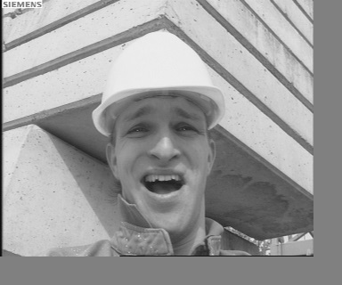

System Working - DEMO
Y Only input Video
Encoder Recon
Decoded Recon

Slide 6
Challenges
The encoder motion estimation algorithm took many tries to get correct. Both the bound checking logic and GMV indexing logic needed to be rewritten.
Deciding on a specified Encoder output data format for the residuals and motion vector data that could be easily interpreted by the Decoder took some careful planning.
Mixing variable data types (unsigned and signed chars and integers) lead to unexpected results. Extra care had to be taken with using these variables.

Slide 7
Observations
The higher the search ranges the better SAD per frame
The lower the rounding the better SAD per frame
The smaller the block size the better SAD per frame
Parallel processing using threads can be used to speed up the block based motion estimation search for GMVs.

Slide 8
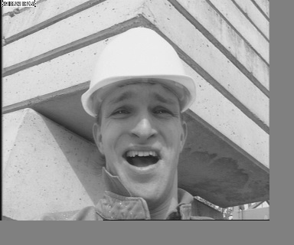
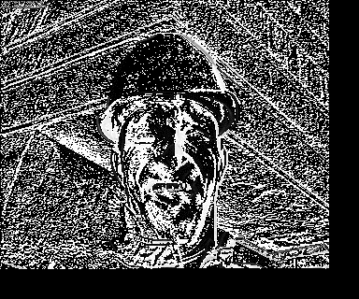
Results
Current Frame
Previous Recon Frame
(Using GMV)
Residual
(Cur-Rec Frame)

Slide 9
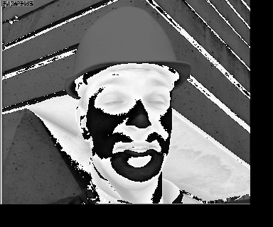
Results
Areas in black represent minor delta differences in the residual between the current frame and the previous inter predicted block chosen
White areas represent large delta in the residual difference. Meaning that the inter predicted block used was not a good match
Frame 1
Frame 25

Slide 16
Ideas and thoughts
As we start increasing the numbers of frames to be encoded the runtime increases
Adding parallelism in computing the motion vectors would improve the run time
Quality of the video is well preserved since the residual data is only being rounded. This however is not efficient since we required to send the entire residual content of the frame to the decoder
Lossless compression can be achieved using Entropy encoding techniques
Quantizing/Transforming encoding the residual would yield better compression rates but with loss in quality

