Slide 1
ECE1718H: Assignment #1
Group #8: Juan Fuentes, Irfan Khan and David Chakkuthara

Slide 2
Introduction
Problem Statement:
Second level
Third level
Fourth level
Fifth l
mentioning the observations/challenges

Slide 3
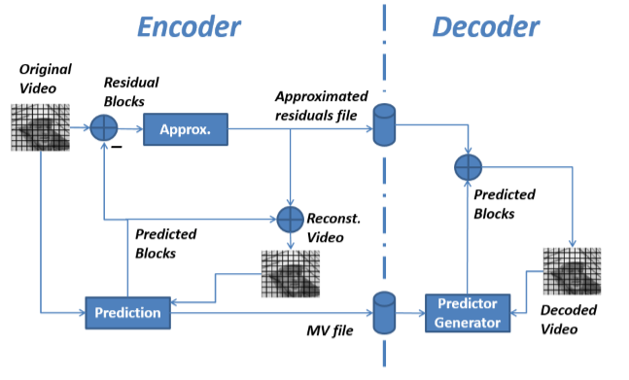
explaining how it was approached
First bullet point here
Second bullet point here
Third bullet point here
Group A
Task 1
Task 2
Group B
Task 1
Task 2
Group C
Task 1
Task 2

Slide 4
showing evidence that the system is working
Y Only input Video
Reconstructed Video
Decoded video

Slide 5
Title and Content Layout with Chart

Slide 6
Two Content Layout with Table
Class | Group A | Group B
Class 1 | 82 | 85
Class 2 | 76 | 88
Class 3 | 84 | 90
First bullet point here
Second bullet point here
Third bullet point here

Slide 7
SAD: Forman CIF r =4, n=3

Slide 8
SAD: Forman CIF i = 8, n=3

Slide 9
SAD: Forman CIF i = 8, r = 4

Slide 10
SAD: Akiyo QCIF r =4, n=3

Slide 11
SAD: Akiyo QCIF i = 8, n=3

Slide 12
SAD: Akiyo QCIF i = 8, r = 4

Slide 13
Ideas and thoughts

