Slide 1

WOSH 2019
An introduction to Formal Verification

Slide 2
What is Formal Verification?

Slide 3
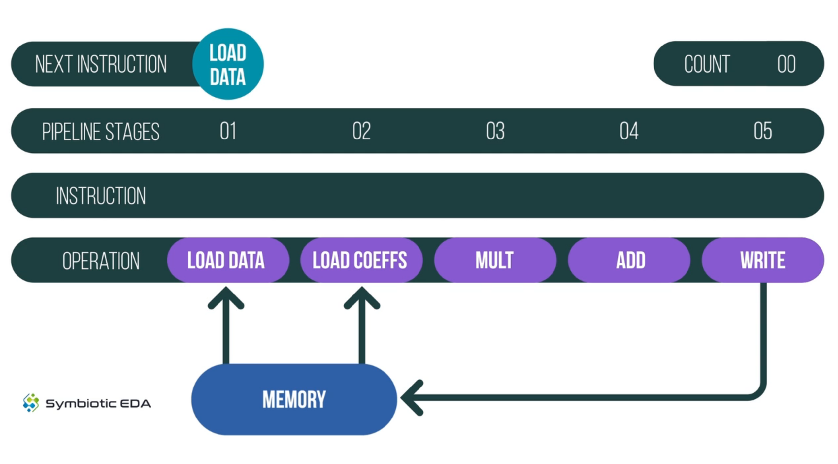
MARLANN pipeline

Slide 4
Formal Verification uses SMT solvers

Slide 5
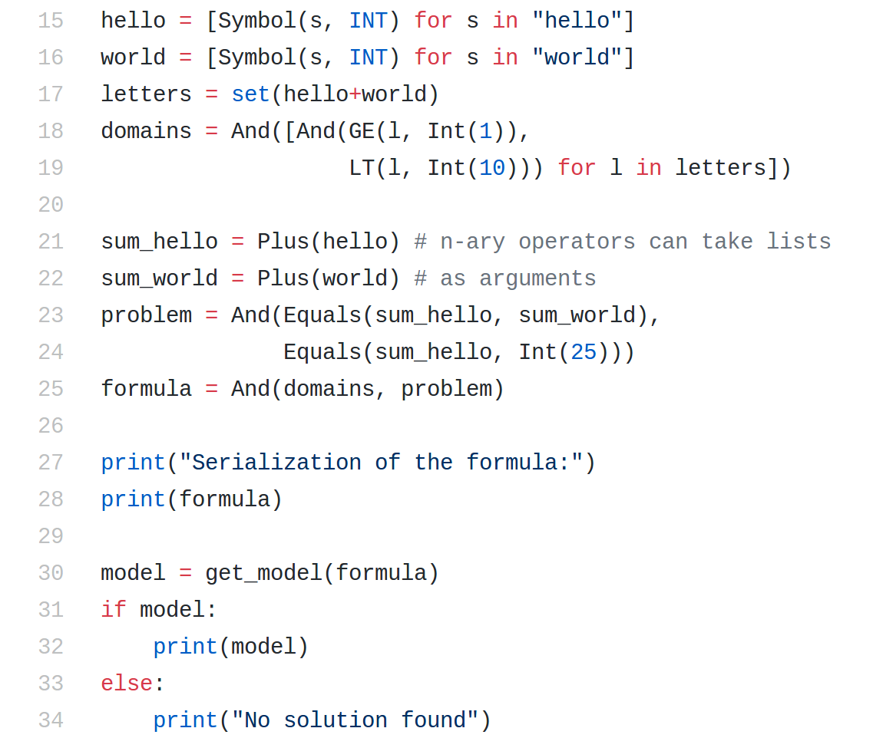
Demo: pySMT
https://github.com/pysmt/pysmt/blob/master/examples/puzzle.py

Slide 6
Cover tests a liveness property. It proves that something may happen

Slide 7
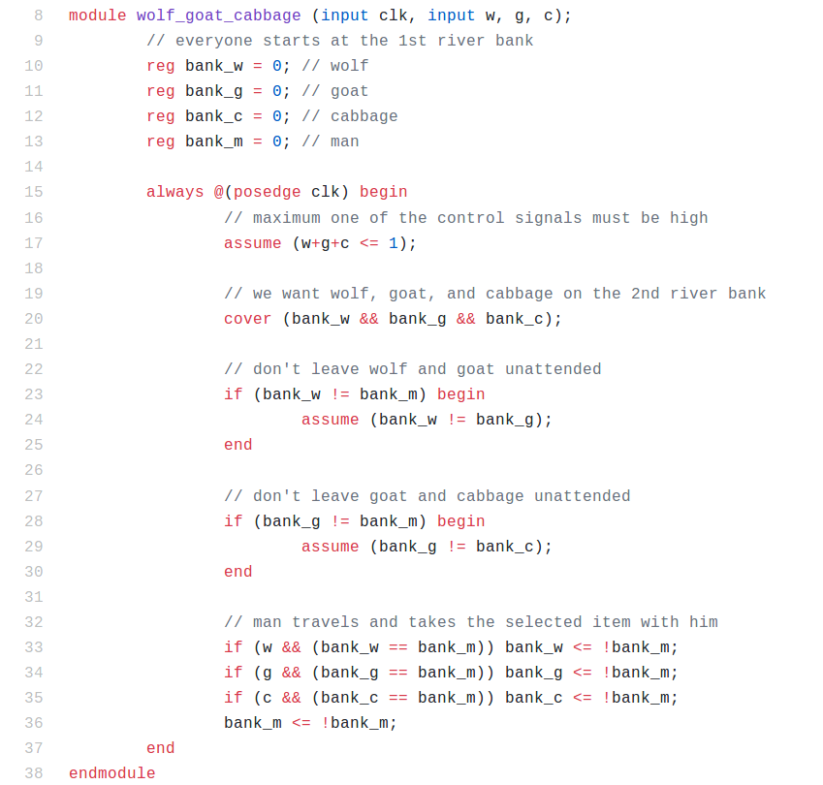
Demo: Wolf, Goat, Cabbage
https://github.com/YosysHQ/SymbiYosys/blob/master/docs/examples/puzzles/wolf_goat_cabbage.sv

Slide 8
Demo: Cover an AXI Lite transaction
https://github.com/mattvenn/axi-lite-formal

Slide 9
Bounded Model Check

Slide 10
For circuit analysis SAT and SMT solvers can be used to answer questions like:
  “Given a circuit, is there a state with property A that has a valid transition to another state with property B.”

Slide 11
Are the bad states reachable from the initial states ?

Slide 12
In steps 1 .. k-1:
UNSAT → next step
SAT → FAIL
Step 1:
0
Step 2:
0
1
Step 3:
0
1
2
Step 4:
0
1
2
3
In step k:
UNSAT → PASS
SAT → FAIL
Step k:
0
1
2
3
k-1
BMC proves that no bad state is reachable within k cycles.

Slide 13
BMC and induction test safety properties.
They prove that something will not happen

Slide 14
Two basic operators
1. assume()
An assume(X) statement will limit the state space that the formal verification engine examines.
2. assert()
An assert(X) statement indicates that X must be true, or the design will fail to prove.

Slide 15
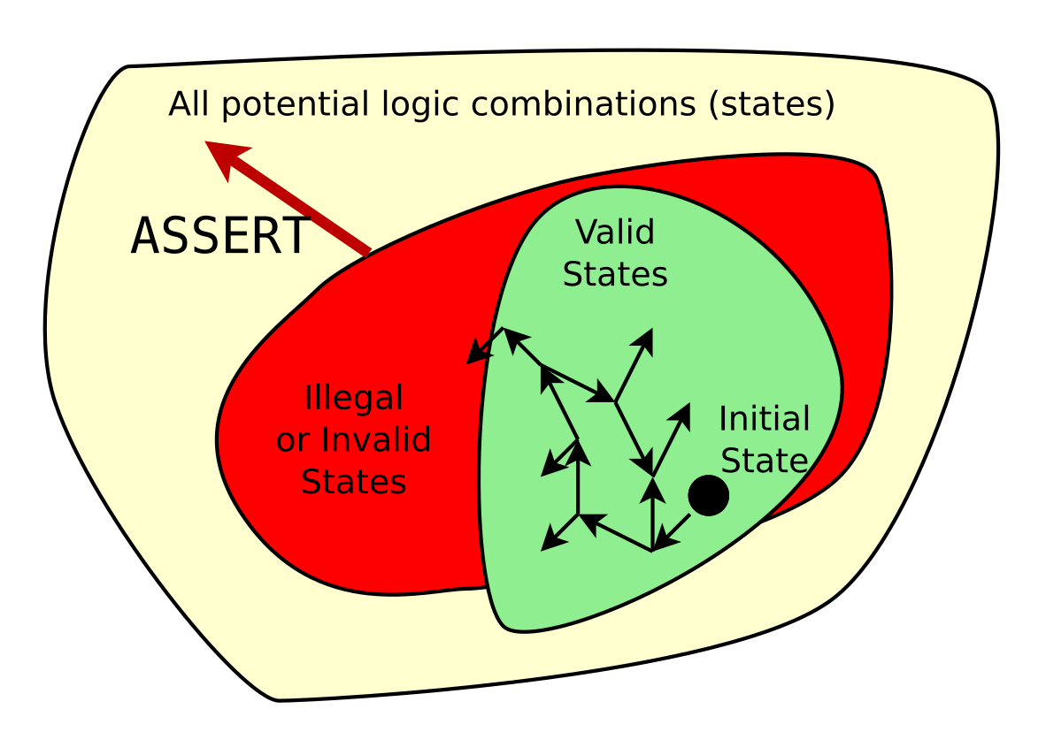
Assertions define the illegal state space.
Additional assertions will increase the size of the illegal state space.

Slide 16
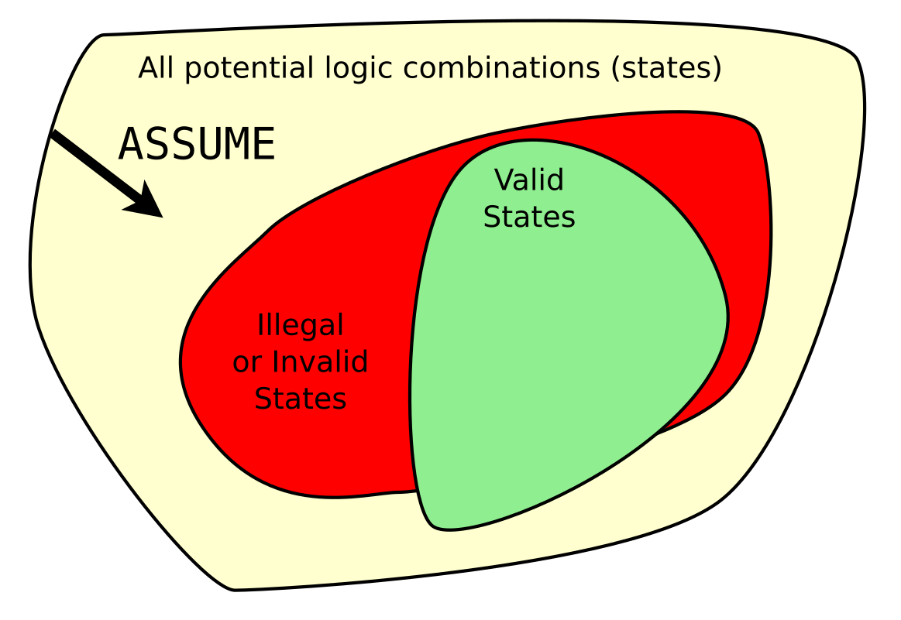
Assumptions limit the universe of all possibilities
Additional assumptions will decrease the size of the total state space
Caution: One careless assumption can void the proof.

Slide 17
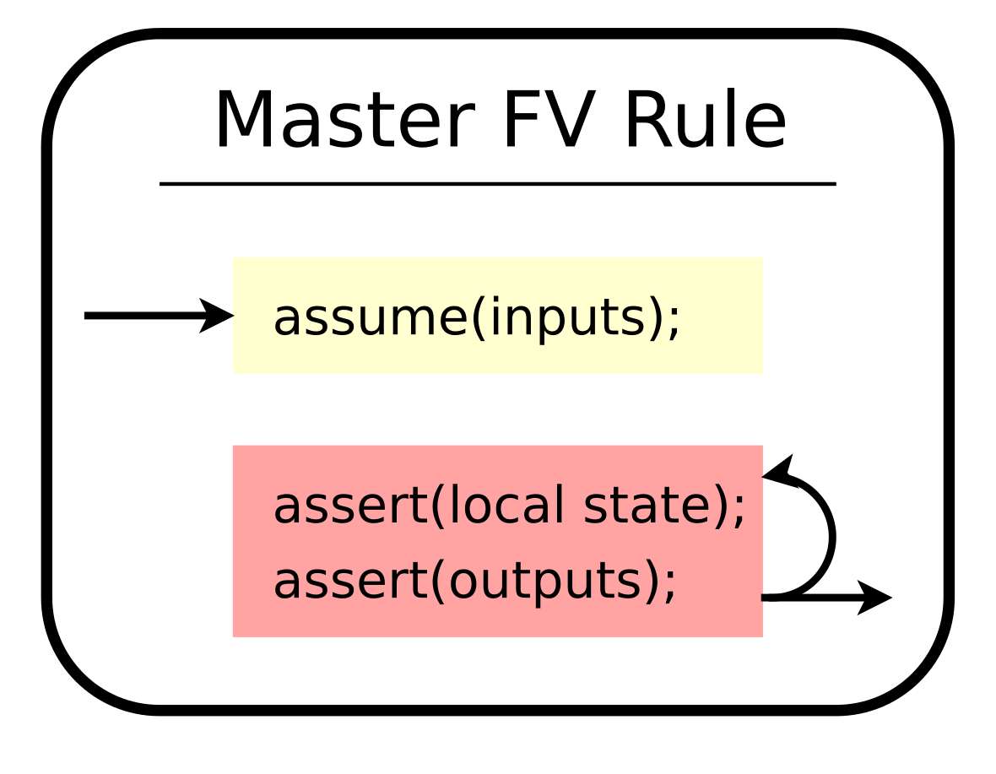

Slide 18
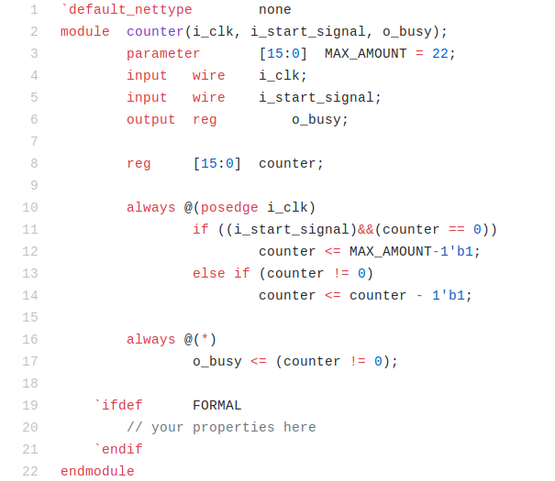
Excercise: busy counter

Slide 19
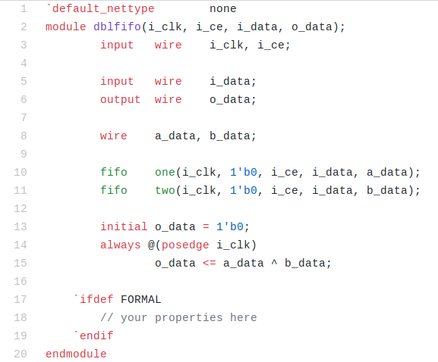
Exercise: Double FIFO

Slide 20
Exercise: How can we prove the MARLANN pipeline is safe?
memory read enable signals:
      mem_rd0_en
      mem_rd1_en
memory write enable signals:
      mem_wr_en

Slide 21
What next?
If you want to formally verify your design, BMC is insufficient
Bounded Model Checking (BMC) will only prove that your design is correct for the first N clocks.
It cannot prove that the design won’t fail on the next clock, clock N + 1
This is the purpose of the induction step: proving correctness for all time

Slide 22
Formal verification uses k-induction
Base case
Assume the first N steps do not violate any assumptions,
Prove that the first N steps do not violate any assertions.
Inductive Step
Assume N steps exist that neither violate any assumptions or assertions, and
Assume the N + 1 step violates no assumptions,
Prove that the N + 1 step does not violate any assertions.

Slide 23
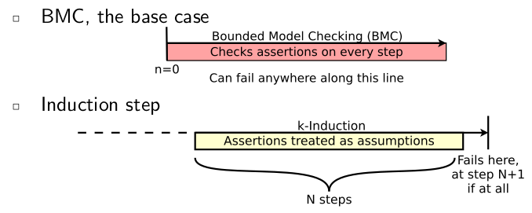
Register values at the beginning of the inductive step can be anything allowed by your assertions and assumptions

Slide 24
In steps 1 .. k:
SAT → next step
UNSAT → PASS
Step 1:
k
Step 2:
k-1
k
Step 3:
k-2
k-1
k
Step 4:
k-3
k-2
k-1
k
In step k+1:
SAT → UNKNOWN
UNSAT → PASS
Step k+1:
0
k-3
k-2
k-1
k
k-induction proves that a sequence of k non-bad states is always followed by another non-bad state. The k used for induction must be ≤ the k used in BMC
for a valid complete proof.

Slide 25
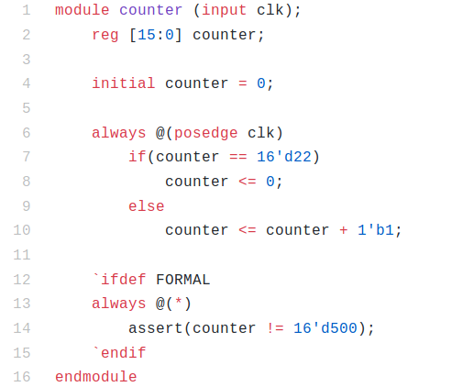
Exercise: Simple counter

Slide 26
Question: busy counter

Slide 27
Exercise: Double FIFO

Slide 28
Formal Verification Typical Workflow
Step 1: Run Bounded Check
  FAIL → Fix design, add assumptions, or loosen asserts
  PASS → So far so good. Proceed to step 2
Step 2: Run Induction Proof
  FAIL → Investigate counterexample: Is it reachable? *
    REACHABLE → Fix design, add assumptions, or loosen asserts
    UNREACHABLE → Add restrictions, strengthen asserts,
    or increase induction length
  PASS → Do you want more asserts in your design?
    YES → Reduce induction length or remove restrictions.
    NO → You are done.
* Counterexample is always unreachable when induction succeeds with a larger induction length.

Slide 29
Workflow example:
Step 1: BMC (k=5, PASS)
1
2
0
1
0
3
3
1
4

Slide 30
Step 2: k-Induction (k=5, FAIL)
2
3
0,4
5
1

Slide 31
Solution: Add new assertion to break the loop
intended target
for the new assert, breaks loop
0
1
2
3
4
5
assertion also made this state a bad state, creating
a new k-induction counter example. Note that 1-2-3 and
2-3-4 are also possible loops. Increasing k would not help.

Slide 32
Solution: Add one more assertion
Now k-induction is UNSAT (PASS)

Slide 33
$past()
$past() allows us to make assertions cross time intervals

Slide 34
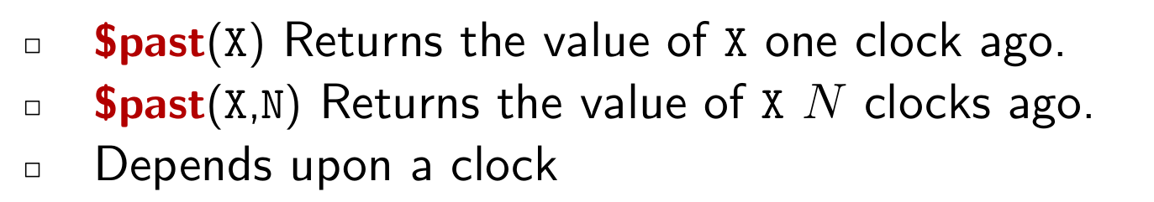
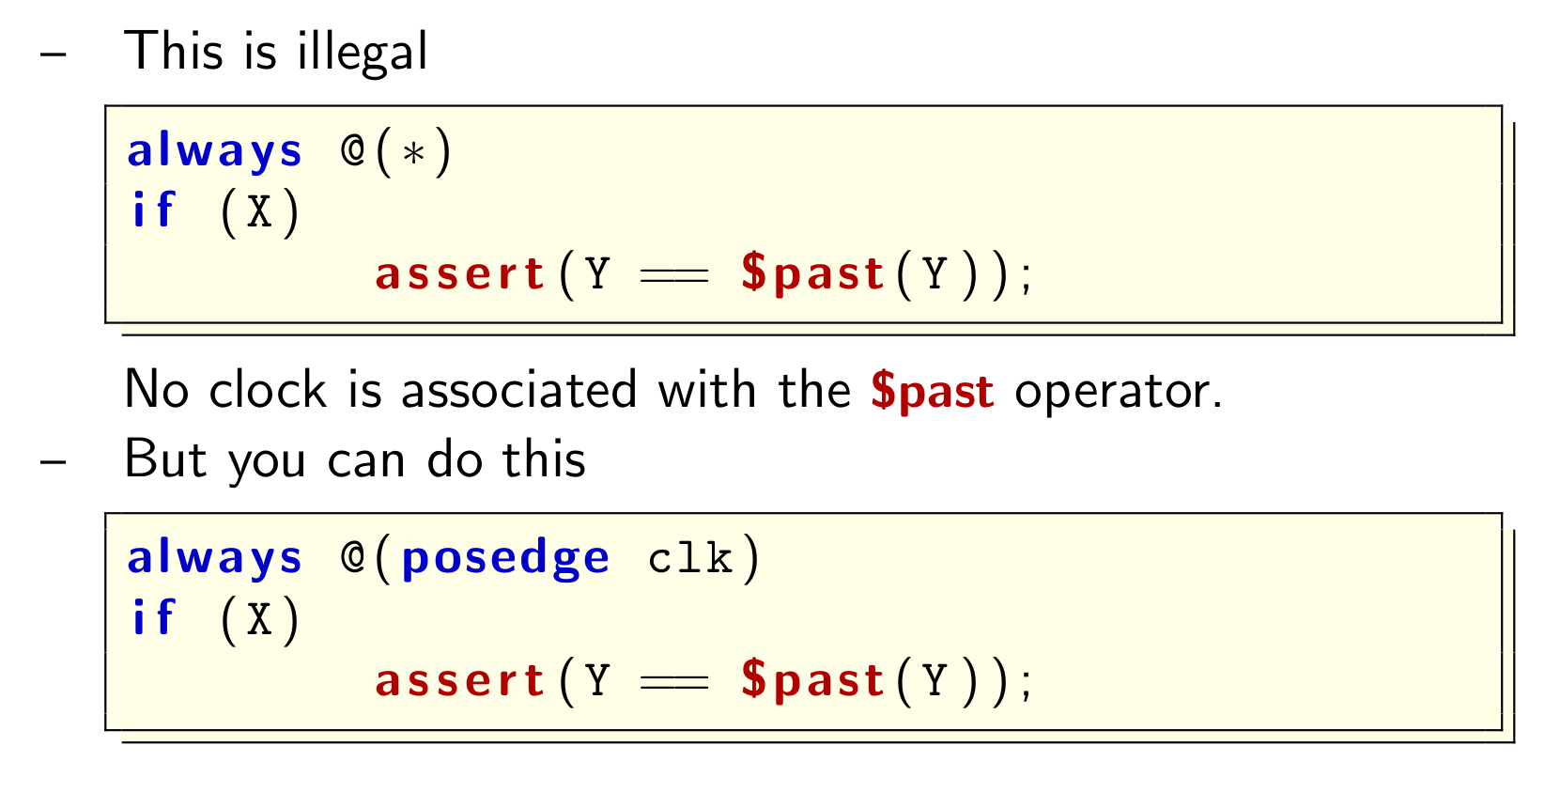

Slide 35
Excercise: $past() busy counter

Slide 36
Demo: Bus Properties
Is Vivado generated AXI Lite IP bug free?
http://zipcpu.com/formal/2018/12/28/axilite.html
https://github.com/mattvenn/axi-lite-formal

Slide 37
Thank you!
bit.ly/wosh-feedback

