Slide 1
Increasing Debian Popularity
An Analysis
Dave Steele
Debconf 17
8 Aug 2017

Slide 2
Perceived Debian Discriminators
Plus
  DFSG
  Deb packaging dominance/capabilities
  Inclusion Activities/Outreach
  Emphasis on Security/Stability
Minus
  DFSG
  Deb complexity
  Documentation/Website
  Engagement/Direction
  Software Age

Slide 3
Perceived Debian Discriminators
Plus
  DFSG
  Deb packaging dominance/capabilities
  Inclusion Activities/Outreach
  Emphasis on Security/Stability
Minus
  DFSG
  Deb complexity
  Documentation/Website
  Engagement/Direction
  Software Age

Slide 4
My Debian Sub-hobby
Analysing BTS entries
  Initially, a screen scrape limited to the Request For Sponsor (RFS) process
  More recently, processing against the rsync logs
    Plus debian-testing-changes for version timing information
    … and Packages

Slide 5
Source: steele.d.n/mentorstats

Slide 7
Steps to More Debian
Answer The Mail

Slide 8
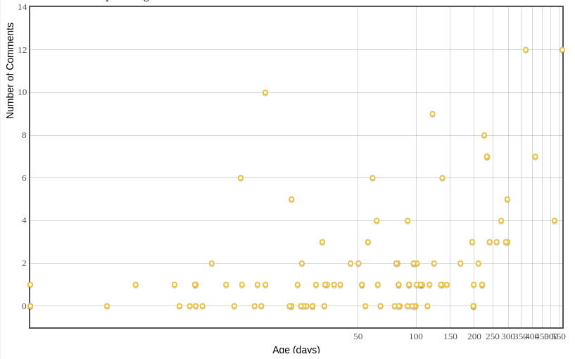
Current RFS Response Activity

Slide 9
Steps to More Debian
Answer The Mail
Broad, Modest, Active Involvement in Core Processes

Slide 10
Software Age
Max Stable Software Age = Open Release Time + 2 * Freeze
Jessie - >2.5 years
10 months of that is in Freeze (30%)

Slide 11
Jessie RC Bug Activity
Currently RC-level
Version matches
testing on submission
date
  10,000 bugs
Activity falls off during
the Freeze

Slide 12
RC Bug Lifetime
Hard limit of 2 weeks
for median bug
closure? (+ 4 week
archive notice)

Slide 13
Package Age for New Bugs
Bugs are
submitted
against mature
package releases
Opportunity to
submit bugs
earlier

Slide 14
Steps to More Debian
Answer The Mail
Broad, Modest, Active Involvement in Core Processes
Freeze Reduction Strategies (Open Season)?

Slide 15
Steps to More Debian
Answer The Mail
Broad, Modest, Active Involvement in Core Processes
Freeze Reduction Strategies (Open Season)?
Answer the Mail

Slide 16
Questions?
Comments?

