Slide 1
Exchange Digital Money using Bitcoin and Python

Slide 2



Resources
Presentation
  http://davesteele.github.com/python-bitcoin-talk/
Software
  {apt-get|yum} install git python-simplejson python-irclib pygame Django
    Or 'easy_install simplejson python-irclib pygame Django'
  git clone git://github.com/davesteele/python-bitcoin-talk.git

Slide 7
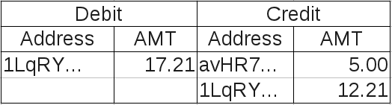




Hash

Slide 8
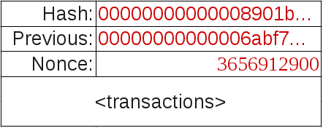
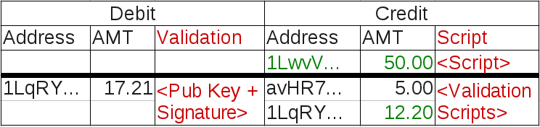
The Secret Sauce...

Slide 9
Terminology
The Bitcoin ledger consists of a communally-maintained chain of Blocks containing Transactions which record balance transfers between Addresses
Addresses are derived from a hash of the public key for a public/private key pair stored in the private Wallet
Transactions are Confirmed as they become embedded in the Longest Block Chain
Addresses can be aggregated locally in the Wallet using text Labels, also called Accounts

Slide 10
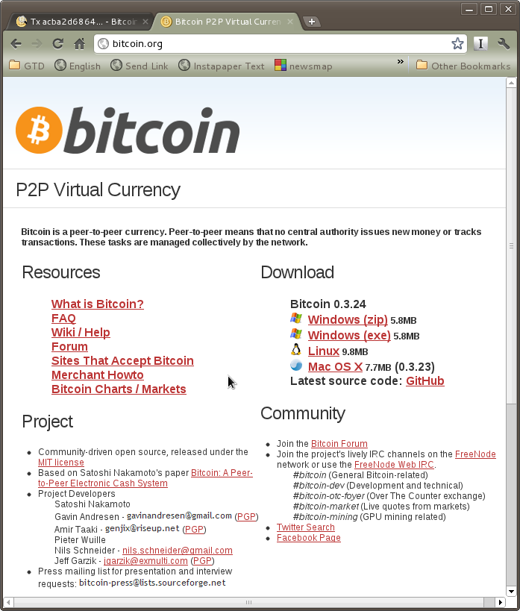

Slide 11
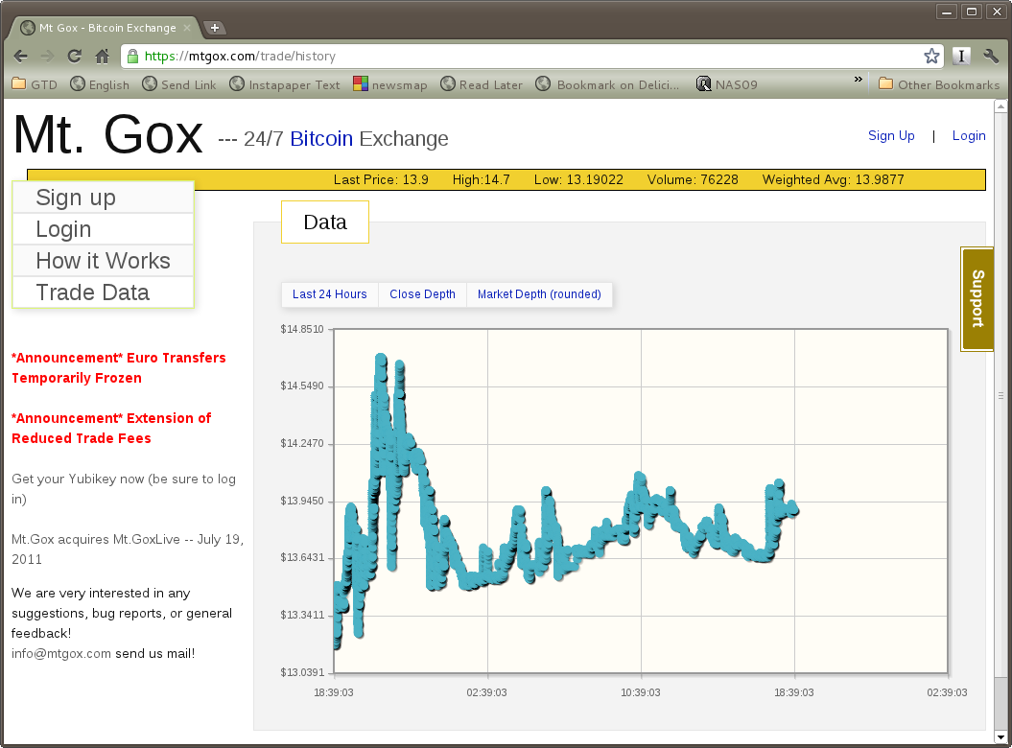
Getting Bitcoins
OR

Slide 12
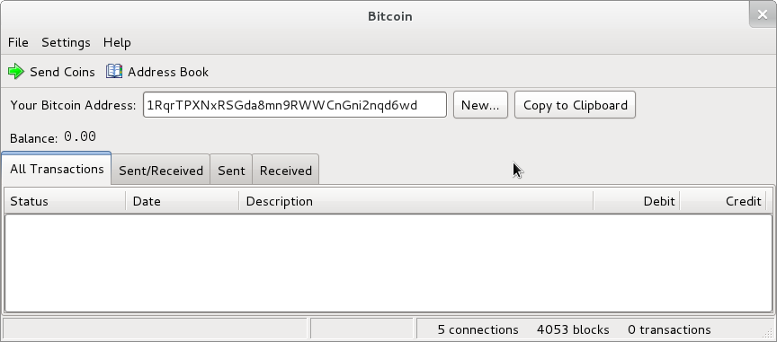
GUI Client

Slide 13
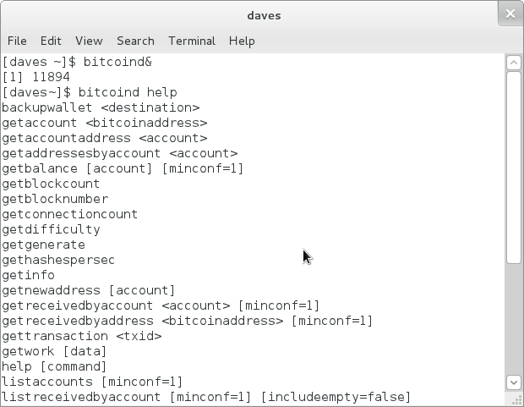
bitcoind

Slide 14
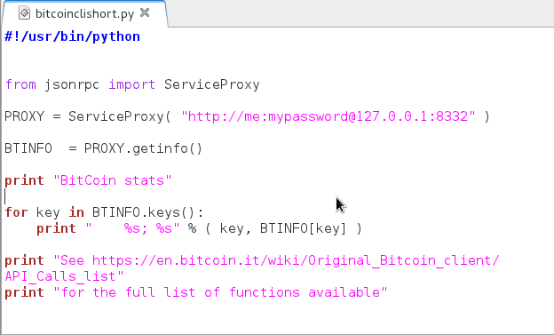
bitcoind JSON-RPC using Python
rpcuser and rpcpassword
defined in
~/.bitcoin/bitcoin.conf
Install python-bitcoinrpc
https://github.com/jgarzik/python-bitcoinrpc
bitcoind running
Ports 8332 and 8333 accessible
API Calls are defined at
https://en.bitcoin.it/wiki/Original_Bitcoin_client/API_Calls_list

Slide 15
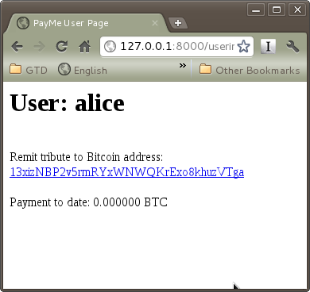
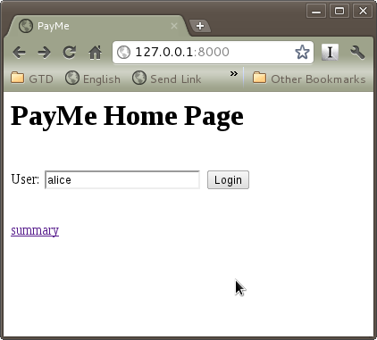
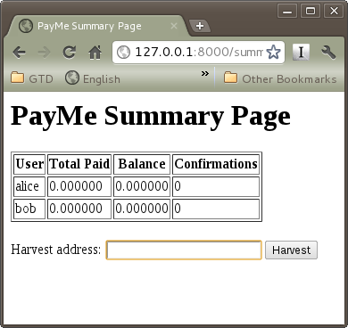
Example Django Website

Slide 16
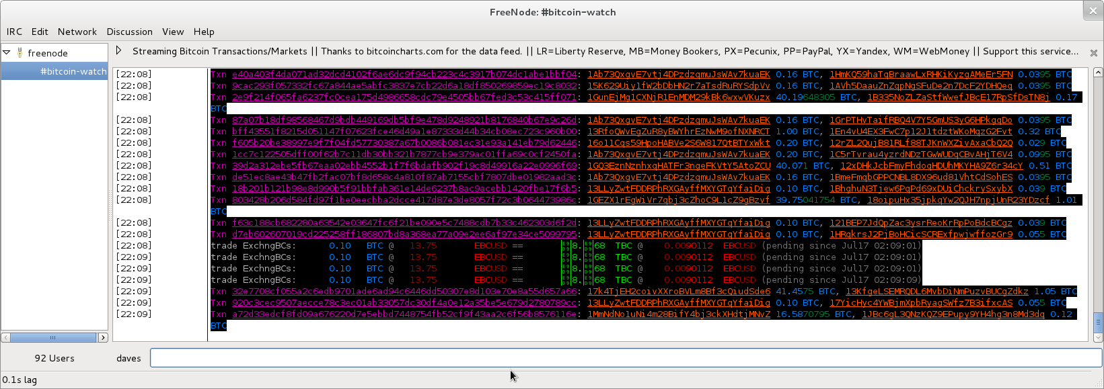
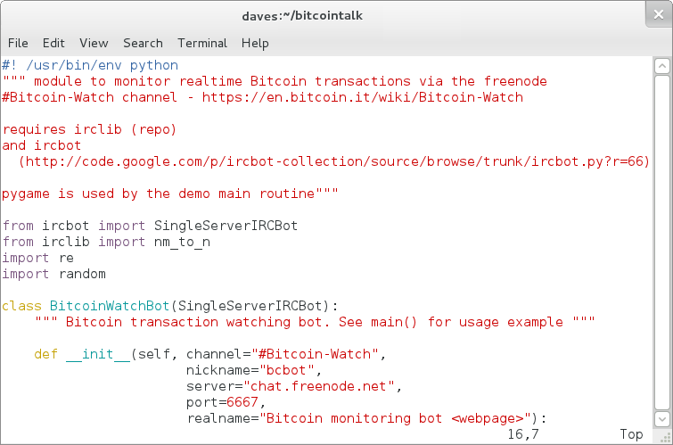
“Bitcoin Watch” Monitor

Slide 17
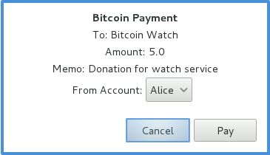
Opportunity – URI Scheme Handler
bitcoin:1Lg7peCQCBRBsmZJ5MoXikuQ25oZ4voBit?amount=5X8&
label=Bitcoin%20Watch&
message=Donation%20for%20watch%20service
https://en.bitcoin.it/wiki/URI_Scheme

Slide 18
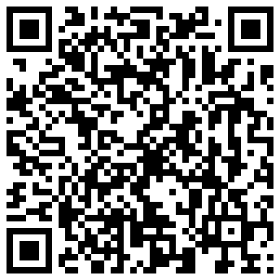
Vending

Slide 19
Opportunity – Wallet Apps
Different:
- Security Levels
- Users
- Use Cases
http://gitorious.org/pycoin - Bitcoin P2P Implementation

Slide 20


Is it Money? - Aristotle's Qualities of a Good Money
Durable
Portable
Divisible
Intrinsic Value

Slide 21
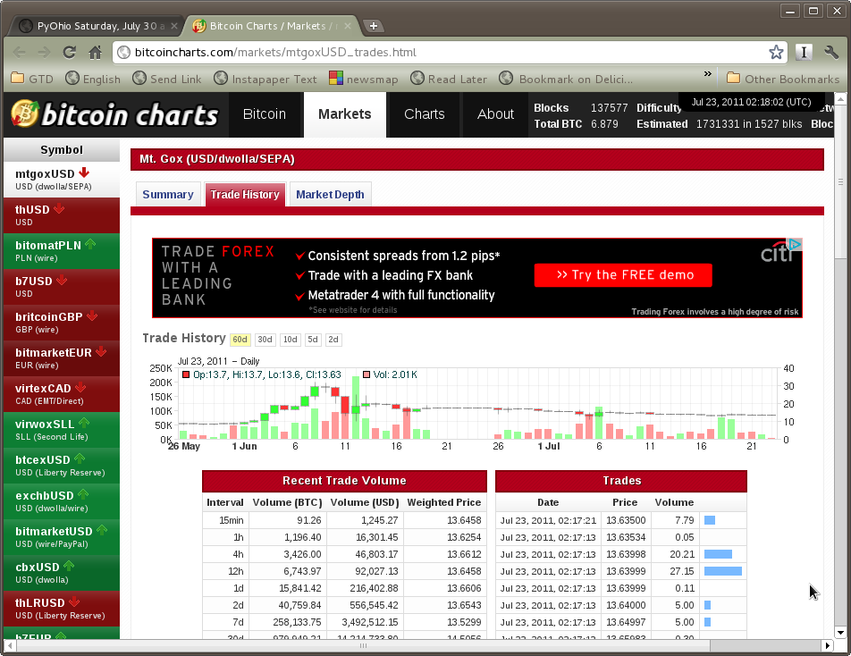
The Market View

Slide 22
Ledger Analysis
Metrics for a better idea of Bitcoin economy health
  Difficulty vs time?
    % Mining Pools
  BTC Velocity?
  Tx Velocity?
  Median Tx BTC?
  Addresses
    Reuse?
    Account detection metric
http://blockexplorer.com/

Slide 23
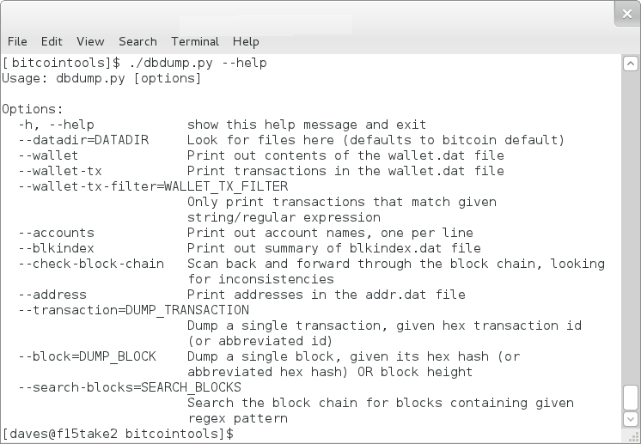
Ledger Analysis using Python
The bitcointools module parses local bitcoin data files
https://github.com/gavinandresen/bitcointools

Slide 24
Bitcoin Links
Market – Bitcoin Charts
  http://bitcoincharts.com
Plumbing – Block Explorer
  http://blockexplorer.com/
  Stats - http://blockexplorer.com/q
Technical – Bitcoin Wiki
  https://en.bitcoin.it/wiki/Main_Page
  Addresses, Transactions, Signing, Blocks, Peer Protocol
Community - http://forum.bitcoin.org/
News
  http://www.bitcoinnews.com/
  http://www.****coins.com/

Slide 25


