Slide 1
MSDS 7330 File Organization and Database Management

Slide 2
Agenda
Semi Structured Data : Context
XML : Introduction
Parsing XMLs
XML : Hands On Lab
JSON
Rest Services
Rest Services : Hands On Lab

Slide 3
Semi structured data – context Data Exchange in 3 tier architecture
Client/ User Interface
Business Tier
db
Enterprise applications are typically designed and deployed in multiple tiers
Data is transmitted/exchanged across the tiers
There needs to be a common mechanism of transmitting data across the layers
Earlier versions of distributed system transmitted data using CORBA , EJBs etc
XML & JSON are modern ,human readable formats for exchanging data

Slide 4
XML : Extensible markup language
In the late 1990s there was a push for a data format that was both human- and machine-friendly.
To meet this need, a consortium of developers considered SGML (Standard Generalized Markup Language),
HTML provided a lot of presentational information, but did not provide any information about data within the document.
XML (Extensible Markup Language) was developed to meet those needs.
Extensibility: new tags can be defined for different situations.

Slide 5
Why XML?
Machine- and human-friendly data interchange format.
Data interchange is increasingly critical in today's environment.
XML now the de facto data interchange format for many.

Slide 6
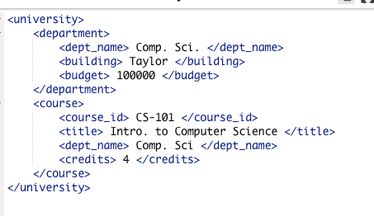
XML Tag Structure
Hierarchical like HTML.

Slide 7
XML V/S RELATIONAL Databases
XML not as structured as relational model
Allows more flexibility
Not better, just different
Tag-based
Hierarchical

Slide 8
XML: Basic Structure
The basic structural units are tags and elements.
Tag: label for a section of data
Element: section of data beginning with <tagname> and ending with matching </tagname>
Elements must be properly nested.
Correct: <course> … <title> … </title> </course>
Incorrect: <course> … <title> … </course> </title>
Start tags must have matching end tags and must be inside same parent element.
Every document must have a single top-level element.

Slide 9
Parsing xml documents
SAX Parsers
Is a stream-based processor.
Only part of XML in memory at any time
Parsing accomplished by implementing callback methods ( e.g. Element started, element ended etc)
DOM Parsers
Tree model parser (Object based) (Tree of nodes).
DOM loads the file into the memory and then parse- the file.
Supports xpath and tree traversals

Slide 10
In-Class Hands on Exercise
Exercise 1 : DOM parsing in Python

Slide 11
JSON format ( JavaScript Object Notation)
Light weight data exchange format
Human readable
Language independent format
data objects consisting of attribute–value pairs and array data types

Slide 12
Rest web Services
REST is a web standards based architecture and uses HTTP Protocol for data communication
A web service is a collection of open protocols and standards used for exchanging data between applications or systems.
Software applications written in various programming languages use web services to exchange data over networks
JSON is the most popular format for exchanging data across Rest services

Slide 13
Hands on lab
Rest Service for accessing data from MySQL

