Slide 1

Team Thárros
April Tag Table Tennis Tracker
Embedded Systems Design II Preliminary Design Review

Slide 2
Team Members
Name | Major Roles
Athaxes Alexandre | GUI Development
Brian Zarzuela | Firmware Development
David Tassoni | Business Lead
Hasnain Akhtar | Software Development
Ryan Schureman | Software Development
Notes:
Hi Everyone, we are Team Tharros. Athaxes suggested the name mainly because it sounds cool, but Tharros is Greek for Courage, so we like to think of ourselves as a courageous group. For our team members, we have Athaxes with a major function of GUI, Brian on Firmware, Dave as business, and both Hasnain and Ryan as Software. Each of us also has our minor function as Algorithm Dev.

Slide 3

Goals
To create a fully working FPGA-based tennis ball tracker
Accurately determine ball position within 3D space
Determine if the ball is within bounds
Remain within an attractive price point
Notes:
The goal of the project is to create an FPGA based tennis ball tracker for the United States Tennis Association.
The tracking system must be able to accurately identify the position of the ball within 3D space in order to determine if the ball is out of bounds when it strikes the surface of the court.

Slide 4


System Overview
Notes:
We’ll start by taking a look at the system requirements and how we plan on implementing them into our design.

Slide 5
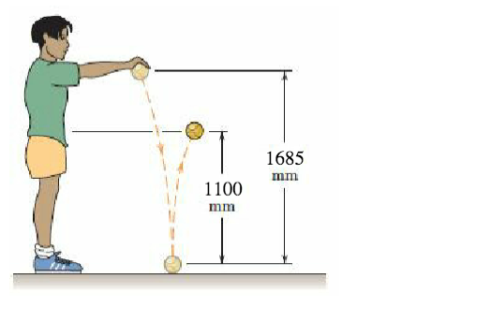
Requirements:
Stereo camera system with minimal tracking errors.
  Test visual feed, positioning, tracking accuracy, z accuracy
Determine the ball’s velocity and capture the coefficient of restitution
Report calculations and error rates with respect to actual values
Tracking LED
April tag with tracking, out of bounds, and z accuracy
3D Visualization - modify image to represent z depth
Notes:
Our plan of work first begins with calibrating the camera - making sure that the system works correctly, is positioned how we’d like it to be, and that it remains consistent enough so that we are able to gauge our tracking accuracy.
To calibrate our cameras on the snickerdoodle, we’ll be using the MATLAB stereo camera calibration application. The calibration app is fairly straightforward, and ensures that our camera system will be tracking correctly.
Next we’ll employ a few algorithms to calculate the ball’s velocity when it moves positions and its coefficient of restitution from its determined position in 3d space.
The coefficient of restitution is the ratio of the final to initial velocity between two objects after they collide
To determine the coefficient for our court, we’ll be running a small experiment similar to the diagram we provided in which:
We’ll drop the ball several times and measure the heights of their bounces
We then average the heights, take the square root of that averaged number, and divide it by the initial drop height.
Giving us our coefficient of restitution, as a value between between 0 and 1.
For some of these measurements we will also be measuring error rates to make sure that our system is working within a certain set of bounds, with not too much variation between each run.
The project specifications also call for having green leds turn on for half a second when the ball bounces, and flash continuously if the ball leaves the court.
To accomplish this, the camera calibration and april tags (which help us visualize the court in 3d space) will need to be fully functional.
If we have an accurate absolute coordinate system, then we will also have an accurate court border.
We will also be tracking the ball in 3d space and our idea is to look for changes in velocity.
When the ball impacts the ground, its velocity will change in magnitude and direction, so we know it’ll have made contact, and the program will toggle the LEDS on for half a second.
And when the system fails to locate the ball when it is out of the court, the leds will continuously flash to signify that.

Slide 6
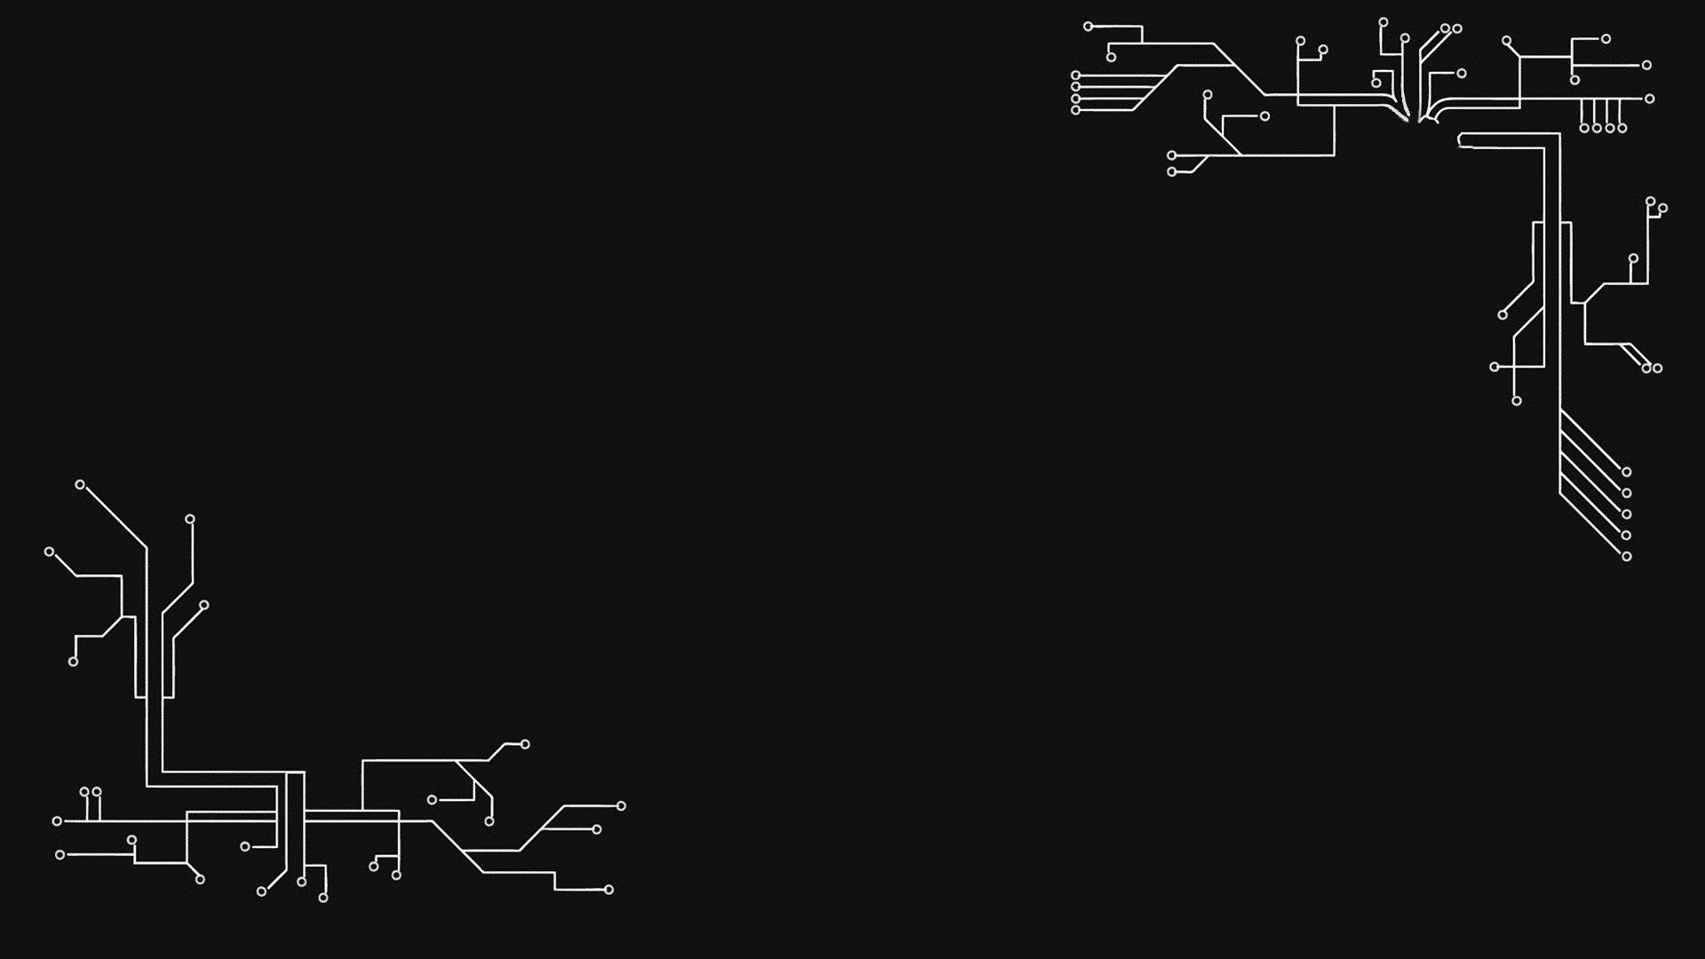
Hardware

Slide 7
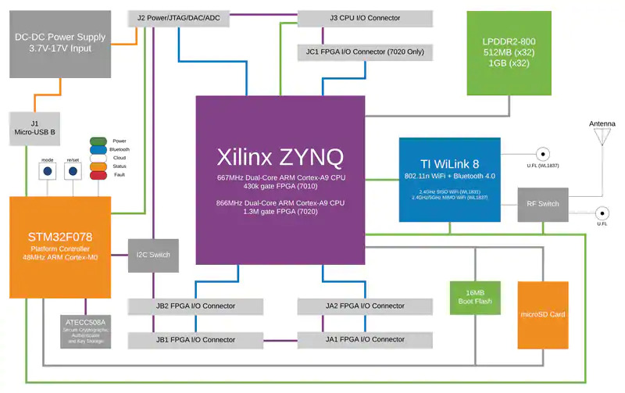
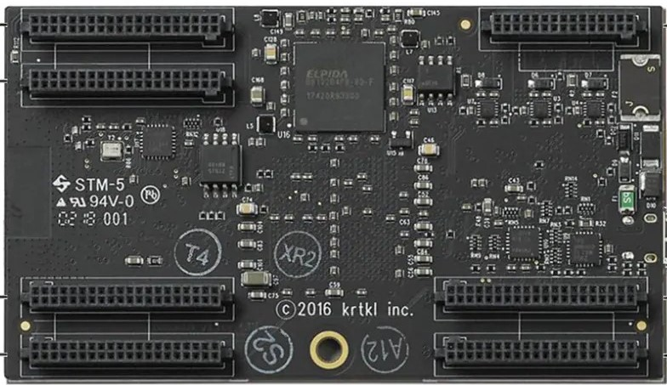
Snickerdoodle Black SoM
  Xilinx Zynq-7020 SoC
  Dual-Band Wi-Fi
Status LEDs
Stereo Cameras
Hardware Overview
Notes:
Of course, we’ll be using the Snickerdoodle black system on a module for this project. It’s built on the Xilinx Zynq 7020 SoC, and we will be utilizing built in features to help with the project. For example, we can use the board’s built in dual-band wi-fi for wireless communications, and the dual stereo cameras for ball tracking. There are multiple led’s on the board too, and those will be used as status leds to report ball information.

Slide 8

Snickerdoodle unplug during use
Wi-Fi connection may not be suitable for all room conditions
Improper camera calibration
Cameras out of focus
Hardware Risks
Notes:
The hardware risks are straightforward, with the most critical one being an accidental unplug during use. This would immediately shut down the whole system, so we want to be wary of that.
Other somewhat common risks to be on the lookout for include an unstable or weak wifi connection, an out of focus camera, or even improper camera calibration. We need to ensure that the cameras are calibrated with the correct settings so our system is accurate.

Slide 9

Software

Slide 10
Software Overview
Camera Calibration
  MATLAB Stereo Calibration
Read Video Feed
Identify 3D Space
  Determine position of ball using April Tags
Send Data to GUI
  Send ball position data to front end
  Turn respective LEDs on/off with state of ball
Error Logging
  Log where the program is at all times
  Log ball coordinates and camera position data

Slide 11

Software Risks
Software may not be able to recognize partially obstructed target
Hardware may fail to capture image data
Image data could be lost if Wi-Fi connection is not strong
Calibration could fail causing the software to not be able to recognize any object
Notes:
Few software risks also come along with our design. For example, a partially obstructed object might not get recognized by the software itself. There is also a risk of hardware malfunction. The hardware may fail to capture the image data either partially or fully.
The Image data could also get lost if we do not have a solid Wi-Fi connection. There is also a risk of the initial calibration not running properly which would cause the software not being able to recognize any object at all.

Slide 12

GUI

Slide 13

GUI Layout
Designed in Python + REMI
Display of a plot to depict system accuracy (Single Tab)
  Allow user to perform test via buttons and input text fields
Display of coefficients of restitution Diagram (Single Tab)
  Allow user to perform test via buttons and input text fields
Video replay of 3D visualization of tennis court using x,y,z positions of ball from Xilinx Zynq-7020 device (Single Tab)
  Text box for X, Y and Z positions of ball
  Text field for the state of ball (Out or In)
Notes:
The GUI will be in Python + REMI
It will have System Accuracy Data Plot of our test + allow the user to perform test (repeat)
Coefficient of restitution Diagram of our test + allow the user to perform test
Video Replay of 3D viz tennis court using x,y,z of the ball
-text box for x, y, and z of ball (Update)
-text field for the state of the ball in or out with text

Slide 14
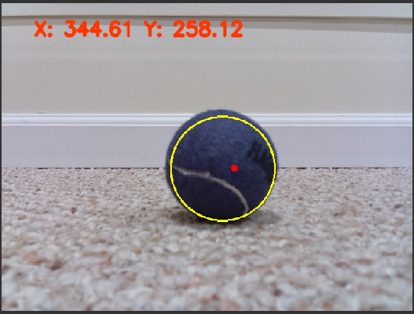
Ball Tracking Example
Source: Ball Tracking with OpenCV (YouTube)
Notes:
This is an example of what we think the tracking of the ball would look like.
-Where the ball has been, etc.
-Example from lab 1 this will be expanded to include the z axis

Slide 15

GUI Risk Examples
Hardware/Software
  Establing a consistent connection
  Accurate and smooth depiction of data
User Functionality
  Readability - size of text, charts, tables, buttons, etc.
Notes:
“Risk”
Speed
Grafical computer problems

Slide 16

Business
Notes:
Now we move onto the business items.

Slide 17

Validation
Accurate system analysis
A few questions to ask ourselves:
  Does the system see the ball?
  Where is the ball now?
  Is the ball even on the court?
Ball location on GUI
Notes:
Design validation - we want to make sure our system performs acceptably
One of the more important parts of the system to focus on is our accuracy. And with that, a few questions that we need to continue to ask ourselves are: Does the system see the ball? Where is the ball now? Is the ball even on the court?
By making sure we can answer those questions, we can ensure that our system precisely finds the location of the balls when they are on the court. And equally as important, the system needs to recognize when there are no balls on the court, since at times the balls will be bouncing out of bounds. This needs to be reflected by turning the LEDs on and off, as specified earlier in the presentation.
Our GUI will also be updated periodically to show the position of the ball, again circling back to the concept of accuracy and validation

Slide 18
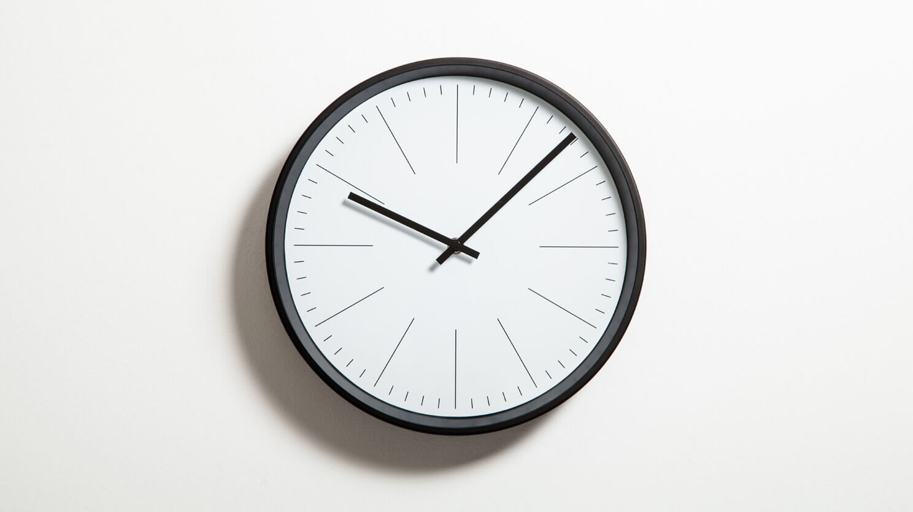
Project Management
Hours Submission
Spreadsheet for team tracking
Accessible and editable by anyone in the group
Official weekly hour submissions to Dr. Kaputa
Weekly Meeting
Aim for once a week
Brainstorming
Looking ahead, check-in
Weekly goals
Notes:
For project management, one area of focus is with our worked hours submissions, and with that, keeping an accurate count of the total hours worked as a team, and a count for each individual member of the team. We need to keep this accurate throughout the whole project, so we can see report our actual hours worked, and how much profit we make at the end.
I’ve been using an Excel spreadsheet to record this data, and I recently added it to our shared Team Drive so any one of us can see it, and add hours when we work them. And of course, I submit our weekly hours each Sunday evening to Dr. Kaputa for an official recording.
We also try to meet once a week, though it honestly has been a bit difficult with our varying schedules and juggling jobs and classes. The past few weeks, our meetings were a means to brainstorm ideas of how we would like to approach the different aspects of the project, and decide if they’d be feasible. And now looking ahead, the weekly meetings will be more of a check-in to ensure we are doing what needs to be done. We will have multiple times per week now where all 5 of us can meet during our lectures and lab times. During this final four week stretch from PDR to CDR, we will be able to code and work on the project, rather than only plan the project. We can determine weekly goals of what we’d like done, complete weekly deliverables as needed, and check to see each other’s progress and give and motivation help when needed.

Slide 19
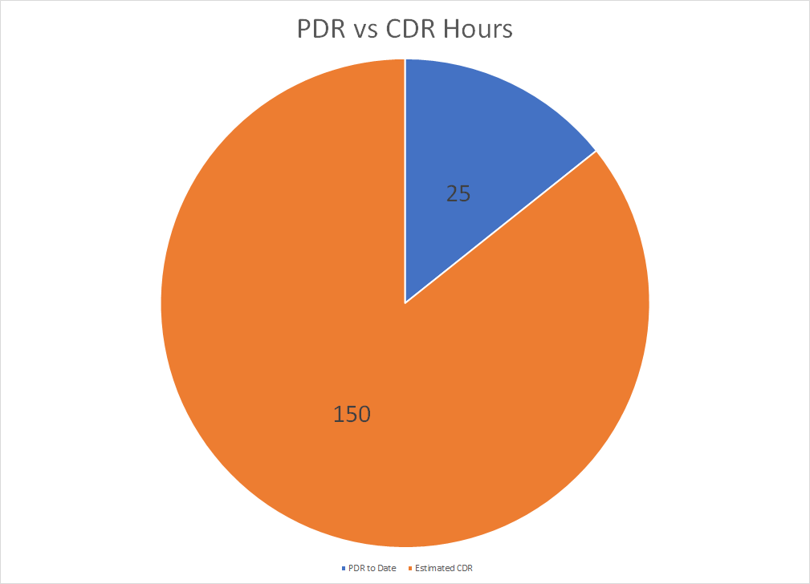
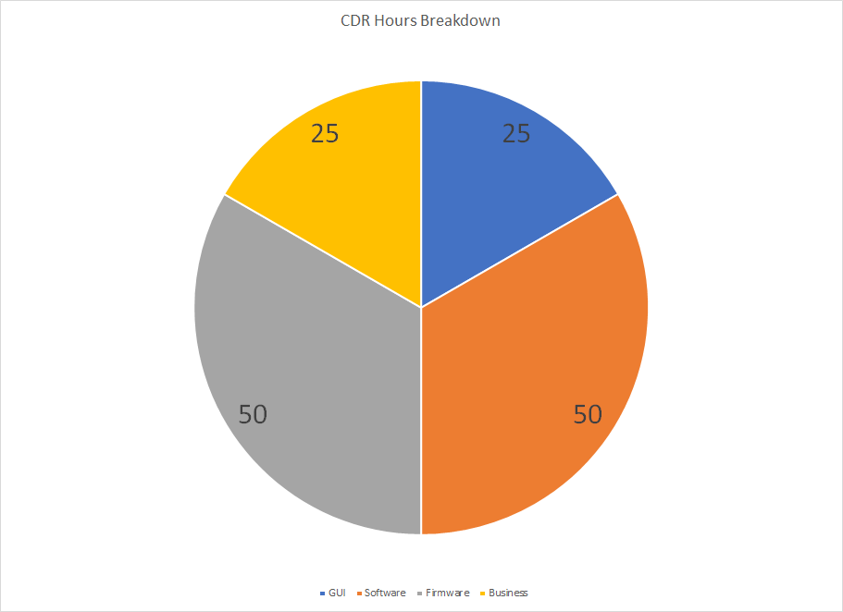
Cost Breakdown
Notes:
Since the start of the project, we’ve put in 25 hours across the team. The total cost from start to PDR is $2,500.
From now until our CDR, we have estimated 150 hours.
This brings us to a final total will be 175 hours for the PDR and CDR combined, as shown in the pie chart on the left, showing the comparison of PDR and CDR estimate.
The pie chart on the right shows our breakdown for the CDR sections.

Slide 20

Moving Forward
Future CDR
Transition planning -> executing
May 10
Estimated Time & Cost
We estimate future hours as follows:
  Business - 25
  GUI - 25
  Firmware - 50
  Software - 50
Total of 150 hours
Total CDR cost @ $100/hr: $15,000
Total PDR & CDR: $17,500
Notes:
As I said on the previous slide, we can begin to work on the CDR. Now that the PDR presentation has come, and is almost gone, we can transition from planning to executing. The CDR presentations begin on May 10, so we have four weeks to finish the project and prepare for the presentation, and our work begins this week.
As you saw in the pie chart, our estimates put us around 150 hours for the CDR. With 25 hours dedicated toward the business portion, 25 for the GUI, and 50 each for the firmware and software portions. This comes out to $15,000 for the total price for the CDR, seeing as how we are billing for $100 per hour.
And a total project cost of PDR and CDR $17,500
At the conclusion of the project, we will be comparing our estimate that we made to our actual hours worked. That way we can see exactly how accurate our predictions were, and if we should have bid the project higher or lower.

Slide 21
Questions?
Notes:
Thanks for listening to our presentation, do you have any questions for the team?

