Slide 1

Modules
CSC102
Notes:
Refer to Nortel ATM Multiservice switched network:
https://www.o2.cz/file_conver/45793/NN10600_700_71s1.pdf

Slide 2
Credits & Acknowledgements
Acknowledgements and appreciation to former Professors of UAT for materials and formatting.
Some of the current content in this slide deck was referenced and reproduced from our textbook.

Slide 3
Chapter Topics
3.1 Introduction
3.2 Defining and Calling a Module
3.3 Local Variables
3.4 Passing Arguments to Modules
3.5 Global Variables and Global Constants

Slide 4
3.1 Introduction
A module is a group of statements that exists for the purpose of performing a specific task within a program.
Most programs are large enough to be broken down into several subtasks.
Divide and conquer: It’s easier to tackle smaller tasks individually.

Slide 5
3.1 Introduction
Benefits of using modules
Simpler code
Small modules easier to read than one large one
Code reuse
Can call modules many times
Better testing
Test separate and isolate then fix errors
Faster development
Reuse common tasks
Easier facilitation of teamwork
Share the workload
Easier Maintenance
Smaller, simpler code is easier to maintain

Slide 6
3.2 Defining and Calling a Module
The code for a module is known as a module definition.
Module showMessage()
Display “Hello world.”
End Module
To execute the module, you write a statement that calls it.
Call showMessage()

Slide 7
3.2 Defining and Calling a Module
A module’s name should be descriptive enough so that anyone reading the code can guess what the module does.
No spaces in a module name.
No punctuation.
Cannot begin with a number.

Slide 8
3.2 Defining and Calling a Module
Definition contains two parts
A header
The starting point of the module
A body
The statements within a module
Module name( )
Statement
Statement
Etc.
End Module

Slide 9
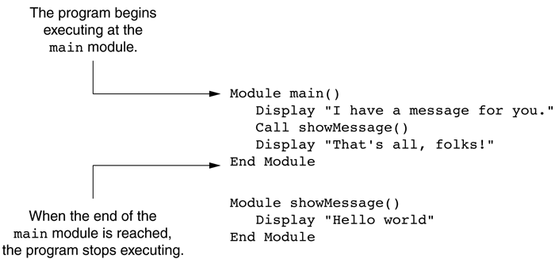
3.2 Defining and Calling a Module
A call must be made to the module in order for the statements in the body to execute.
Figure 3-2 The main module

Slide 10
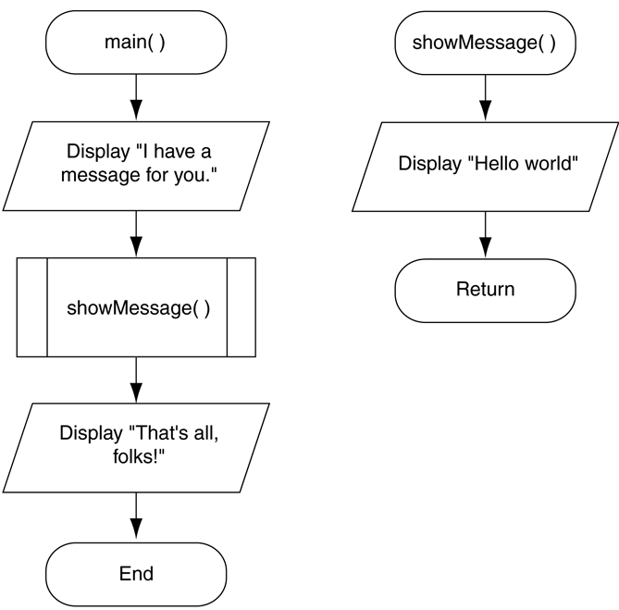
3.2 Defining and Calling a Module
When flowcharting a program with modules, each module is drawn separately.
Figure 3-6 Flowchart for Program 3-1

Slide 11
3.2 Defining and Calling a Module
A top-down design is used to break down an algorithm into modules by the following steps:
The overall task is broken down into a series of subtasks.
Each of the subtasks is repeatedly examined to determine if it can be further broken down.
Each subtask is coded.

Slide 12
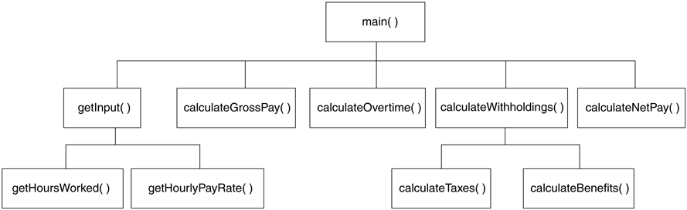
3.2 Defining and Calling a Module
A hierarchy chart gives a visual representation of the relationship between modules.
The details of the program are excluded.
Figure 3-7 A hierarchy chart

Slide 13
3.3 Local Variables
A local variable is declared inside a module and cannot be accessed by statements that are outside the module.
A variable's scope is the part of the program in which the variable can be accessed.

Slide 14
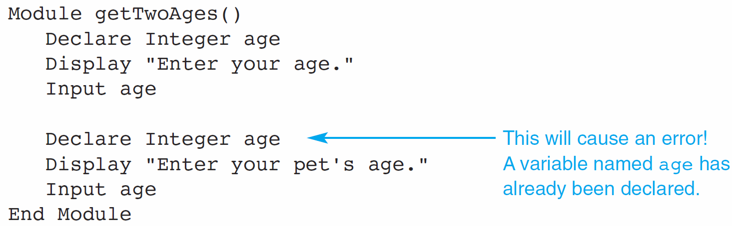
3.3 Local Variables
Duplicate Variable Names: Variables within the same scope must have different names.

Slide 15
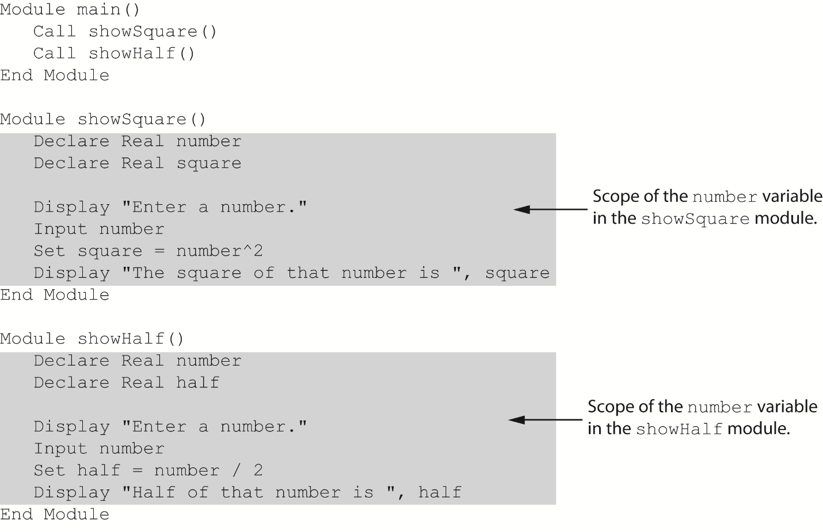
3.3 Local Variables
Duplicate Variable Names: Variables in different scopes can have the same name.

Slide 16
3.4 Passing Arguments to Modules
Sometimes, one or more pieces of data need to be sent to a module.
An argument is any piece of data that is passed into a module when the module is called.
A parameter is a variable that receives an argument that is passed into a module.
The argument and the receiving parameter variable must be of the same data type.
Multiple arguments can be passed sequentially into a parameter list.

Slide 17
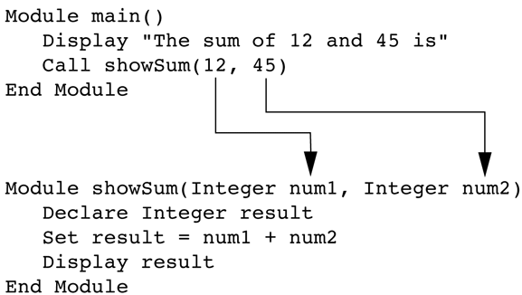
3.4 Passing Arguments to Modules
Figure 3-15 Two arguments passed into two parameters

Slide 18
3.4 Passing Arguments to Modules
Pass by Value vs. Pass by Reference
Pass by Value means that only a copy of the argument’s value is passed into the module.
One-directional communication: Calling module can only communicate with the called module.
Pass by Reference means that the argument is passed into a reference variable.
Two-way communication: Calling module can communicate with called module; and called module can modify the value of the argument.

Slide 19
3.5 Global Variables & Global Constants
A global variable is accessible to all modules.
Should be avoided because:
They make debugging difficult
Making the module dependent on global variables makes it hard to reuse module in other programs
They make a program hard to understand

Slide 20
3.5 Global Variables & Global Constants
A global constant is a named constant that is available to every module in the program.
Since a program cannot modify the value of a constant, these are safer than global variables.

