Slide 1

Decision Structures & Boolean Logic
CSC102
Notes:
Refer to Nortel ATM Multiservice switched network:
https://www.o2.cz/file_conver/45793/NN10600_700_71s1.pdf

Slide 2
Credits & Acknowledgements
Acknowledgements and appreciation to former Professors of UAT for materials and formatting.
Some of the current content in this slide deck was referenced and reproduced from our textbook.

Slide 3
Chapter Topics
4.1 Introduction to Decision Structures
4.2 Dual Alternative Decision Structures
4.3 Comparing Strings
4.4 Nested Decision Structures
4.5 The Case Structure
4.6 Logical Operators
4.7 Boolean Variables

Slide 4
4.1 Introduction to Decision Structures
A decision structure (or selection structure) allows a program to perform actions only under certain conditions
Different types of decisions include
If, also called single alternative
If then else, also called dual alternative
Case structure for multiple alternative decisions

Slide 5
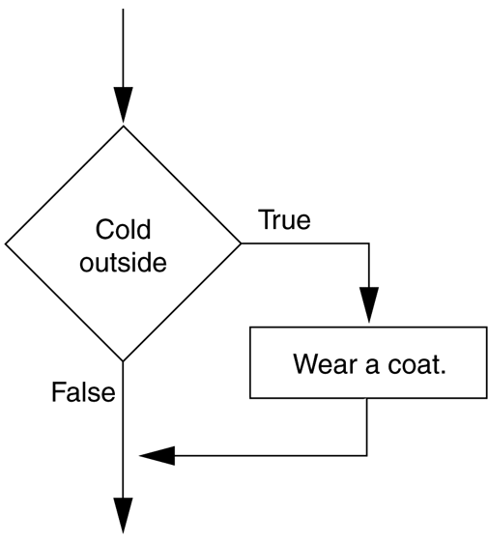
4.1 Introduction to Decision Structures
The if statement
An action only occurs if the decision is true
If condition Then
Statement
Statement
End If
A diamond symbol is used in flowcharts
Figure 4-1 A simple decision structure for an everyday task

Slide 6
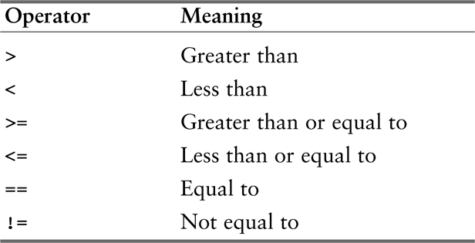
4.1 Introduction to Decision Structures
Relational Operators
Determines whether a specific relationship exists between two values
Used within the condition, a Boolean expression
x > y x<y x >=y x<y x <=y x==y x!=y
Table 4-1 Relational operators

Slide 7
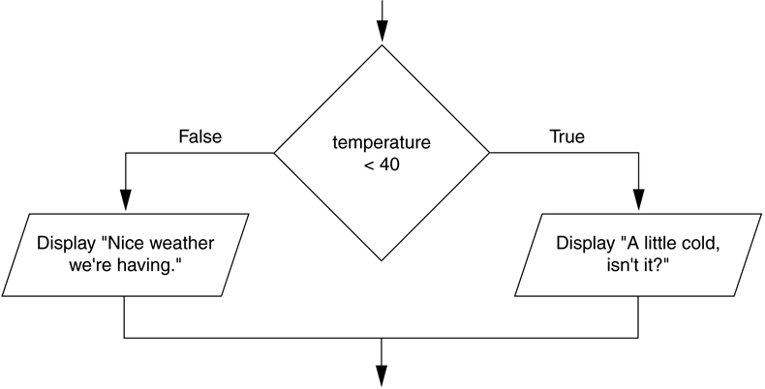
4.2 Dual Alternative Decision Structures
If then else statement
Executes one group of statements if it’s Boolean expression is true, or another group if its Boolean expression is false
Figure 4-8 A dual alternative decision structure

Slide 8
4.2 Dual Alternative Decision Structures
If condition Then
statement
statement
Else
statement
statement
End if
If temperature < 40 Then
Display “A little cold”
Display “Get a coat!”
Else
Display “Nice weather”
Display “And sunny!”
End if

Slide 9
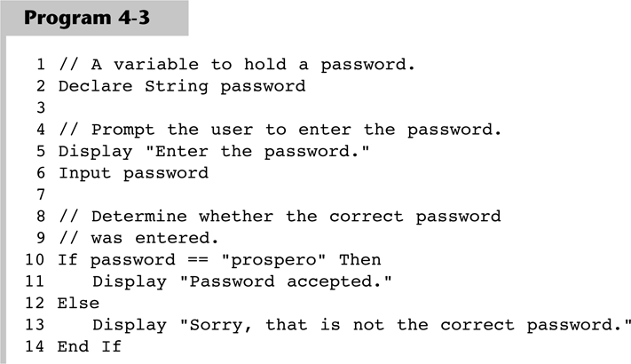
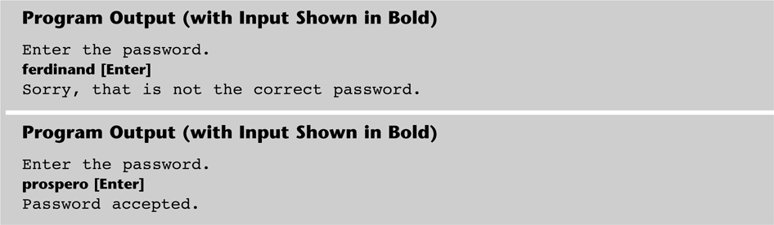
4.3 Comparing Strings
Most languages allow you to compare strings

Slide 10
4.3 Comparing Strings
Other String Concerns
String and strings can be compared
name1 == name 2
String and string literals can be compared
Month != “October”
String comparisons are generally case sensitive
You can also determine whether one string is greater than or less than another string (allows for sorting strings)

Slide 11
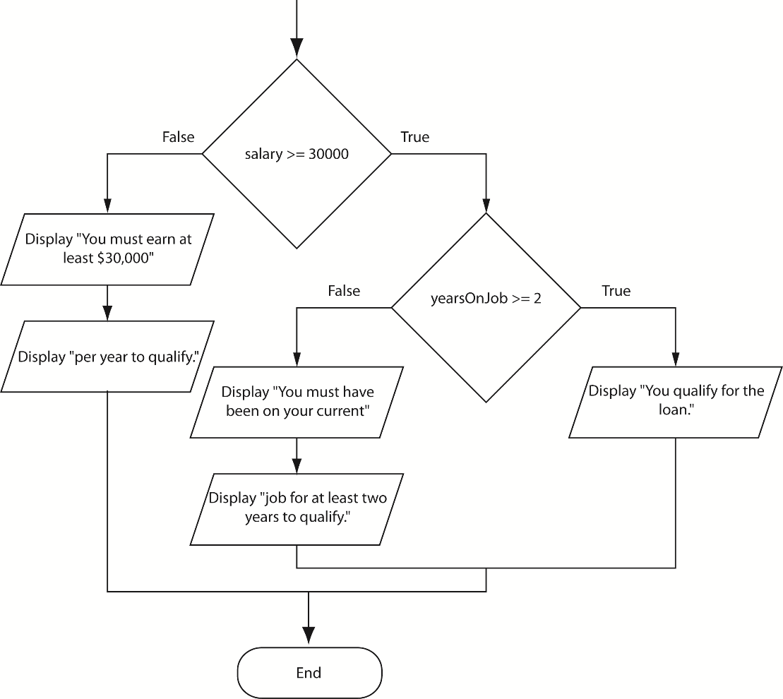
4.4 Nested Decision Structures
Decisions are nested in order to test more than one condition
If then if else example
Figure 4-15 A nested decision structure

Slide 12
4.4 Nested Decision Structures
The if then else if statement can make nested logic simpler to write
If score < 60 Then
Display “Grade is F.”
Else If score < 70 Then
Display “Grade is D.”
Else If score < 80 Then
Display “Grade is C.”
Else If score < 90 Then
Display “Grade is B.”
Else
Display “Grade is A.”
End If

Slide 13
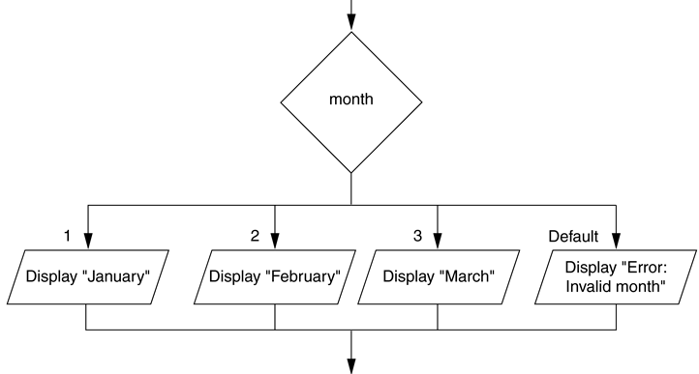
4.5 The Case Structure
The case structure lets the value of a variable or an expression determine which path of execution the program will take
Can be used as an alternative to nested decisions
Figure 4-18 A case structure

Slide 14
4.6 Logical Operators
Logical Operators are used between conditions to create complex Boolean expressions
AND – Both conditions must be true
OR – Either condition must be true
NOT – Reverses the truth of an expression

Slide 15
4.6 Logical Operators
AND example
If temperature < 20 AND minutes > 12 Then
Display “The temperature is in the danger zone.”
End If
OR example
If temperature < 20 OR temperature > 100 Then
Display “The temperature is in the danger zone.”
End If
NOT example
If NOT (temperature > 100) Then
Display “This is below the maximum temperature.”
End If

Slide 16
4.6 Logical Operators
Short-Circuit Evaluation: Supported by many languages for increased performance
AND operator: If the expression on the left side of the AND operator is false, the expression on the right side will not be checked.
OR operator: If the expression on the left side of the OR operator is true, the expression on the right side will not be checked.

Slide 17
4.6 Logical Operators
Range Checking
Often used for range checking
When checking for a number inside a range, use AND
If x >=20 AND x <=40 Then
Display “The value is in the acceptable range.”
End If
When checking for a number outside a range, use OR
If x < 20 OR x >40 Then
Display “The value is outside the acceptable range.”
End If

Slide 18
4.7 Boolean Variables
A variable of the Boolean data type can hold one or two values: true or false
Declare Boolean isLunchTime
If time >=12 then
Set isLunchTime = True
Else
Set isLunchTime = False
End If

