Slide 1

Decision Structures - Repetitions
CSC102
Notes:
Refer to Nortel ATM Multiservice switched network:
https://www.o2.cz/file_conver/45793/NN10600_700_71s1.pdf

Slide 2
Credits & Acknowledgements
Acknowledgements and appreciation to former Professors of UAT for materials and formatting.
Some of the current content in this slide deck was referenced and reproduced from our textbook.

Slide 3
Chapter Topics
5.1 Introduction to Repetition Structures
5.2 Condition-Controlled Loops: While, Do-While, and Do-Until
5.3 Count-Controlled Loops and the For Statement
5.4 Calculating a Running Total
5.5 Sentinels
5.6 Nested Loops

Slide 4
5.1 Introduction to Repetition Structures
A repetition structure causes a statement or set of statements to execute repeatedly
Allow a programmer to avoid duplicate code
Duplicate code makes a program large
Write a long sequence of statements is time consuming
If part of the duplicate code has to be corrected or changed, then the change has to be done many times

Slide 5
5.2 Condition-Controlled Loops
While Loop
While a condition is true, do some task
Do-While Loop
Do some task, while condition is true
Do-Until Loop
Do some task, while a condition is false (or until it’s true)
With all loops, be careful not to create infinite loops – always provide a way to break out

Slide 6
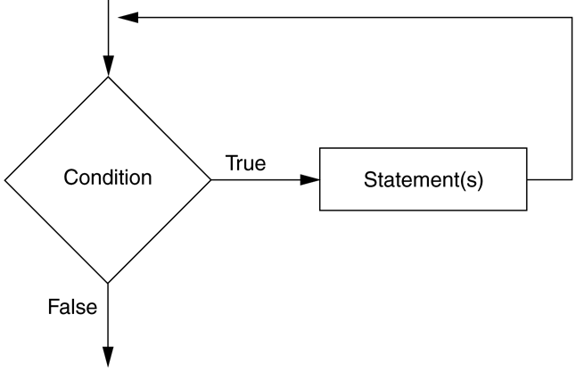
5.2 Condition-Controlled Loops
The While Loop – pretest loop
While condition
Statement
Statement
End While
Figure 5-1 The logic of a While loop

Slide 7
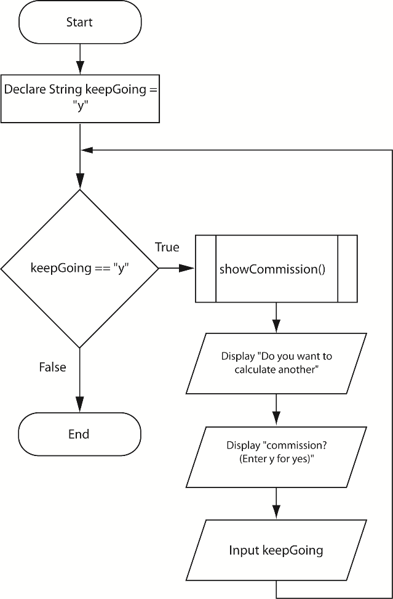
5.2 Condition-Controlled Loops
Working with Modules and Loops
To run a program multiple times, modules can be put within a loop
Figure 5-5 The main module of Program 5-4

Slide 8
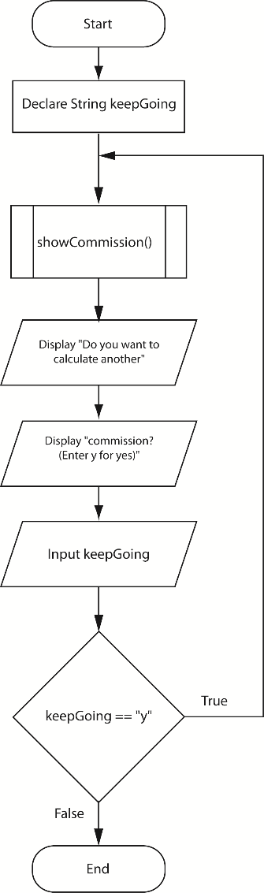
5.2 Condition-Controlled Loops
The Do-While Loop – posttest loop
Do
Statement
Statement
While condition
Figure 5-8 Flowchart for the main module in Program 5-5

Slide 9
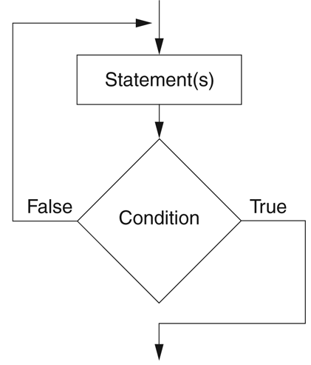
5.2 Condition-Controlled Loops
The Do-Until Loop
Loop iterates until a condition is true, but not all languages support this type of loop
Figure 5-10 The logic of a Do-Until loop

Slide 10
5.3 Count-Controlled Loops
A count-controlled loop iterates a specific number of times
A for loop is best used for this situation
For counterVariable = startingValue to maxValue
statement
statement
End for
There is an Initialization, Test, and Increment expression that controls the loop

Slide 11
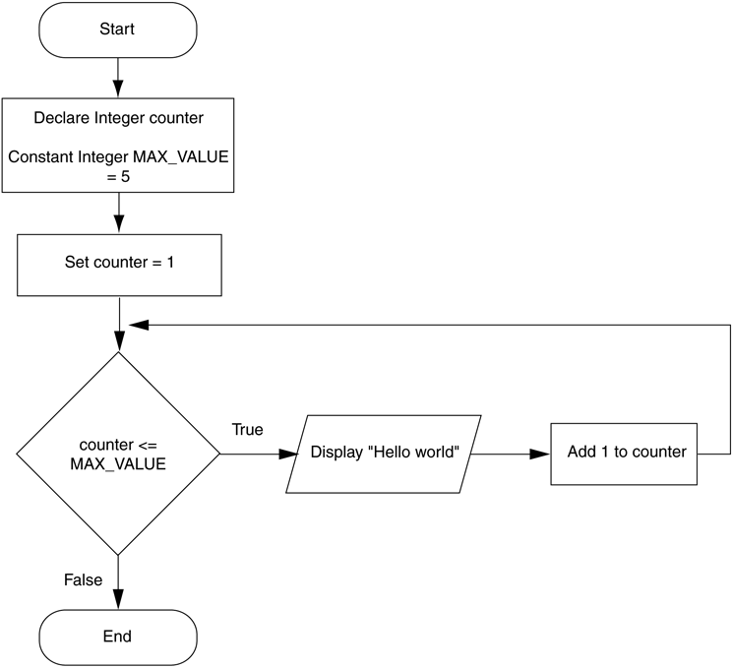
5.3 Count-Controlled Loops
For loops can also increment by more than one, count backwards by decrementing, or allow the user to control the number of interactions
The for loop in action
Figure 5-14 Flowchart for Program 5-8

Slide 12
5.3 Count-Controlled Loops
General loop concerns
Do not forget to initialize the loop control variable
Do not forget to modify the loop control variable
Many loops are interchangeable, but generally
Use while loop when loop may not have to process
Use do while when it must process at least once
Use for loop with specific number of iterations

Slide 13
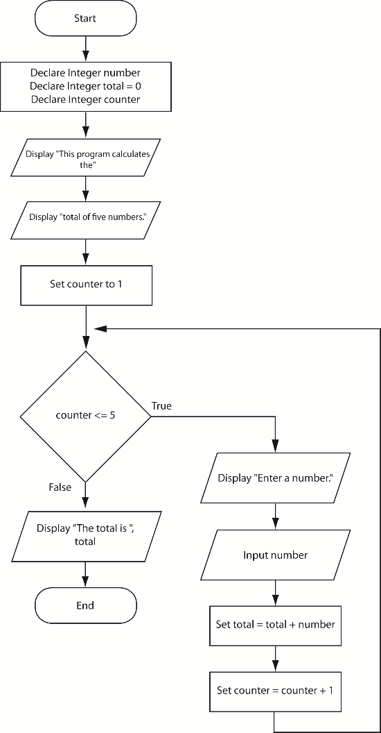
5.4 Calculating a Running Total
A running total is a sum of number that accumulates with each iteration of a loop
Figure 5-19 Flowchart for Program 5-18

Slide 14
5.5 Sentinels
A sentinel is a special value that marks the end of a list of values, used as stop values for loops
How it can be done
Ask the user at the end of each loop iteration, if there is another value to process
Ask the user at the beginning of the loop, how many times the loop should process

Slide 15
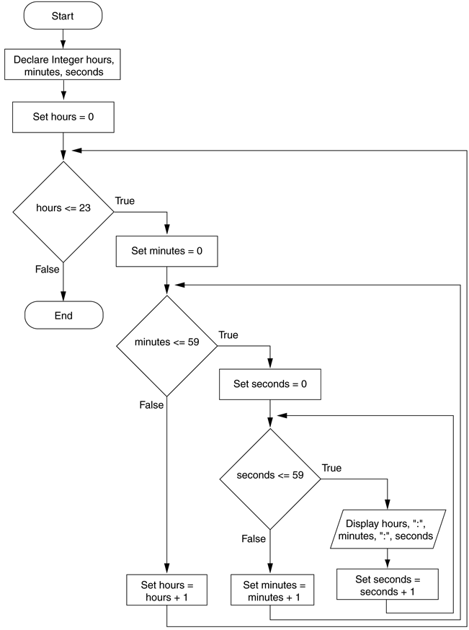
5.6 Nested Loops
All loops can be nested, that is, a loop inside of a loop
Figure 5-21 Flowchart for a clock simulator

