Slide 1

Data Structures - Functions
CSC102

Slide 2
Credits & Acknowledgements
Acknowledgements and appreciation to former Professors of UAT for materials and formatting.
Some of the current content in this slide deck was referenced and reproduced from our textbook.

Slide 3
Chapter Topics
6.1 Introduction to Functions: Generating Random Numbers
6.2 Writing Your Own Functions
6.3 More Library Functions

Slide 4
6.1 Introduction to Functions
A function is a module that returns a value back to the part of the program that called it
Many languages provide libraries of functions that you can use, such as Random Number Generator
A function is like a module, but it returns a value that can be used in your program
Library functions
Written functions that come with most languages
Usually common tasks and save time for the programmer because it allows for code reuse

Slide 5
6.1 Introduction to Functions
The Random Number Generator function is useful in:
Game programs
Simulation programs
Statistical programs
Computer security such as encryption
How random function works
Set number = random(1, 100)
1 and 100 define the range of the number that can be returned, and are called arguments
The function is called and a random number is returned and assigned to the variable number

Slide 6
6.2 Writing Your Own Functions
Most languages allow coders to write functions
The function header specifies the data type of the value that is returned, the name of the function, and any parameter variables
The function body are the statements that execute when the function calls
The return statement specifies the value that is returned when the function ends

Slide 7
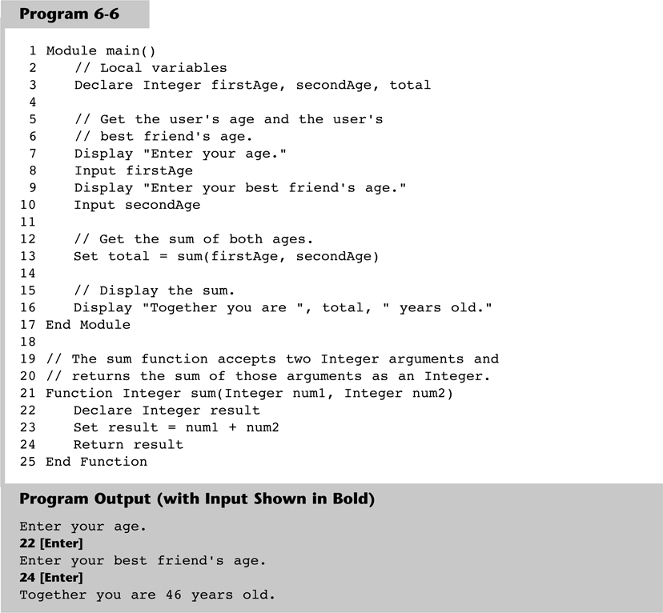
6.2 Writing Your Own Functions

Slide 8
6.2 Writing Your Own Functions
Additional concerns
While you can pass as many arguments into a function, you can only return one value
Functions simplify code, increase the speed of development, and ease the facilitation of teamwork
Each function should be flowcharted separately
IPO (input, processing, and output), can be used to show what a function does
IPO Chart for the getRegularPrice Function
Input | Processing | Output
None | Prompts the user to enter an item’s regular price | The item’s regular price, as a Real

Slide 9
6.3 More Library Functions
Mathematical Functions
Functions typically accept one or more values as arguments, perform a mathematical operation using the arguments, and return the results
Set result = sqrt(16)
Returns the square root of 16
Set area = power(4, 2)
Raises the value of 4 to the power of 2

Slide 10
6.3 More Library Functions
Other Common Mathematical Functions
abs calculates the absolute value of a number
cos returns the cosign of an argument
round rounds to the nearest integer
sin returns the sine of an argument
tan returns the tangent of an argument

Slide 11
6.3 More Library Functions
Data Type Conversion Functions
Library functions that convert values from one data type to another
toInteger converts a real to an integer
toReal converts an integer to a real
Real numbers can store integers
Integers cannot store real numbers
Type mismatch errors will occur without converting values

Slide 12
6.3 More Library Functions
Formatting Functions
Allow to format a number in a certain way
currencyFormat will be used to format a number to a currency
Declare Real amount = 6450.879
Display currencyFormat(amount)
Display would be $6,450.88

Slide 13
6.3 More Library Functions
String Functions
Allow for working with strings
length function returns the length of a function
append function joins multiple strings together
toUpper and toLower converts a string to upper or lower case
substring can extract a character or a portion of a string out of a string

Slide 14
6.3 More Library Functions
String Functions
contains identifies similar strings within two strings
stringToInteger and stringToReal converts string that stores a number, to a number data type
isInteger and isReal test numbers to see if it can be converted to a string

