Slide 1

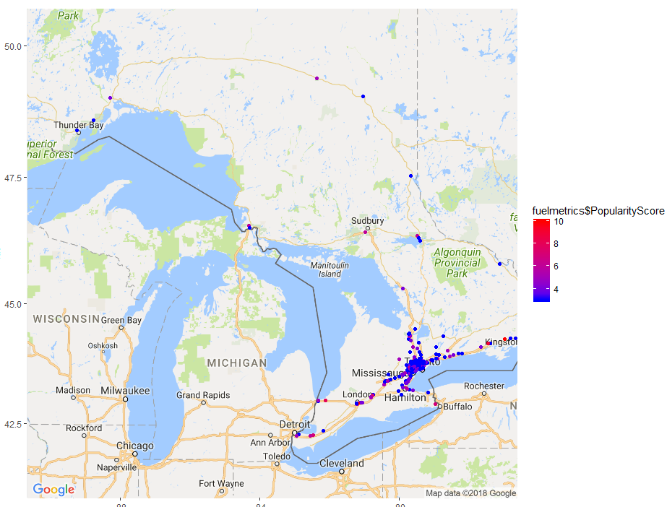
azure ml model to predict FUEL station POPULARITY
3/4/2018
Team: we<3azure

Slide 2


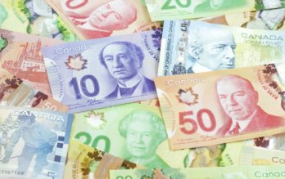
Opening a gas station?
Potential Location
Azure ML Model
Probability of Being Popular

Slide 3
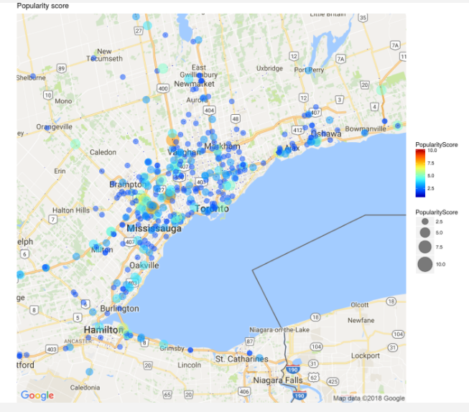

Slide 4
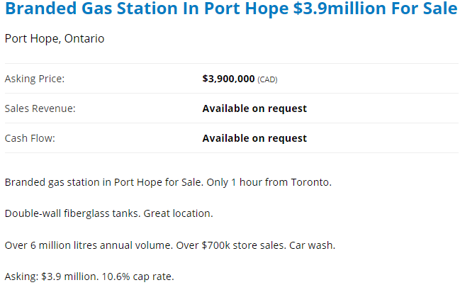
Solution
Business Problem: Where to build new fuel stations
Solution: Model to predict popularity of fuel station locations
Business Value:
2.5mm to open a gas station in the United States

Slide 5
OUTLINE OF WORK
Feature Generation
Geotab Datasets Used: Road Impediments, Fuel Station Metrics, Hazardous Driving Areas, Searching For Parking
Feature exploration
Correlation Matrix
K-Means Clustering
Predictive Model
Two-Class Boosted Decision Tree
Anomaly Detection (SVD vs PCA)

Slide 6
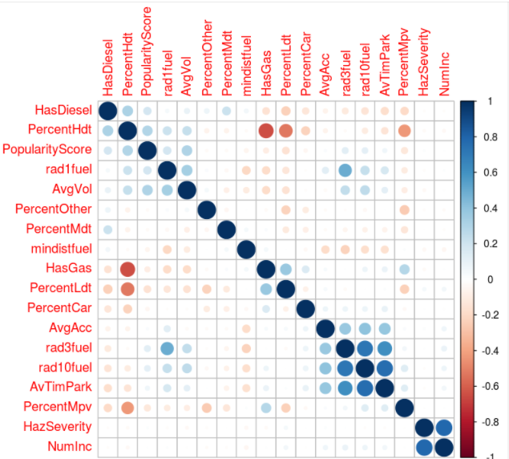
Key Data Transformations & Correlation between features
Score | Count
1 | 2366
2 | 330
3 | 138
4 | 55
5 | 30
6 | 12
7 | 6
8 | 7
9 | 1
10 | 7

Slide 7
Potential Location of a gas station

Slide 8
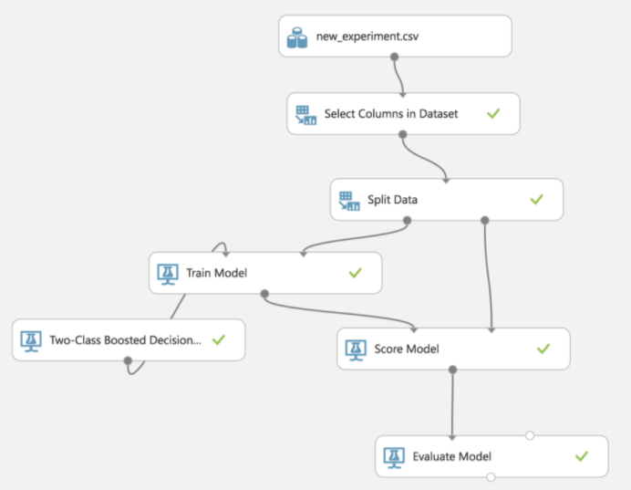

Slide 9
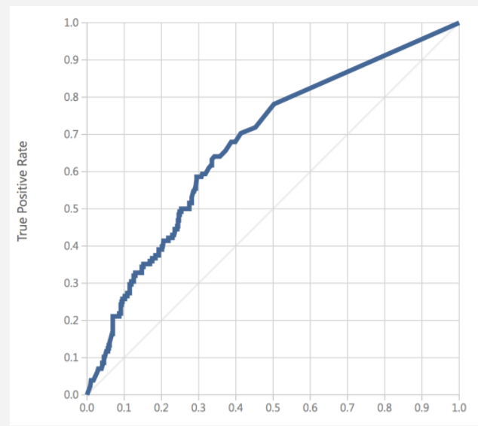
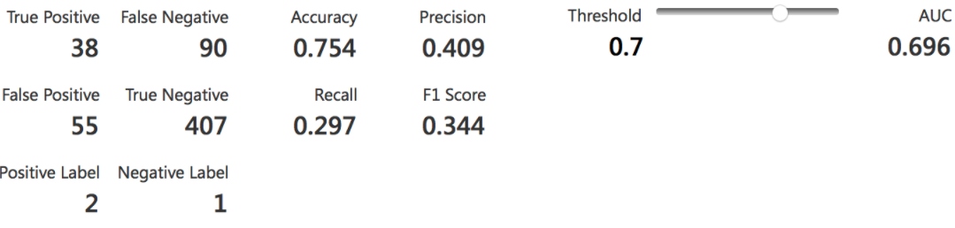

Slide 10
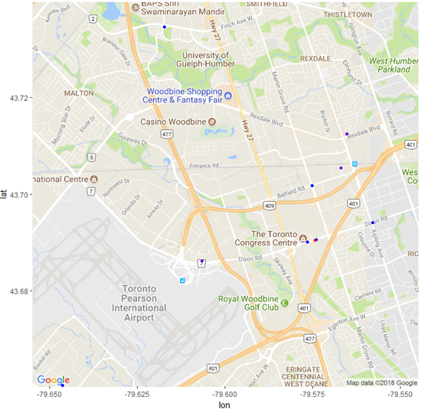

Slide 11
Features of Potential location
Gas Stations in Radius 1km: 2
Gas Stations in Radius 3km: 9
Gas Stations in Radius 5km: 141
Minimum Distance to Other Fuel Station: 908m
Average Volume of Cars Per Day (3km Radius): 1198
Has Gas: 1
Has Diesel: 1
Predicted Classification: 2
Probability of Belonging to Class: 0.868812

Slide 12
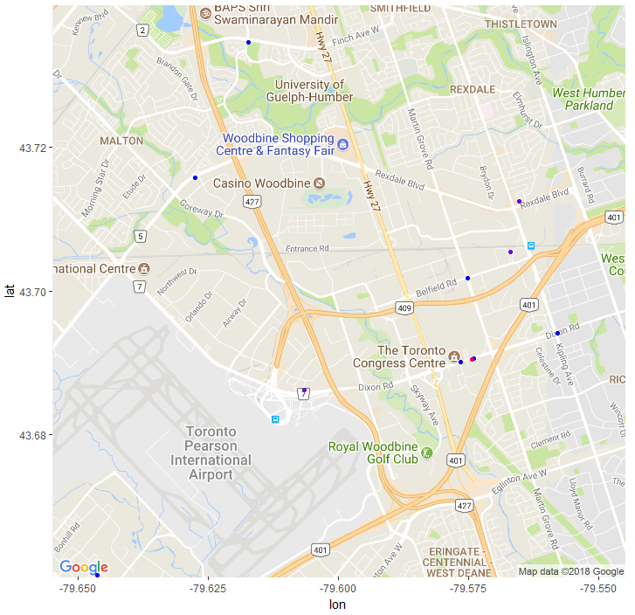

Slide 13
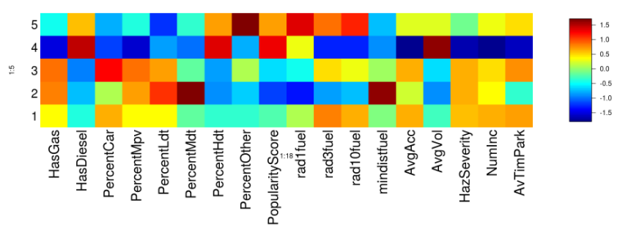
Clustering
Features of Popular Stations
High Average Car Volume
Has Diesel Fuel
Percent Heavy Duty Trucks High
Number of Other Stations In 1km Radius

Slide 15
Solution
Potential Location
Azure ML Model
Probability of Success
Thank you to Microsoft Azure Team, Geotab, and UofT for the terrific case competition!
Team: we<3azure

Slide 16
Appendix

Slide 17
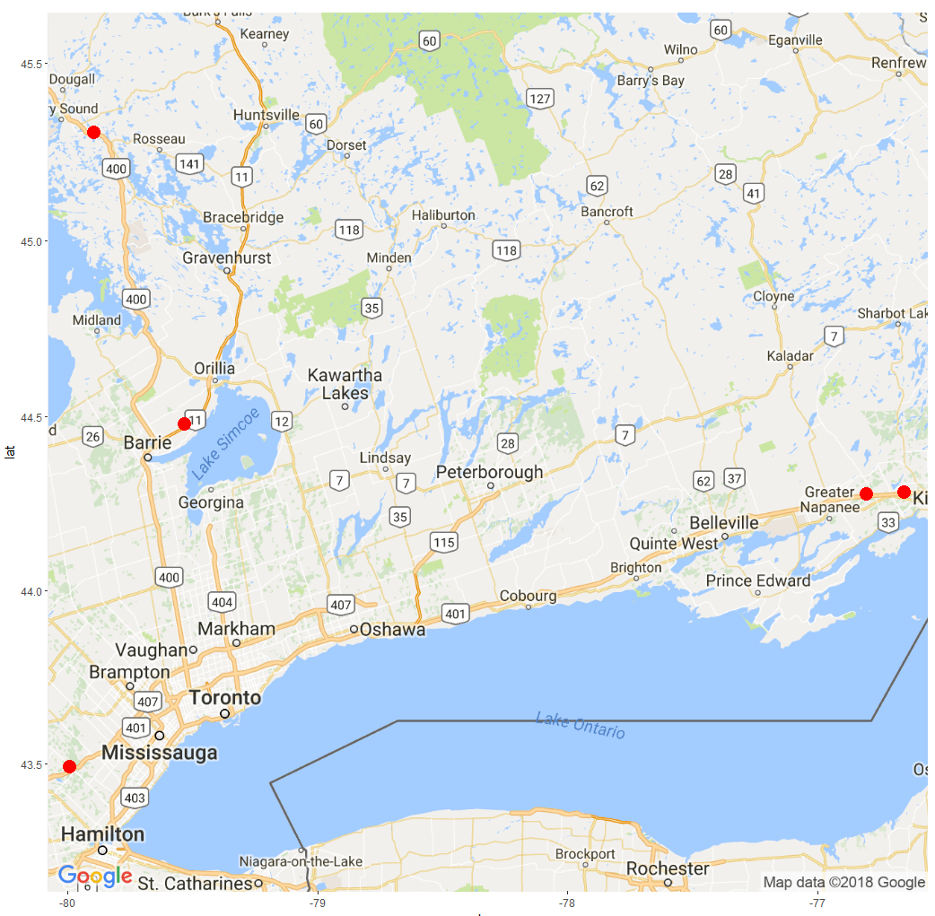
Areas of Expansion
Popular gas stations in areas where next gas station is at least 5km away are attractive sites.
Relatively uncompetitive locations which seemingly could support another station.

Slide 18
THE VALUE OF DIESEL
 |  | Popularity
 |  | No | Yes
Has Diesel | No | 689 | 5
 | Yes | 2007 | 251

