Slide 1
Maximum Likelihood Estimation
We usually know which parametric model the data is drawn from. However, we often do not know the model parameters.
Example:
We have data (size=n) to predict if a patient would be readmitted; binary output-either the patient is readmitted or not; and some predictors; here parametric model is logistic regression. But we don’t know p=P(patient is readmitted). We have to calculate it using the data.
Maximum likelihood estimation is a method to estimate unknown parameters of the underlying distribution of data. It was introduced by R. A. Fisher, a great English mathematical statistician, in 1912.

Slide 2
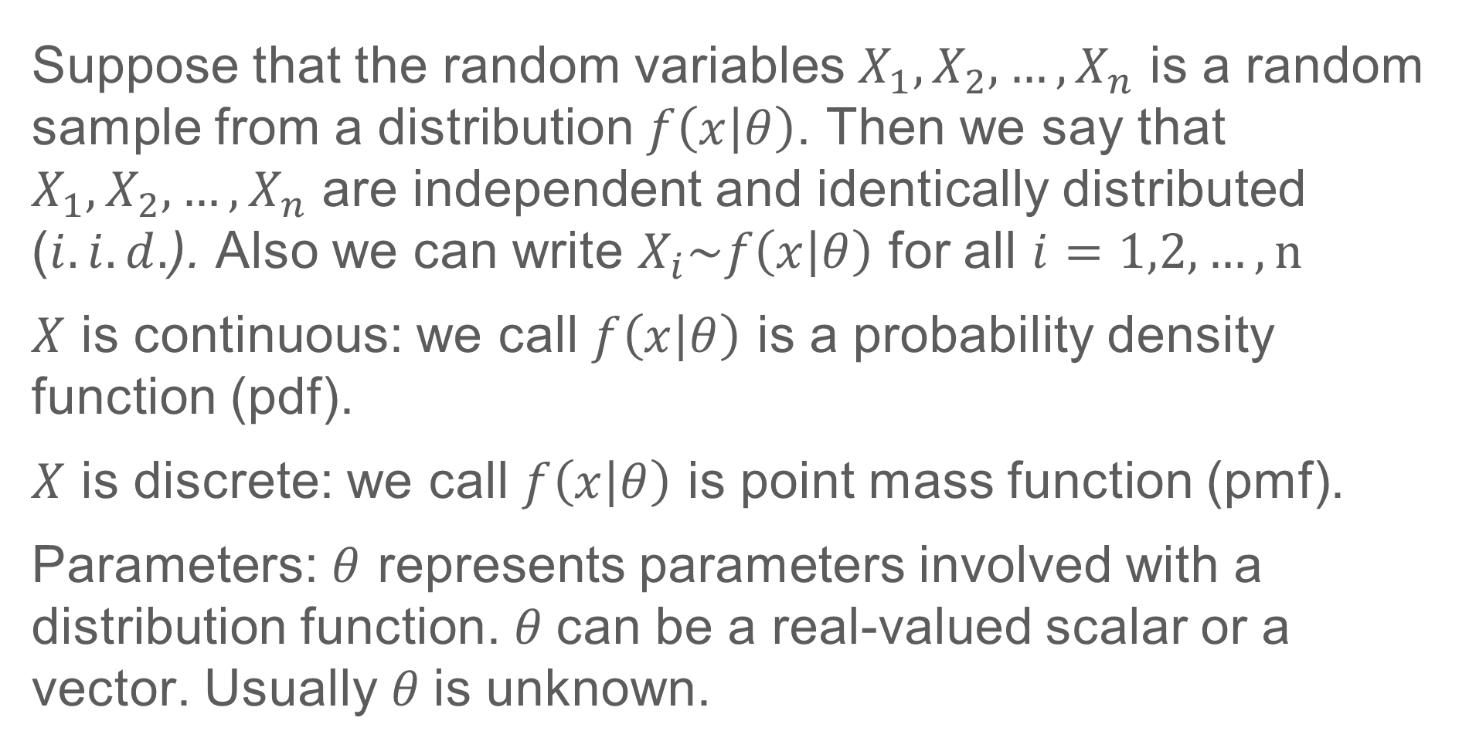
Maximum Likelihood Estimation Contd.
Suppose that the random variables $X_{1},X_{2},…,X_{n}$ is a random sample from a distribution $f\left(x | θ\right)$. Then we say that $X_{1},X_{2},…,X_{n}$ are independent and identically distributed ($i.i.d.$). Also we can write $X_{i}\sim f\left(x | θ\right)$ for all $i=1,2,…,n$
$X$ is continuous: we call $f\left(x | θ\right)$ is a probability density function (pdf).
$X$ is discrete: we call $f\left(x | θ\right)$ is point mass function (pmf).
Parameters: $θ$ represents parameters involved with a distribution function. $θ$can be a real-valued scalar or a vector. Usually $θ$is unknown.

Slide 3
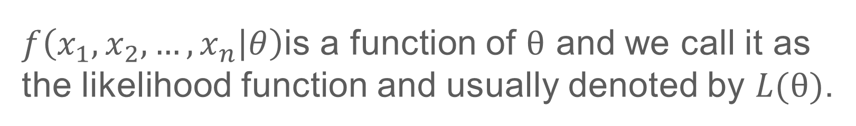
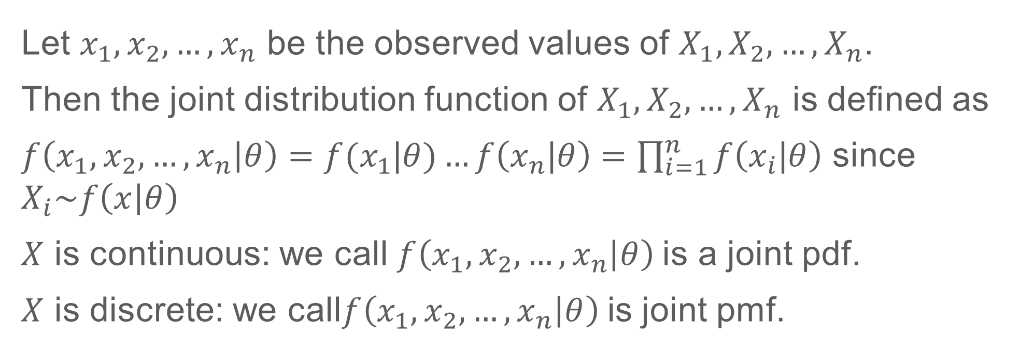
Joint Distribution Function
Let $x_{1},x_{2},…,x_{n}$ be the observed values of $X_{1},X_{2},…,X_{n}$.
Then the joint distribution function of $X_{1},X_{2},…,X_{n}$ is deﬁned as
$f\left(x_{1},x_{2},…,x_{n} | θ\right)=f(x_{1}$|$θ)…f\left(x_{n}\text{|}θ\right)=\prod_{i=1}^{n}{f\left(x_{i}\text{|}θ\right)}$ since $X_{i}\sim f\left(x | θ\right)$
$X$ is continuous: we call $f\left(x_{1},x_{2},…,x_{n} | θ\right)$is a joint pdf.
$X$ is discrete: we call$f\left(x_{1},x_{2},…,x_{n} | θ\right)$is joint pmf.
Likelihood function
$f\left(x_{1},x_{2},…,x_{n} | θ\right)$is a function of $θ$ and we call it as the likelihood function and usually denoted by $L(θ)$.

Slide 4
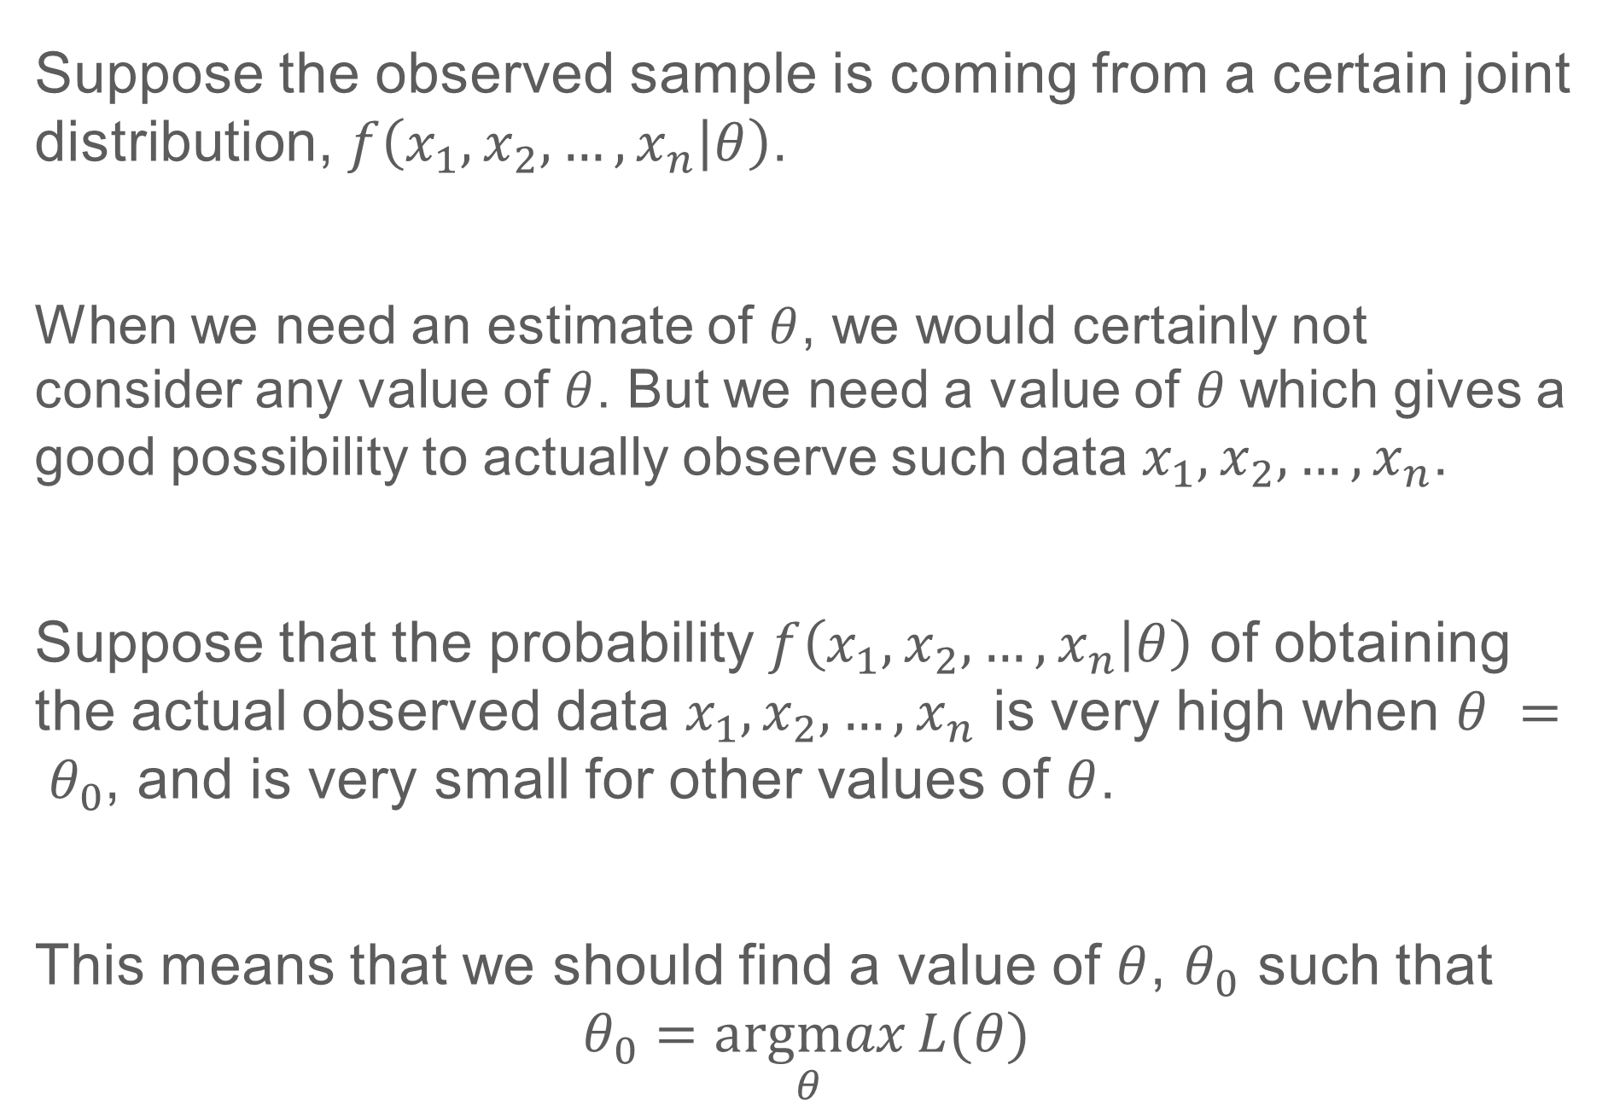
Why do we maximize $L(θ)$ to estimate $θ$
Suppose the observed sample is coming from a certain joint distribution, $f\left(x_{1},x_{2},…,x_{n} | θ\right)$.
When we need an estimate of $θ$, we would certainly not consider any value of $θ$. But we need a value of $θ$which gives a good possibility to actually observe such data $x_{1},x_{2},…,x_{n}$.
Suppose that the probability $f\left(x_{1},x_{2},…,x_{n} | θ\right)$ of obtaining the actual observed data $x_{1},x_{2},…,x_{n}$ is very high when $θ = θ_{0}$, and is very small for other values of $θ$.
This means that we should find a value of $θ$, $θ_{0}$ such that
$$θ_{0}=\underset{θ}{argmax}{L(θ)}$$

Slide 5
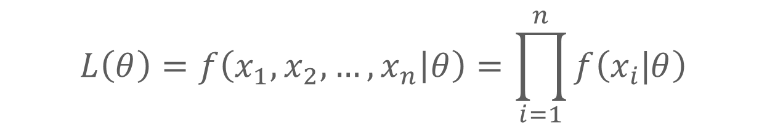

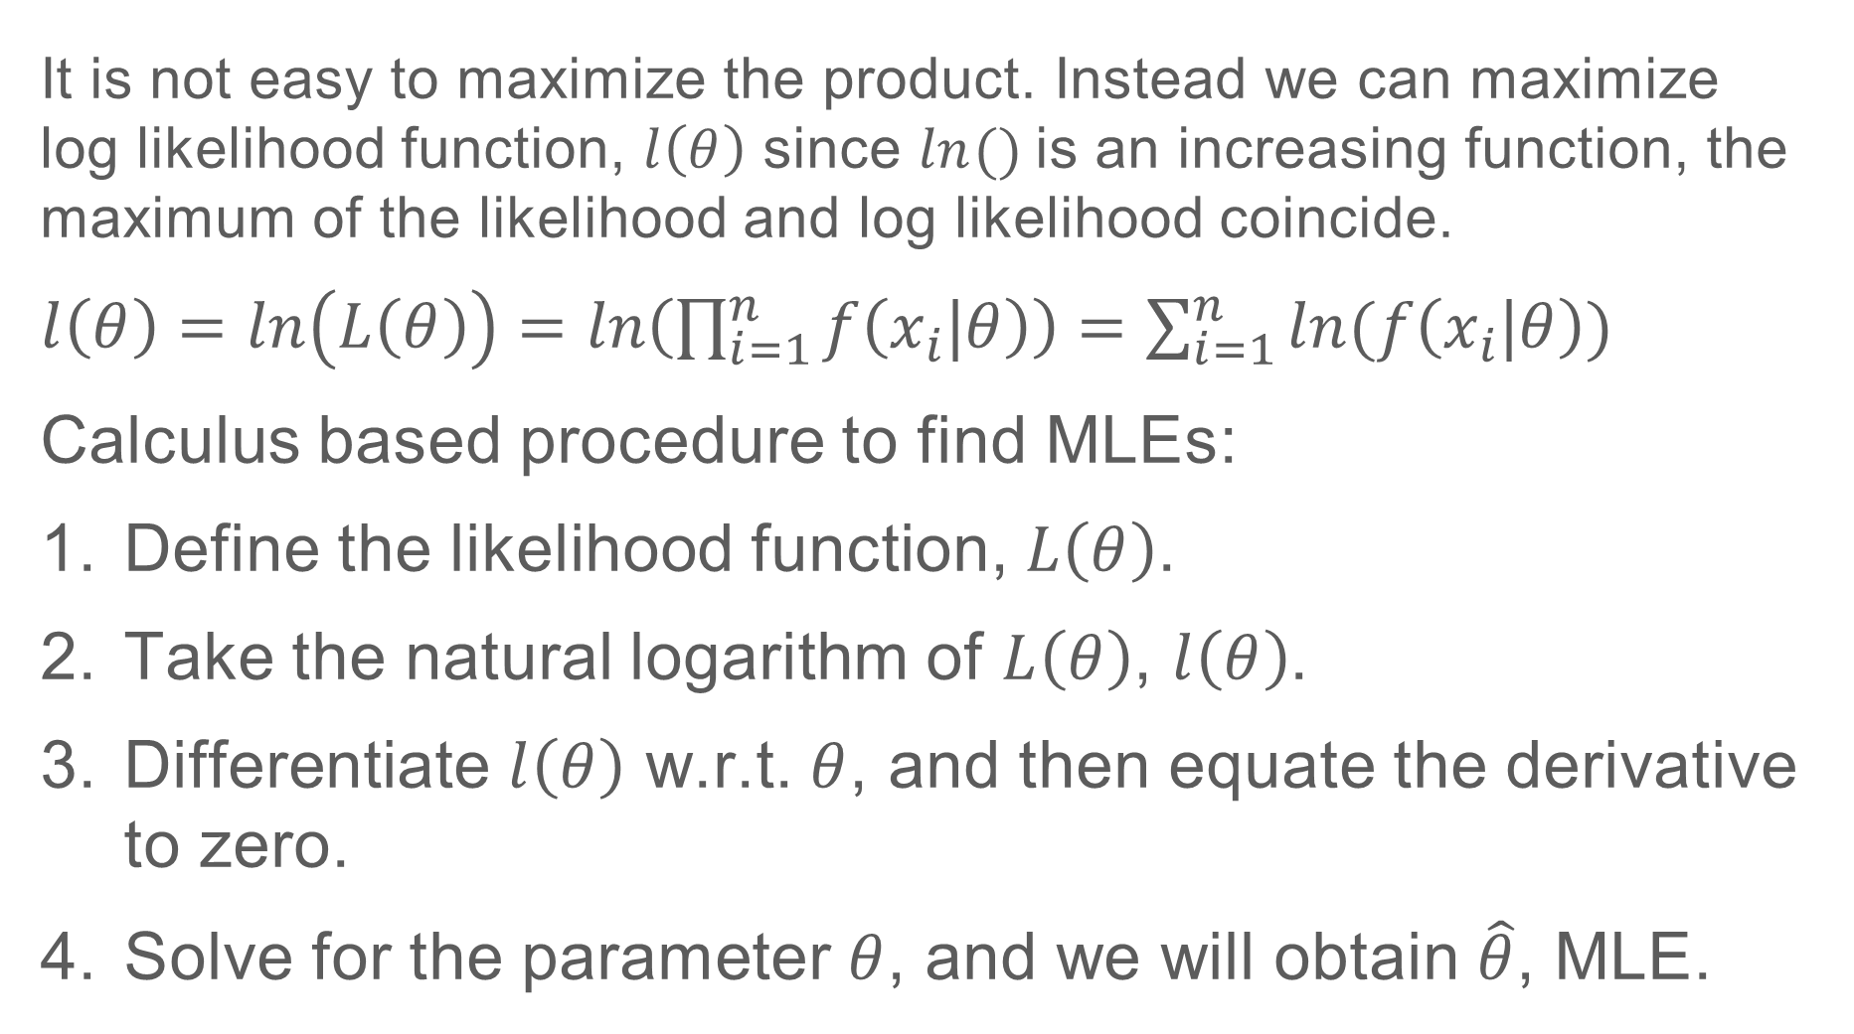
Maximizing $L(θ)$
$$L\left(θ\right)=f\left(x_{1},x_{2},…,x_{n} | θ\right)=\prod_{i=1}^{n}{f\left(x_{i}\text{|}θ\right)}$$
It is not easy to maximize the product. Instead we can maximize log likelihood function, $l\left(θ\right)$ since $ln⁡()$is an increasing function, the maximum of the likelihood and log likelihood coincide.
$l\left(θ\right)=$ $\ln\left(L\left(θ\right)\right)=\ln\left(\prod_{i=1}^{n}{f\left(x_{i}\text{|}θ\right)}\right)=\sum_{i=1}^{n}{ln(f\left(x_{i}\text{|}θ\right))}$
Calculus based procedure to find MLEs:
Define the likelihood function, $L\left(θ\right)$.
Take the natural logarithm of $L\left(θ\right)$, $l\left(θ\right)$.
Differentiate $l\left(θ\right)$ w.r.t. $θ$, and then equate the derivative to zero.
Solve for the parameter $θ$, and we will obtain $\hat{θ}$, MLE.

Slide 6
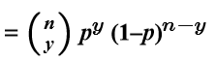
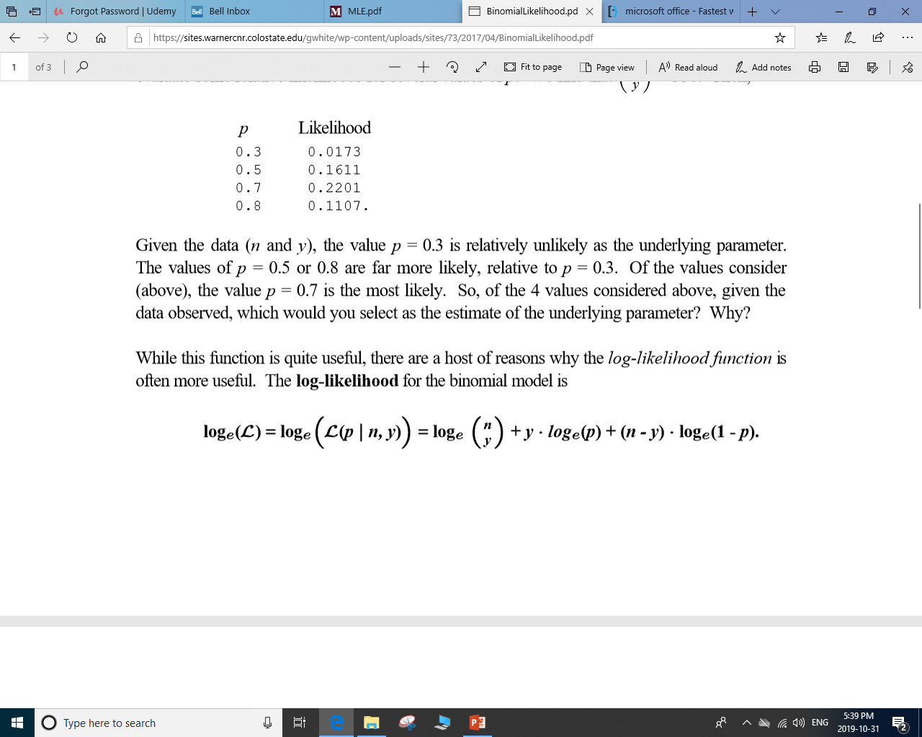
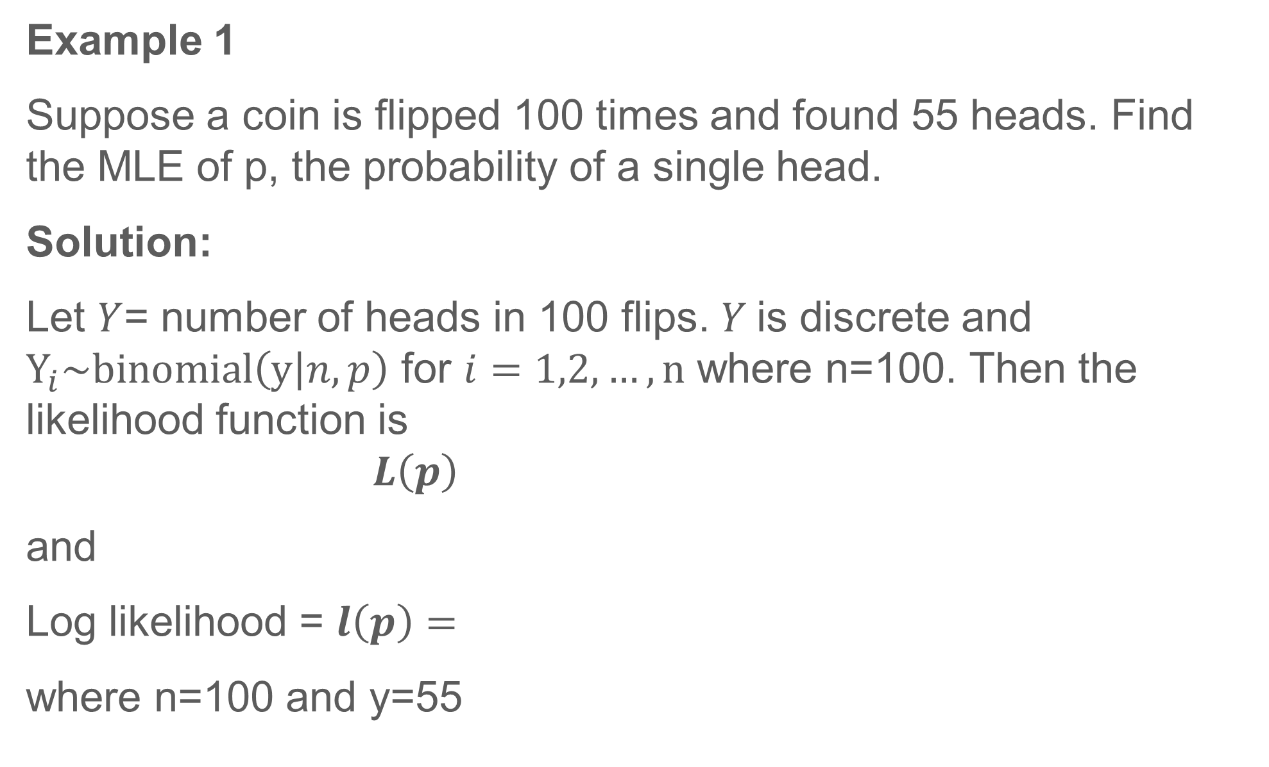
Examples
Example 1
Suppose a coin is flipped 100 times and found 55 heads. Find the MLE of p, the probability of a single head.
Solution:
Let $Y$= number of heads in 100 flips. $Y$is discrete and $Y_{i}\sim binomial\left(y | n,p\right)$ for $i=1,2,…,n$ where n=100. Then the likelihood function is
$$L\left(p\right)$$
and
Log likelihood = $l\left(p\right)=$
where n=100 and y=55

Slide 7
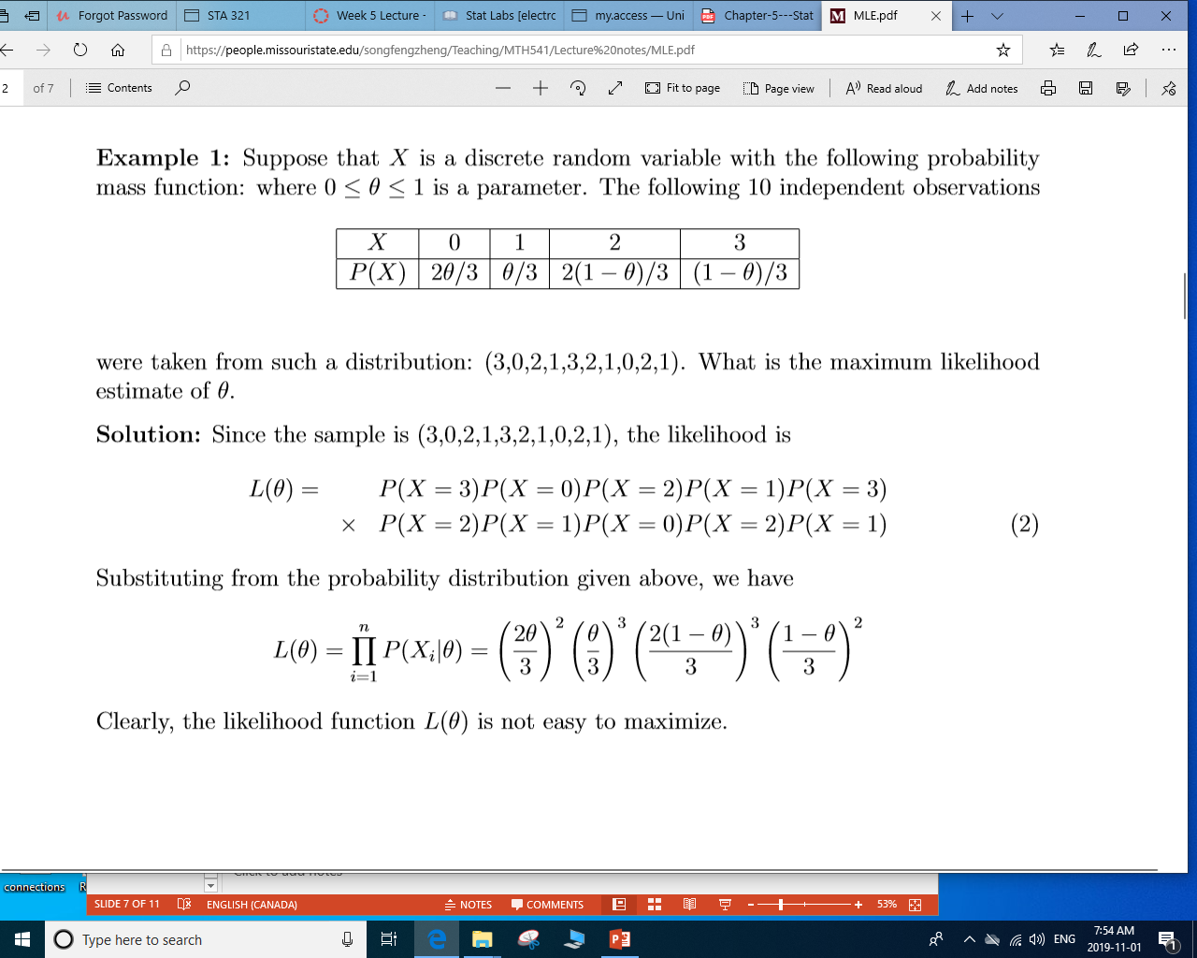
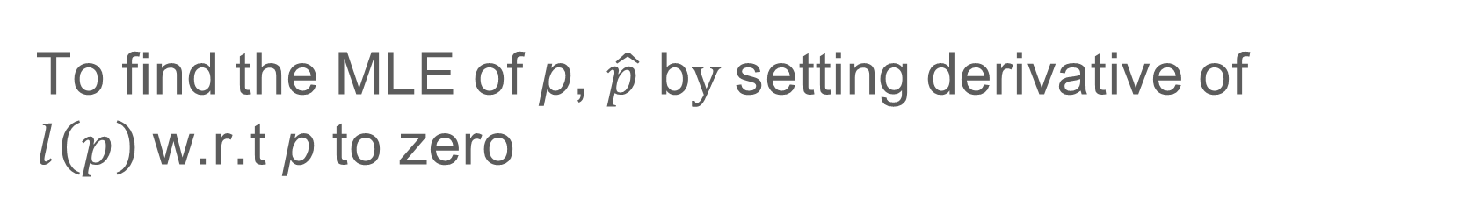
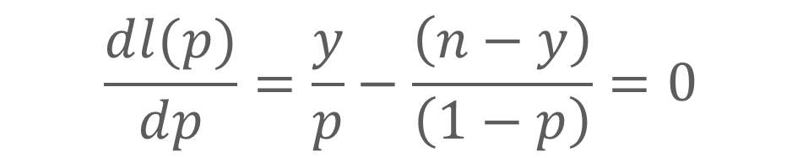


Example 1 Contd.
To find the MLE of p, $\hat{p}$ b$y$setting derivative of $l\left(p\right)$w.r.t p to zero
$$\frac{dl(p)}{dp}=\frac{y}{p}−\frac{\left(n−y\right)}{\left(1−p\right)}=0$$
T$hen \hat{p}=\frac{y}{n}=\frac{55}{100}=0.55$
Example 2
Suppose that $X$ is a discrete random variable with the below pmf where $0≤θ≤1$ is a parameter.

Slide 8
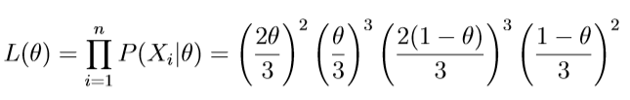
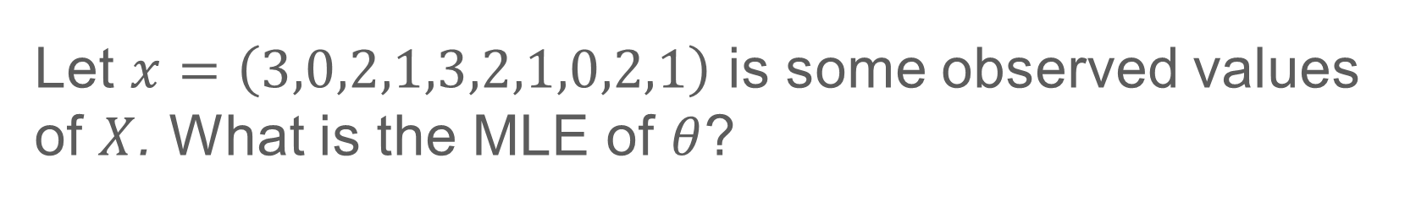
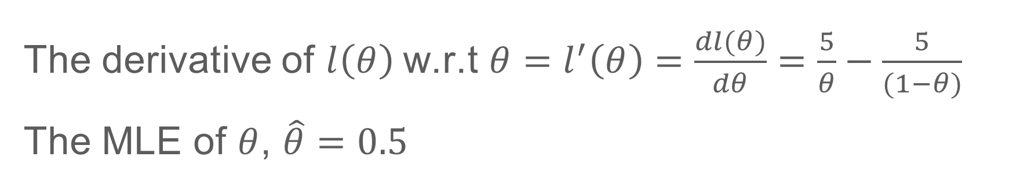
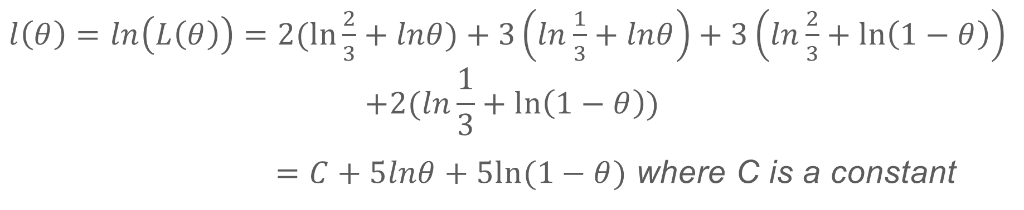
Example 2 Contd.
Let $x=\left(3,0,2,1,3,2,1,0,2,1\right)$ is some observed values of $X$. What is the MLE of $θ$?
Solution:
$l\left(θ\right)=$ $\ln\left(L\left(θ\right)\right)=2(ln⁡\frac{2}{3}+lnθ)+3\left(ln\frac{1}{3}+lnθ\right)+3\left(ln\frac{2}{3}+\ln\left(1−θ\right)\right)$
$$+2(ln\frac{1}{3}+\ln\left(1−θ\right))$$
$=C+5lnθ+5ln⁡(1−θ)$ where C is a constant
The derivative of $l\left(θ\right)$w.r.t $θ=l^{′}\left(θ\right)=\frac{dl(θ)}{dθ}=\frac{5}{θ}−\frac{5}{(1−θ)}$
The MLE of $θ$, $\hat{θ}=0.5$

Slide 9
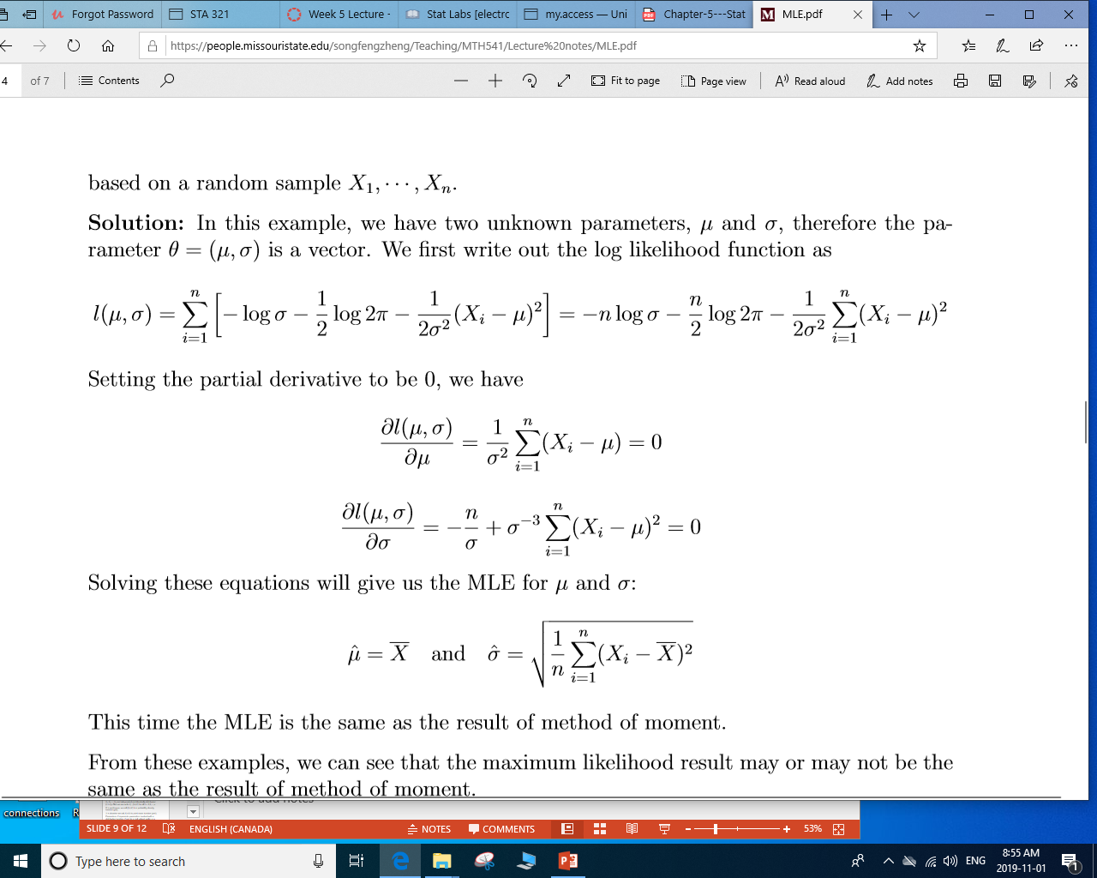

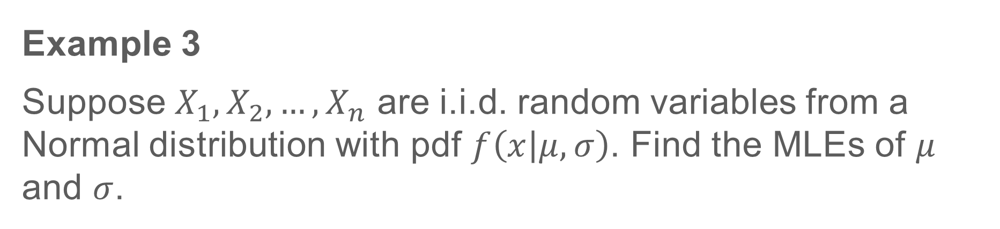
Example 3
Suppose $X_{1},X_{2},…,X_{n}$ are i.i.d. random variables from a Normal distribution with pdf $f\left(x | μ,σ\right)$. Find the MLEs of $μ$ and $σ$.
Solution:
Letting partial derivatives to be zero

Slide 10
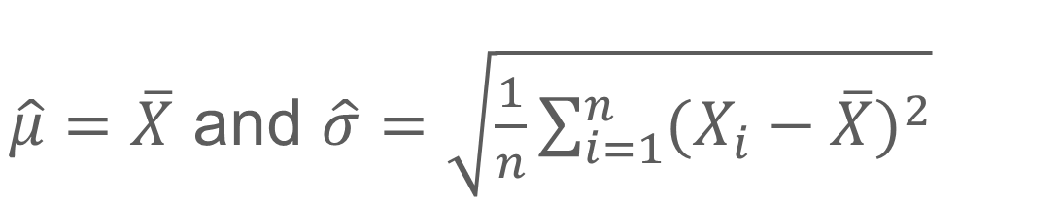
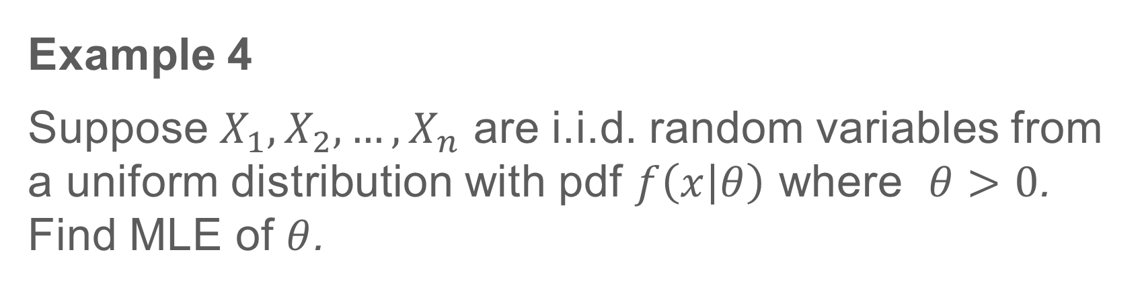
Solution Contd.:
Solving the equations, we get MLEs of $μ$ and $σ$ as
$\hat{μ}=\overline{X}$ and $\hat{σ}=\sqrt{\frac{1}{n}\sum_{i=1}^{n}{{(X_{i}−\overline{X})}^{2}}}$
Example 4
Suppose $X_{1},X_{2},…,X_{n}$ are i.i.d. random variables from a uniform distribution with pdf $f\left(x | θ\right)$ where $θ>0$. Find MLE of $θ$.

Slide 11
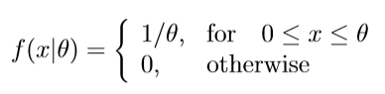



Solution:
Given $X_{i}\sim U\left(0,θ\right), i=1,2,…, n$. Then
The likelihood, $L\left(θ\right)=\frac{1}{θ^{n}}$ is positive and decreasing as a function of $θ$ for fixed n.

Slide 12
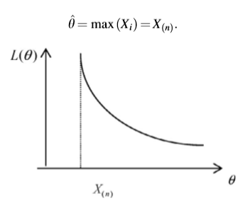

The MLE of $θ$, $\hat{θ}$is the largest order statistic.

Slide 13
MLE Computations
MLE in many cases have explicit formula
For some distributions even though there are no explicit formula, there are standard (existing, numerical procedures) routines that can compute MLE.
Example: Logistic regression
Numerical methods:
Newton-Raphson
Fisher’s scoring method
expectation–maximization (EM) algorithm

