Slide 1
Azure Blockchain Service

Slide 2
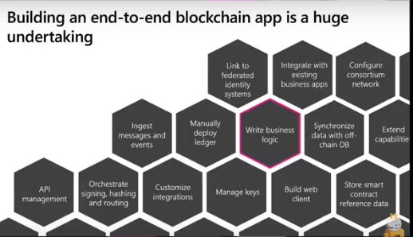

Slide 3

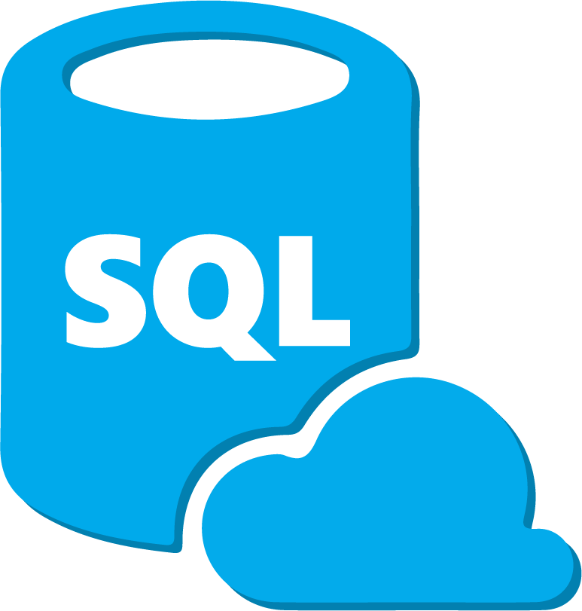












Azure Blockchain Product Portfolio Overview
Fast to deploy, easy to use managed blockchain services integrated with the Enterprise and connected to the broad set of data services of the Azure Platform.
Client apps & devices
Dev Kit
Data
Workbench
Logic Apps
Flow
VSCode
SaaS
CCF
Osaka
Systems & Services
Azure Blockchain Service
Notes:
fully managed ledger service based on Ethereum quorum ledger. R3 and hyperledger have been added.
this solves “the network problem”
in the middle, those products allow you to connect to any blockchain and pull data off, do analytics
CCF: nee coco framework. the consensus element gets pulled out of your blockchain and moved to an “enclave” allowing you to have dramatically better thruput. get much better confidentiality.
Service is BaaS. Quorum, Corda, Hyperledger Fabric (runs on AKS)
Also have Azure Blockchain Tokens and Blockchain Data Manager

Slide 4
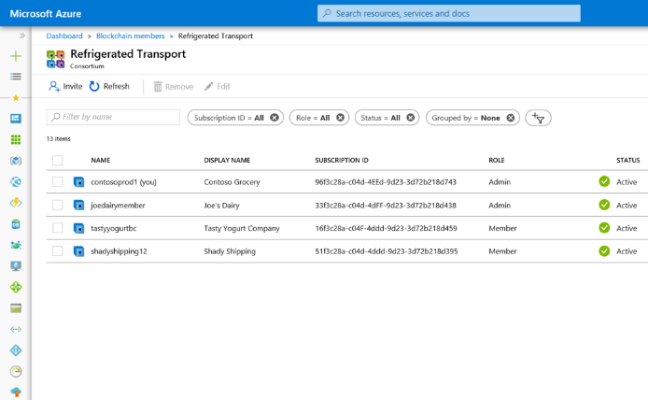
Azure Blockchain Service with built-in consortium management
Holistic view of your consortium See all members participating in your consortium, their role in the network and participation in network consensus
Easily add and remove members
Invite other participants to join your consortium through simply inviting their Azure subscription ID
Customizable network policy
Easily change the roles of members of the consortium as Admins or Members without complex smart contract development
Notes:
just a couple interesting notes
fully managed service
consortium elements across trust boundaries is handled for you.
works with AWS, GCP. no vendor lock in
you still need to “manage” the consortium. in practice, this is a difficult problem to solve.

Slide 5
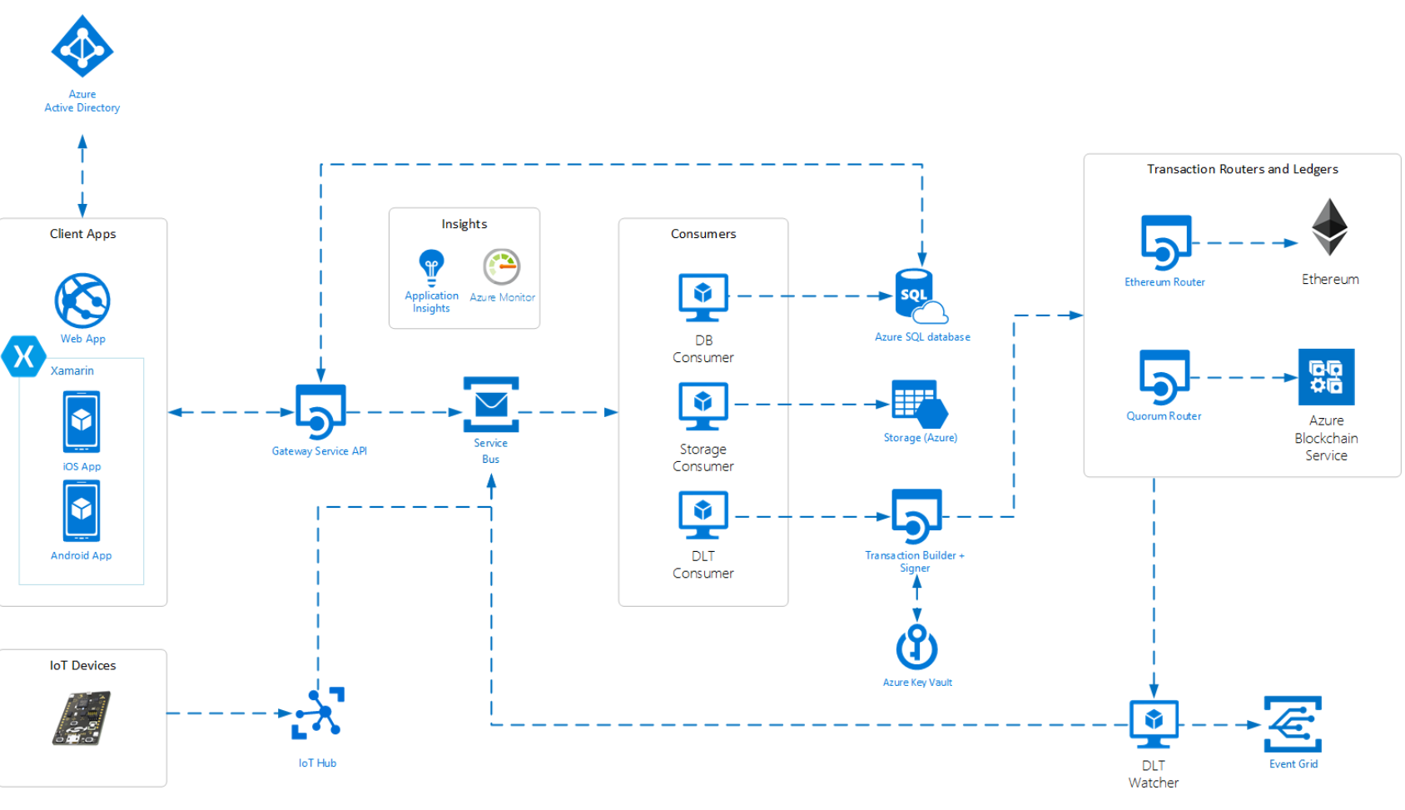
Azure Blockchain Workbench
Expedite Blockchain development running on preconfigured Azure network
Quick build and validate use cases and workflows
Integrate with additional Azure components

Slide 6



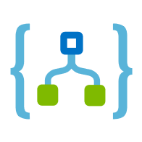









Blockchain Data Manager
Capture, transform, and deliver blockchain data in real time
Power
Automate
Power Apps
Logic Apps
Apps
Functions
Power BI
SQL
Event Grid
Blockchain Data Manager for Azure Blockchain Service
Cosmos DB
Machine Learning Studio
MySQL
Azure Data Explorer
Notes:
capturing data from an Azure Blockchain Service transaction node.
ability to provide decoded event and transaction data ,smart contract properties, monitoring for smart contract creation, so there’s no need to provide the smart contract address.
Blockchain data manager is designed to support reliable delivery of events and is designed to support multiple output destinations for any given Azure Blockchain Service transaction node. You can now easily build a scalable data publishing solution for any blockchain deployment, enabling quick application integration, historical auditing, visualizations, or machine learning.
- Scalable and reliable production grade capability to seamlessly integrate your end-to-end blockchain solutions
- Ensure all transactions and events are captured
- Support for dynamic contract creation discovery
- Reliably capture event and smart contract property changes, scale with your transaction load, pay only for what you use, and no fixed fees

Slide 7

Azure Blockchain Tokens
Easily define and create Token Taxonomy Initiative-compliant tokens that represent digital or physical assets
Manage enterprise-ready tokens with built-in security across ledgers, and use composable templates for common scenarios
Incorporate compliant tokens into existing applications through a set of open SDKs
Build tokens based on open community standards developed by blockchain experts

Slide 8
Azure Blockchain Development Kit

Slide 9
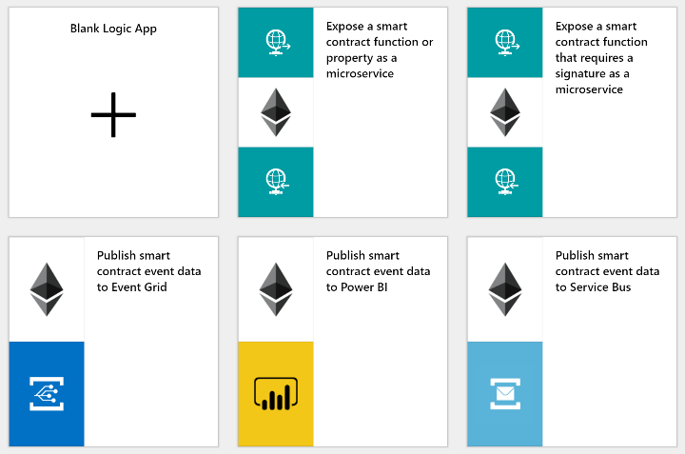
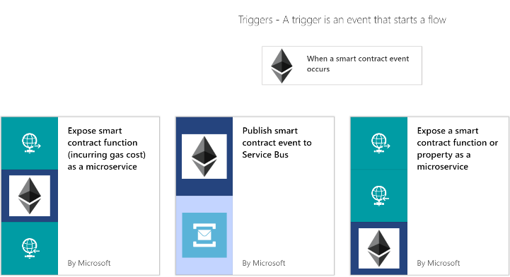
Development tools and ecosystem
Azure Blockchain Dev Kit VSCode Write, build and deploy your Solidity contracts without having to leave VSCode
Logic App and Flow connectors Ethereum & Corda Logic App and Flow connectors designed to quickly enable low/no-code workflows
Notes:
we are going to use this so I’m not going to talk about it now in depth
push and pull data off the blockchain with ease

Slide 10
Demo?
Notes:
35:30

Slide 11
Common Application Patterns

Slide 12


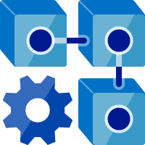




Logic Apps Centric Design
Consuming Apps, Databases, Services & Systems
Data Sources
Power BI
Process Trigger
Store Meta-data Off-Chain in DB
Flow
Apps
API
Process Request
Submit Transaction(s)
Publish State and Events
Logic Apps
Event Grid
Sensors Data
Store Files and Content Off-Chain in Storage
Process Route
Service Bus
Azure AD
Azure Key Vault
Application Insights
Virtual Networking
Note – Also works with IaaS Ledgers
and Ethereum Public Chain
Notes:
many times you really just want some tools to help you write smart contracts and integrate with other partners. You don’t need all of this.
we focus on serverless. why?
pattern:
generally a consortium will set up AAD federation (or equivalent) for all members to use. members will be invited in. solves password resets, low friction, easy to get started.
kv for transaction signing
vnets become interesting in hybrid scenarios
LA will have “triggers”
CCF handles the blockchain work
API is auto-generated when you spin it up
how to handle not putting some stuff on the blockchain. PII. You need an “off blockchain” solution. The “id” can be on-chain with a lookup for PII. Tampering? Store a hash of the lookup on-chain.
never store files on blockchain. IPFS.
IoT data: you don’t want all of that necessarily on-chain. You can get creative with IoT Hub with a route that only pushes certain data on-chain.

Slide 13



Power Platform
Consuming Apps, Databases, Services & Systems
Store Meta-data Off-Chain in DB
Data Sources
Process Trigger
Power BI
Flow
Power Apps
API
Process Request
Submit Transaction(s)
Publish State and Events
Event Grid
Sensors Data
Store Files and Content Off-Chain in Storage
Process Rule
Service Bus
Azure AD
Azure Key Vault
Application Insights
Virtual Networking
Note – Also works with IaaS Ledgers
and Ethereum Public Chain

Slide 14
Business Integration Patterns

Slide 15
One-Way Eventing Pattern (Inbound)
Transaction
sent to ledger
Event Trigger Occurs
External
System
Logic Apps or Flow
Blockchain
State Change
Within the Contract
Contract

Slide 16
One-Way Eventing Pattern (Outbound)
Service Bus
State Change
Within the Contract
Event Grid
Contract
Blockchain
Logic Apps or Flow
SaaS
Event is sent to
the ledger
Event triggers
DB
External Application
Event Consumed
Notes:
something goes out of compliance...

Slide 17
Interactive Integration
State change
within the contract
Event Grid
Contract
Blockchain
Logic Apps or Flow
Service Bus
Event is sent to
the ledger
Event Consumed
External Application
Blockchain
Logic Apps, Flow, Function, or Custom Code
Contract function called and state updated
Event triggered
Notes:
think of this as a state machine workflow or just a biz workflow
example: an external service is needed for document signing
ready to sign
signing complete

Slide 18
API Integration ( Off Chain Query)
Authenticates to App
Queries transaction data in appropriate store
AAD
External
App
Calls API
SQL DB
Logic Apps, Flow, Functions, or Custom Code
Returns Data
Blockchain
Note – For web clients, an App Registration of type “web” is done in AAD.
For mobile, bots, and desktop apps, a “native” App Registration is used
Notes:
in this case sqldb may have the same data or subset of the chain. querying the chain directly for complex queries is not smart.

Slide 19
Storage Integration
Persist content
Storage
Generate hash
of content
External
System
Hashing Service
Send hash and storage pointer as parameters
Transaction sent to the ledger
Logic App
Blockchain
State Change
Within the Contract
Contract

