Slide 1
Solidity Smart Contracts
Notes:
Demo Visual Studio Code (20 minutes)
Open VS Code
Connect to Azure Blockchain Service
Create new Solidity Contract
Build Solidity Contract
Deploy Solidity Contract to Azure Blockchain Service
Test Write/Read of Solidity Contract
Show smart contract interaction page
Show JavaScript commands for executing functions

Slide 2
Smart Contracts in Solidity
Solidity is an object-oriented programming language for writing smart contracts. It is used for implementing smart contracts on various blockchain platforms, most notably, Ethereum.
Common Solidity syntax
Value Types
Variables and Parameters
Functions
Events

Slide 3
Solidity Types
Booleans (true or false)
Integers (signed - int, int8, int256: unsigned - uint, uint8, uint256)
Fixed Point Numbers (fixed, ufixed)
Addresses (address – 20 byte value)
Fixed/Dynamic Sized Byte Arrays
Enums (user defined types)
Arrays
Structs (define new types)
Mappings Types (collection of any type)

Slide 4
Solidity Structures
Example:
struct shippingInformation{
string shipmentName;
string startLocation;
string endLocation;
uint256 numberOfContainers;
string description;
}

Slide 5
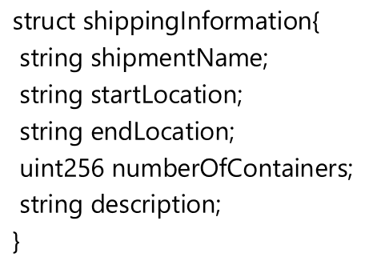
Solidity Mappings
Example:
mapping (uint => shippingInformation) shipments;

Slide 6
Solidity Variables
Example:
uint256 public totalShipments;
Initialize:
constructor() public{ totalShipments = 0; }

Slide 7
Solidity Events
Example:
event ShipmentEvent(string shipmentName,
string startLocation,
string endLocation,
uint256 numCont,
string description);

Slide 8
Solidity Operations
Example:
function newShipment(string memory shipmentName,
string memory startLocation,
string memory endLocation,
uint256 numContainers,
string memory description) public returns (uint256 total)
{
}

Slide 9
Solidity Operations
Example:
function getShipment(string memory shipmentName) public view returns(string memory name,
string memory start,
string memory end,
uint256 numCont,
string memory desc){
for(uint256 i = 0; i<totalShipments; i++){
if(compareStrings(shipments[i].shipmentName, shipmentName)){
return (shipments[i].shipmentName, shipments[i].startLocation, shipments[i].endLocation, shipments[i].numberOfContainers, shipments[i].description);
}
}
revert('shipment not found');
}

Slide 10
Helper Function
Example:
function compareStrings (string memory a, string memory b) public pure returns (bool) {
return (keccak256(abi.encodePacked((a))) == keccak256(abi.encodePacked((b))) );
}

Slide 11
Modify Smart Contract in Visual Studio Code - Demo
Notes:
Modify Smart Contract in VS Code
- Add variables and functions to support new smart contract

Slide 12
Modify Smart Contract in Visual Studio Code – Activity
Notes:
Modify Smart Contract in VS Code
- Add variables and functions to support new smart contract

Slide 13
Modify Smart Contracts
We will start with the basic HelloBlockchain.sol solidity contract.
Deploy it locally
Deploy it to Azure
View and interact with the Smart Contract
Now we will modify the Smart Contract to match your use case from the Ideation Session
We have some sample contracts you can use in the git repo
We have pointers to places where you can download tested and audited smart contracts

